Slide 1
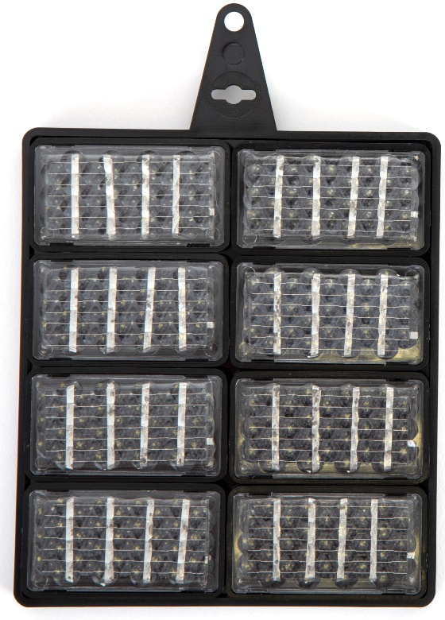
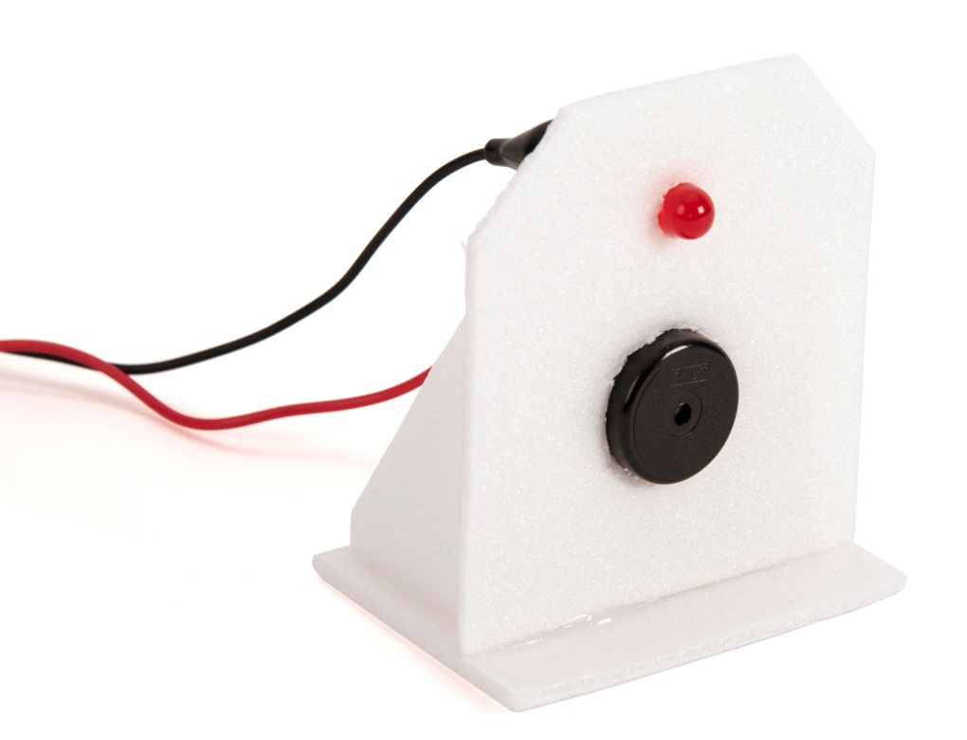
Renewable energy – Module 5
Use the solar panel to power different devices
Light an LED
Sound a buzzer
Design a sun alarm
Try and produce wind energy

Slide 2
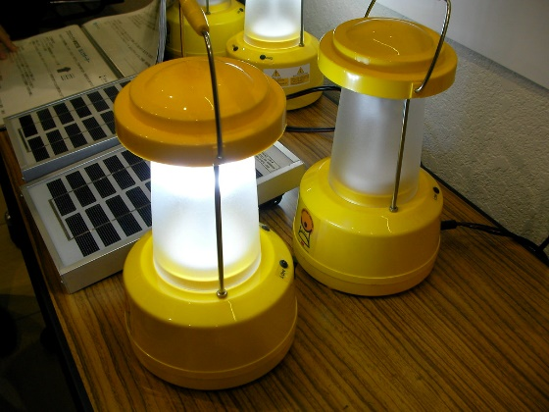
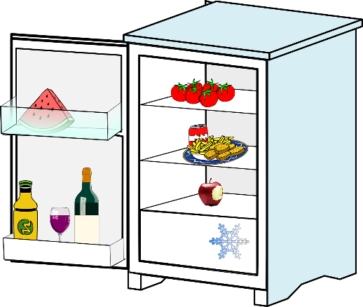
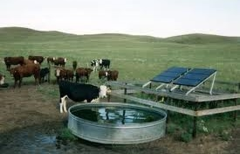
What could you use solar PV for?
Imagine you live in a remote village without mains electricity
What could you use solar PV for?
Notes:
You could use solar PV for lighting, refrigerating food, pumping drinking water, irrigating crops, powering mobile phone masts, televisions and radios, sewing machines…

Slide 3
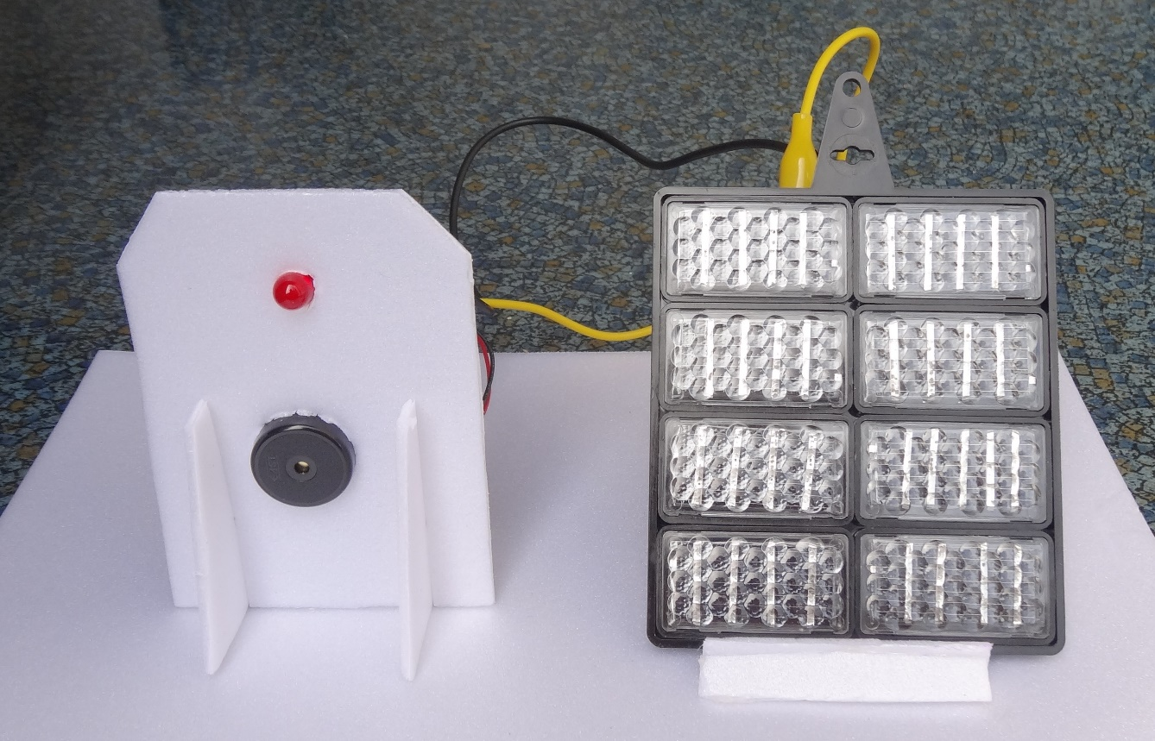
Make a sun alarm

Slide 4
STEM learning objectives
Science: Electricity – compare and give reasons for variations in how components function
Electricity - recognise some common conductors and insulators
Technology – use electrical systems in your products
Engineering – learn to troubleshoot problems
Maths – measure distances in mm

Slide 5
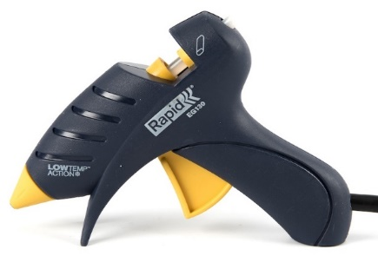
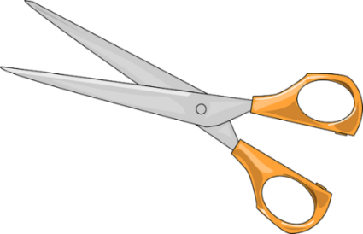
1. Work safely
Look at the tools and equipment. Can you spot any potential hazards?
Can you think of ways to reduce the risks?
Notes:
Don’t cut yourself or burn your fingers.
Use cool melt glue guns to avoid serious burns.
Don’t look directly at the sun as you could damage your eyes.

Slide 6
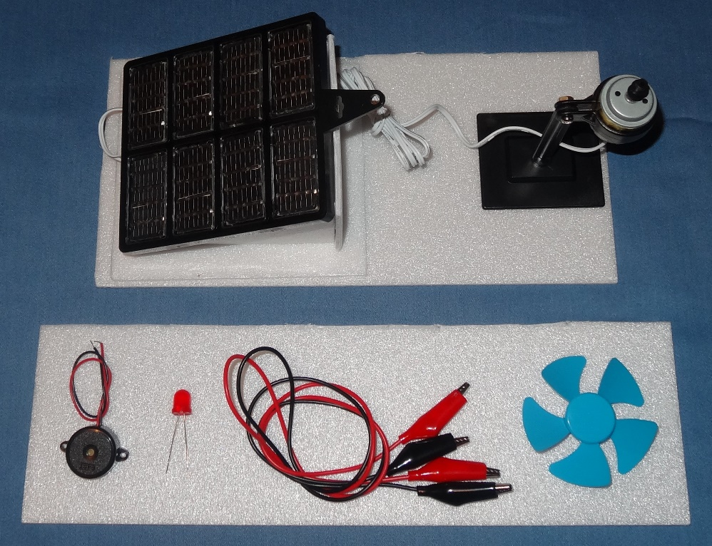
2. Collect your materials
You will need:
A solar energy kit (from the spinner completed in module 4)
Offcuts of polystyrene foam
A buzzer
An LED (light emitting diode)
Two crocodile leads
A propeller

Slide 7
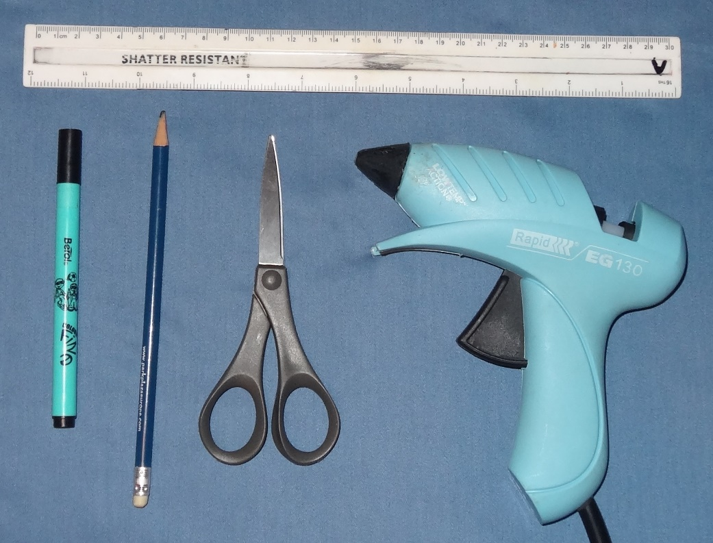
3. Assemble your tools
You will need:
A ruler
A felt tip pen
A pencil
A pair of scissors
A cool melt glue gun

Slide 8
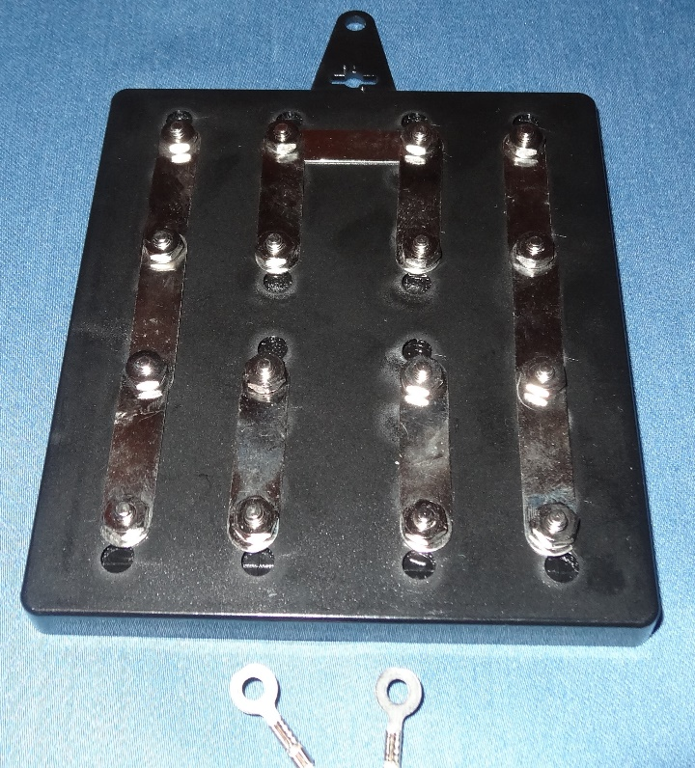
4. Disconnect the motor
Unscrew the two nuts holding the motor contacts onto the solar panel
Take off the nuts and washers
Slide the motor contacts off the studs
Re-fit the washers and nuts so you don’t lose them

Slide 9
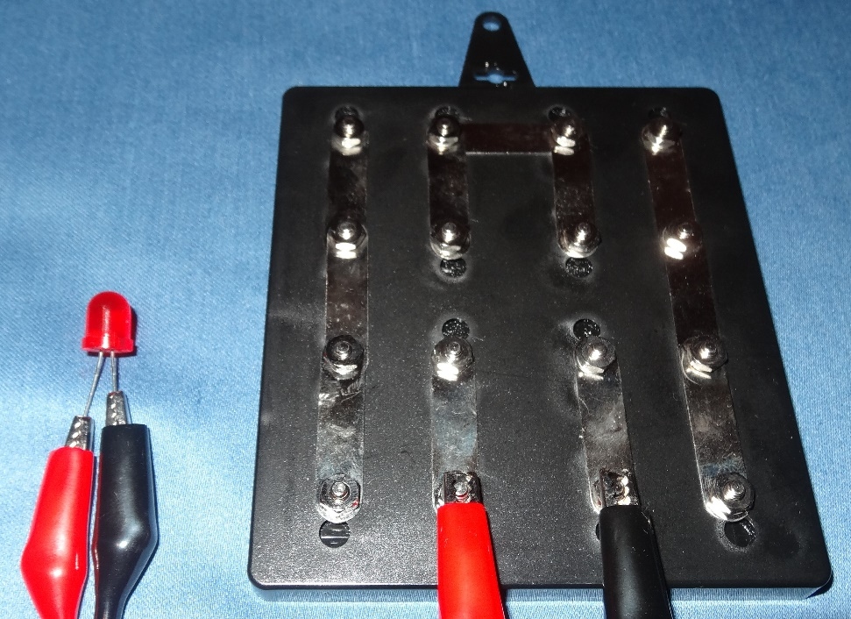
5. Light up the LED
Gently bend the LED legs apart
Connect one crocodile lead from the positive (+) terminal to the long LED leg as shown
Connect the other crocodile lead from the negative (–) terminal to the short leg
Orientate the panel to face the sun and check the LED lights up
What happens if you connect the LED the other way round?
Notes:
You bend the LED legs apart so the metal ends of the crocodile clips don’t touch.
Bend them gently to avoid snapping them off.
The crocodile clips need to be connected to the same contacts to which the motor was connected.
Positive (+) and negative (-) signs are moulded into the plastic by the terminals
If the LED is connected back to front it won’t light up.

Slide 10
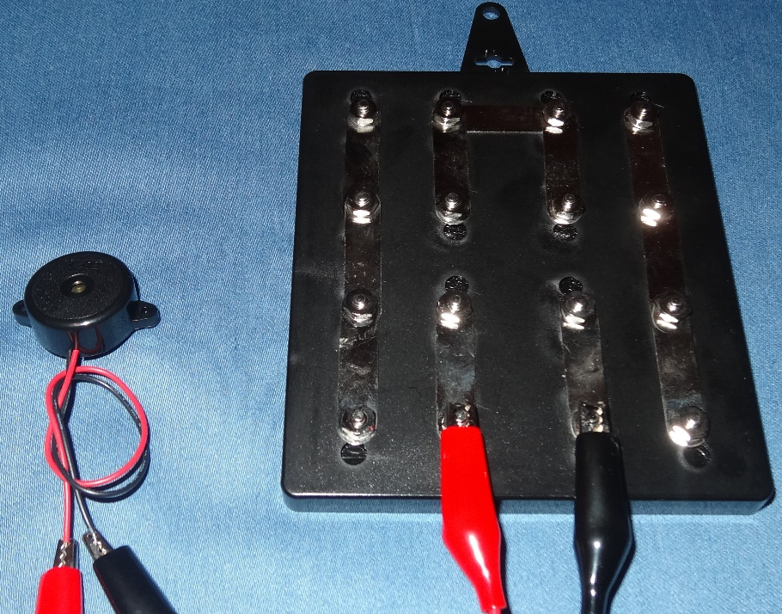
6. Make the buzzer sound
Disconnect the crocodile clip from the long leg of the LED and connect it to the red wire of the buzzer
Disconnect the crocodile clip from the short leg of the LED and connect it to the black wire of the buzzer.
Turn the panel to face the sun and see if the buzzer sounds
What happens if the buzzer is connected back to front?
Adjust the panel orientation to vary the volume of sound
Notes:
Make sure you clip onto the metal ends of the buzzer wires, not onto the plastic insulation.
The buzzer only works when connected one way round.
So if, in step 5, you had just connected the LED back to front then you may end up connecting the buzzer back to front.
This makes a useful exercise in troubleshooting!

Slide 11
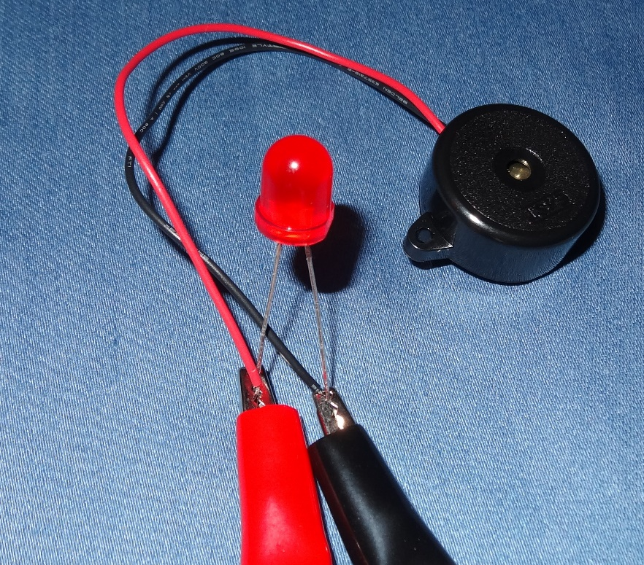
7. Make both light & buzzer come on
Connect the crocodile clip attached to the red wire of the buzzer to both this and the LED long leg simultaneously
Connect the clip attached to the black wire of the buzzer to both this and the LED short leg simultaneously.
Turn the panel to face the sun and see if both the LED and buzzer come on
What happens if you clip onto the plastic sleeve instead of the metal end of the wire?
Notes:
It is quite fiddly to clip onto both the buzzer wire and the LED leg at the same time.
Plastic is an insulator, so if you clip onto the plastic sleeve instead of the metal end of the wire then the electricity can’t flow so the buzzer won’t sound.

Slide 12
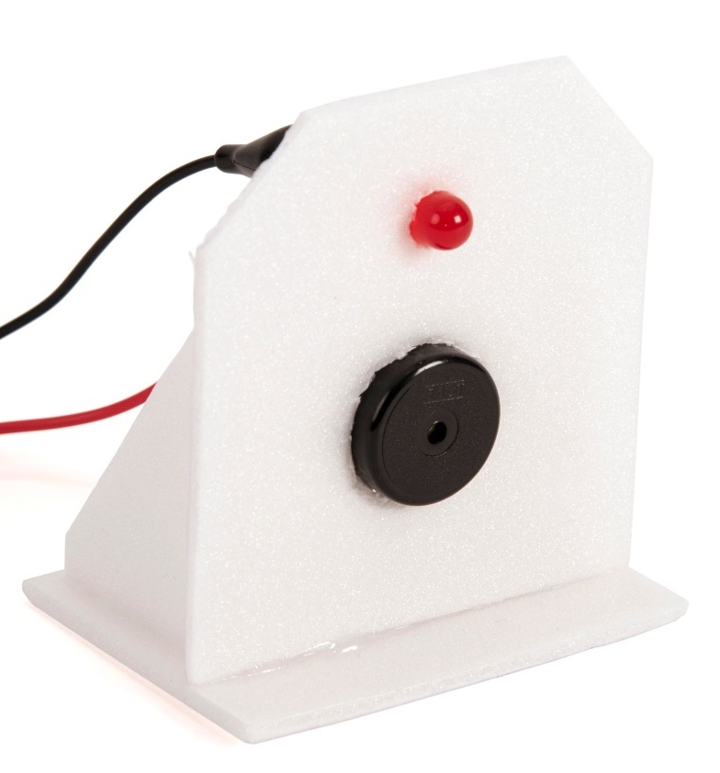
8. Construct a stand
Design a way of mounting the LED and buzzer using the polystyrene foam offcuts – an example is shown here
You can use the pencil to pierce a hole to fit the LED – make it a maximum of 8 mm diameter so that the LED fits tightly
You can cut out a hole for the buzzer with scissors – make it a maximum of 23 mm diameter so that the buzzer fits tightly
Peel the motor stand off the mount and replace it with the stand you have just made
Notes:
The pupils can design any stand they want – it doesn’t need to look anything like the example shown.

Slide 13
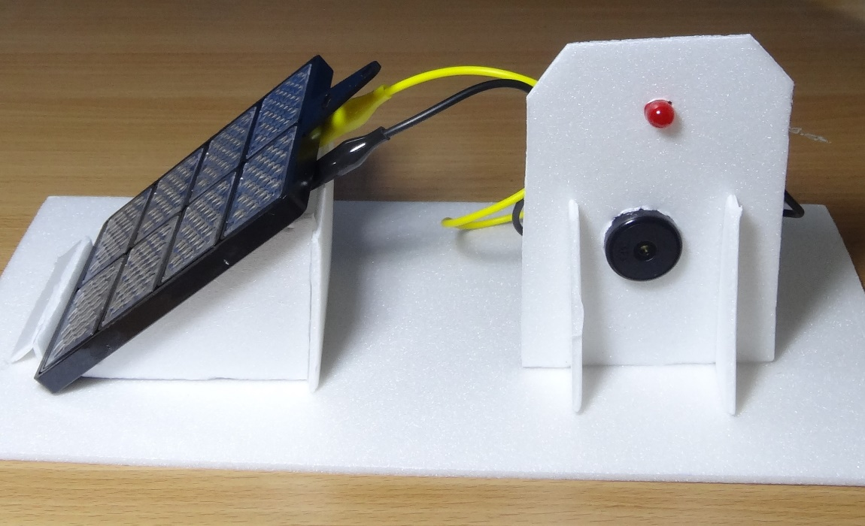
9. Try out the sun alarm
Orientate the solar panel to face the sun and try out the sun alarm
Can you think of things it might be useful for?
Could it remind you to put on your sunscreen?
To put the washing out to dry?
Anything else?

Slide 14
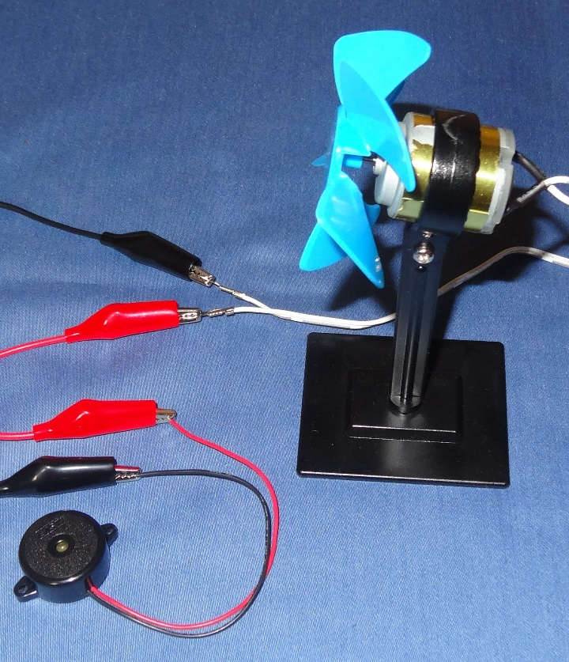
10. Try using wind power
Remove the motor pulley and fit the propeller (also turn the motor so the shaft is horizontal)
Disconnect the crocodile leads from the solar panel; use them to connect the motor contacts to the buzzer
Ask someone to hold the buzzer to their ear
Ask someone else to blow really hard into the fan to make it spin fast!
Can the buzzer be heard? If not try connecting it the other way round.
Notes:
Make sure the metal ends of the crocodile leads aren’t touching one another.
Make sure the motor contacts aren’t touching one another either.

Slide 15
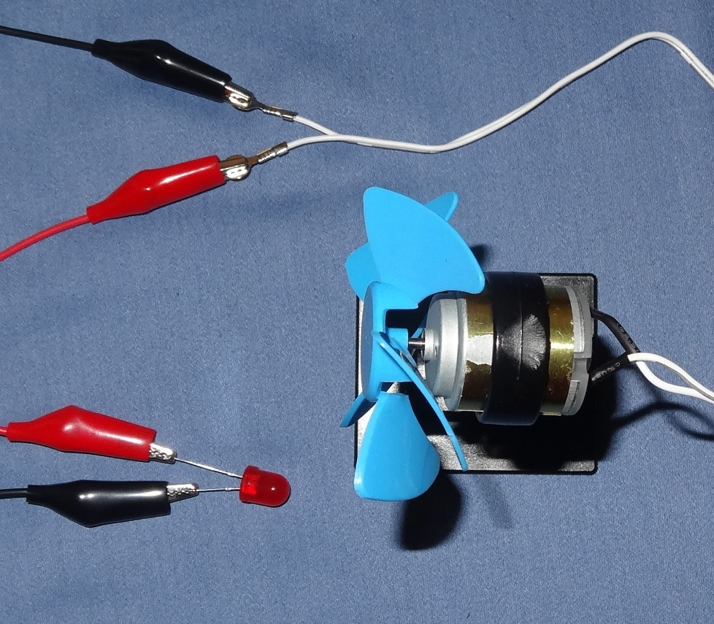
11. Use wind power to light the LED
Disconnect the crocodile clip from the red wire of the buzzer and connect it to the long leg of the LED
Disconnect the crocodile clip from the black wire of the buzzer and connect it to the short leg of the LED
Blow as hard as you possibly can and see if you can get the LED to light up
Notes:
Make sure the metal ends of the crocodile leads aren’t touching one another.
Make sure the motor contacts aren’t touching one another either.
If the pupils can’t blow hard enough to get the buzzer to buzz then they are unlikely to get the LED to light.
You could demonstrate this to them instead.

Slide 16
12. What did you learn?
What might solar PV be useful for if you live in a remote village without mains electricity?
Does an LED work if connected either way round?
How about the buzzer?
An LED converts electrical energy to what kind of energy?
How about the buzzer?
Why do you need to connect to the metal ends of the buzzer wires, not onto the plastic sleeve?
What problems did you encounter and how did you solve them?
What does STEM stand for?
Notes:
Lighting, refrigerating food, pumping drinking water, irrigating crops, powering mobile phone masts, televisions and radios, sewing machines…
An LED only works one way round.
So does the buzzer.
The LED converts electrical energy to light energy.
The buzzer converts electrical energy to sound energy.
The metal ends of the wires conduct electricity; the plastic sleeve does not.
STEM stands for Science, Technology, Engineering, Maths.
Combining the learning of these subjects together should make it easier to understand how they are relevant and can be applied in real life.

