Slide 1
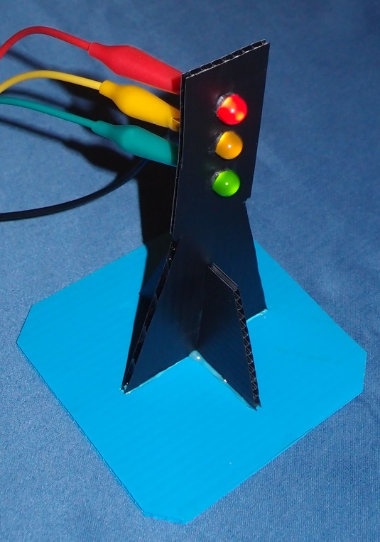
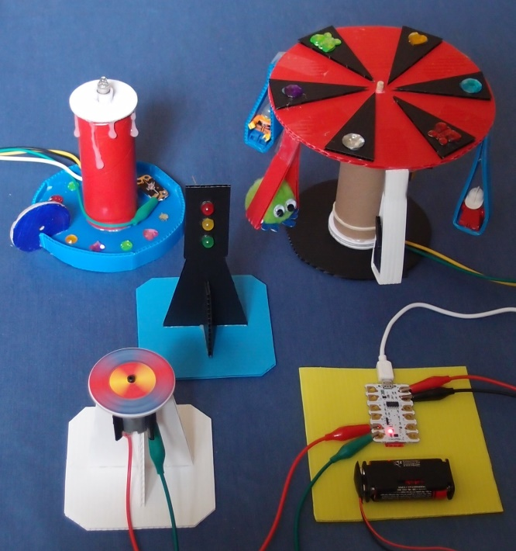
Crumble PowerPoint 3

Slide 2
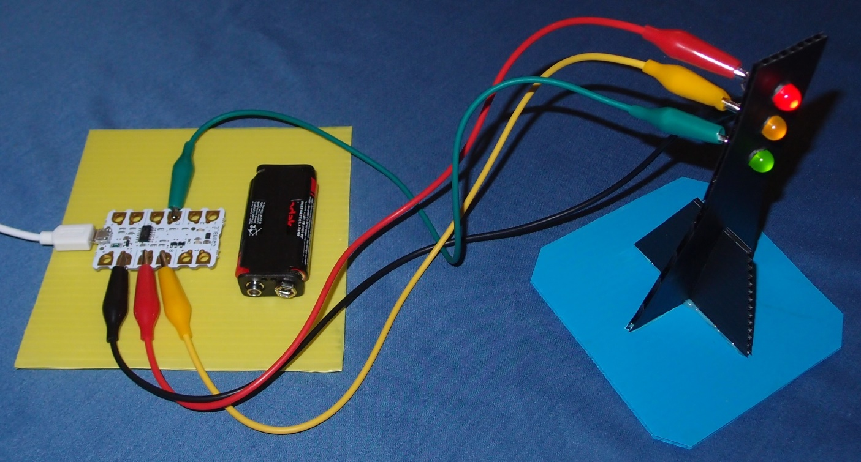
Make a set of traffic lights

Slide 3
Learning objectives
Follow a circuit diagram to wire up a more complex circuit
Design, write and debug programs controlling physical systems
Solve problems by decomposing them into smaller parts
Use sequence and repetition in programs
Learn to create flowcharts

Slide 4
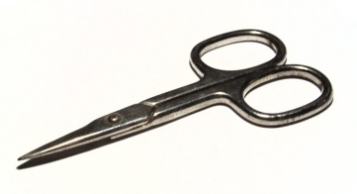
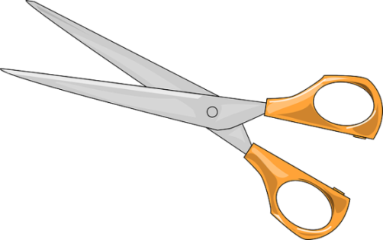
1. Work safely
Look at the tools and equipment. Can you spot any potential hazards?
Can you think of ways to reduce the risks?

Slide 5
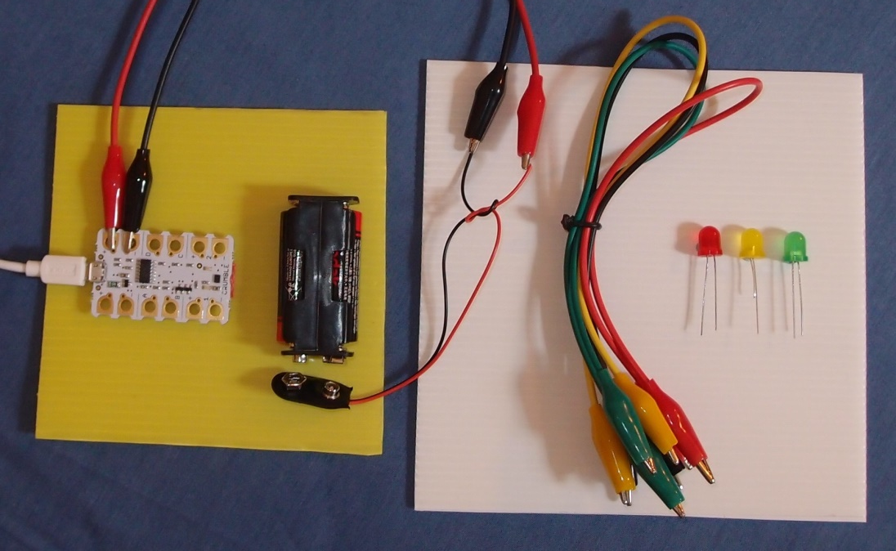
2. Collect your parts
Make sure you have all the parts listed in your workbook.

Slide 6
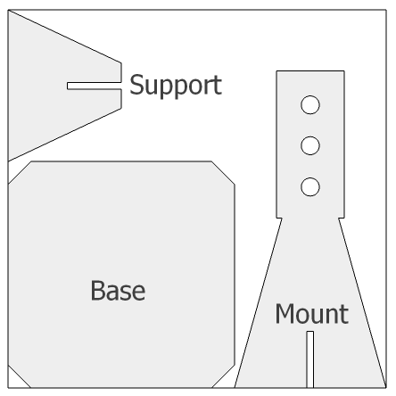
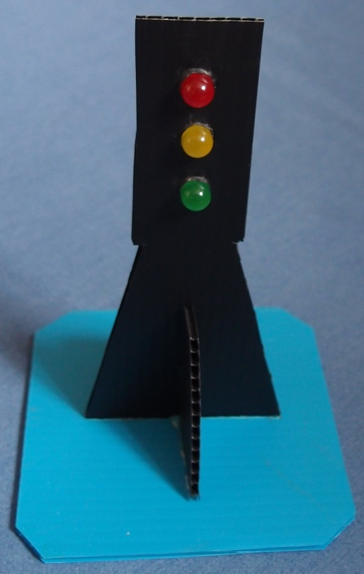
3. Make a stand to fit your LEDs

Slide 7
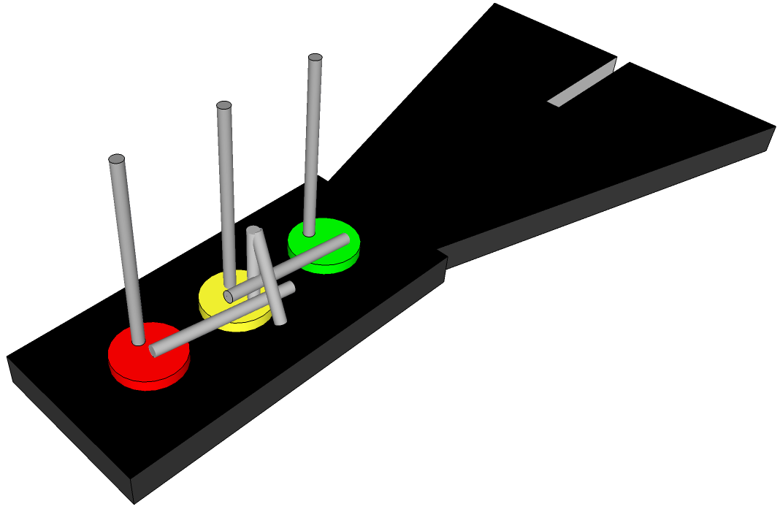
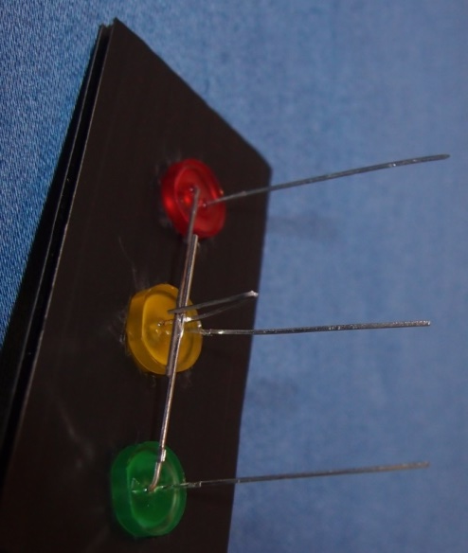
4. Connect the short legs together
Rotate the LEDs so the short legs are all on the same side.
Gently bend the short leg of the red LED down and the green LED up.
Gently fold the short leg of the yellow LED in half so it traps them.

Slide 8
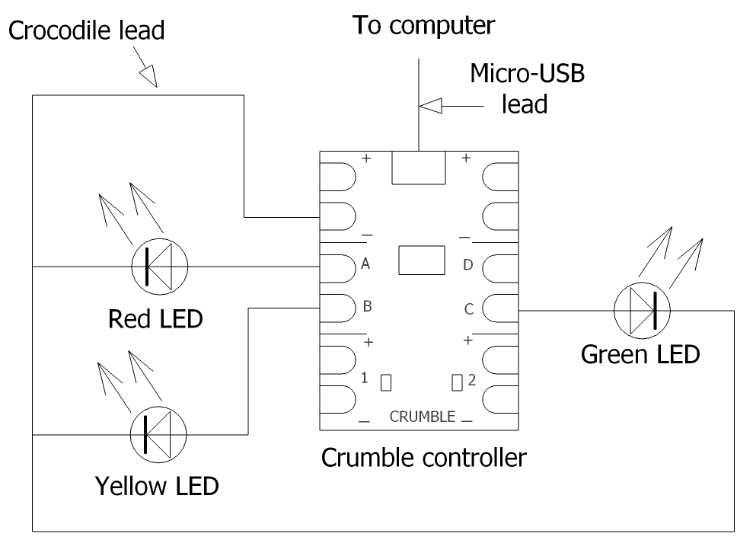
5. Make this circuit
(N.B. The crocodile lead to minus (-) must connect to all three LED short legs. Otherwise some of the LEDs won’t light up.)

Slide 9
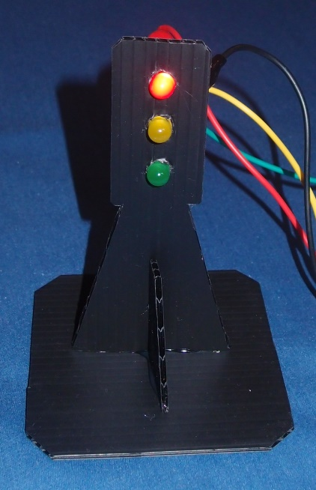
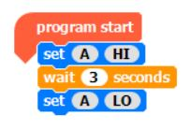
6. Run the ‘Light LED’ program
Double click on your ‘Light LED’ program.
Run the program and check the red LED comes on for a few seconds and then goes off.
Click on A and change to B. Run and check the yellow LED comes on.
Change to C and check the green LED comes on.

Slide 10
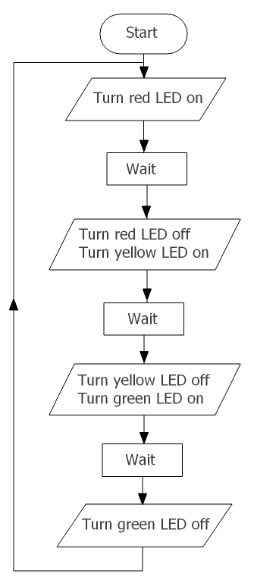
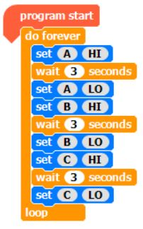
7. Create this program
Read through the flow chart to understand the logic.
The LEDs should turn on and off in sequence, and then repeat continuously.
Create the program, run it and watch what happens.
Do the LEDs do what you expect?

Slide 11
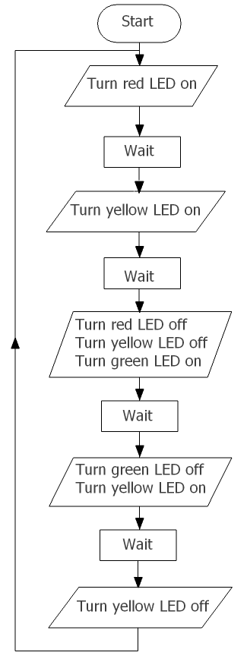
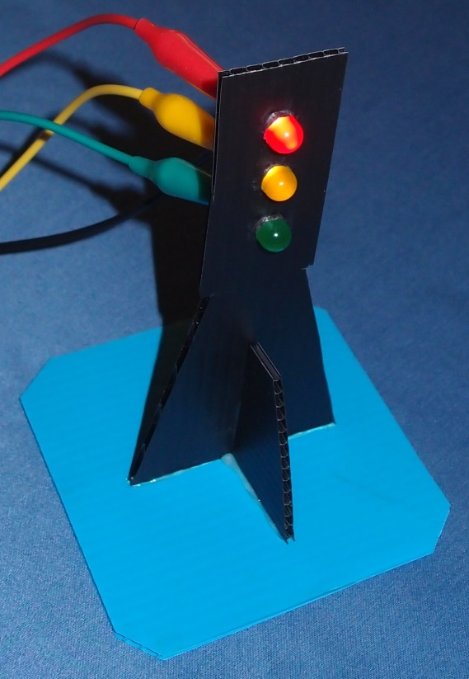
8. Program this sequence:
In the UK the traffic lights sequence is red, red and yellow, green, yellow then back to red.
Create and run a program to do this. You can use the flow chart on the right to help you.
Do the LEDs come on in that order?

Slide 12
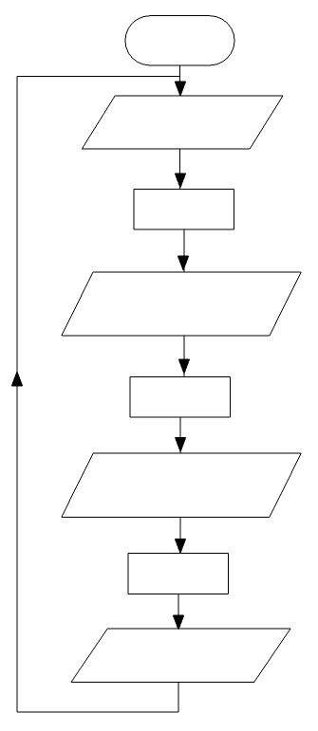
9. Extension activity
In America the traffic light sequence is red, green, yellow then back to red.
Fill in the blank flowchart in your workbook and then create a program to switch the LEDs in this sequence.
Check it does what you expect.

Slide 13
What did you learn?

Slide 14
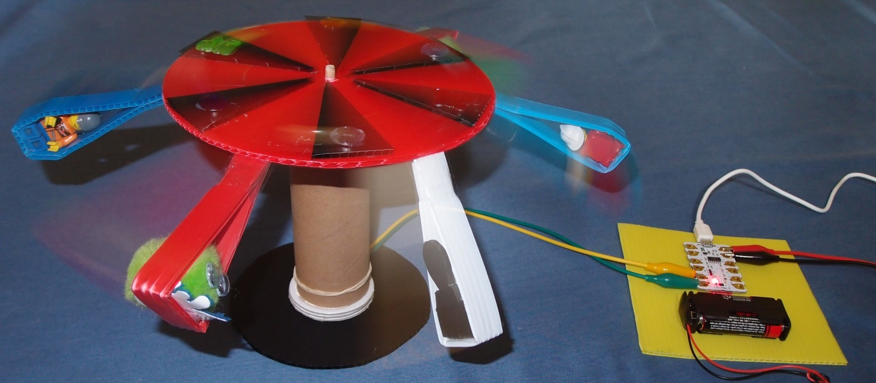
Move on to the next module
Copyright © Caroline Alliston 2017

