Slide 1
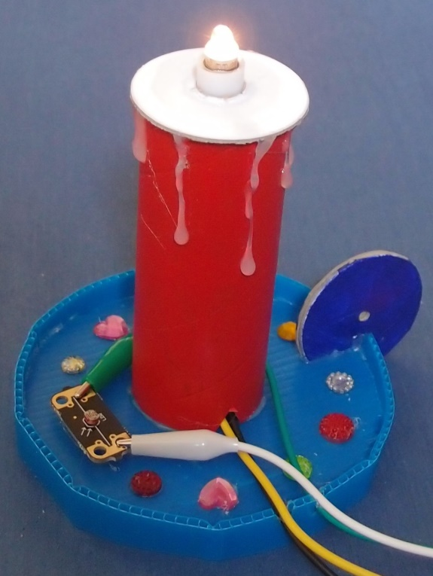
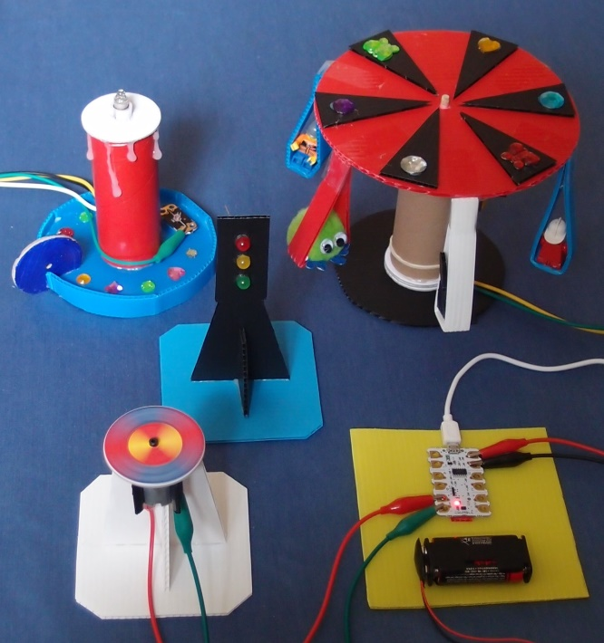
Crumble PowerPoint 5

Slide 2
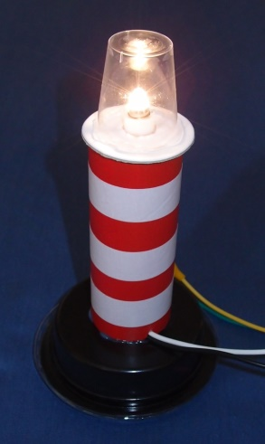
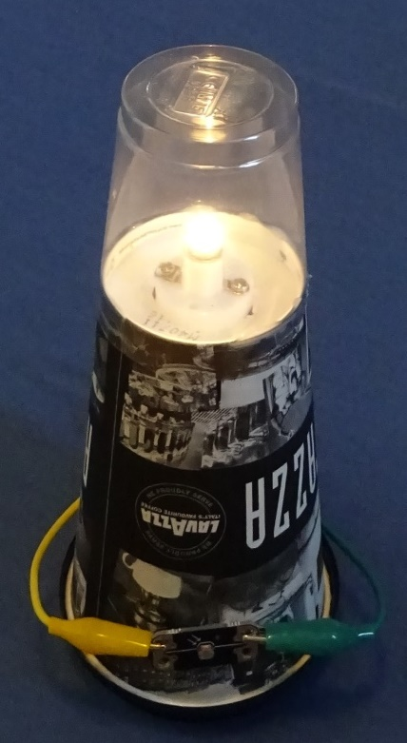
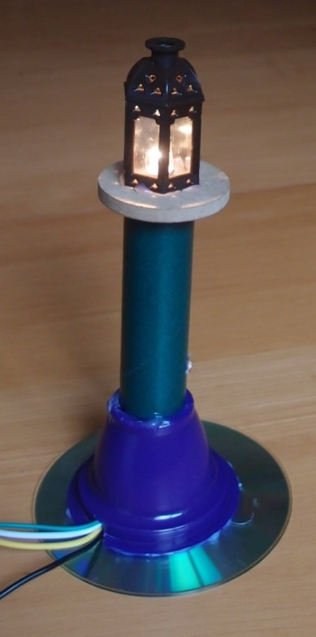
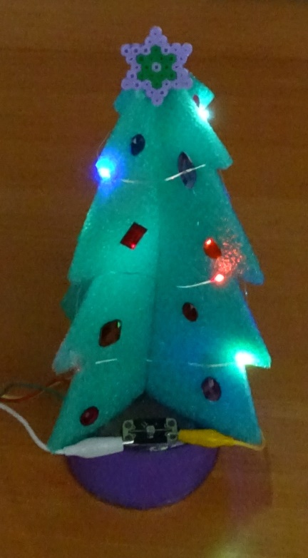
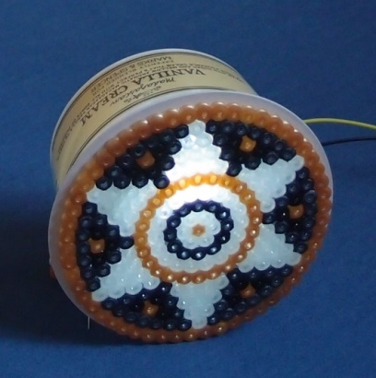
Design and make a nightlight

Slide 3
Learning objectives
Design innovative, functional, appealing products
Think of unusual and creative uses for everyday materials
Use computing to program, monitor and control your products
Use sequence, selection and repetition in programs
Work with variables and various forms of input and output

Slide 4

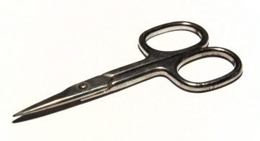

1. Work safely
Look at the tools and equipment. Can you spot any potential hazards?
Can you think of ways to reduce the risks?

Slide 5
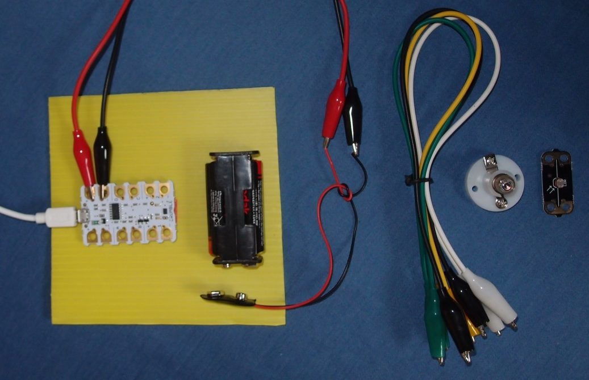
2. Collect your parts
Make sure you have all the parts listed in your workbook.

Slide 6
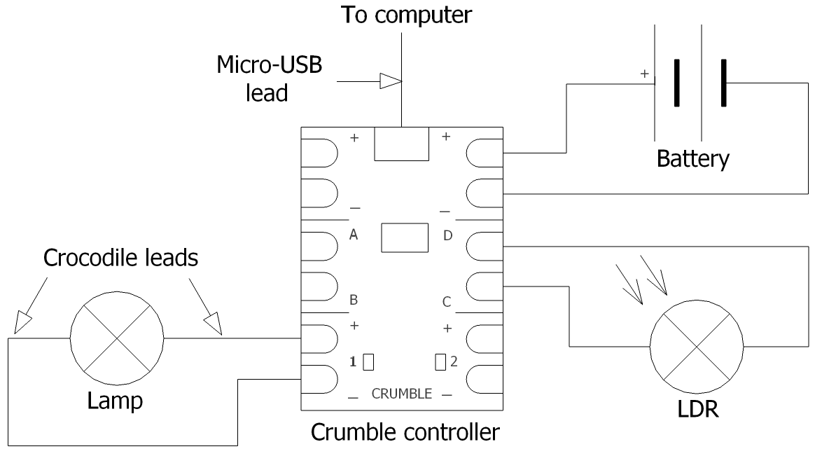
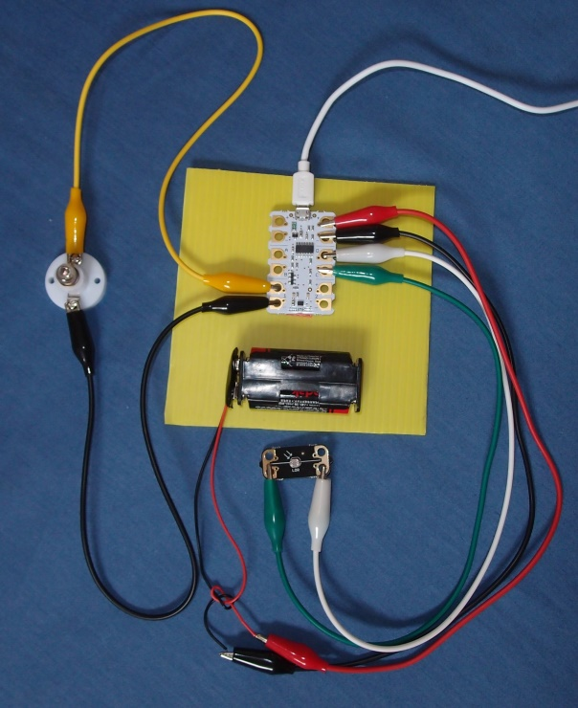
3. Connect up this circuit

Slide 7
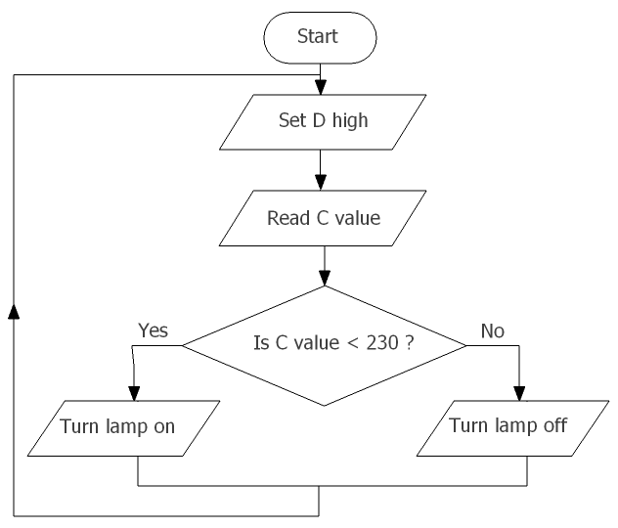
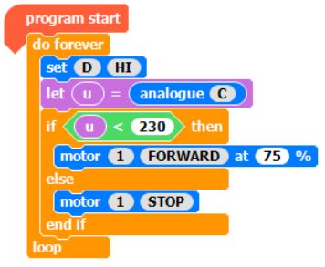
4. Create and run this program
How will you test whether the lamp comes on in the dark?

Slide 8
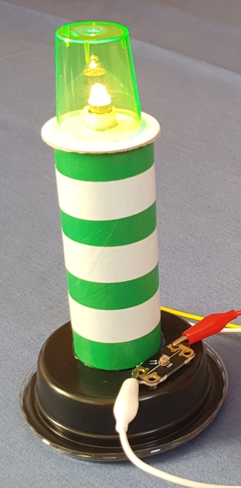
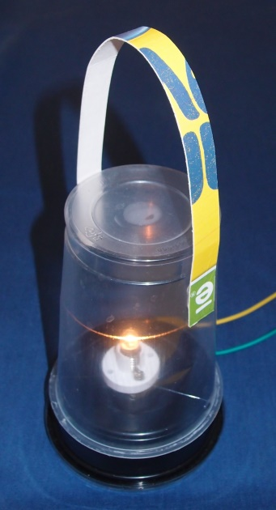
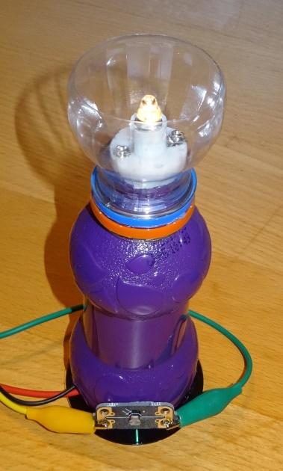
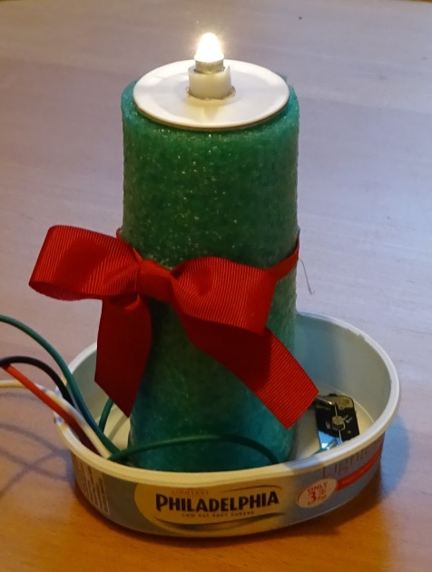
5. Make and test your nightlight
Read step 4 of your worksheet and design your nightlight. Here are some ideas to help inspire you.

Slide 9
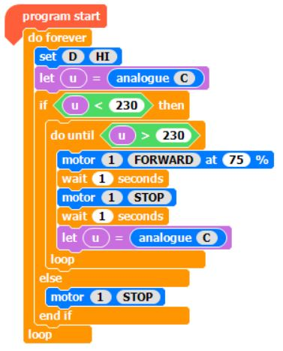
6. Extension activities
Modify your program to make your lamp glow more or less brightly.
Adjust the light levels at which your nightlight comes on by changing the value in the green box.
Experiment with different effects, such as making your candle flicker or your lighthouse flash (here is an example).
Does it matter which way round your LDR is connected?

Slide 10
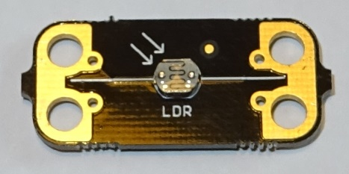
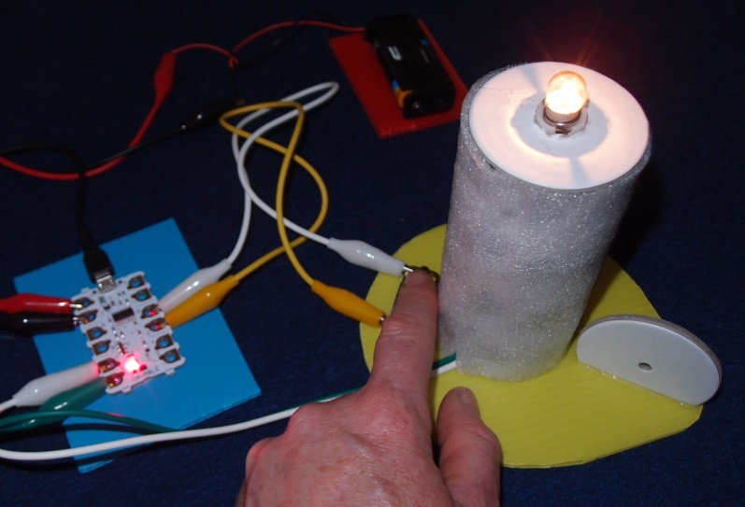
What did you learn?
Where in this program do we use:
sequence?
selection?
repetition?

Slide 11
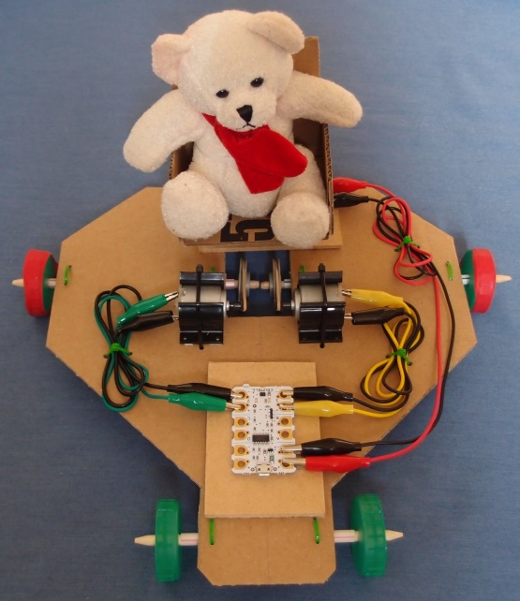
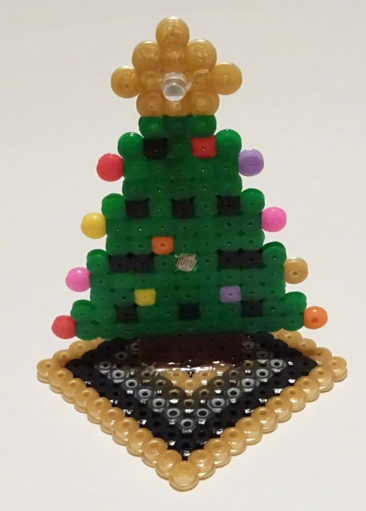
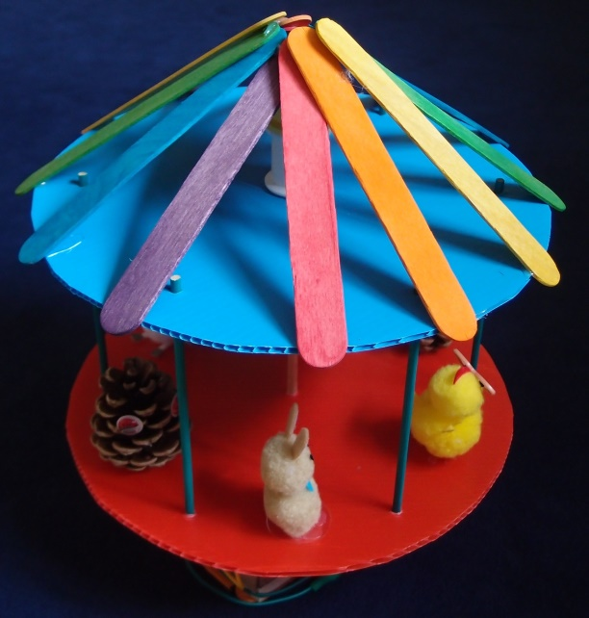
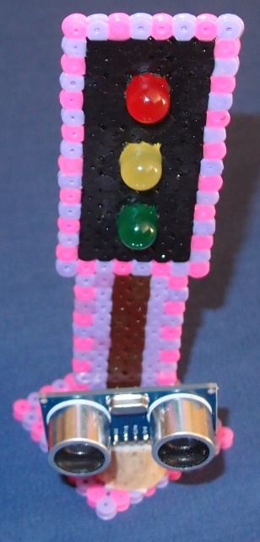
What else could you use your Crumble for?
Copyright © Caroline Alliston 2017

