Slide 1
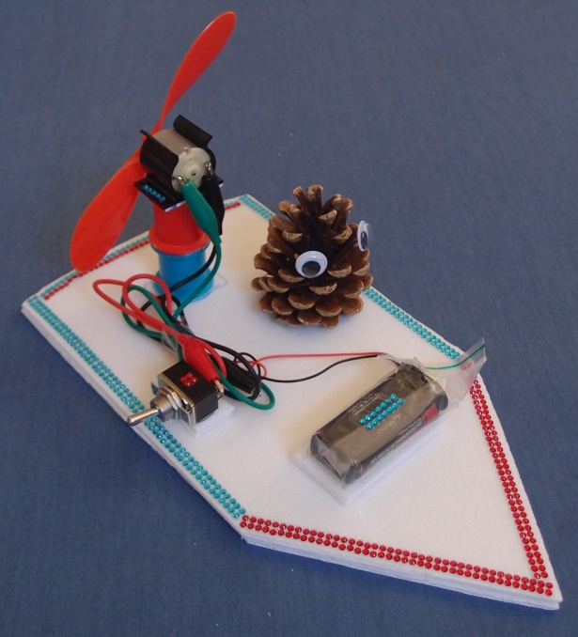
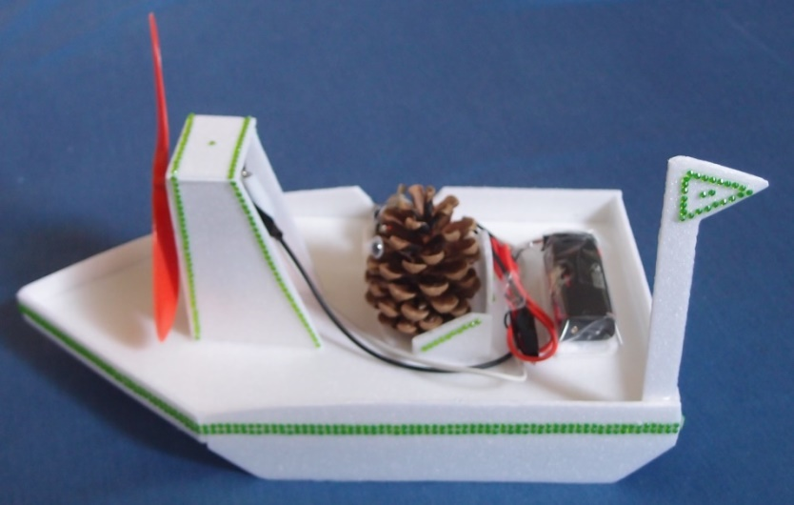
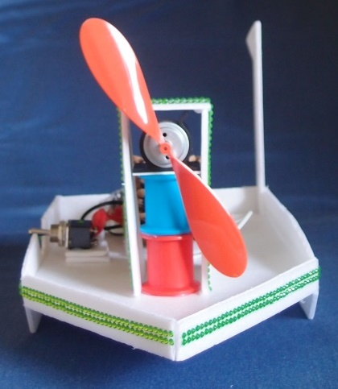
Fan Boats PowerPoint

Slide 2
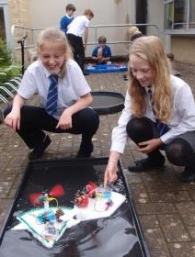
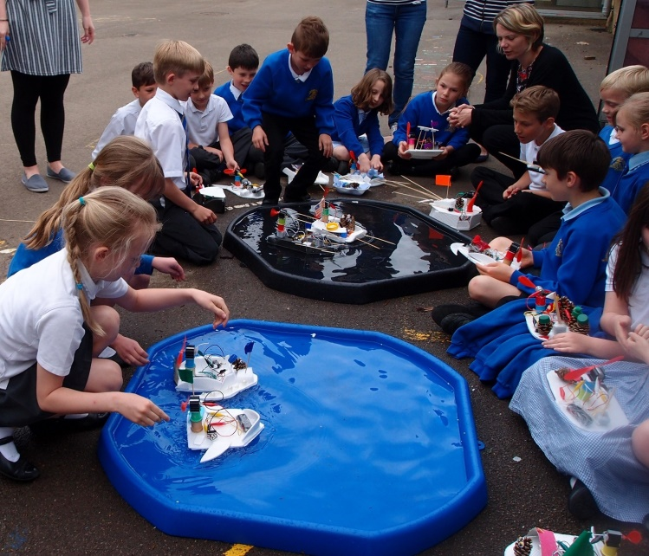
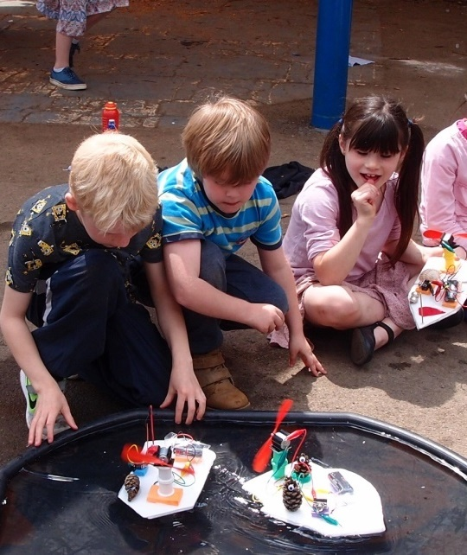
Design, build and test a fan boat

Slide 3
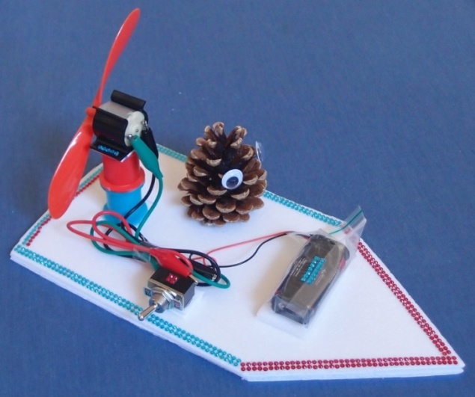
Plan for the day
Morning
Introduction & safety briefing
Flotation and forces
Designing and prototyping
Break
Electric circuits
Making your boat
Lunch
Testing and improving your boat
Tidying up and discussion

Slide 4
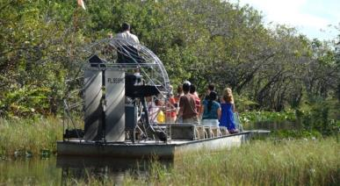
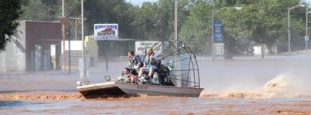
Where fan boats are used
A fan boat doesn’t have a propeller in the water – it is propelled by a giant fan. This means it can be used in shallow water and swamps.
It can also be used for flood and ice rescue operations

Slide 5
Learning objectives
Predict which materials will float.
Understand the forces acting on a fan boat.
Make and use simple series circuits.
Get to know the engineering design process.
Discover how much fun STEM can be!

Slide 6
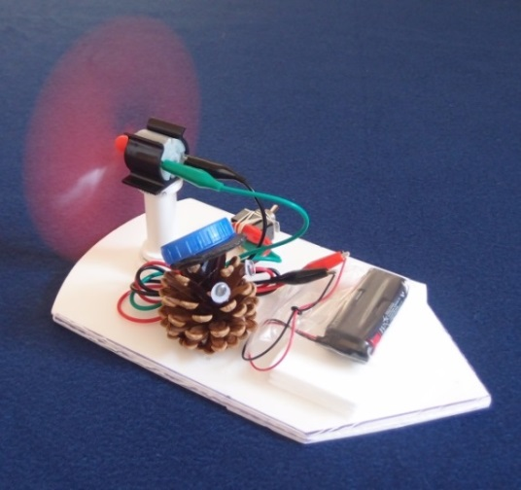
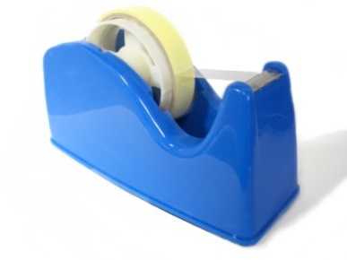
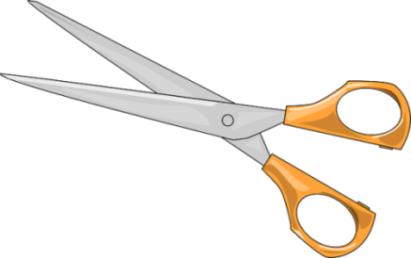
1. Working safely
Look at the tools and equipment, and the sample boat. Can you spot any potential hazards?
Can you think of ways to reduce the risks?
(Do not put the spinning propeller near your eyes.
Do not put your fingers in the way of the propeller.)

Slide 7
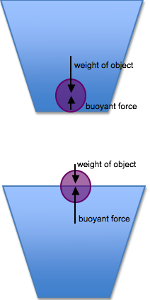
2. Why things sink or float
Archimedes was an ancient Greek mathematician, physicist and engineer.
He discovered how buoyancy works.
If an object is heavier than the same amount (volume) of water then it will sink.
If an object is lighter than the same amount of water then it will float.

Slide 8
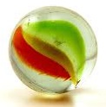
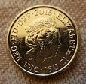
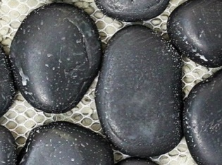
3. Flotation exercise
Identify which items are made of metal, wood, glass, rock or plastic.
Which of the materials do you think will float?
If solid polystyrene sinks in water; why does foamed polystyrene float?
Which materials could you use to make your boat, and why?

Slide 9
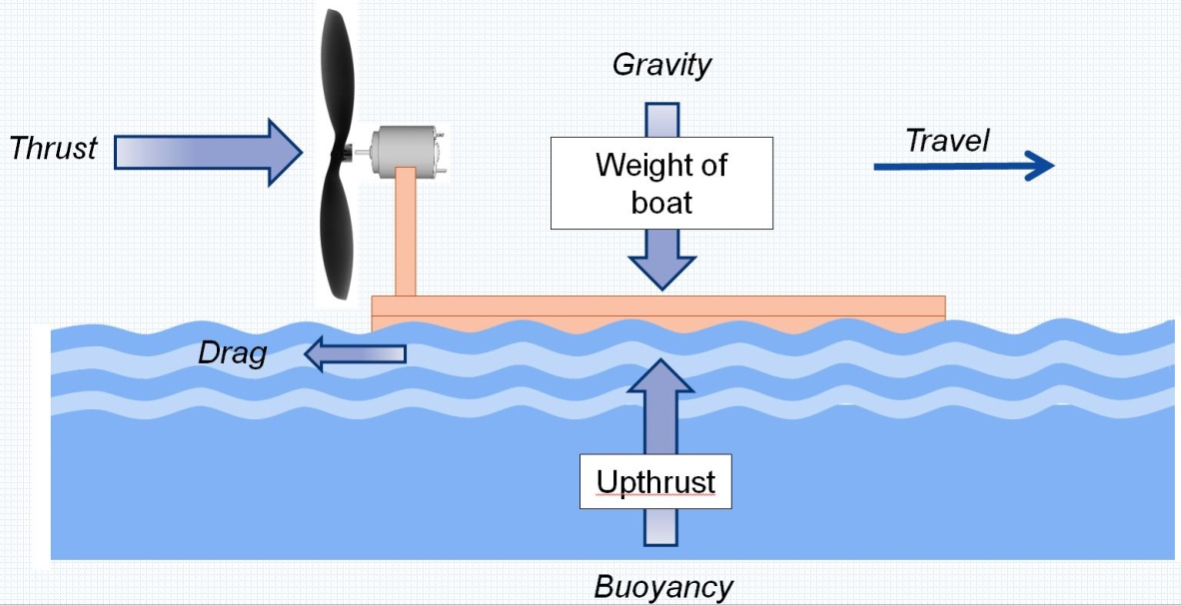
4. Forces
What force is pulling the boat down onto the water?
What opposing force is pushing the boat up?
If the force pulling the boat down was bigger than the force pushing it up, what would happen?
Why does the boat move across the water?
What is the main force opposing the boat moving?

Slide 10
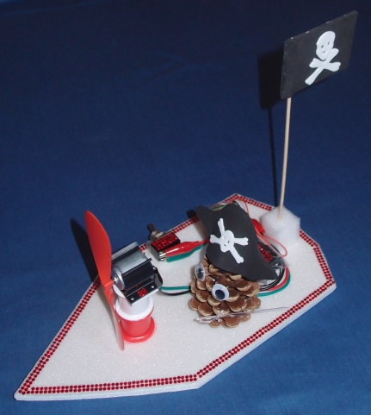
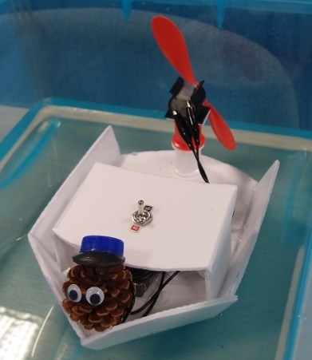
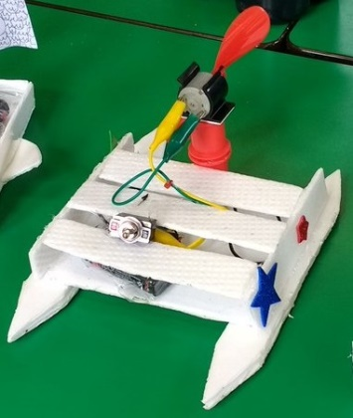
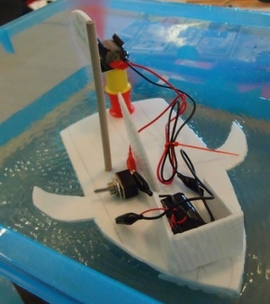
5. Design criteria
In your workbook, write down some design criteria for your boat. For example your boat should:
Float
Be stable (not capsize)
Keep the electrical parts dry
Think of some more criteria:
Go in a straight line, or round in a circle? Carry a passenger or cargo? Look nice? Any special features? You decide.

Slide 11
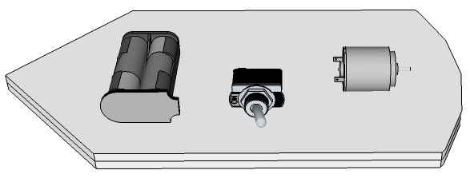
6. Where to put your electrical parts
Think about where you are going to put your electrical parts on your boat base.
What will happen if the centre of gravity is too near:
the front?
the back?
What if it is over to one side?

Slide 12
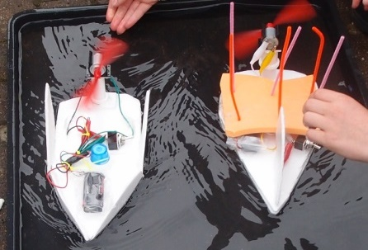
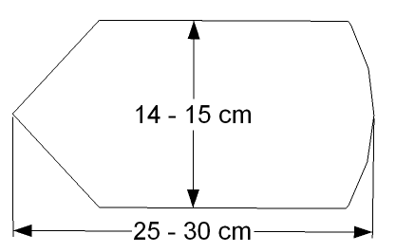
7. Designing your boat
Sketch a design in your workbook to fit your design criteria.
Think about what materials you have available.
Imagine the resistance of the water – what shape would cut through the water easily?
Don’t make the base too small or too narrow.
Make a prototype from card.

Slide 13
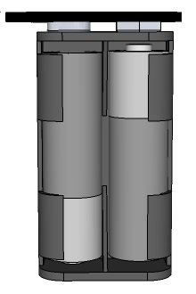
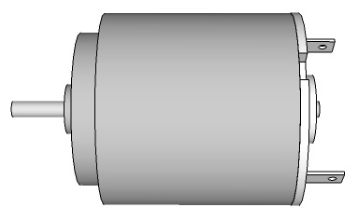
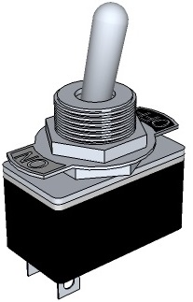
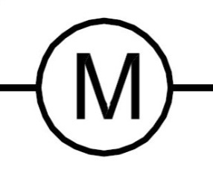
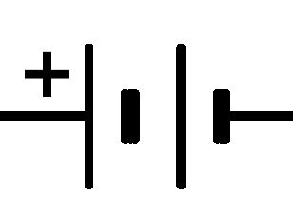
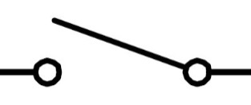
8. Electrical parts
Name these electrical components:

Slide 14
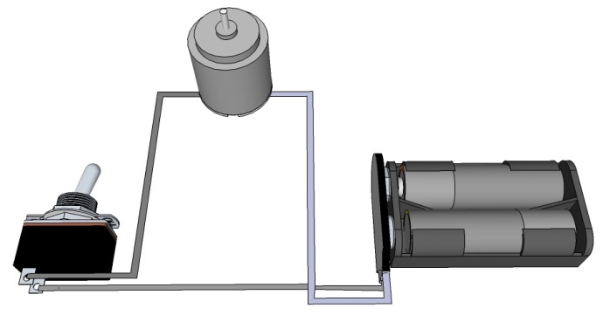
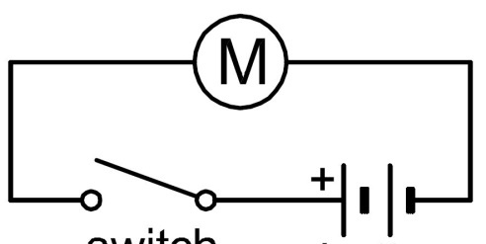
9. Electrical circuit
This shows the electrical circuit you will make:
Using circuit symbols instead of actual components makes it easier to draw.

Slide 15
10. Avoiding short circuits
If batteries are ‘short-circuited’ they can get very hot. Do not connect the bare metal ends of the wires from the battery directly together; they must be connected across the motor. Also:
Tie the black wire and the red wire from the battery clip in a reef knot to stop the bare ends touching.
Make sure the plastic sleeves cover the crocodile clips as shown here, to help prevent short-circuits if the clips touch.

Slide 16
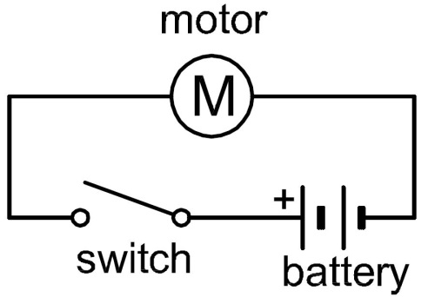
11. Making your circuit
Collect your electrical components (see your workbook)
Tie the black and red wires from the snap battery connector in a reef knot then push the connector firmly onto the battery holder.
Lay out your components in a triangle and connect up the circuit.
Clip crocodile leads onto bare metal, not onto plastic insulation!
Fit the cells into the battery holder (the right way round). Switch on and check the motor shaft rotates, then switch off.

Slide 17
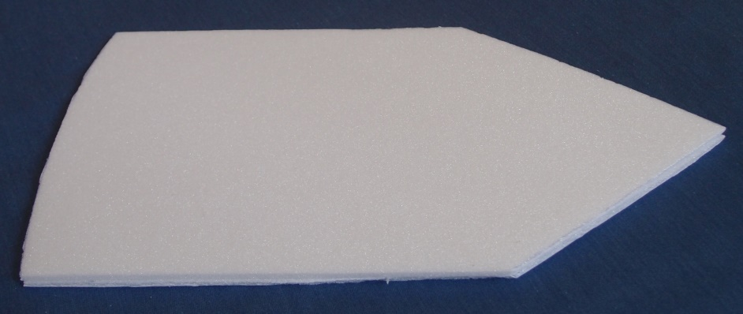
12. Making your boat base
Draw round your prototype on one of your pieces of polystyrene foam with a felt tip pen.
Check your design with an adult then cut it out using large scissors.
Place this on a second piece of polystyrene foam, draw round it and then cut it out.
Glue the two pieces together.

Slide 18
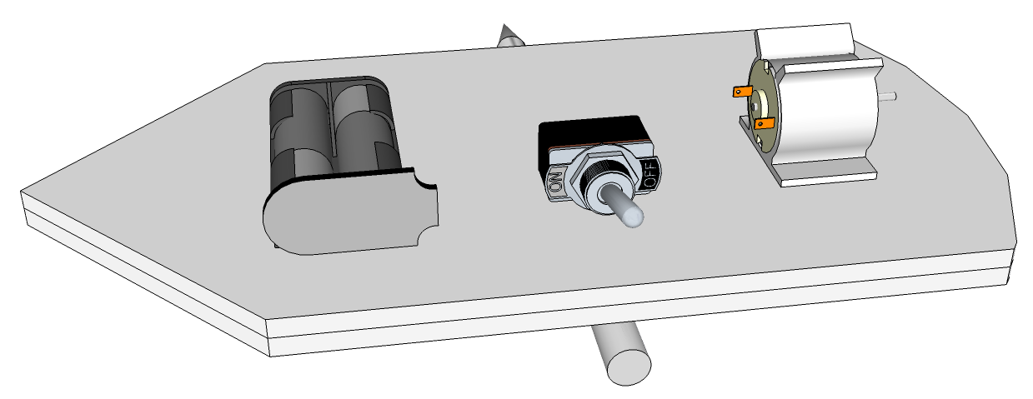
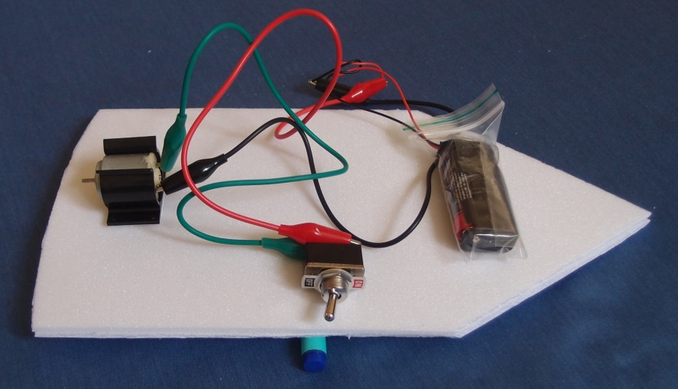
13. Making your boat
Clip the motor into the motor mount.
Lay out your electrical parts on your base, making sure the centre of gravity is near the middle.
Mark the positions with felt tip pen.
Seal your battery inside the plastic bag, with the wires sticking out. This is to help prevent it getting wet.

Slide 19
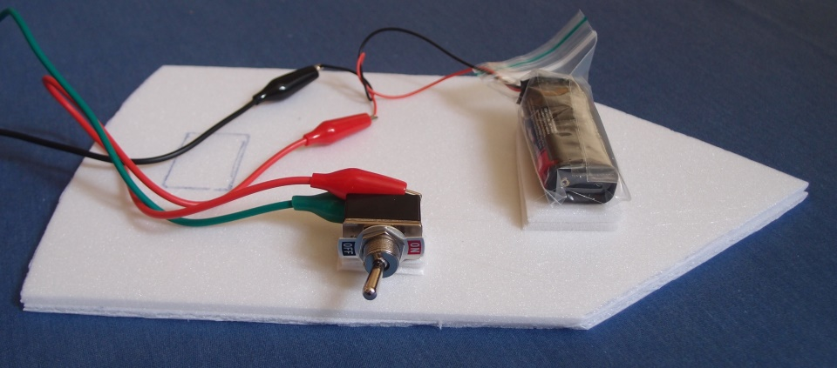
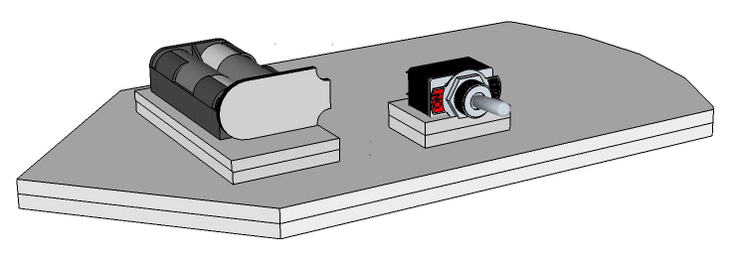
14. Keeping your electrical parts dry
Make a double thickness raised platform out of polystyrene foam offcuts to stick the battery on. This is to help stop it getting wet.
Make a raised platform for the switch as well.
Glue these onto the boat base, then glue the battery and switch onto them.

Slide 20
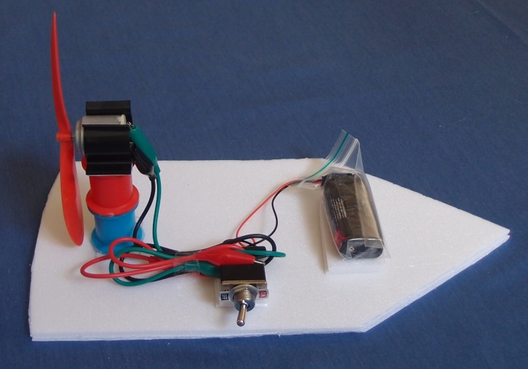
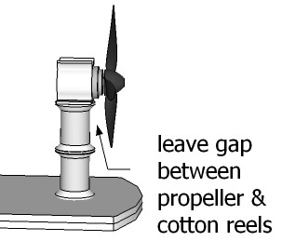
15. Assembling your fan
Stick your cotton reels onto your boat base, one on top of the other.
Remove the plastic film from the motor mount sticky pad, and stick it to the top of the cotton reel stack.
Hold the motor and press the propeller onto the motor shaft.
Turn the propeller all the way round with your finger to check it doesn’t touch the cotton reels.

Slide 21
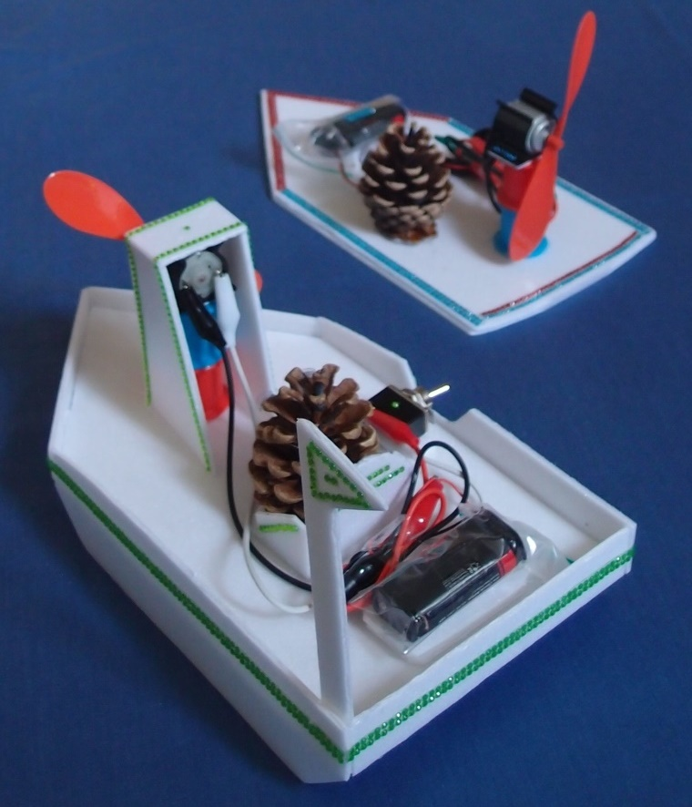
16. Completing your boat
Fold the crocodile leads neatly and tape them together.
Make a pilot for your boat using a pine cone and wiggly eyes.
Add any other features you had planned such as sides, a motor house, fins etc. But make sure you don’t block the airflow to the fan.
Decorate your boat.

Slide 22
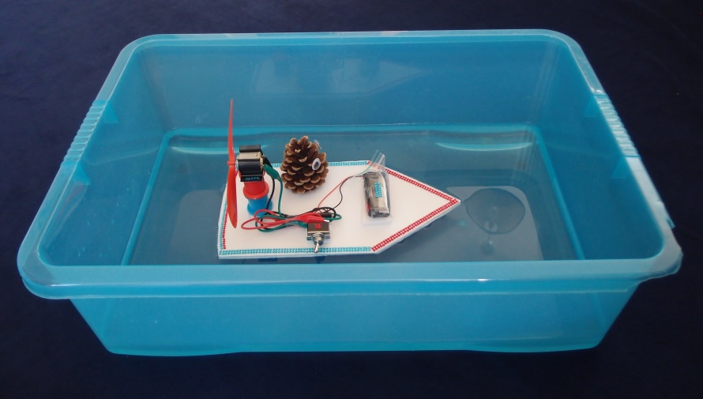
17. Testing your boat
Switch on. If the propeller isn’t spinning can you work out why not? Is it catching on the cotton reels? Has a connection come loose?
Try out your boat in the water tray.
Your propeller will fit either way round on your motor. It works much better one way than the other. Can you work out which way is best?
Is the boat going forwards or backwards? If it is going the wrong way you could swap over the crocodile clips attached to the motor contacts.

Slide 23
18. Improving your boat
Does your boat meet your design criteria?
Compare your boat with other boats.
Ask others what they think of your boat, and whether they feel it could be improved.
Are there any modifications you want to make?
Try out your boat after making any changes to see if they have made a difference.
Clean up thoroughly, then complete your workbook.
.

Slide 24
19. Plenary
Discuss how the activity went and what you have learnt.
What difficulties did you encounter and how did you overcome them?
What would you do differently if you were starting again?
What have you learnt about:
Electric circuits?
Forces acting on a fan boat?
Using materials for particular purposes?
What did you enjoy most about the activity?

Slide 25
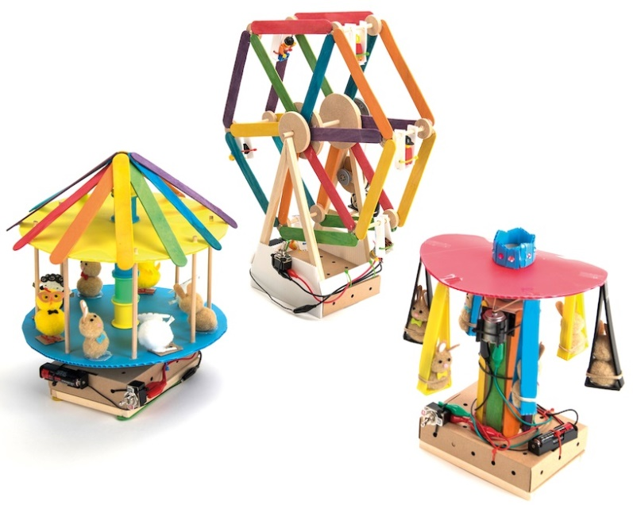
More fun TTS class kits
Make your own light Fairground rides Motorised vehicles
Copyright © Caroline Alliston 2017

