Slide 1
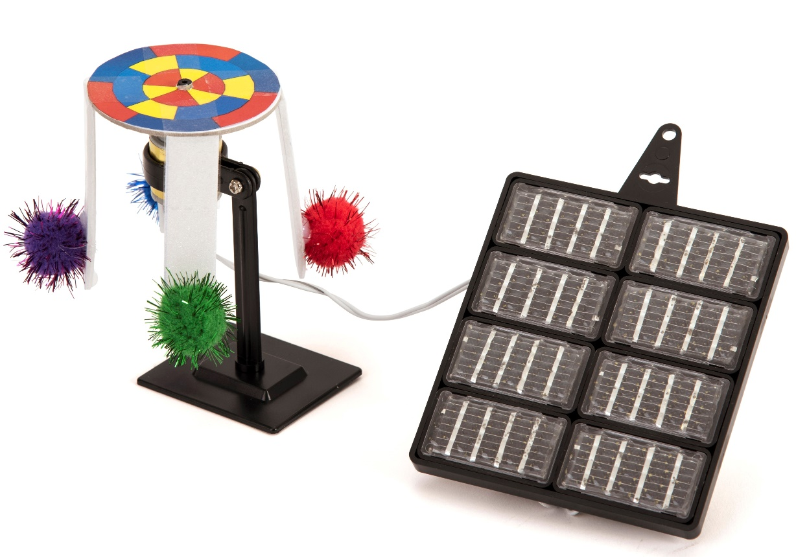
Renewable energy – Module 2
Discover more about renewable energy
What are variable energy sources?
Can energy be stored?
Make a solar powered fairground ride

Slide 2
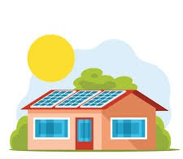
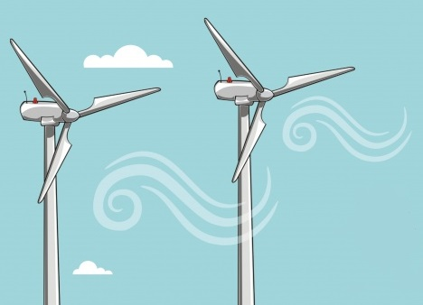
What is renewable energy
Most of our energy comes from burning fossil fuels which causes climate change
Fossil fuels are non-renewable – they get used up
We can use energy from clean sources such as the sun, the wind and water which do not get used up
These are renewable energy sources

Slide 3
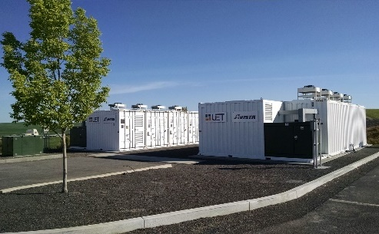
But what if the wind doesn’t blow?
Wind and solar power are variable resources
You want the wind to blow and the sun to shine
What about when the wind doesn’t blow?
You could use variable resources when available, reducing your fossil fuel usage
You could store energy, e.g. in batteries

Slide 4
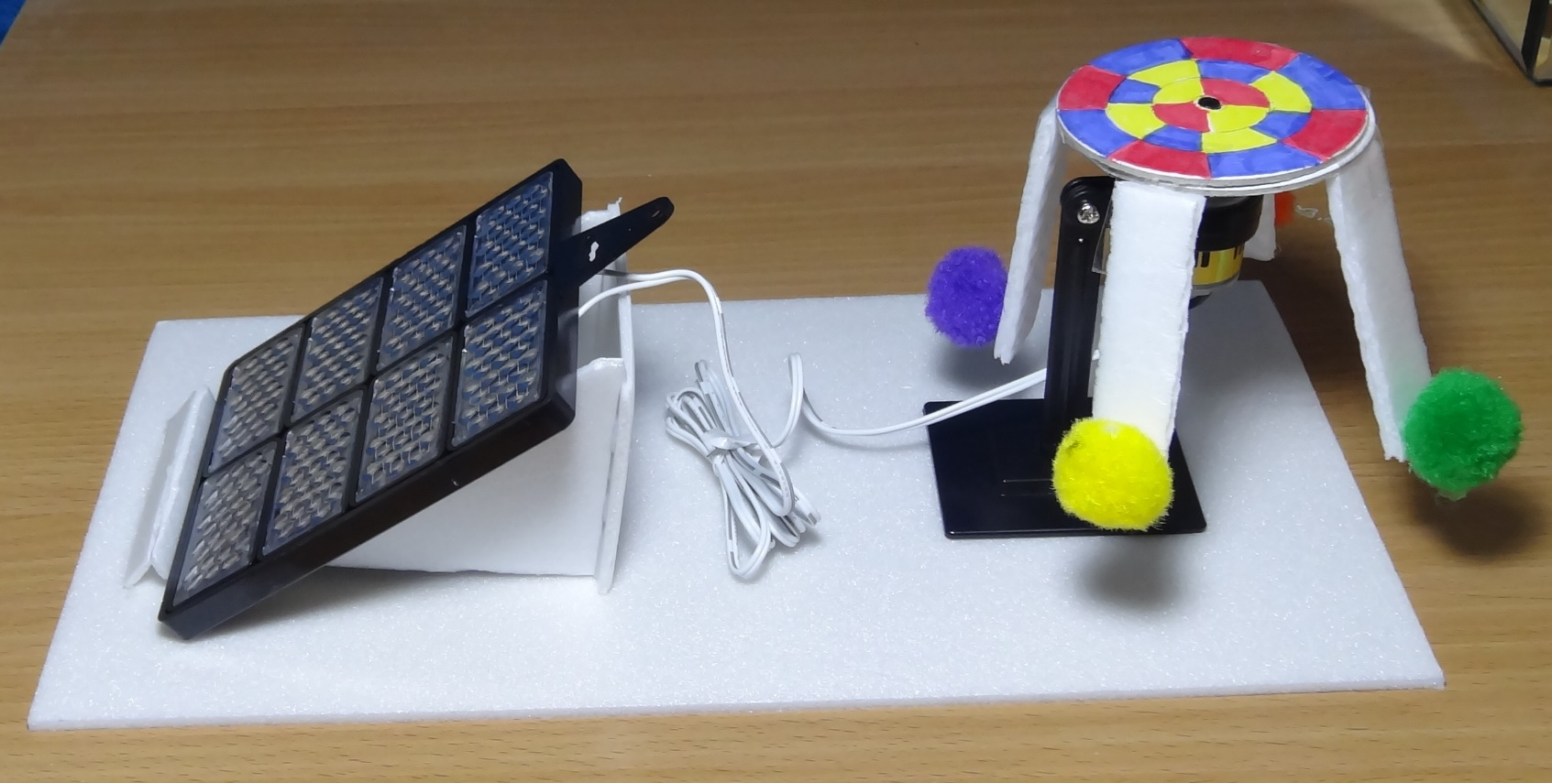
Make a solar powered fairground ride

Slide 5
STEM learning objectives
Science: Forces – effects of gravity and air resistance Electricity – construct a simple electrical circuit, recognise common conductors and insulators
Technology – use a range of tools and equipment to perform practical tasks
Engineering – design of rotating equipment
Maths – draw circles and know that diameter is twice the radius

Slide 6
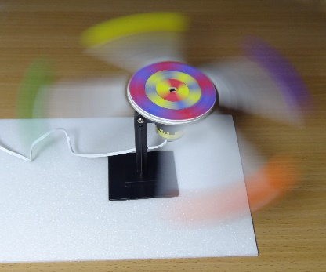
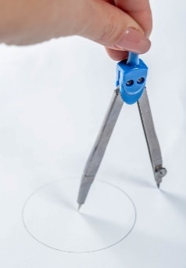
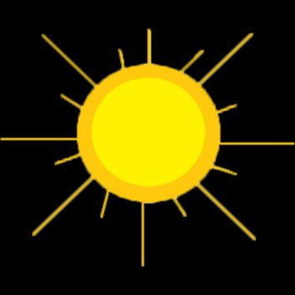
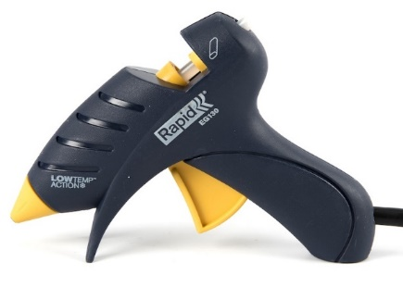
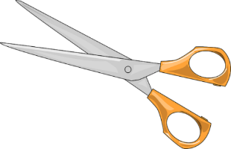
1. Work safely
Look at the tools and equipment. Can you spot any potential hazards?
Can you think of ways to reduce the risks?
Notes:
Don’t cut yourself or burn your fingers.
Use cool melt glue guns to avoid serious burns.
Don’t put your eye near the rotating fairground ride.
Don’t spike yourself with the compasses.
Don’t look directly at the sun as you could damage your eyes.

Slide 7
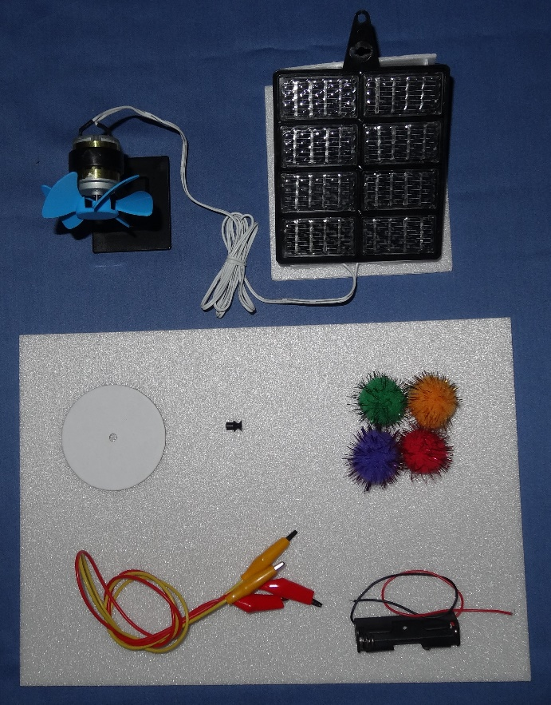
2. Collect your materials
You will need:
A solar energy kit (pedestal fan completed in module 1)
A sheet of polystyrene foam
A card disc
A motor pulley
Four pompoms
Two crocodile leads
A battery holder

Slide 8
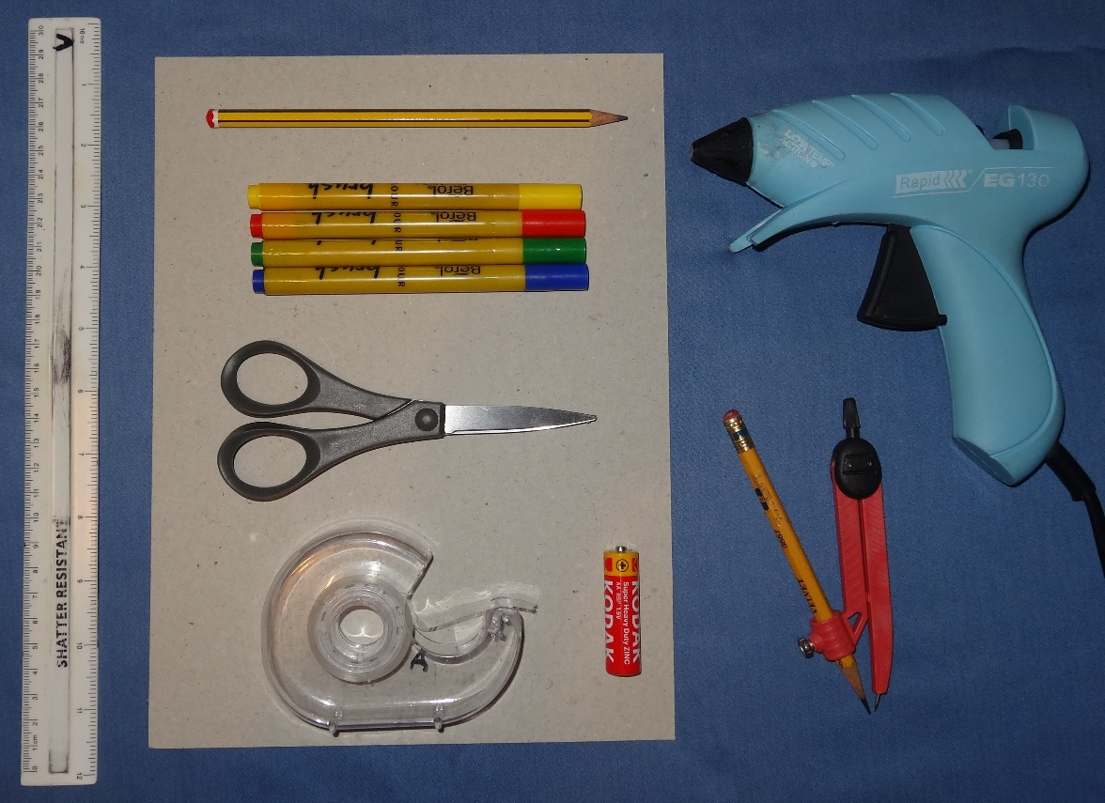
3. Assemble your tools and consumables
You will need:
A ruler
A sheet of card
A pencil
Coloured felt tip pens
A pair of scissors
Transparent sticky tape
A cell (battery)
A cool melt glue gun
A pair of compasses

Slide 9
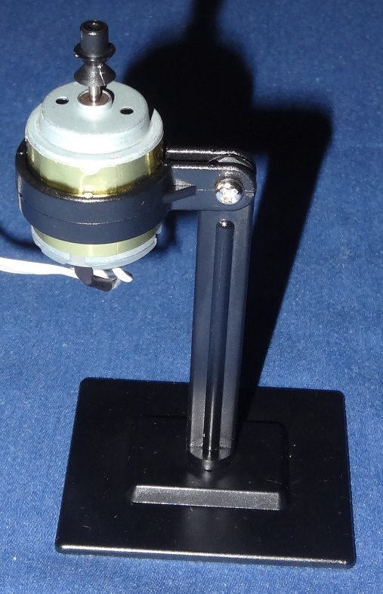
4. Prepare the motor
Pull the propeller off the motor shaft
Replace it with the motor pulley - the nose of the pulley must face away from the motor as shown
Use the plastic spanner from the solar energy kit to loosen the nut slightly on the motor stand
Turn the motor so the shaft faces vertically upwards
Re-tighten the nut

Slide 10
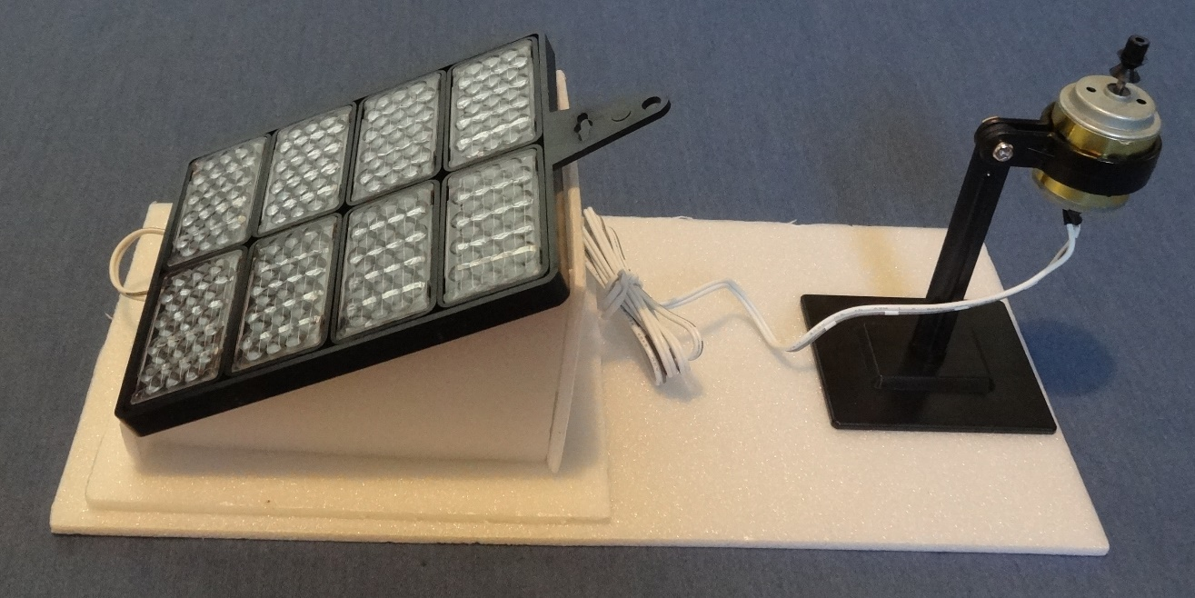
5. Make the base
Cut a base 12 cm x 25 cm from the polystyrene foam
Glue the solar panel stand to one end, facing outwards
Glue the motor stand to the other end. The motor should be on the side furthest away from the solar panel

Slide 11
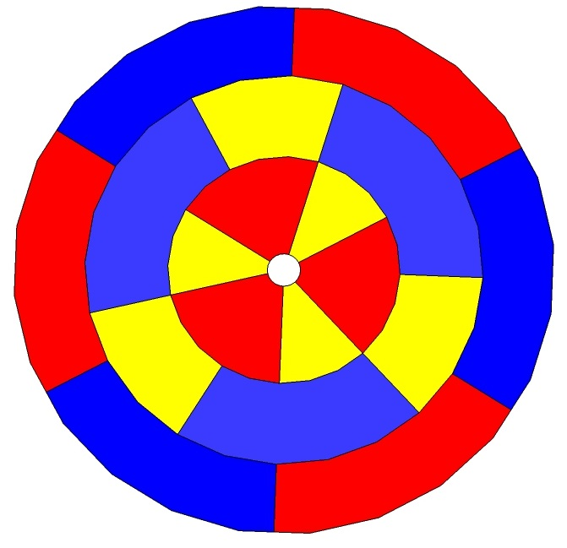
6. Colour in the card disc
Hold the card disc firmly on the sheet of card
Use the compasses to draw two concentric circles of 3 cm and 5 cm diameter on the card disc
How do you know what radius to set the compasses at?
Colour the concentric rings in alternating colours
When the disc spins the colours appear to mix – try to predict what colours you will see
Notes:
The radius is half the diameter.

Slide 12
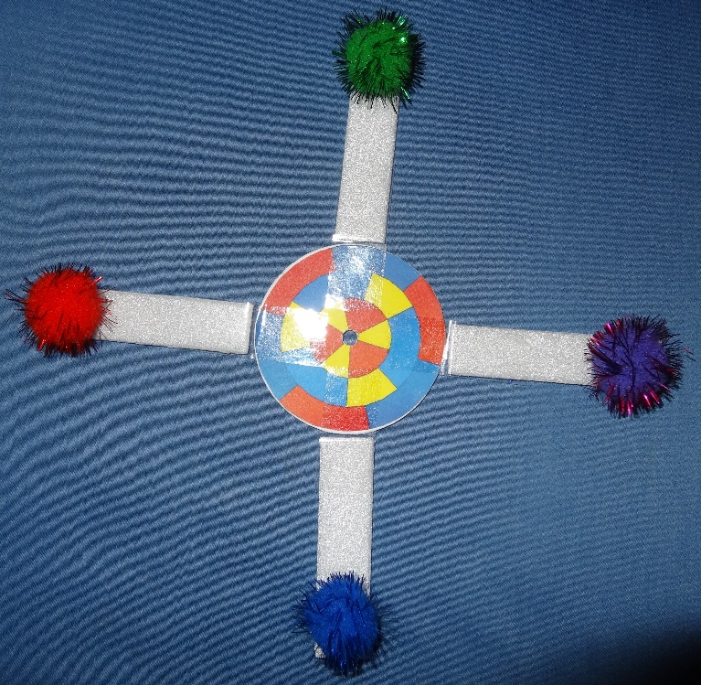
7. Make rotating part of fairground ride
gap
sticky tape
Cut four strips of polystyrene foam 1.5 cm x 7 cm
Glue the four pompoms (passengers) on
Use transparent sticky tape to attach the strips to the disc
Make sure there is a gap between the strip and disc - the sticky tape must act as a hinge so the strips can hang down when the ride is stationary and fly out when the ride is rotating

Slide 13
8. Complete the fairground ride
Slide the card disc onto the nose of the motor pulley
If it is loose then glue it on
Make sure the wires aren’t in the way of the ride turning
Orientate the panel so that it is facing the sun
Watch what happens to the ride

Slide 14
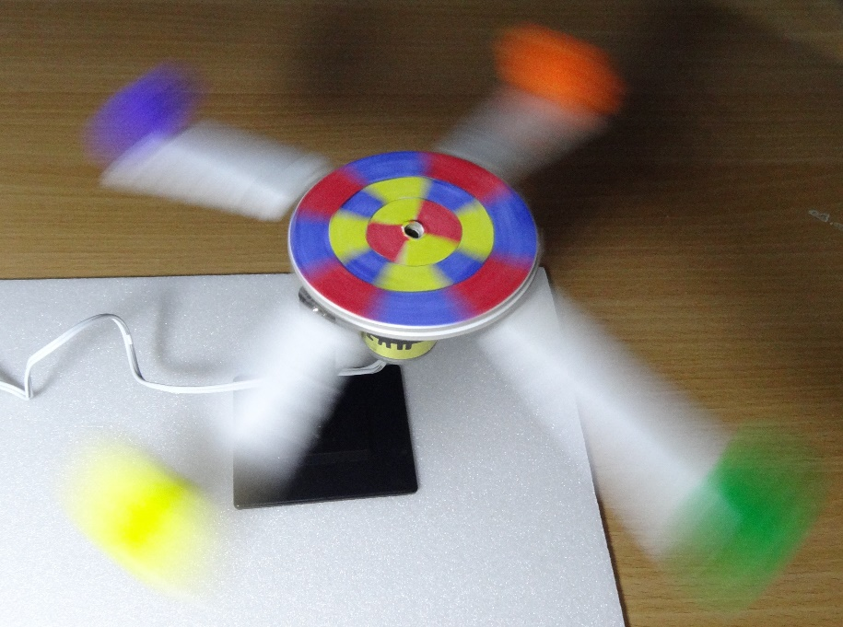
8. How does the ride work?
Watch what happens to the passengers as the ride speeds up
What would happen if the strips weren’t attached firmly?
What force pulls the passengers downwards?
Why do the passenger fly out to the sides?
What force slows them down?
Did you predict the colour mixtures correctly?
Notes:
If the strips weren’t firmly attached then they would fly off.
This would obviously be very dangerous on a real fairground ride.
Gravity pulls the passengers downwards.
As the ride rotates the passengers need to be pulled inwards to make them go round in a circle – otherwise they would continue travelling in a straight line. The faster the ride goes the more they fly out.
Air resistance slows them down.

Slide 15
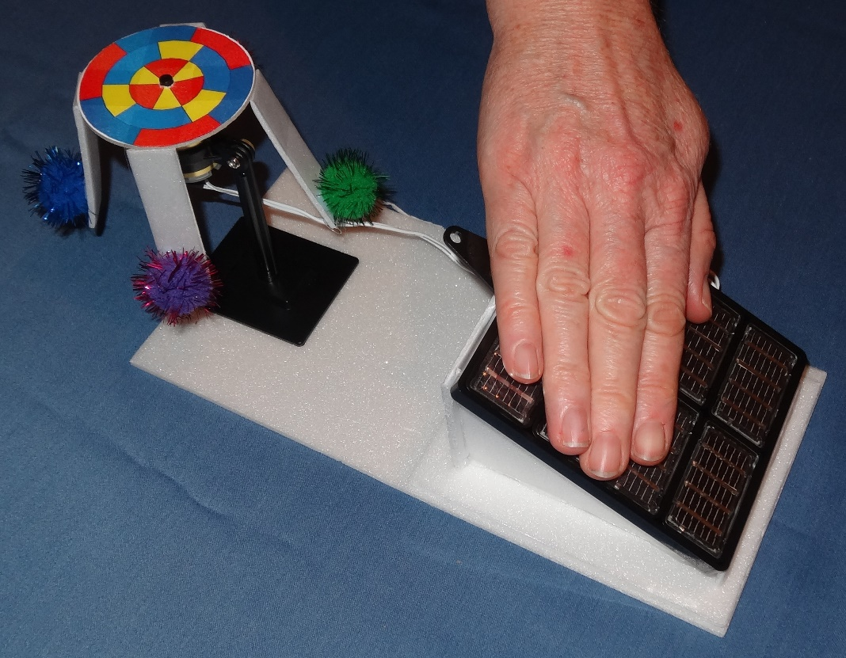
9. Try controlling the ride
Try slowing the ride down or stopping it by covering the solar panel with your hand.
What proportion of the solar cells need to be covered up to prevent the ride form starting at all?

Slide 16
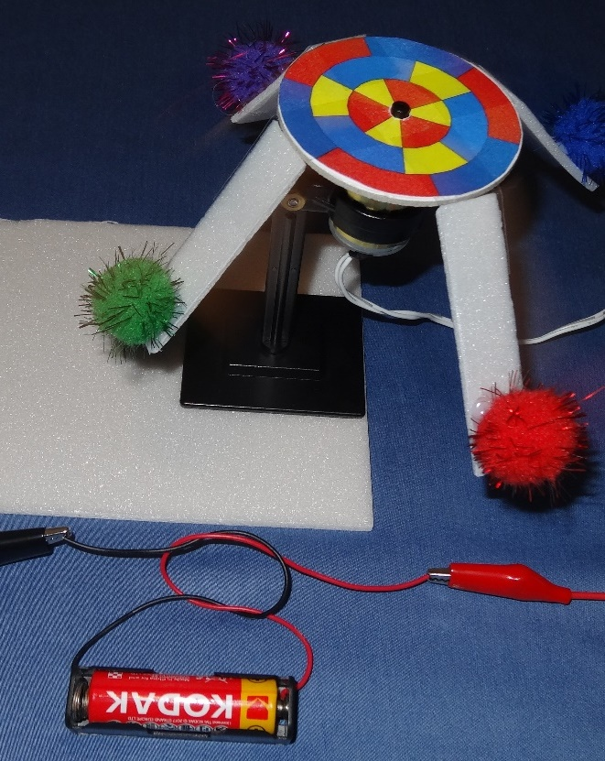
10. What if the sun doesn’t shine?
Power your fairground ride with a battery
Remove the motor contacts from the solar panel
Fit the cell into the battery holder.
Clip one crocodile lead from the red wire from the battery holder to one of the motor contacts
Why do you need to clip onto the metal end of the wire, not the plastic cover?
Clip the other crocodile lead from the black wire to the other motor contact
What happens if you swap the clips over?
Notes:
After removing the motor contacts from the solar panel, make sure the washers and nuts are re-fitted to the panel so they don’t get lost.
Make sure the metal parts of the crocodile clips don’t touch or you will short circuit the battery.
You have to clip onto the metal end rather than the plastic cover because metal is a conductor of electricity and plastic is an insulator.
If you swap the clips over the ride should rotate the other way.

Slide 17
11. What did you learn?
What is renewable energy?
Name a ‘variable’ renewable energy resource
How could you store energy for when you need it?
What forces are acting on the passengers as the fairground ride rotates?
Name a material which conducts electricity
Name a material which is an insulator (does not conduct electricity)
Which tools did you use to construct your fairground ride?
What else did you learn?
Notes:
Renewable energy is energy from sources which do not get used up.
When the wind doesn’t blow, for example, you cannot extract energy from it.
Energy is often stored in batteries. These are many other ways of storing energy as well.
Gravity acts downwards, ‘centripetal’ force pulls the passengers inwards so they travel round in a circle, air resistance slows them down.
Metal conducts electricity.
Plastic is an insulator (and so are lots of other materials).

