Slide 1
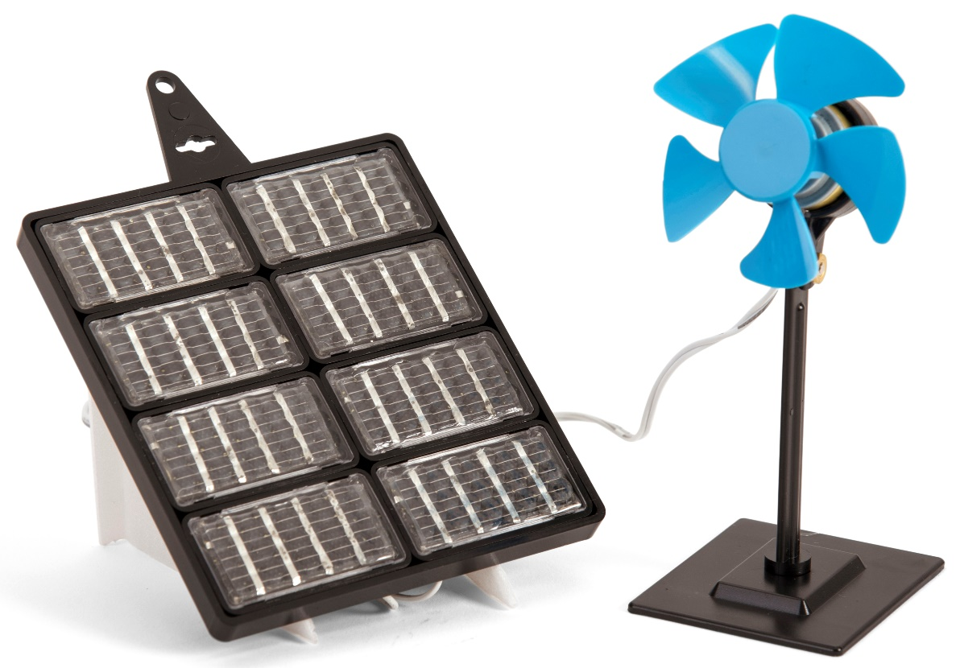
Renewable energy – Module 1
Learn about renewable energy
Find out how to assemble a solar panel
Learn how to orientate it relative to the sun
Use it to power a pedestal fan

Slide 2

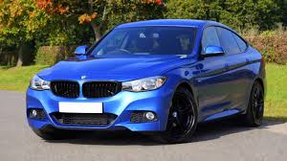

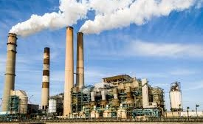
What do we use energy for?
Transport
Houses (e.g.
for heating)
Industry
Other things

Slide 3
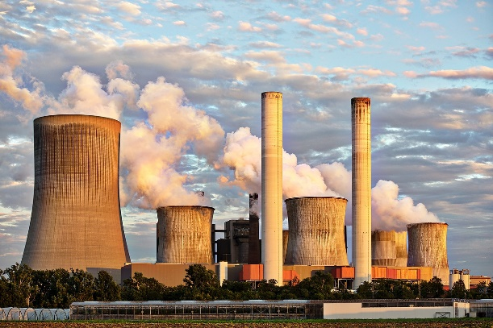
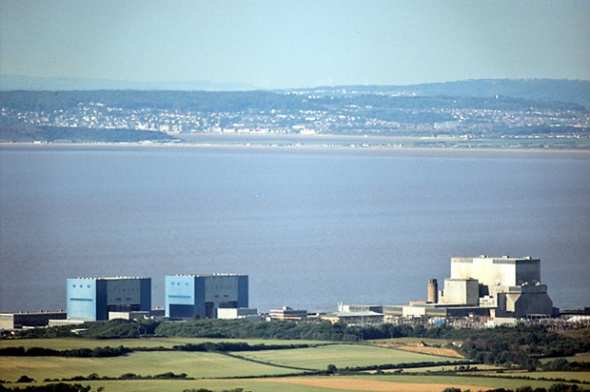
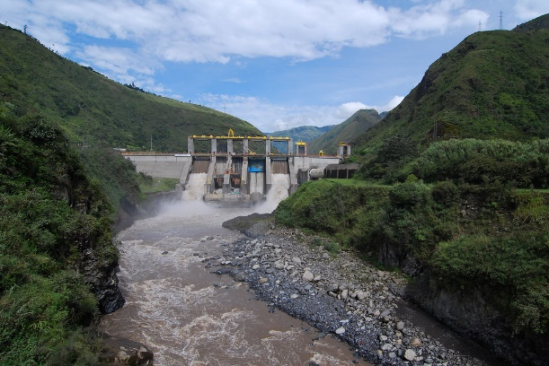
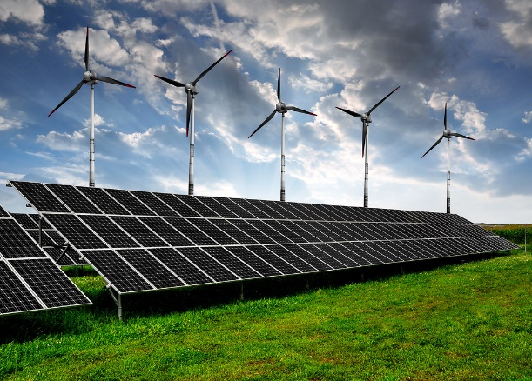
Where does our energy come from?
Fossil fuels (mostly)
Nuclear energy
Renewable energy e.g. hydroelectric, wind & solar

Slide 4
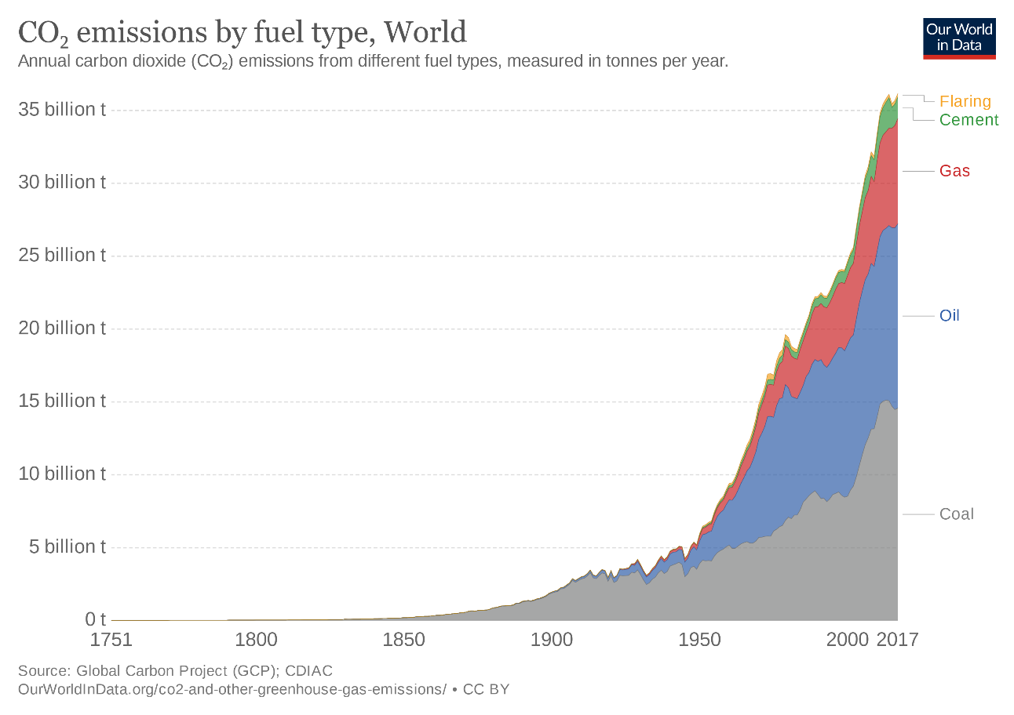
Fossil fuels and climate change
Fossil fuels include oil, coal and natural gas
Most of our energy at present comes from burning fossil fuels
This produces ‘greenhouse gases’ which cause climate change
Notes:
This graph shows how steeply carbon emissions are rising.

Slide 5
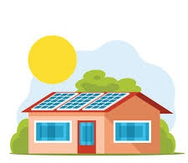
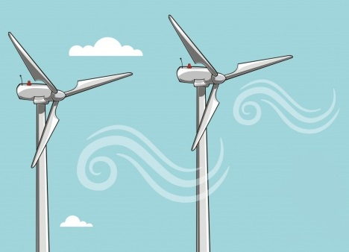
Renewable energy
We need to reduce our carbon emissions
We must reduce our dependency on fossil fuels
One of the ways we can help is to use renewable energy which does not produce greenhouse gases
Renewable energy comes from sources that do not get used up

Slide 6
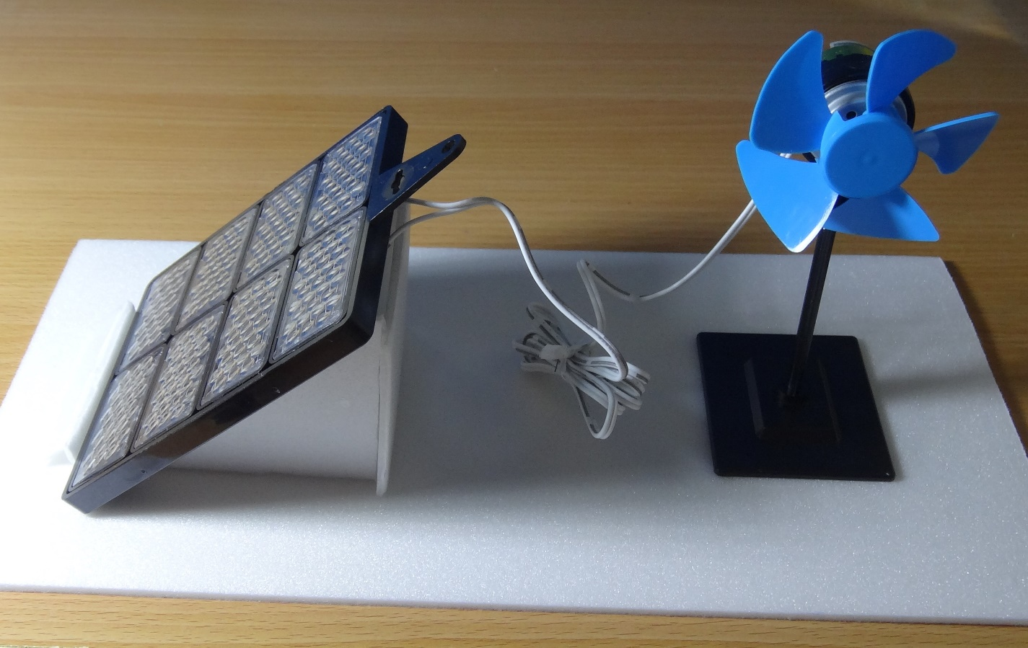
Make a fan powered by solar energy

Slide 7
STEM learning objectives
Science: Electricity – compare and give reasons for variations in how components function Light - recognise how shadows are formed
Technology – engage in an iterative process of designing and making
Engineering – optimise the performance of equipment
Maths – draw and measure angles using a protractor

Slide 8
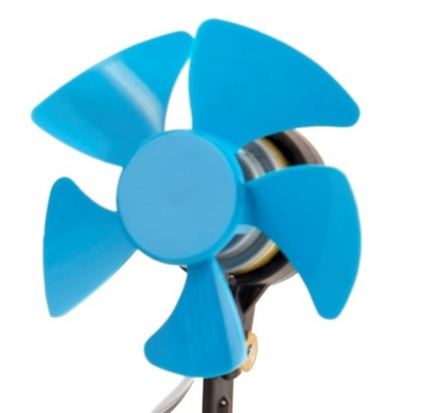
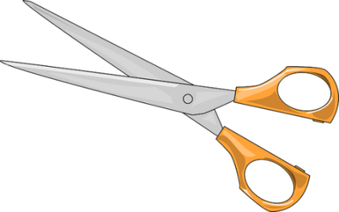
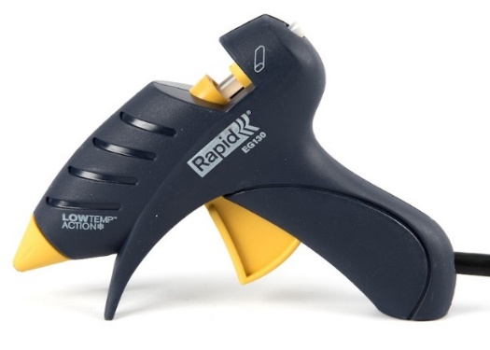

1. Work safely
Look at the tools and equipment. Can you spot any potential hazards?
Can you think of ways to reduce the risks?
Notes:
Don’t cut yourself or burn your fingers.
Use cool melt glue guns to avoid serious burns.
Don’t put the fan near your eye.
Don’t look directly at the sun as you could damage your eyes.

Slide 9
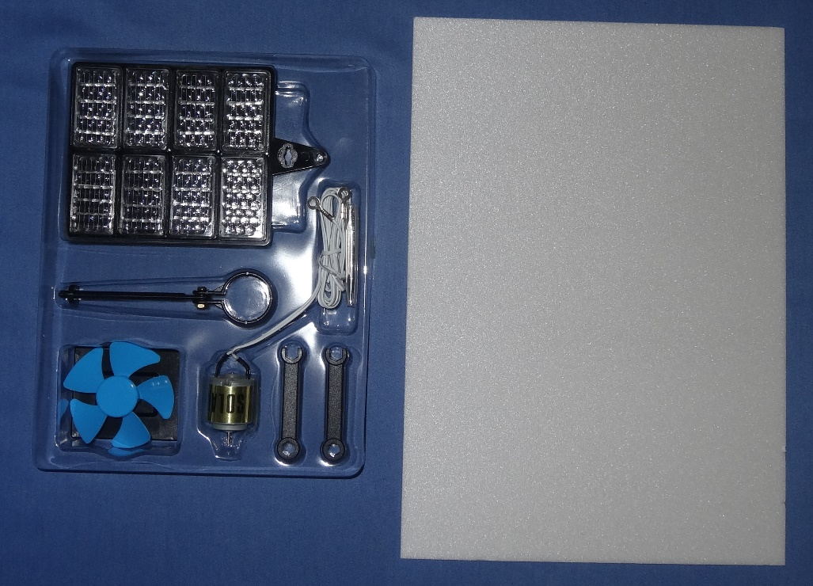
2. Collect your materials
You will need:
A solar renewable energy kit
A sheet of polystyrene foam

Slide 10
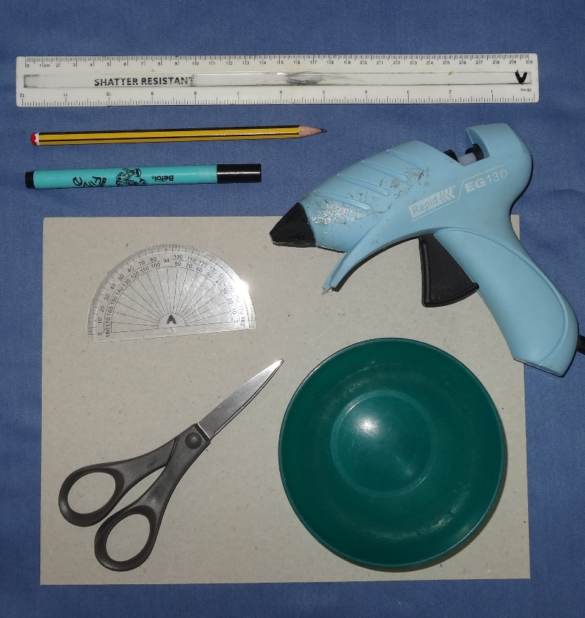
3. Assemble your tools
You will need:
A ruler
A pencil
A felt tip pen
A protractor
A pair of scissors
A cool melt glue gun
A bowl
A sheet of card

Slide 11
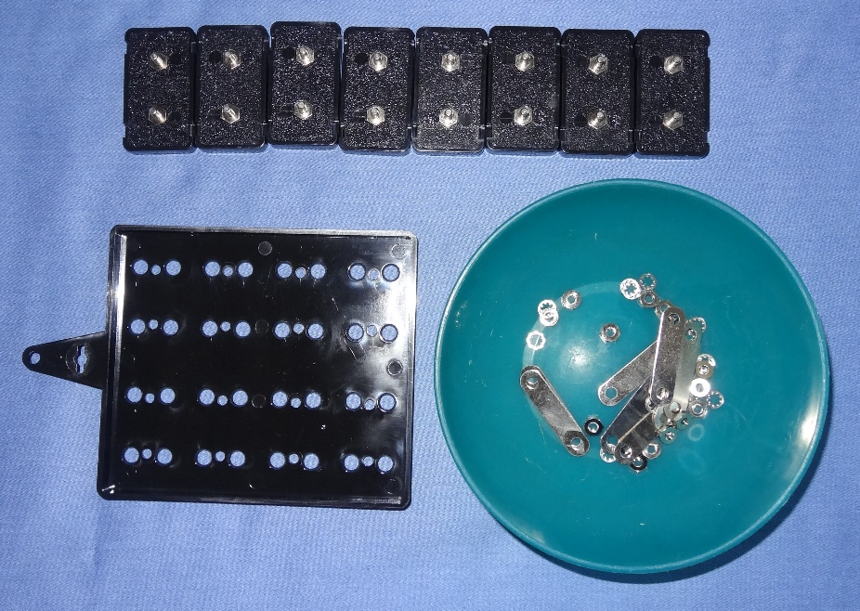
4. Prepare the solar cells
Open the solar renewable energy kit
Remove the 8 solar cells from the mounting plate
Unscrew all the nuts and washers
Remove the metal connecting strips
Place the nuts, washers and strips in the bowl so you don’t lose them

Slide 12
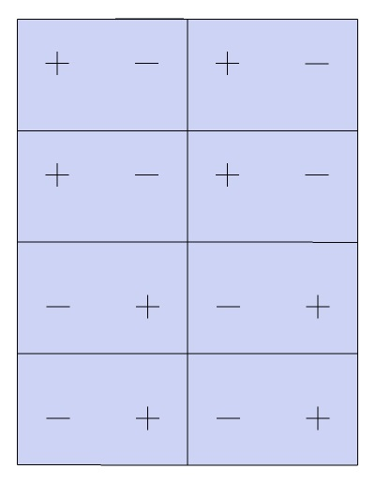
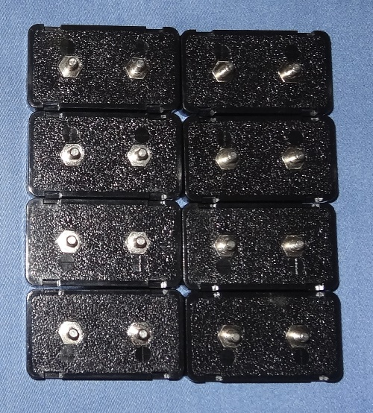
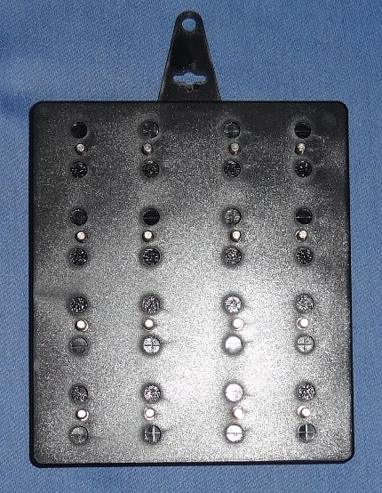
5. Assemble the solar cell
Lay out the solar cells in the order shown
Plus (+) and minus (-) signs are moulded into the back of each cell
Turn the mounting plate over and slide the small holes onto the studs

Slide 13
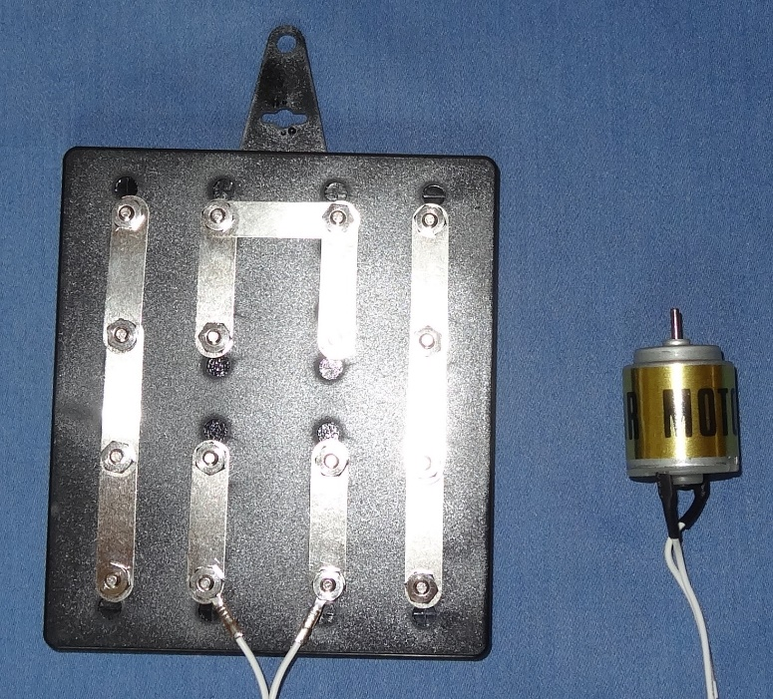
6. Connect up the solar panel
Fit the metal connecting strips
Place the contacts from the solar motor onto the two studs shown
Slide a washer onto each stud
Spin a nut onto each stud with your fingers
Nip up the nuts with the plastic spanner provided
Make sure all the nuts are screwed on before you lift up the panel

Slide 14
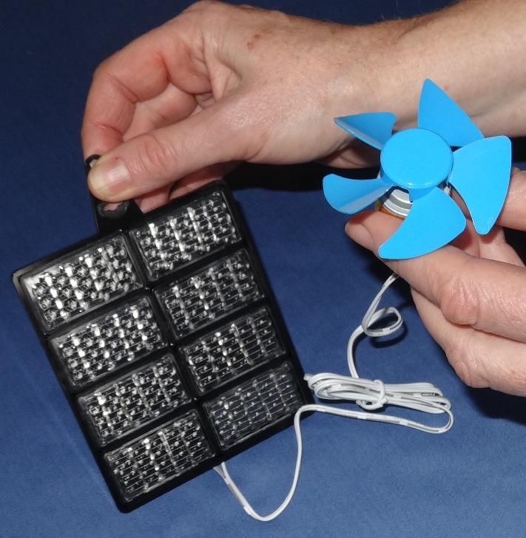
7. Make sure the fan works
Fit the propeller onto the motor shaft Hold the solar panel facing the sun and check the propeller spins
Feel whether the air is blowing away from the motor
If it isn’t then swap over the motor connectors on the solar panel – this will make the motor turn the other way
Hold the solar panel at varying angles to the sun and try work out whether this affects how hard the fan blows

Slide 15
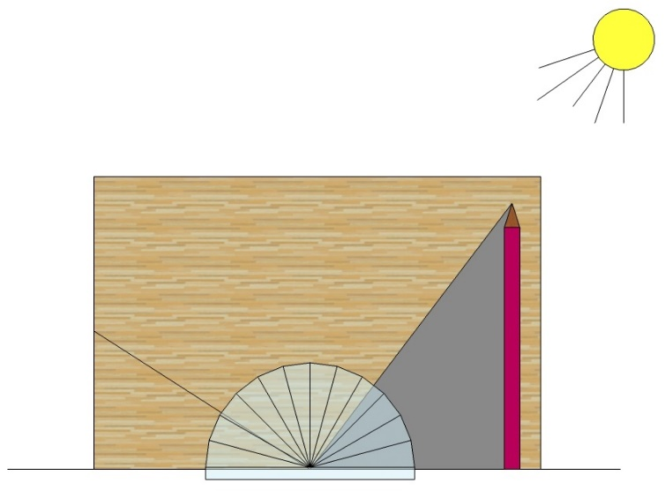
8. Work out at what angle to mount the solar panel
The panel needs to be mounted at right angles to the sun’s rays to maximise power output
Take a sheet of card and hold vertically on a flat table in the sun
Hold the pencil vertically as shown and mark the point on the card
Mark on the card where the shadow meets the table
Draw a line between the two marks
Draw another line at right angles to this
Measure the angle of the second line from horizontal
shadow
pencil
angle

Slide 16
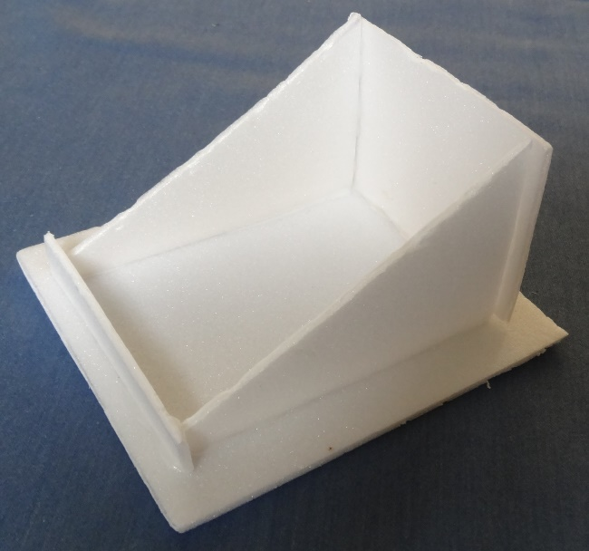
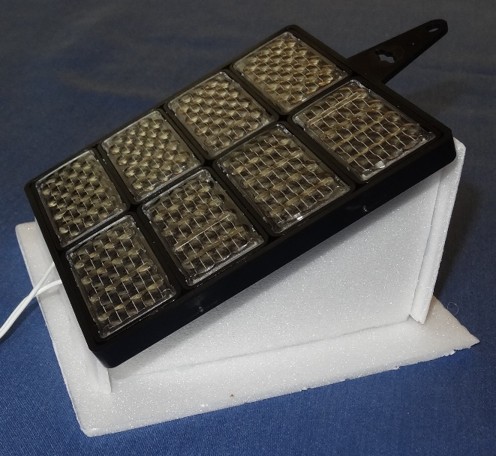
9. Make a stand for the solar panel
Design and make a stand for the solar panel
The panel needs to be mounted at the angle you measured in step 8
You need to be able to take the panel on and off the stand

Slide 17
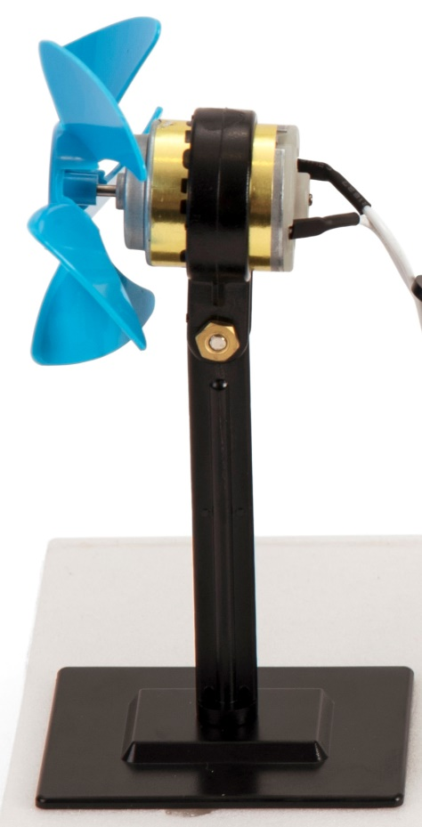
10. Assemble the stand for the fan
Push the end of the upright down into the slot in the base
Twist it clockwise through 90°
Take the propeller off the motor shaft
Loosen the screw on the upright and push the motor in
Nip up the screw and refit the propeller

Slide 18

11. Try out your pedestal fan

Slide 19
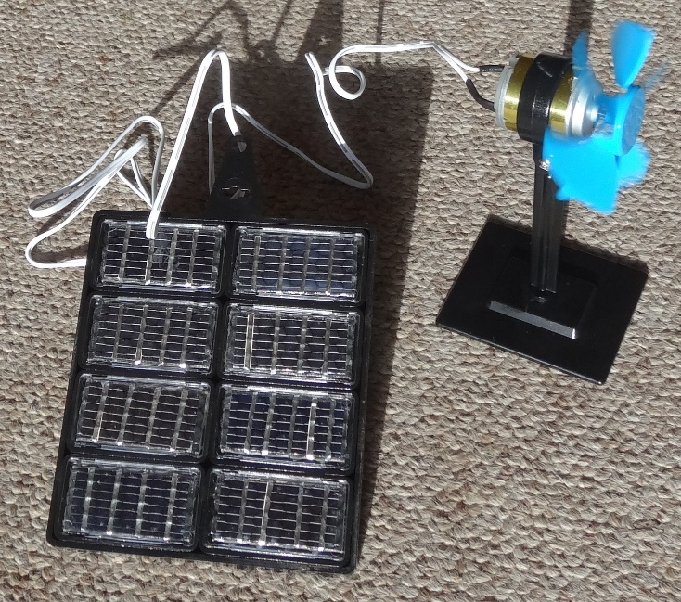
12. What did you learn?
Where does most of our energy come from?
What is the problem with this?
Name some sources of renewable energy
How does the orientation of the solar panel affect the fan performance?
How are shadows formed?
How does a solar powered electric fan work?
Notes:
Most of our energy comes from burning fossil fuels.
This causes climate change.
Sources of renewable energy include hydro-electric (water) power, wind and solar.
The solar panel needs to be at right angles to the sun’s rays to get best performance.
Shadows are formed when the light is blocked by an opaque (i.e. not see-through) object.
The solar panel produces electricity when sunlight falls on it – this electricity is used to turn the motor. The propeller mounted on the motor pushes the air to produce a breeze which makes you feel cool.

