Slide 1
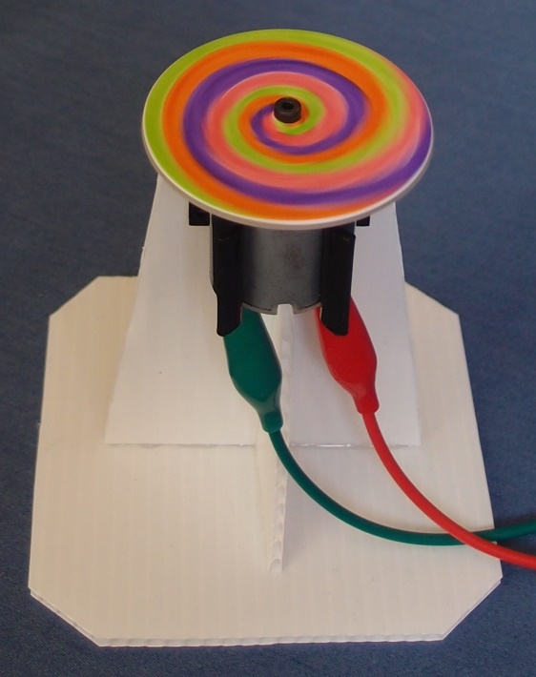
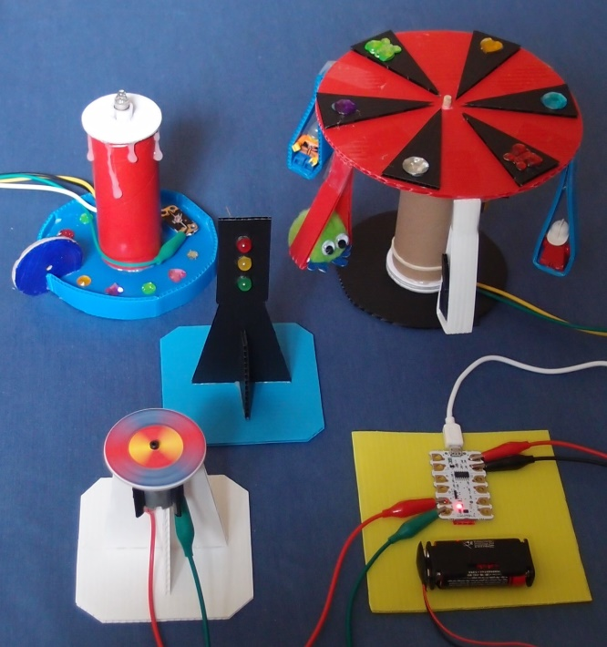
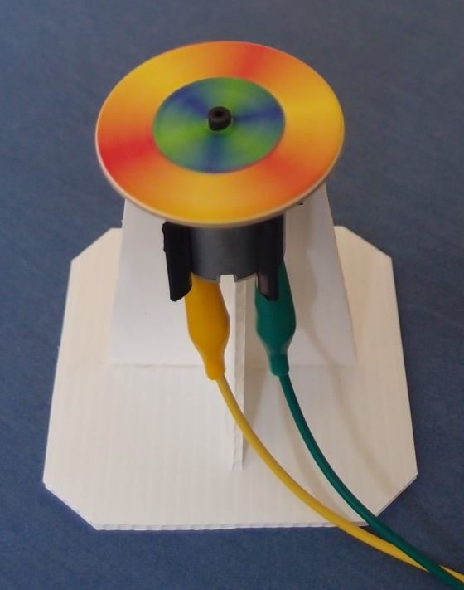
Crumble PowerPoint 2

Slide 2
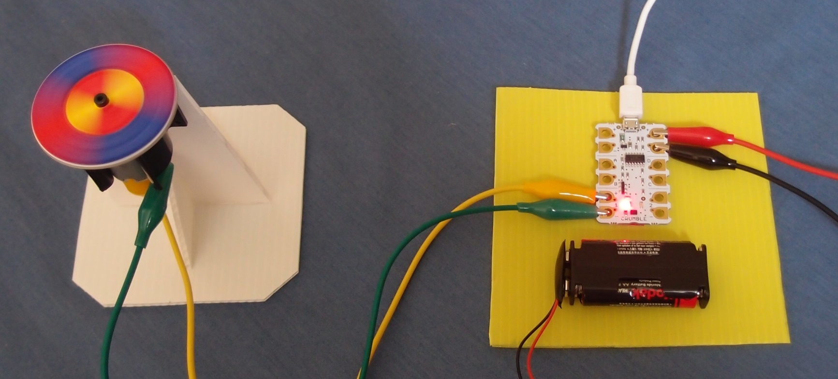
Make a coloured spinner

Slide 3
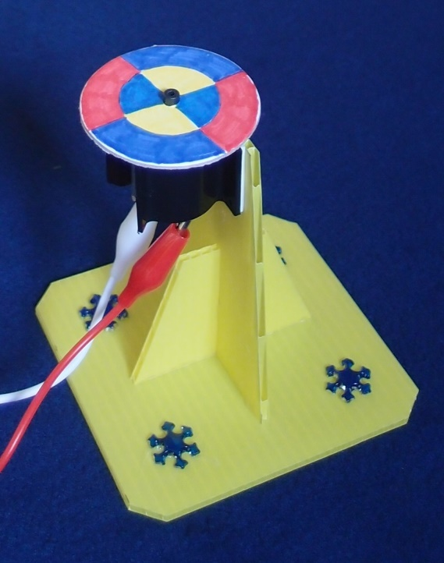
Learning objectives
Design and make a structure for a particular purpose
Program your motor to change its rotational speed and direction
Experiment with mixing coloured light

Slide 4
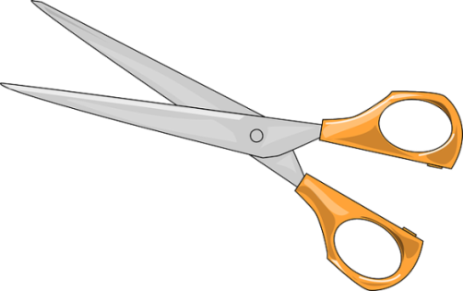
1. Work safely
Look at the tools and equipment. Can you spot any potential hazards?
Can you think of ways to reduce the risks?

Slide 5
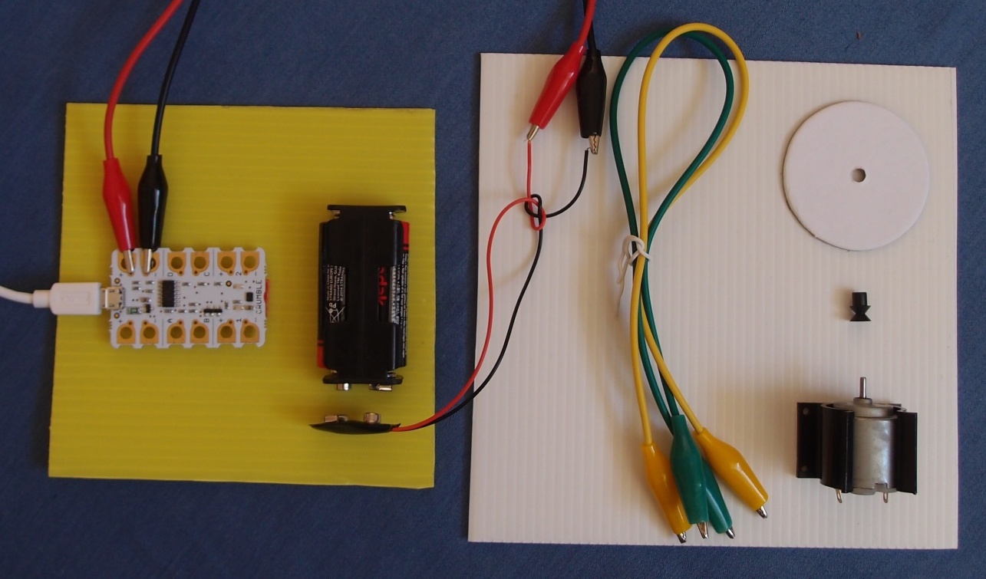
2. Collect your parts
Make sure you have all the parts listed in your workbook.

Slide 6
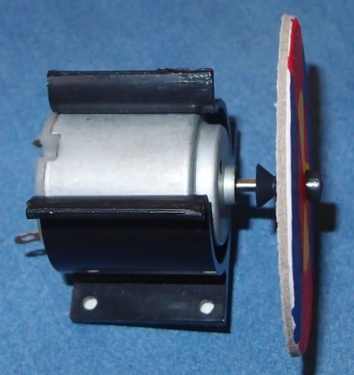
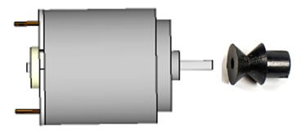
3. Fit your pulley and disc
Push the pulley onto the motor shaft.
Push the card disc onto the pulley.

Slide 7
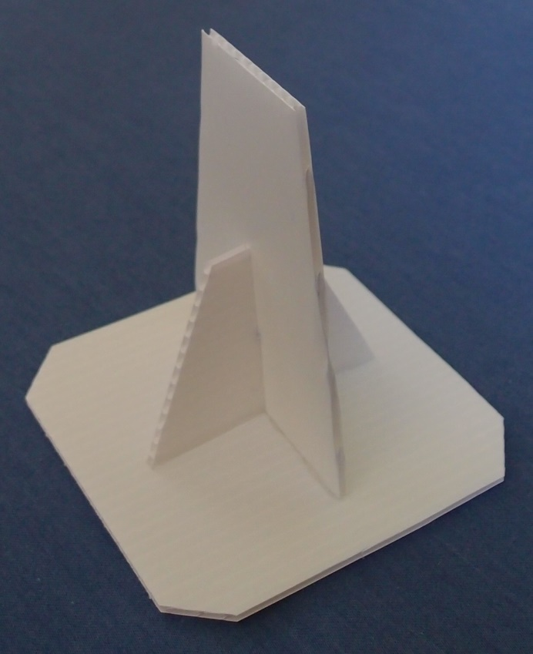
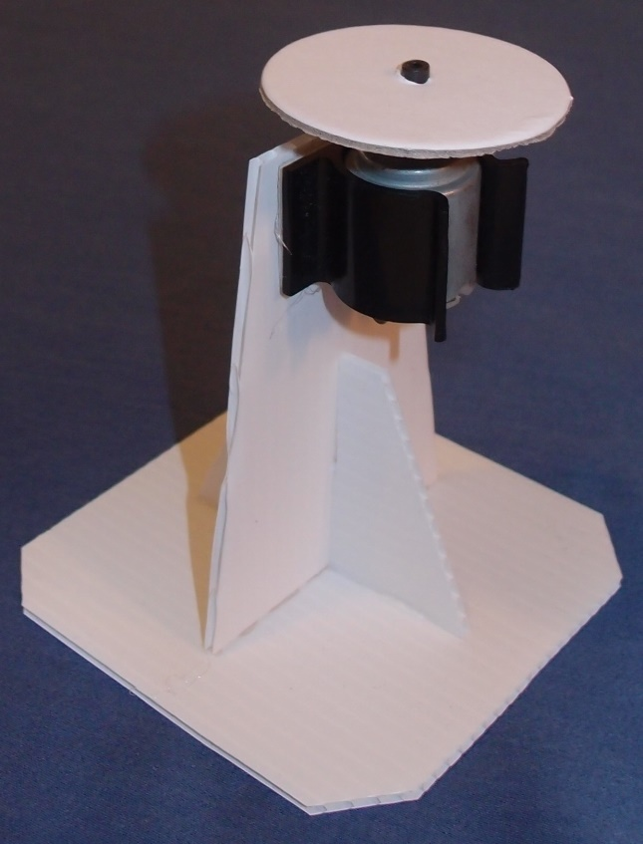
4. Design a stand for your motor

Slide 8
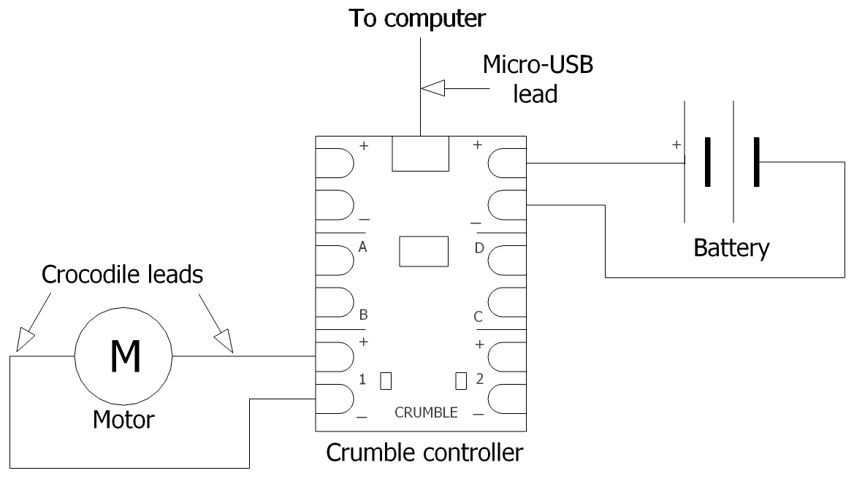
5. Make this circuit

Slide 9
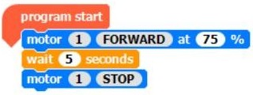
6. Run the motor
Double click on your ‘Run motor’ program.
Run the program and check the motor shaft rotates for a few seconds and then stops.

Slide 10
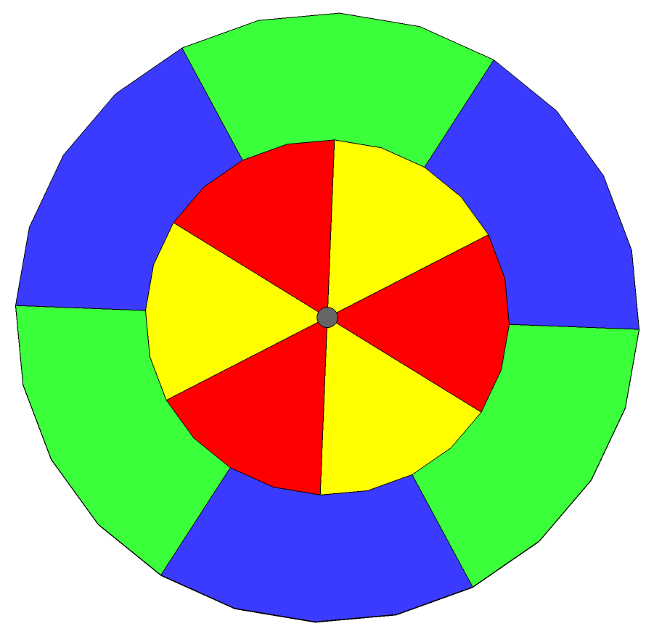
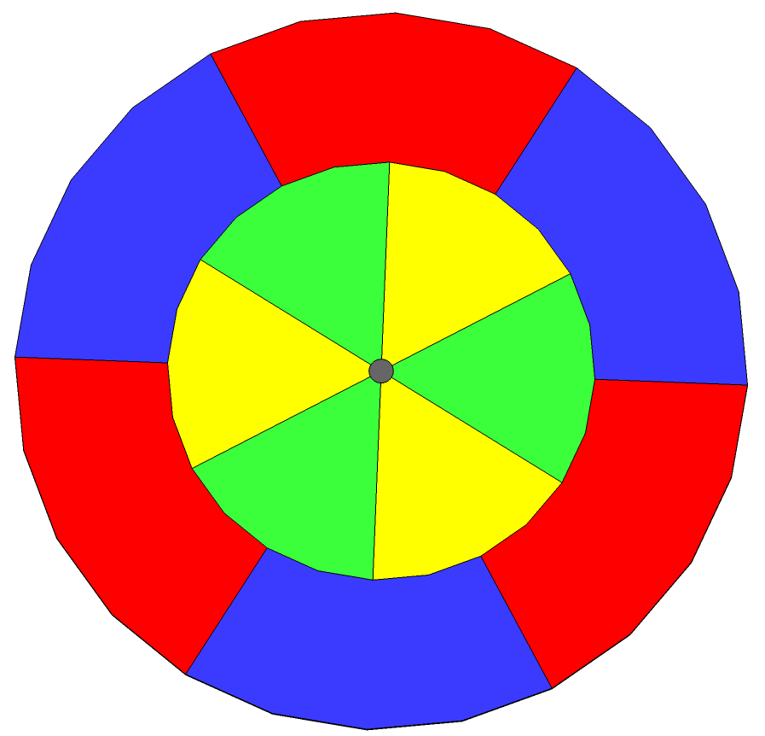
7. Colour the card disc

Slide 11
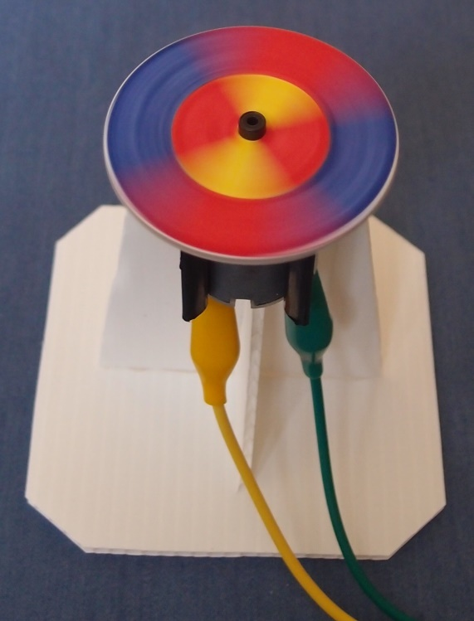
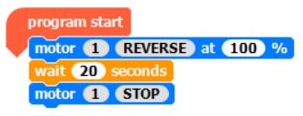
8. Rotate the disc
Put the disc back on the pulley.
Run the motor and see what effects you get.
Try altering the speed of the motor, the direction and the time it runs for.

Slide 12
9. Extension activities
Try out various colour mixing effects.

Slide 13
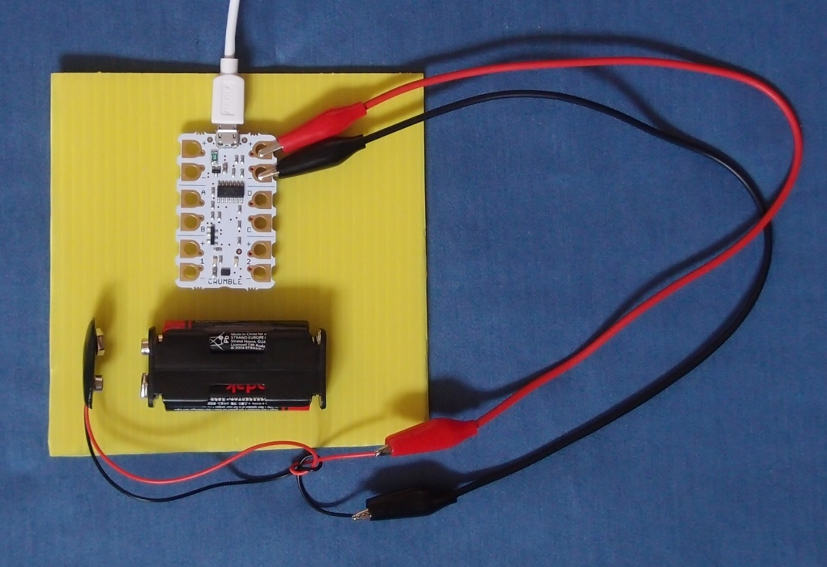
10. Disconnect the battery
Remember to unclip the snap battery connector to avoid draining the battery.

Slide 14
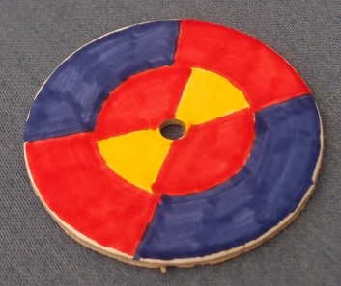
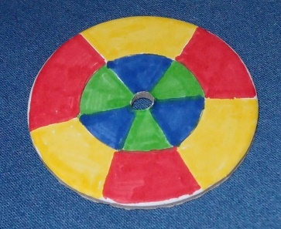
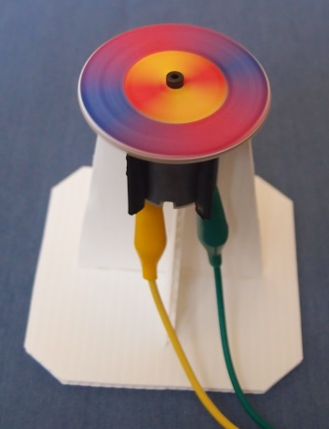
What did you learn?

Slide 15
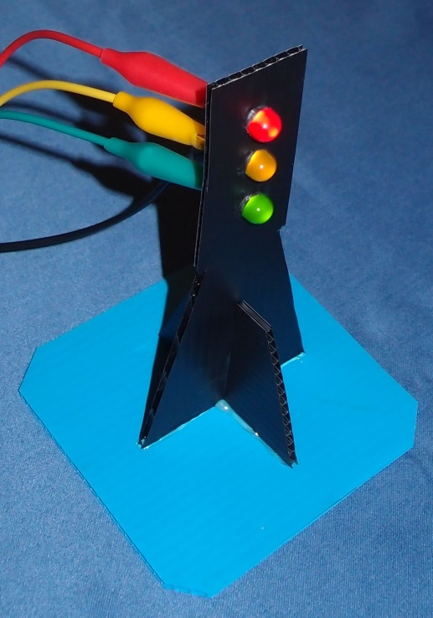
Move on to the next module
Copyright © Caroline Alliston 2017

