Slide 1
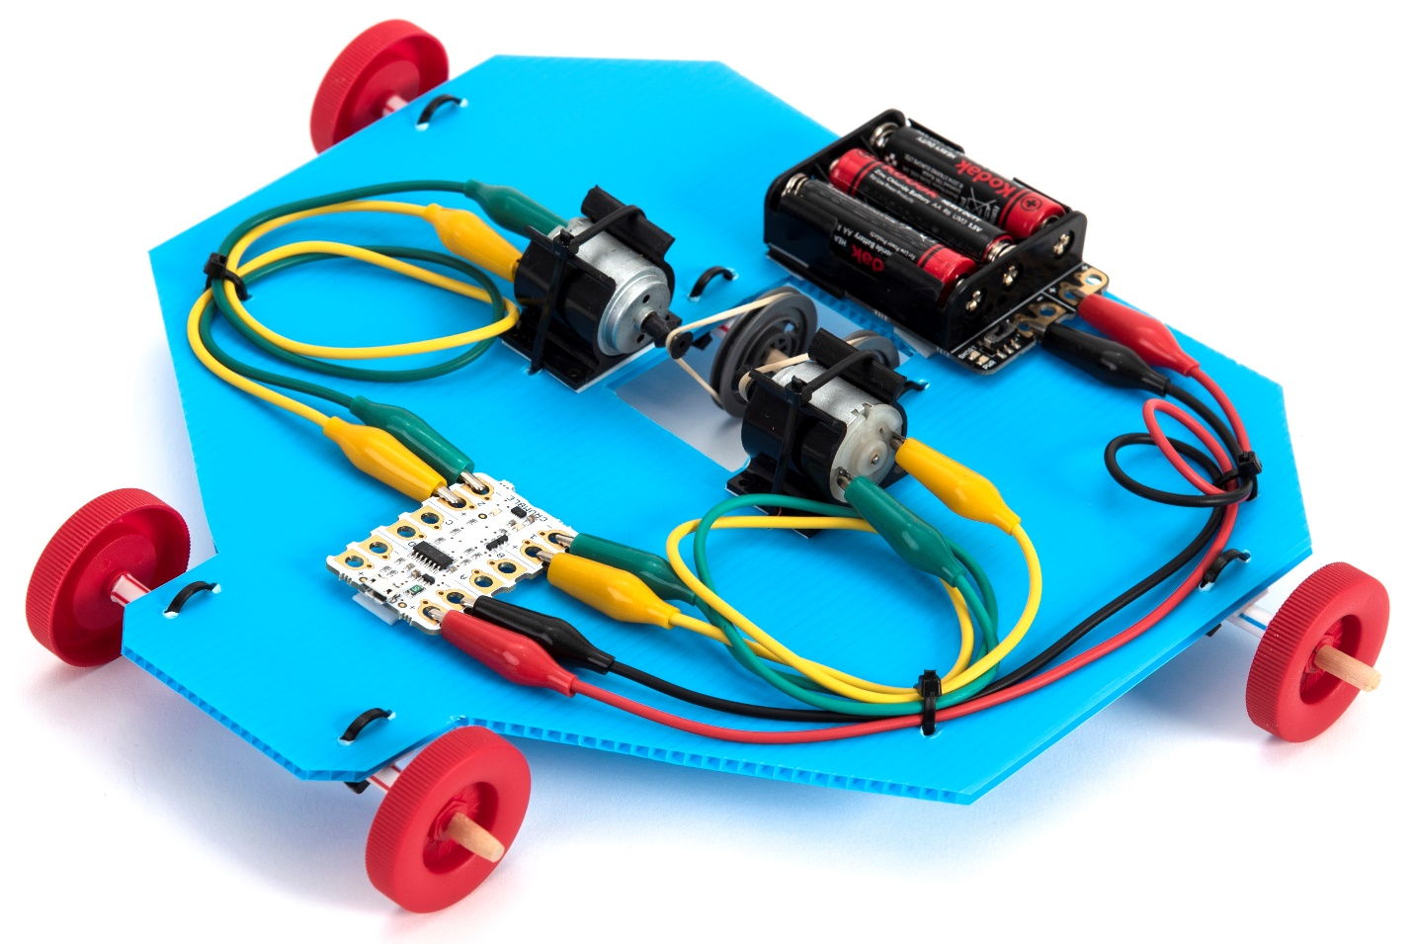
Make a Crumble Robotic Vehicle

Slide 2
Learning objectives
Electricity – compare and give reasons for variations in how components function.
Forces - Identify the effects of friction that acts between moving surfaces.
Design and Technology – understand and use mechanical, electrical and control systems in products.
Computing – design, write and debug programs.

Slide 3
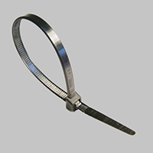
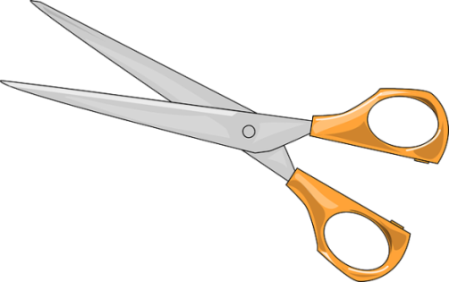
1. Work safely
Look at the tools and equipment. Can you spot any potential hazards?
Can you think of ways to reduce the risks?
Notes:
Pupils sometimes cable tie their fingers which could cut off the blood supply. You need to cut off the cable tie.

Slide 4
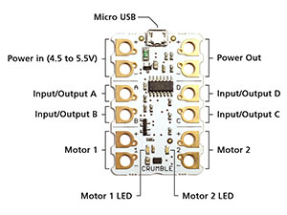
2. Program the Crumble controller
Collect a Crumble controller and micro-USB lead.
Plug one end of the micro-USB lead into the Crumble.
Plug the other end into your computer.
Place the Crumble on your worksheet.
Construct and run this program.
Check ‘Motor 1 LED’ lights up.
Notes:
You should place the Crumble on the worksheet to avoid placing it on a conductive surface (in case you short circuit and damage it).

Slide 5
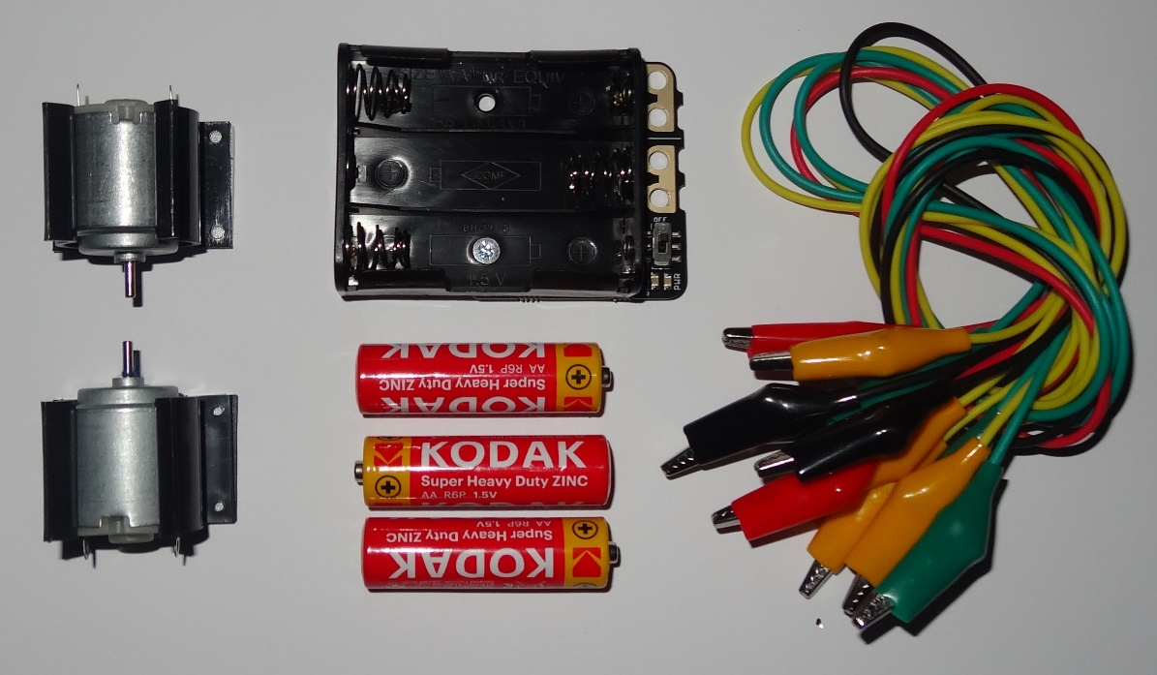
3. Collect your electrical parts
Collect the following parts:
2 motors
2 motor mounts
1 battery box
3 cells
6 crocodile leads
Push the motors into the motor mounts (from the end, not from above) to stop them rolling away.
Notes:
Push the motors into the mounts in the direction shown by the red arrows. If you push them in from above you can snap the motor mounts.

Slide 6
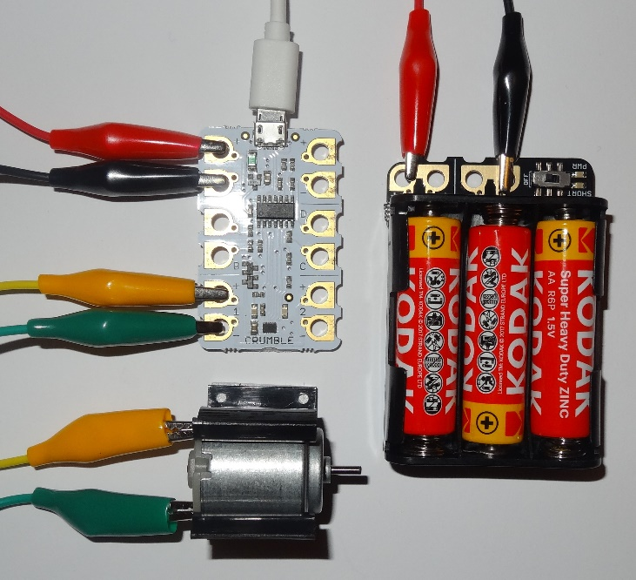
4. Try running the motor
Connect the battery box to the ‘Power in’ terminals on the Crumble.
Connect a motor to the ‘Motor 1’ terminals.
Ask an adult to check you have wired it correctly.
Fit the cells and switch on the battery box.
Try programming the motor to run forwards and backwards at different speeds.
Connect the controller to the computer with the micro-USB cable.
Notes:
Make sure the battery box is connected to the ‘Power in’ terminals before fitting the cells. If it is connected to any of terminals A to D you can damage the Crumble. Pupils have a labelled diagram of the Crumble on their worksheet for reference. Check the battery is connected the right way round, i.e. the positive terminal of the battery is connected to the positive ‘Power in’ terminal on the Crumble.

Slide 7
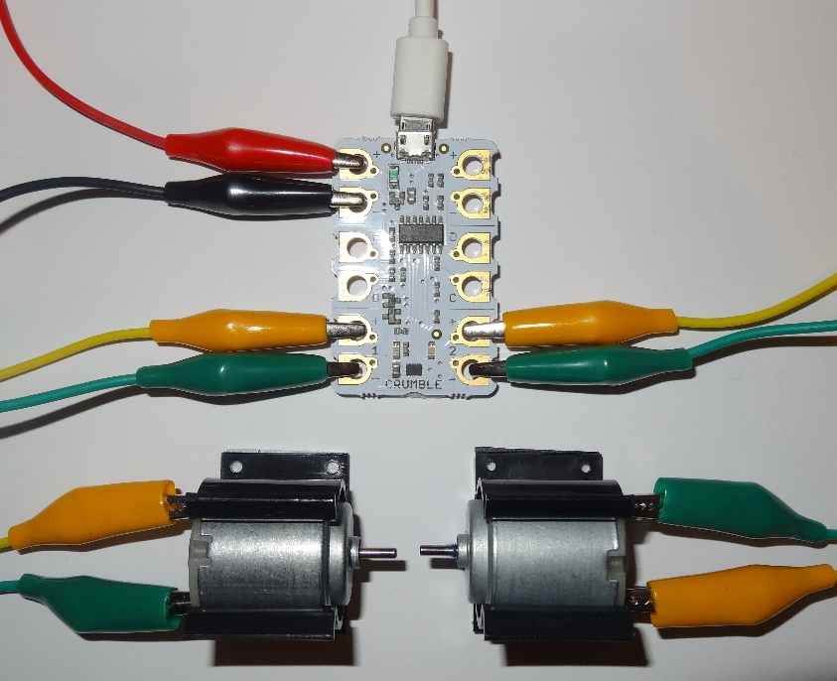
5. Run both motors
On your worksheet, complete the wiring diagram to show the second motor connected to the ‘Motor 2’ terminals.
Connect up the second motor.
Your worksheet shows a flowchart to run both motors at 50% power for 5 seconds and then stop.
Construct and run a program to do this and check the motors behave as you expect.
Remove all the leads.
Notes:
If the classroom is noisy you may not be able to hear the motors rotating, but you can feel the motor shafts rotating with your finger.

Slide 8
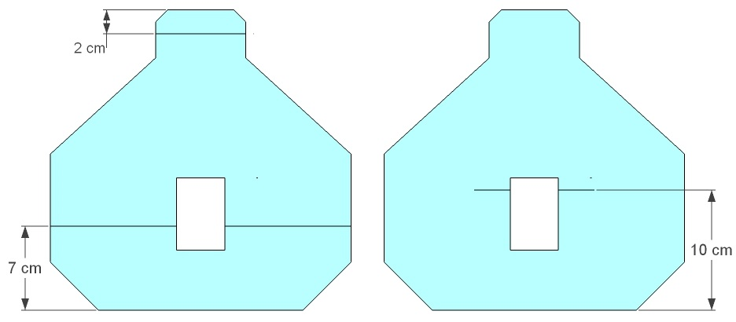
6. Prepare the base
Select your vehicle base and neatly cut out the outline.
Mark the lines shown on the underside and top.
This is to help you position your components correctly.
underside
top
name of vehicle
Select a name for your vehicle and write it on the underside.
Notes:
It is best to mark the lines with marker pen, because felt tip can smudge.

Slide 9
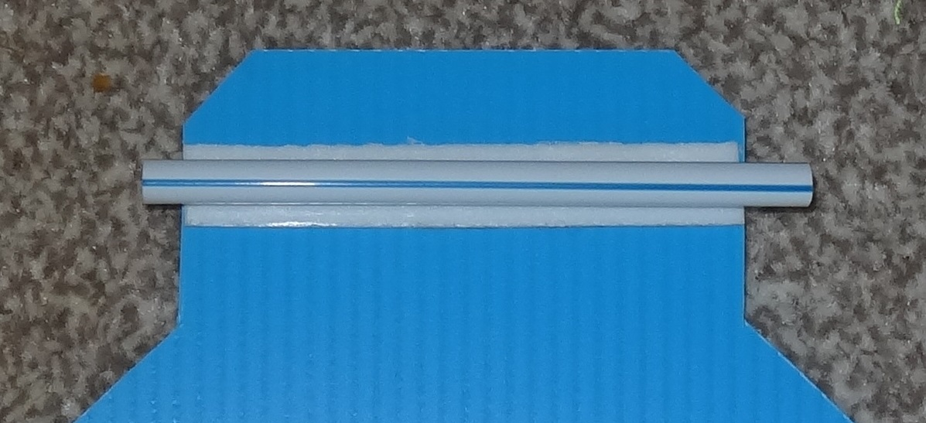
7. Fit the front bearing
Cleanly cut a 9.5 cm length of straw.
Stick an 8 cm length of foam tape centrally along the line 2 cm from the front.
Peel off the plastic film.
Stick on the straw as shown.
This is the front bearing.
Notes:
Don’t squash the straw down onto the foam tape – it needs to be cylindrical.
If the straw becomes flattened when cutting then round it out again with the end of a pencil.

Slide 10
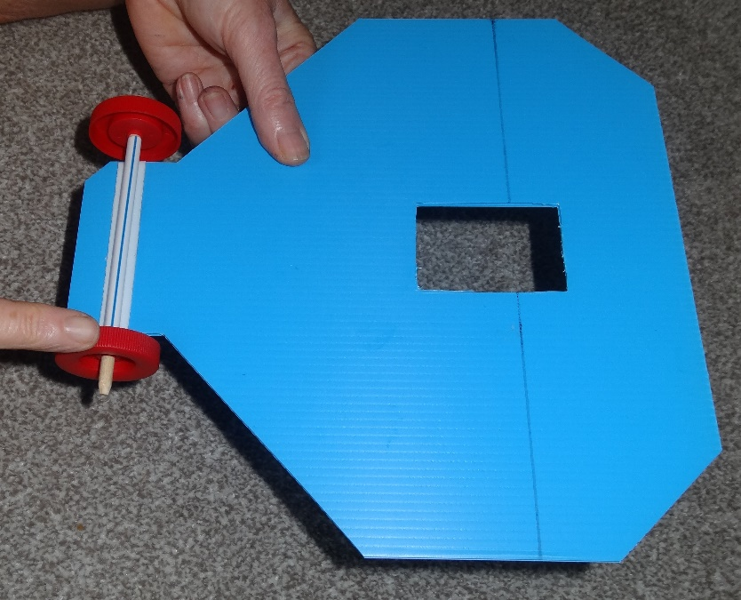
8. Fit the front axle
Take a 14 cm rod and two wheels.
Sharpen the rod ends slightly and push on the wheels.
Remove one wheel and push the rod through the straw.
Refit the second wheel with a gap of about 2 mm between the wheel and straw end.
Hold the base and spin the wheel to check the axle (rod) rotates easily in the bearing.
Notes:
If the wheels are too tight to fit you can sand the rod down a little. If they are too loose you can glue them on, but don’t get glue in the bearing.

Slide 11
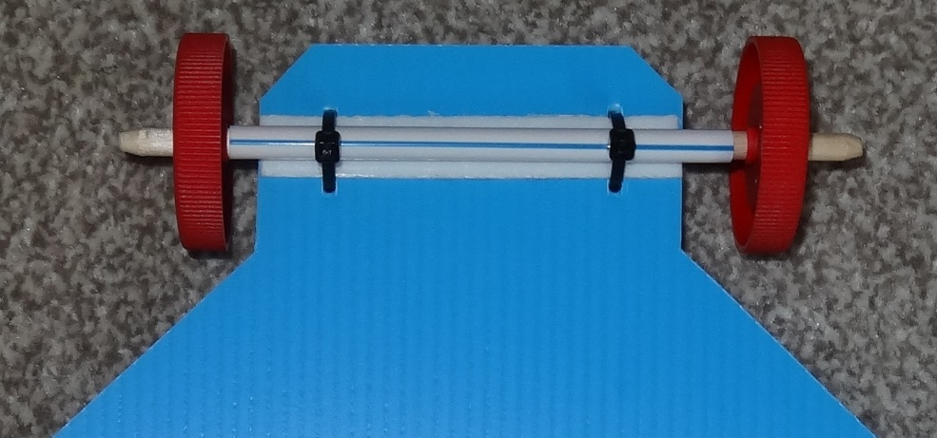
9. Restrain the front bearing
Make holes either side of the foam tape with the sharp pencil.
Fit cable ties through the holes.
Tighten them gently to stop the bearing moving then snip the ends off.
Don’t pull them too tight (or you can crush the straw onto the axle and stop it rotating).
Check the axle still rotates freely in the bearing.
Notes:
The cable ties should just touch the straw, not crush it onto the axle. If they are too tight cut them off and fit new ones. Make sure the ends are cut off short enough so they don’t drag on the floor.

Slide 12
10. Assemble the rear axles
Take two straws and two 16 cm rods.
Cleanly cut the straws to 12 cm long.
Mark 0.5 cm from the ends of straws and rods.
Very slightly sharpen the ends of the rods.
Push the pulleys on so the mark just shows.
Slide on the straw pieces.
Push on the wheels, leaving a gap about 2 mm between the wheel and end of the straw.
Notes:
The sharpened part of the rod needs to be less than 0.5 cm long (i.e. the mark should still be visible after sharpening) or the pulley will be loose. Both wheels and pulleys need to fit tightly. Make sure the pulleys sit at right angles to the rod – if they are wonky the rubber bands tend to come off when running.
If the straw becomes flattened when cutting then round it out again with the end of a pencil.

Slide 13
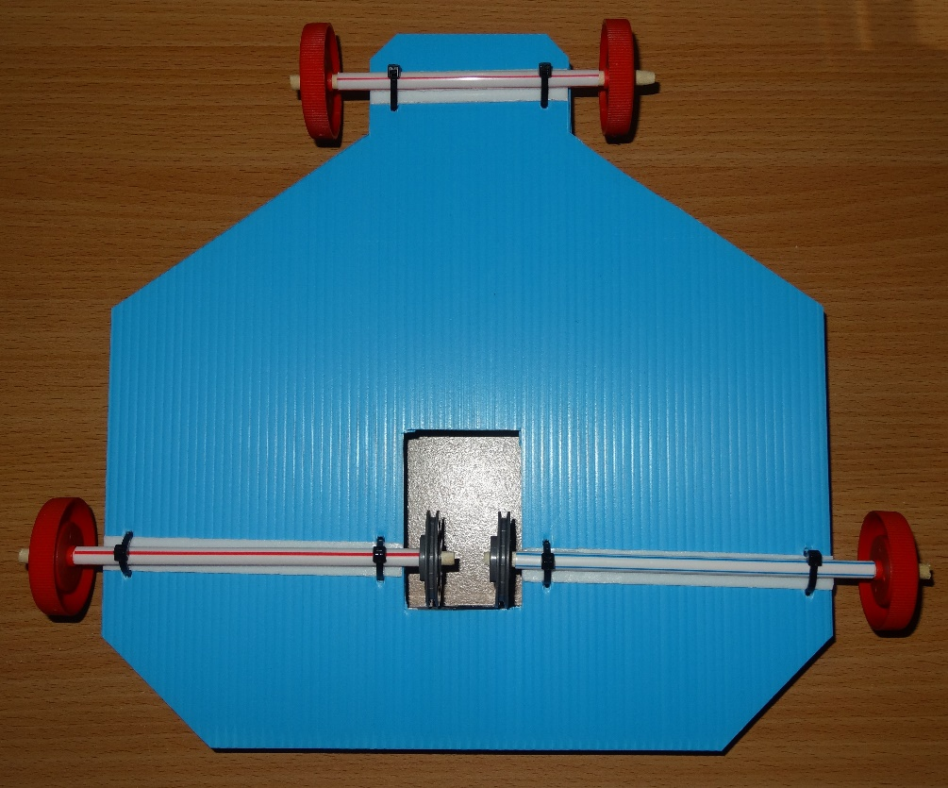
11. Fit the rear axles
Stick 10.5 cm lengths of foam tape centrally along the lines 7 cm from the rear.
Peel off the plastic film.
Stick on the rear axle assemblies as shown.
The marks on the straw bearings should line up with the edge of the slot.
Gently cable tie the bearings in position.
Notes:
Hold the base and rotate the wheels to make sure the axles can rotate easily in the bearings. If the cable ties are too tight cut them off and fit new ones. Make sure the axles are positioned correctly.

Slide 14
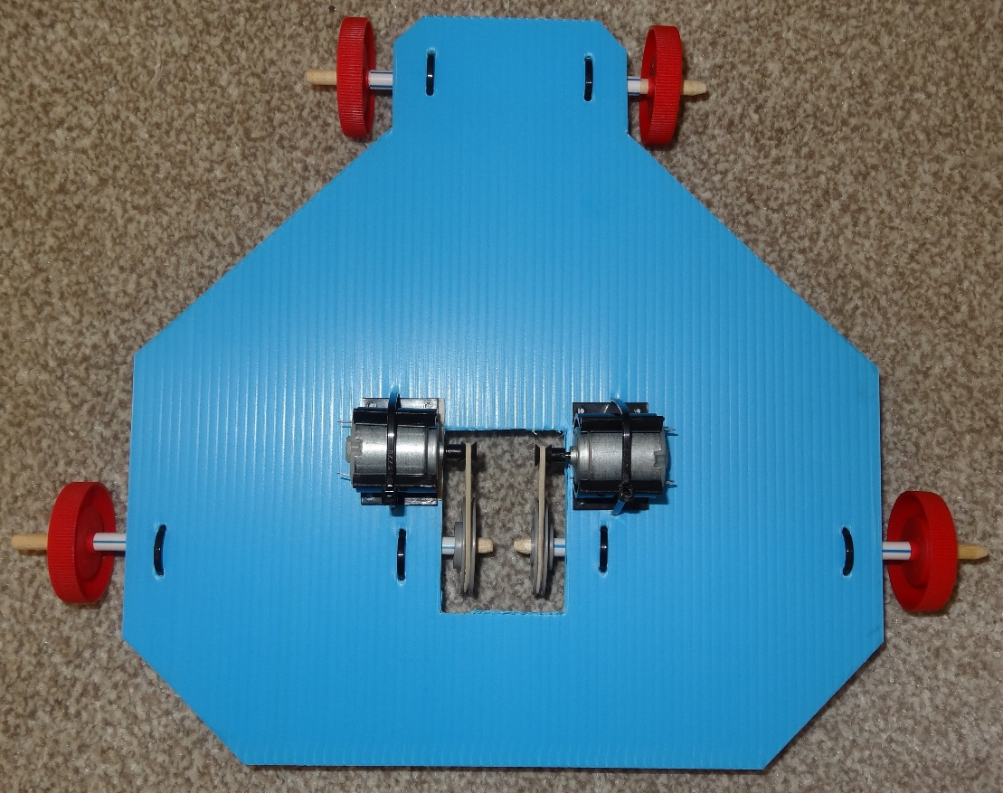
12. Fit the motors
Turn the base over.
Fit the motor pulleys.
Stick the motor mounts onto the base so the motor shafts line up with the lines marked 10 cm from the rear.
The vees of the pulleys should line up.
Cable tie on the motors.
Fit 6 cm long rubber band drive belts.
Notes:
Don’t hand out the motor pulleys until they are just about to be fitted, as they can easily get lost otherwise.
To prevent the rubber band drive belts falling off when running: You can slide the motors forwards or backwards in their mounts a little to line up the vees of the pulleys. The rubber bands should be slightly stretched. If they are loose you can reposition the motors forward a little. The motors should be parallel to the rear axles.

Slide 15
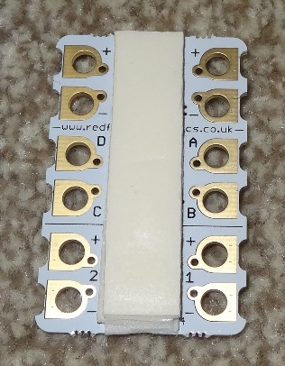
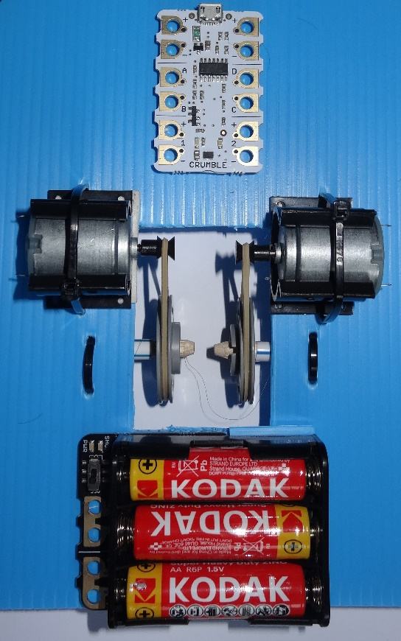
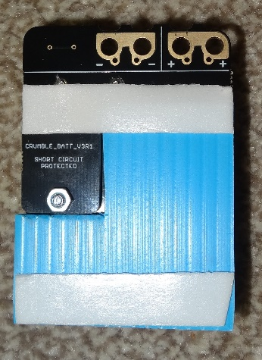
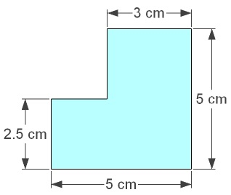
13. Fit the battery box
Stick a double layer of foam tape to the underside of the Crumble.
Attach it to the base.
Cut this shape from corrugated plastic.
Foam tape it to the bottom of the battery box.
Foam tape the battery box to the base.
Notes:
Tape the underside of the Crumble – that’s the side without the components on it.
You need a double layer of foam tape on the Crumble to allow space (height) to fit the crocodile clips.
Remember to remove the plastic film from the foam tape.
The micro-USB socket on the Crumble should face the front so you can plug in easily.

Slide 16
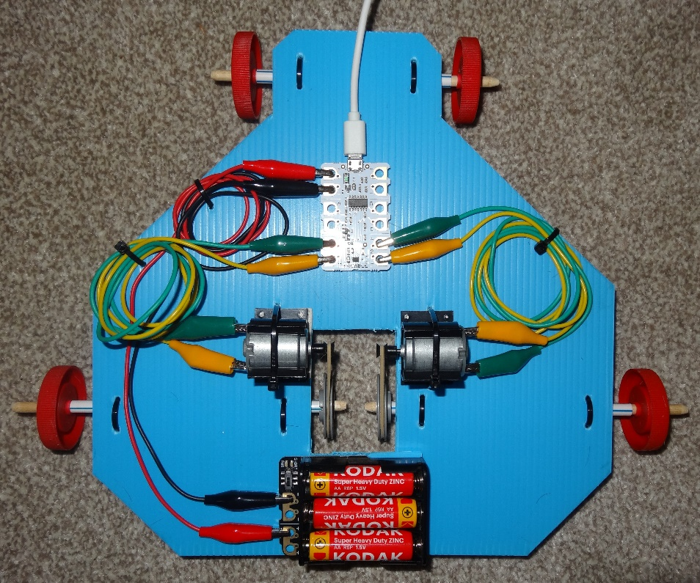
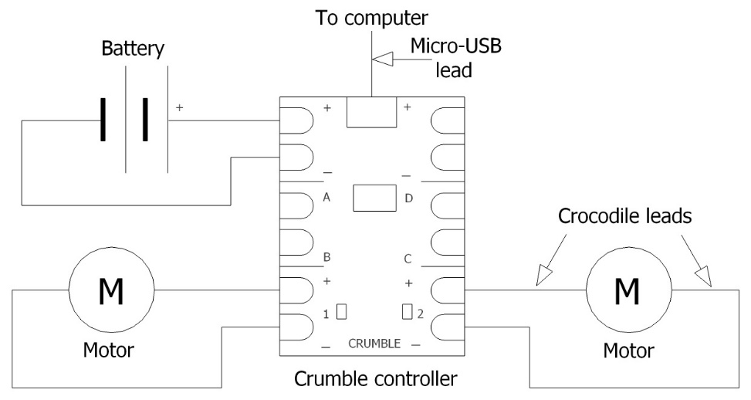
14. Re-connect the circuit
Re-connect the circuit.
Coil the wires up neatly and cable tie in position.
Notes:
The wires need to be positioned so the centre of gravity is just in front of the rear axles. You can judge this by balancing the vehicle on the side of your finger, or by pressing down on the back of the vehicle and checking it is easy to tilt.

Slide 17
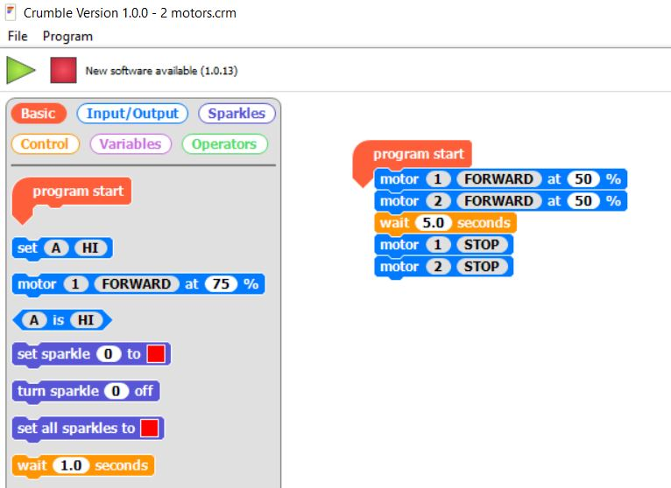
15. Construct a program
Construct this program - drag commands from the left and drop them on the right.
Click on the values to change them.
Hold the vehicle in your hand, switch on the battery box and click on the green arrow to start.
Check both drive wheels turn forwards.
If either turns backwards swap over the crocodile clips on the motor terminals.
Notes:
The language used is similar to Scratch so most pupils will already be familiar with it. Each command needs to attach to the one above it.
If the rubber bands come off when you run the motors then there could be several reasons i) the pulley vees are not in line ii) the rubber band is loose iii) the pulleys aren’t straight on the axles iv) the axles or motors aren’t at right angles to the rubber band.

Slide 18
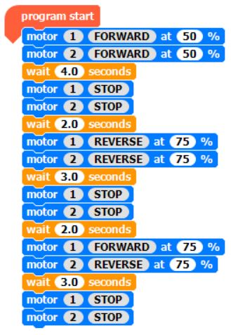
16. Try out the vehicle
Disconnect the micro-USB lead.
Place the vehicle on a smooth floor.
Switch the battery off and then on again.
The vehicle should go forwards for 5 seconds then stop.
Program the vehicle to go backwards, forwards and spin on its axis – an example is shown here.
Always start the motors on 50% power or less.
Program the vehicle to follow the course laid out.
Always switch off the battery when not in use.
Notes:
If you start the motors on more than 50% power they draw too much current and the Crumble cannot boot up.
The Crumble draws current even when not being used, so you must remember to switch off the battery to avoid draining it.

Slide 19
17. Plenary
Discuss what you learnt and complete your worksheet.
How did you get the motors to go faster and slower?
Suggest two ways to reverse the direction of the motors.
Why do you need low friction between the axles and the bearings?
What precautions did you take to ensure this, and how did you check?
Why do you need high friction between the rubber band drive belts and the pulleys?
Why do the wheels and pulleys need to be a tight fit on the axles?
What problems did you encounter and how did you overcome them?
What was the most interesting thing you learnt?
Notes:
You can reverse the motor direction by either programming it to go the other way or by swapping over the crocodile clips.
If there is high friction between the axles and bearings it slows the vehicle down.
You need high friction between the drive belts and pulleys because otherwise they can slip, so the motion of the motor is not transmitted to the pulley.
Similarly the pulley and wheel need to be a tight fit on the axle or they can slip.

Slide 20
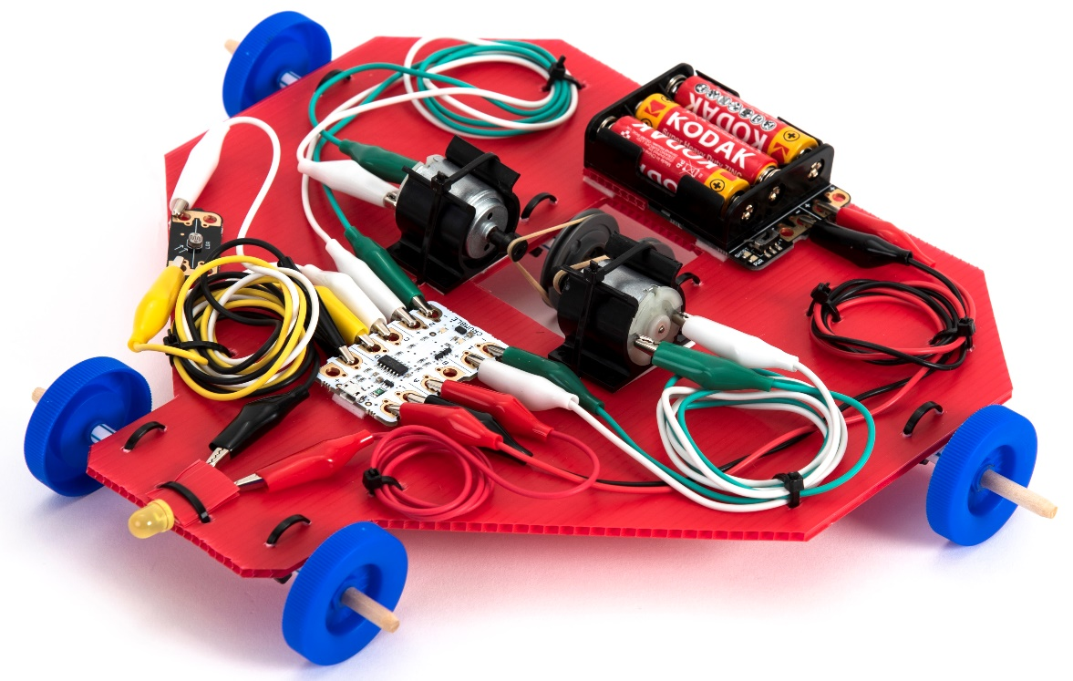
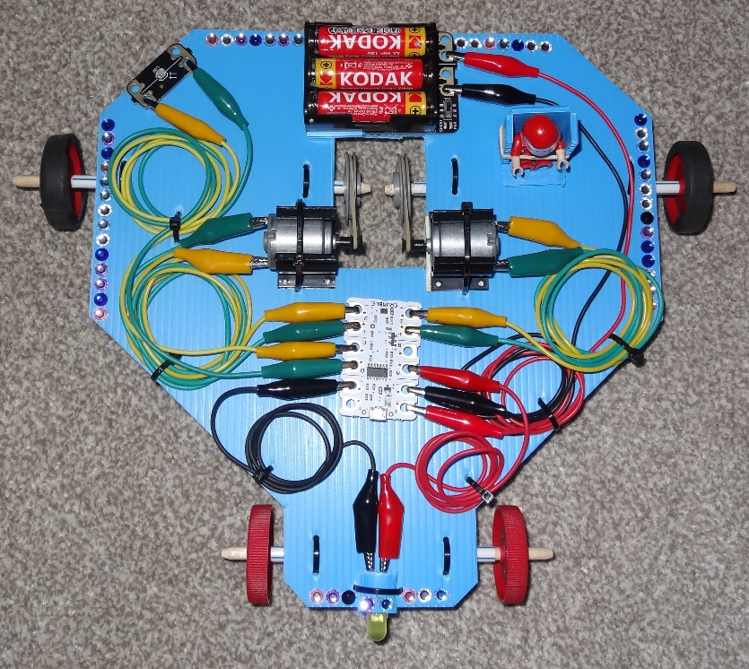
Move on to the Extension Activities
Copyright © Caroline Alliston 2022
Notes:
See the Crumble vehicle extension activities PowerPoint

