Slide 1
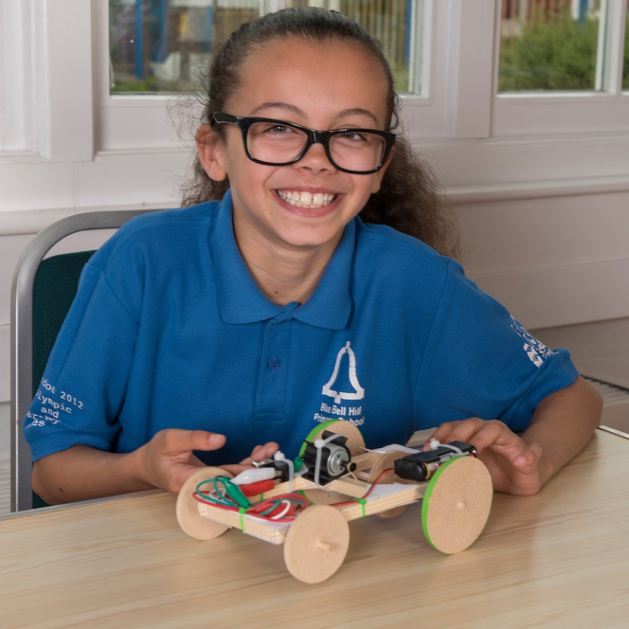
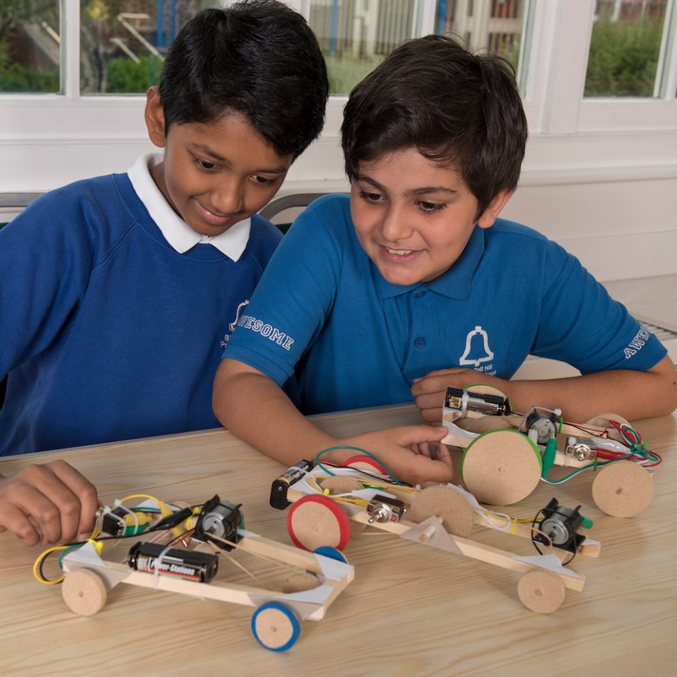
Design, build & test a motorised vehicle

Slide 2
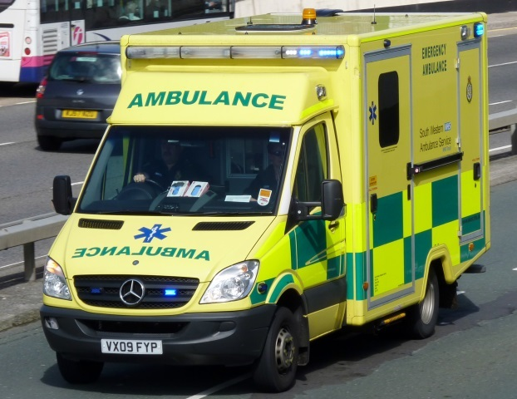
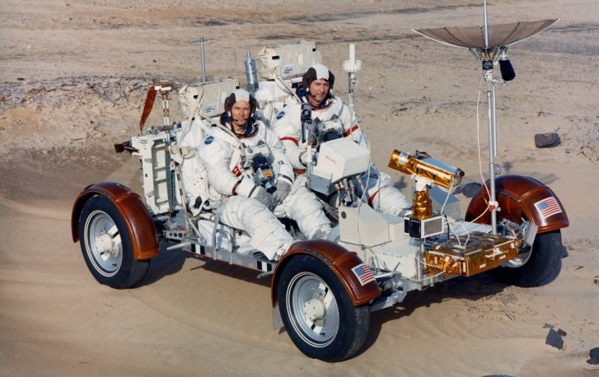
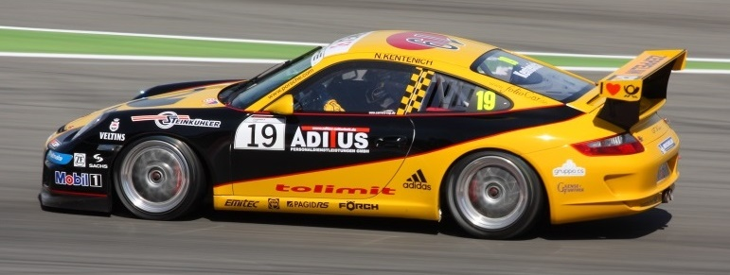
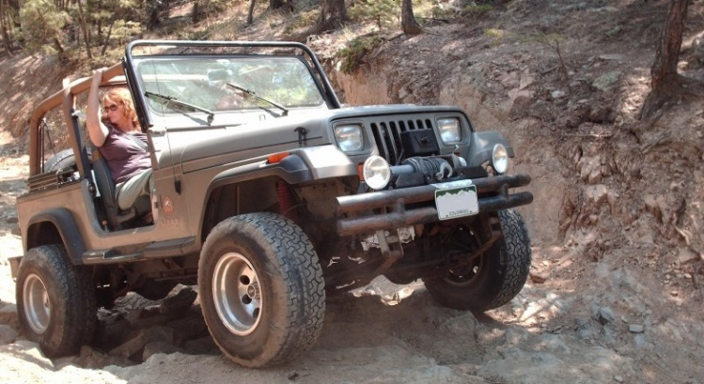
Vehicles
What are these vehicles used for?

Slide 3
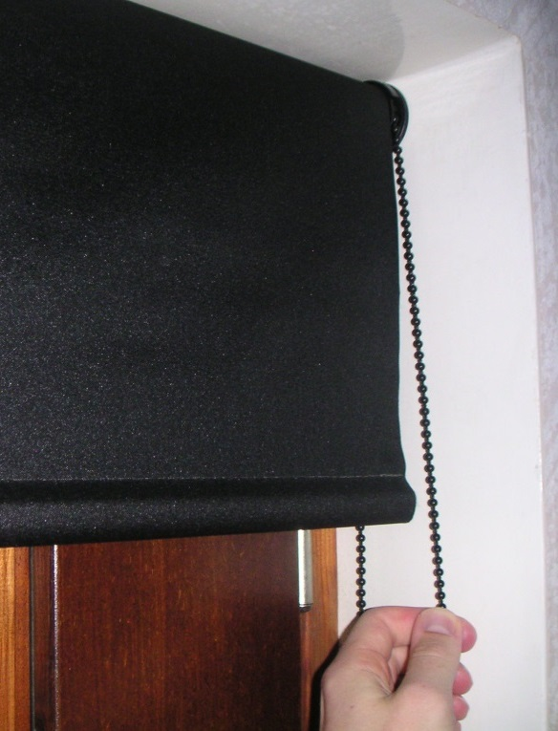
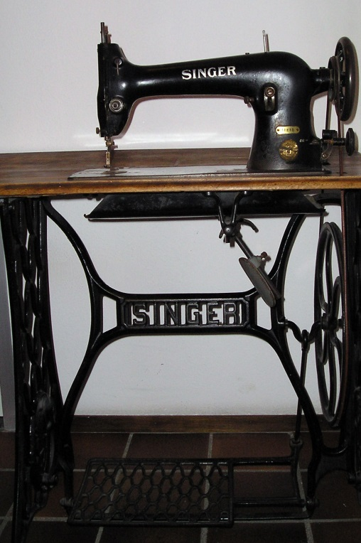
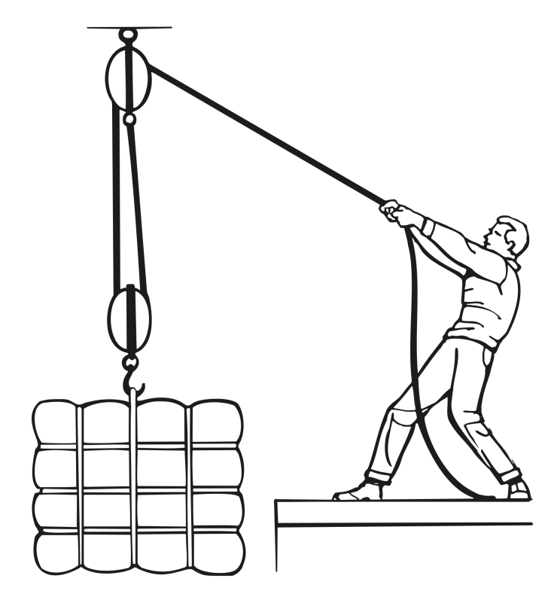
Pulleys
Do you recognise these? What are the pulleys being used for?

Slide 4
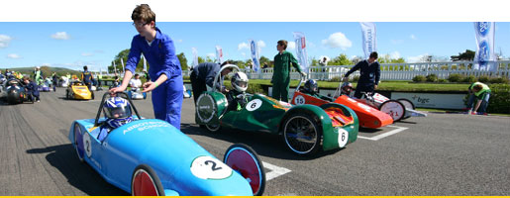
Context
Your school is entering the Formula 24 Electric Car competition, and wants to design the winning car.
The race track is mostly flat with one gentle slope.
All cars have the same motor and battery but the wheels, pulleys, size and shape of vehicle, tyre materials etc vary.
Design and build the fastest prototype you can.

Slide 5
Learning Objectives
Make and use simple series circuits.
Understand and use mechanical systems, e.g. pulleys, wheels, axles and bearings
Build and reinforce structures.
Measure length and time; calculate average speed.

Slide 6
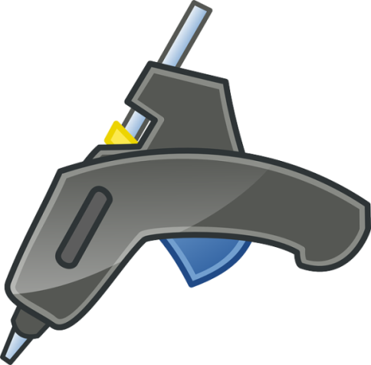
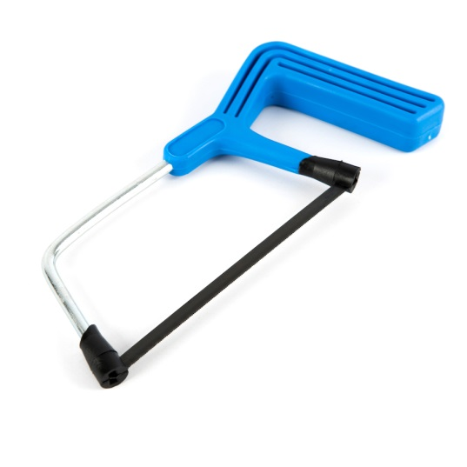
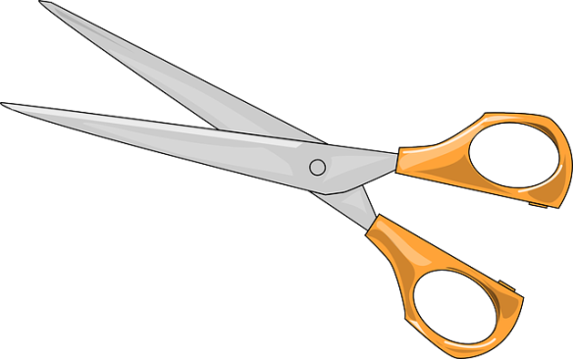
1. Safety
Look at the tools and equipment. Can you spot any potential hazards?
Can you think of ways to reduce the risks?
Notes:
Don’t burn yourself with the glue gun. You could ask an adult to man the gluing station.
To avoid cutting yourself with the saw you can use a vice or bench hook to hold the piece of wood you are cutting.
Be careful not to cut yourself with the scissors.

Slide 7
2. How the vehicle works
Try out the sample vehicle, both on the flat and up the gentle slope to find out how it performs.
Discuss how it works.
Identify the motor, driving pulley (the little plastic one on the motor), drive belt (rubber band), driven pulley (the wooden one), wheels, axles and bearings (straws).
Run through the pitfalls highlighted in the lesson plan.
Can you think of ways to reduce the risks?

Slide 8
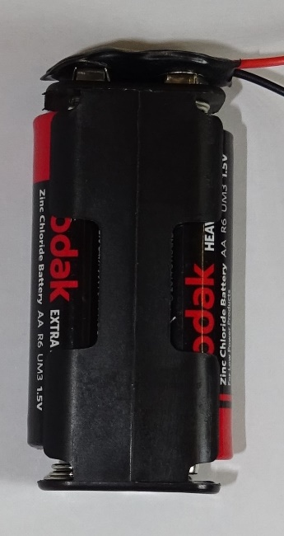
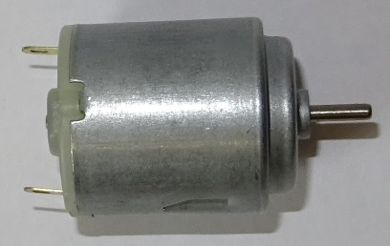
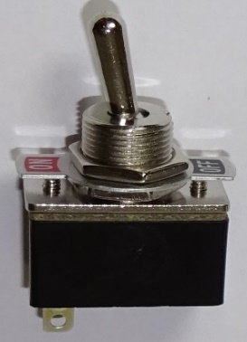
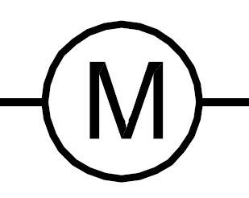
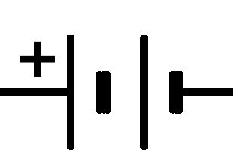
3. Electrical parts
Name these electrical components:
Notes:
Motor, switch, battery, wires or crocodile leads.

Slide 9
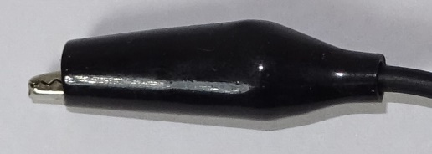
4. Avoid short circuits
If batteries are ‘short-circuited’ they can get very hot.
Do not use alkaline or rechargeable batteries.
Do not connect the bare ends of the wires from the battery directly together; they must be connected across the motor.
Tie the black wire and the red wire from the battery clip in a reef knot to stop the bare ends touching.
Make sure the plastic sleeves cover the crocodile clips as shown here, to help prevent short-circuits if the clips touch.
Notes:
It is very common for pupils to accidentally short circuit batteries whilst wiring up their circuits.

Slide 10
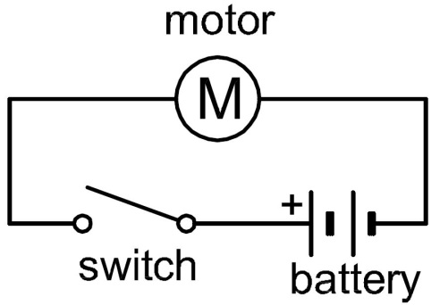
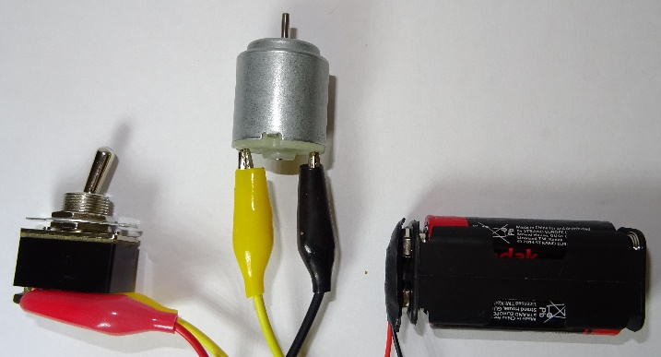
5. Make your circuit
Fit the cells into the battery holder (the right way round).
Push the snap battery connector on firmly.
Lay out your components in a triangle and make the following circuit, then check it works.
Crocodile leads must be clipped onto bare metal, not onto plastic insulation!
Notes:
It is a good idea to demonstrate how to connect up the circuit, including showing the pupils which way round to fit the batteries. Pupils often clip the crocodile leads onto the plastic insulation on the wires from the battery, instead of onto the metal ends.

Slide 11
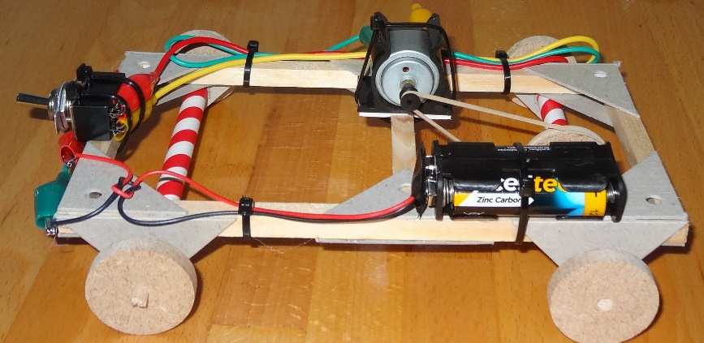
6. Design your vehicle
Think of a design for your vehicle and sketch it on your design sheet. Here is an example to help you (the frame is 11 cm x 20 cm).
Select which driven pulley to use. A smaller pulley should go faster on the flat, and a larger pulley should go better up hill.
Select which wheels to use initially. It should go faster with larger wheels, but if the wheels go too fast they can slip. You can always change them at the end if you need to.
Work out where your electrical parts will go.

Slide 12
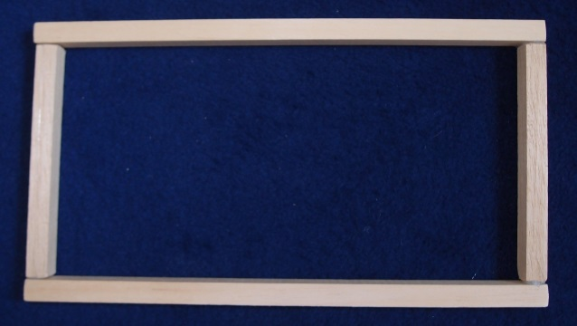
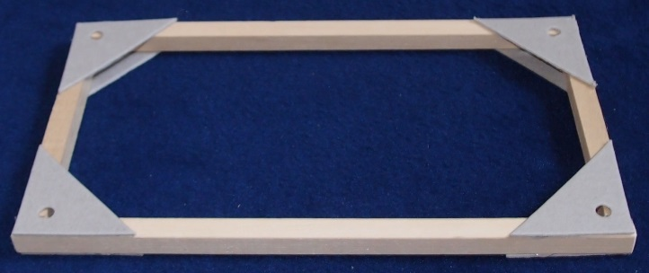
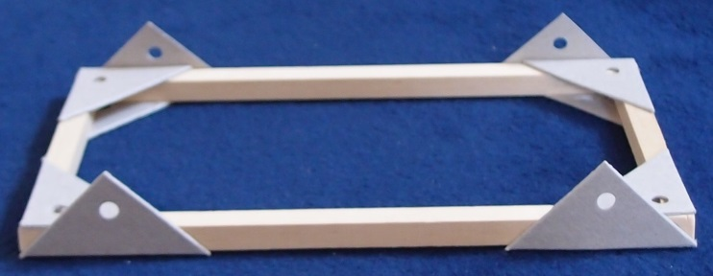
7. Make your outer frame
Mark out and cut your wood. Smooth the ends with sandpaper.
Glue together the outer frame, then reinforce with cardboard triangles.
Glue four axle holders on to the frame. Try to make them symmetrical. If you chose a big pulley, position the axle holders so it won’t touch the frame.

Slide 13
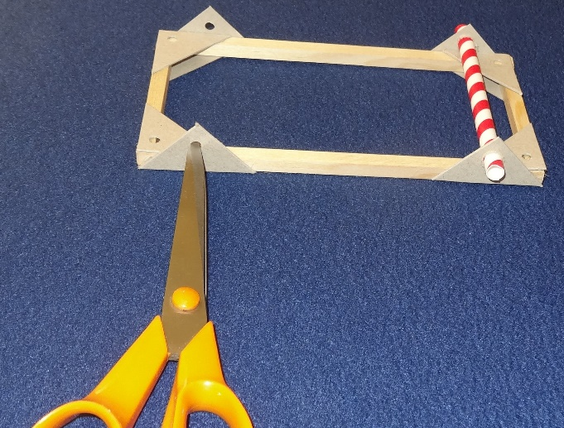
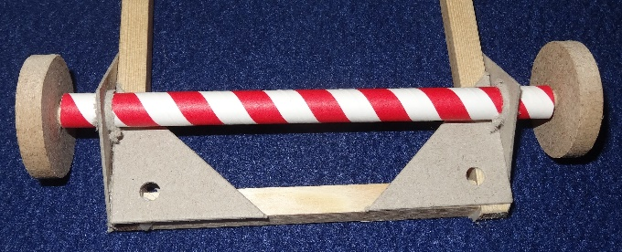
8. Fit your non-driven axle
Cut a length of straw 2 cm longer than your frame width. Round out the cut end with a pencil.
Enlarge both the front and back axle holder holes to just fit the straw. Slide the straw in; it should be a tight fit. You could glue it to the axle holders.
Cut and fit an axle 2cm longer than the straw. Push on the wheels until they nearly touch the straw. Check the axle spins freely.
Notes:
You can smooth the very ends of the axle so the wheels go on easily. The wheels should fit tightly on the axles. If they are loose you can glue them on. If they are too tight to fit you can sand the axle down slightly until they just fit.

Slide 14
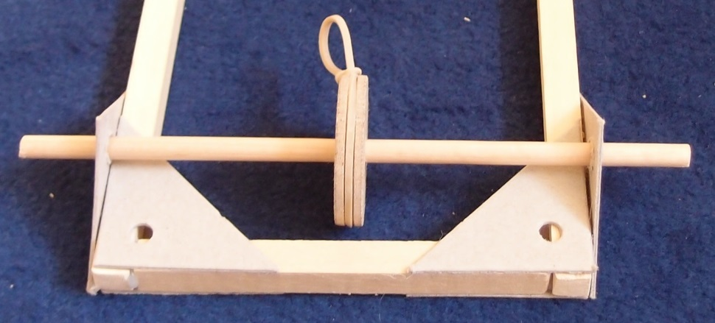
9. Fit your driven axle
Cut an axle 4 cm longer than the width of your frame.
Smooth the ends and check the wheels fit.
Slide the wooden pulley to the middle; it should be a tight fit.
Fit the rubber band over the pulley. You can tie a slip knot to hold it in place.
Slide in the axle.
Notes:
If the pulley is loose then you can glue it on.

Slide 15
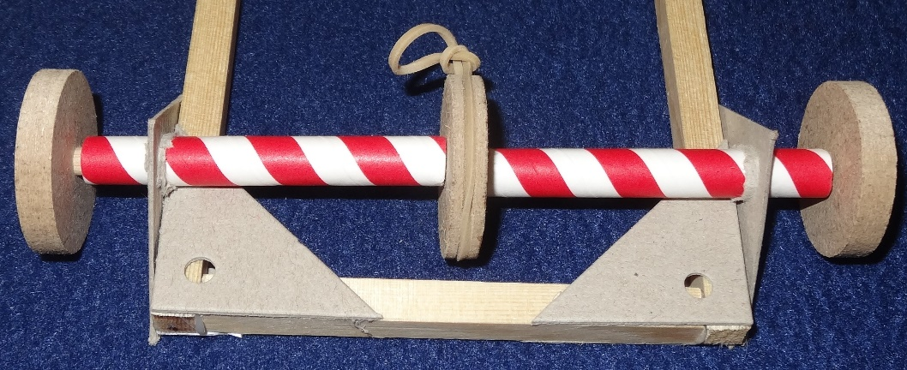
10. Fit your bearings
Cut a length of straw 2 cm shorter than your axle. Cut the length of straw in half. Slide the two halves onto the axle.
Fit the wheels. Adjust until there is roughly a 1 mm gap between pulley and straw, and between straw and wheel.
Glue the straws to the axle holders. Don’t get glue on the wheels or axles. Undo the slipknot and check the axle rotates freely.
(This straw is in two halves.)
Notes:
Round out the cut ends of the straw with a pencil.

Slide 16
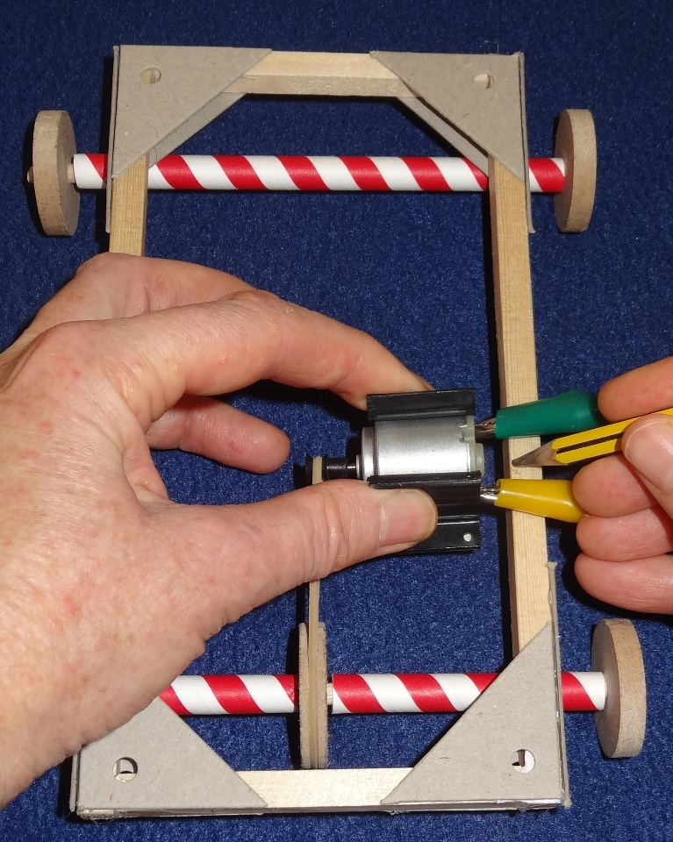
11. Fit your motor
Press the driving pulley onto the motor shaft.
Push the motor into the motor mount from the end.
Fit the rubber band onto the driving pulley. Position the motor so that the rubber band is just tight but not stretched, as shown.
Mark the centre line of the motor on the wooden frame.
Notes:
If you snap the motor into the motor mount from above then you can snap the motor mount. It is better to push the motor into the mount from the end.

Slide 17
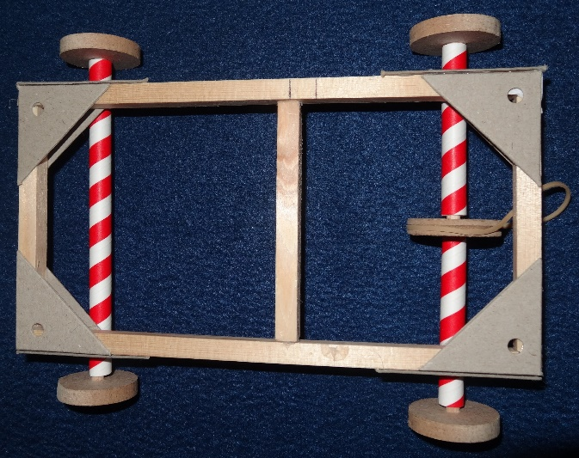
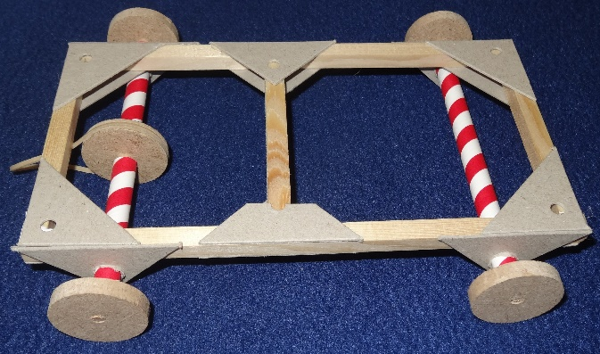
12. Fit your motor (cont.)
Make a 2nd mark 1 cm along the frame, as you will need to tension (i.e. stretch) the rubber band.
Measure, mark, cut and attach a length of wood to fit across the frame with the centre in line with your 2nd mark.
Reinforce with card triangles. Cut the nose off one card triangle, so that the motor can mount directly on the wood.

Slide 18
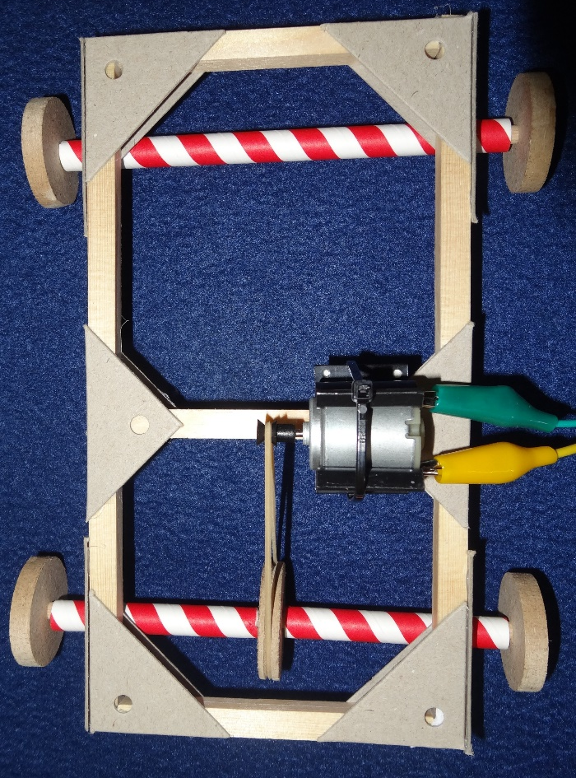
13. Fit your motor (cont.)
Make sure your motor chassis is the right way up (i.e. the wheels are on the bottom).
Stick your motor assembly to the top of your crosspiece so that the two pulley centres are exactly in line as shown.
Cable tie it firmly in place.
Fit the rubber band onto the pulley.
Notes:
If the pulleys are not in line then the rubber band may fall off the pulley during operation. If you put a slipknot in the rubber band to hold it onto the pulley during fitting then you need to untie the knot.

Slide 19
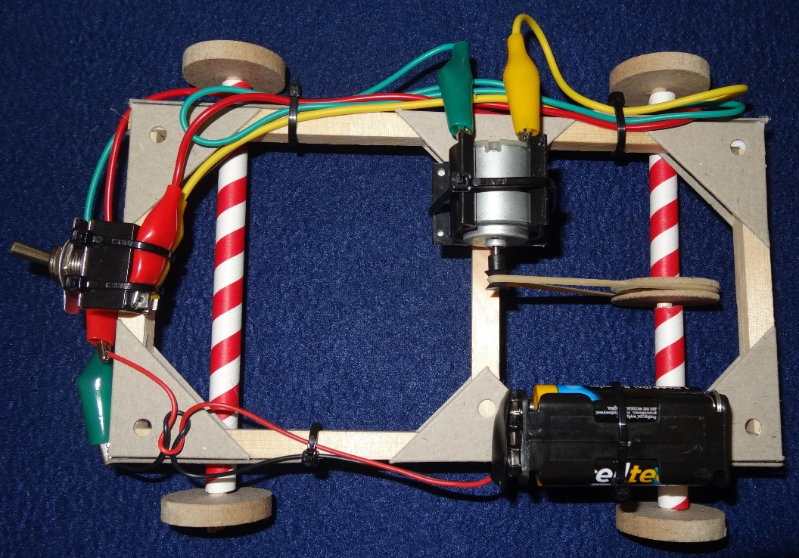
14. Complete your vehicle
Work out where to attach your battery and switch, making sure nothing will interfere with the rotating parts.
Glue and cable tie them firmly to the frame.
Tidy up your wires, making sure the crocodile clips don’t touch. Cable tie the wires and trim off the ends of the cable ties.
Notes:
Be very careful not to cut the wires when trimming the ends off the cable ties.

Slide 20
15. Test your vehicle
Try out your motorised vehicle on different surfaces. You may find the driving wheels slip on a smooth surface; you can cut sections of balloon or bicycle inner tube and fit them as tyres.
Time your vehicle over a measured distance to calculate the speed.
Use a ramp to find out how steep a slope it can climb.
You could try different wheel sizes and compare the performance of the vehicle.
To make your vehicle to go in the opposite direction, swap over the crocodile clips on the back of the motor.

Slide 21
16. Race the vehicles
When everyone has finished improving their vehicles race them along the track to find out which is the fastest.
Have a good look at the winning vehicle to try and understand what features are responsible for its success.
Tidy up thoroughly.
Complete your worksheet.

Slide 22
17. Plenary
Discuss how the activity went and what you have learnt.
What difficulties did you encounter; how did you overcome them?
Which vehicle was the fastest?
Can you explain why?
Why do cars have rubber tyres?
What have you learnt about:
Electric circuits?
Pulleys, axles, bearings and wheels?
Calculating speed?
What did you enjoy most about the activity?

Slide 23
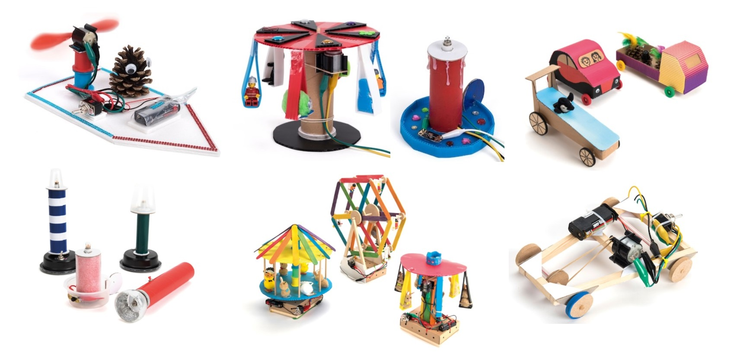
Fun TTS STEM design & make class kits
Fan boats Crumble controlled models D&T vehicles
Make your own light Fairground rides Motorised vehicles

