Slide 1
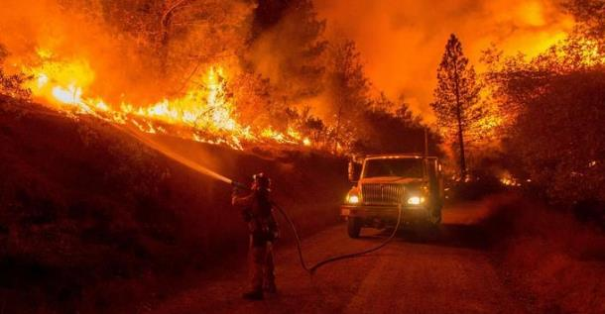
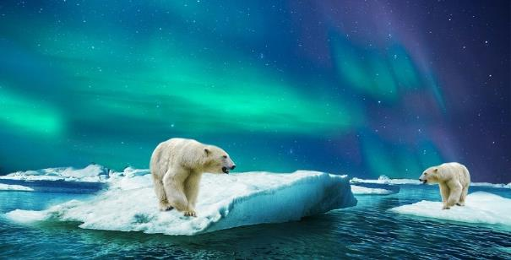
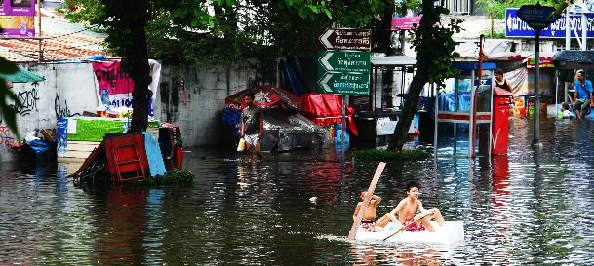
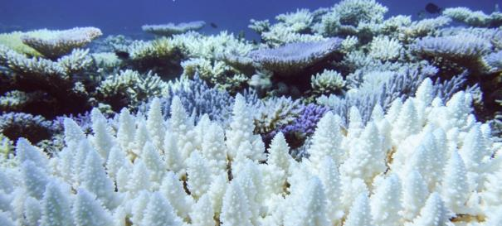
What is climate change?
Notes:
Climate change is the change in average conditions (such as temperature and rainfall) in a region.
Since 1950 the global average temperature has increased by 0.82°C. Scientists agree that this is due to human activities.
The following climate change problems are shown in these slides:
Larger and more frequent wildfires are occurring due to long periods of drought and increased temperatures.
Polar bears losing their natural habitat as the polar sea ice melts due to global temperature rises.
Flash flooding caused by increasingly heavy rains.
Coral ‘bleaching’ due to warming sea.
Photo of California wildfire by SnappyGoat.com
Photo of polar bears from Pixabay (link: https://pixabay.com/photos/polar-bear-glass-bear-polar-animal-3065359/)
Photo of flooding from PxHere (link https://pxhere.com/en/photo/684114)
Photo of coral bleaching by the Australian Institute of Marine Science (link: https://www.aims.gov.au/coral-bleaching)

Slide 2
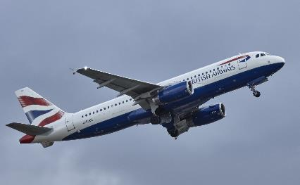
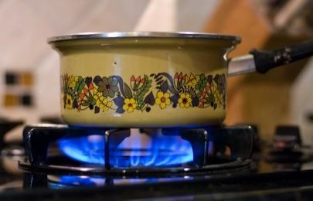
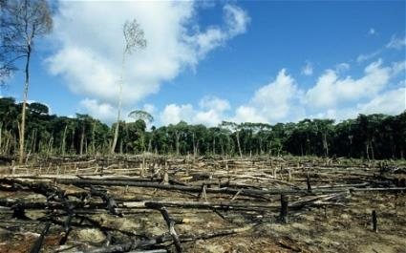
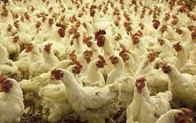
Which human activities cause climate change?
Burning fossil fuels for energy (e.g. for transport, industry and home energy)
Deforestation (e.g. to create more farmland)
Increasingly intensive agriculture
Notes:
Fossil fuels include coal, oil and gas. These are formed from the remains of plants and animals which died millions of years ago.
The main transport polluters are cars, trucks and planes.
The biggest industrial polluters are steel and concrete production and heating.
Home energy includes heating, hot water, cooking, lighting and electrical appliances (most electricity is still produced by burning fossil fuels).
Increasingly intensive agriculture includes overuse of fertilizer and pesticides, and rearing animals in closed spaces using animal feed.
Plane photo from PxHere (link: https://pxhere.com/en/photo/682175)
Cooking photo by Ashley Bischoff, Flickr (link: https://tinyurl.com/4r46m3nz)
Deforestation image by Dikshajhingan Wikimedia (link: https://commons.wikimedia.org/wiki/File:Deforestation_2074483b.jpg)
Chicken photo from PxHere (link: https://pxhere.com/en/photo/564042)

Slide 3
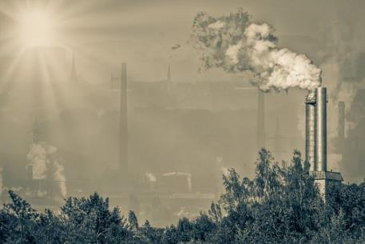
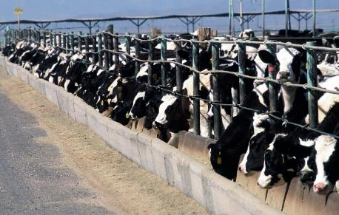
What effect do these activities have?
Burning fossil fuels produces carbon dioxide and other pollutants.
Deforestation reduces the planet’s ability to absorb carbon dioxide.
Increasingly intensive agriculture produces methane and nitrous oxide.
Notes:
Carbon dioxide, methane and nitrous oxide are ‘greenhouse gases’.
Methane is produced by animals such as cows burping and by growing rice in paddy fields.
Nitrous oxide is produced by increasing use of fertilizer.
The photo of air pollution is from Pixabay
The photo of cattle farming is from PxHere (link: https://pxhere.com/en/photo/706374)

Slide 4
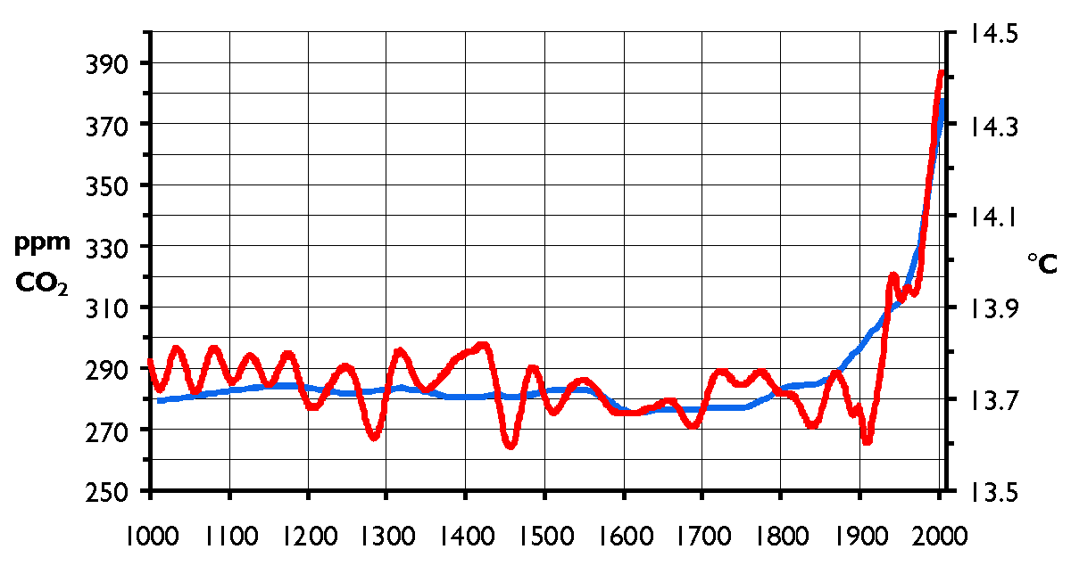
How does this cause climate change?
Carbon dioxide, methane and nitrous oxide are called ‘greenhouse gases’.
When they accumulate in the atmosphere they absorb heat.
This warms up the Earth.
Notes:
This graph shows changes in greenhouse gas concentration (the blue line, left axis) and global temperature (the red line, right axis) from the year 1000 to the year 2000.
Since the industrial revolution (about 1850) the greenhouse gas concentration has increased dramatically due to use of fossil fuels, warming up the planet.
The graph is by Hanno, Wikimedia (link: https://commons.wikimedia.org/wiki/File:CO2-Temp.png)

Slide 5
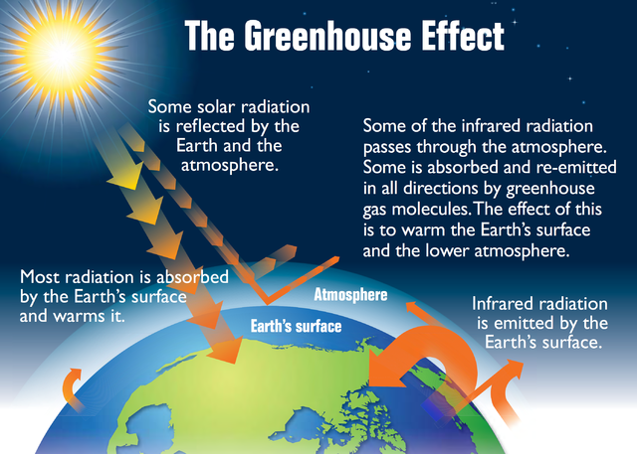
Why does this warm up the Earth?
Greenhouse gases in the atmosphere absorb solar radiation.
They then re-emit it, warming the Earth.
The more greenhouses gases there are the more warming takes place.
Notes:
This ‘greenhouse effect’ is what keeps our planet warm enough to be habitable.
The problem is that we are adding more greenhouse gases to the atmosphere, causing the planet to get hotter.
The Greenhouse Effect diagram is from The Royal Society.

Slide 6
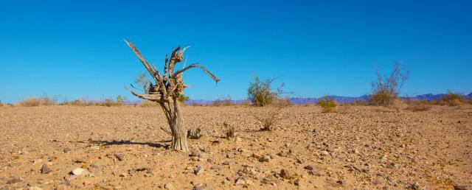
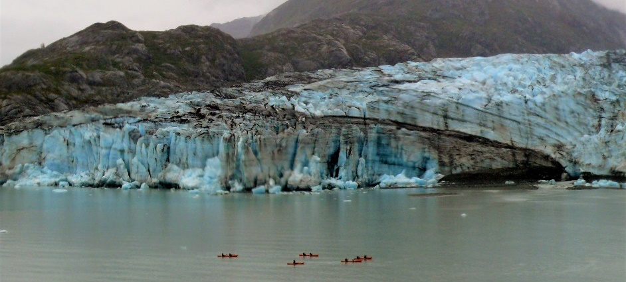
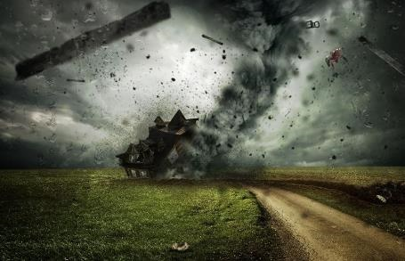
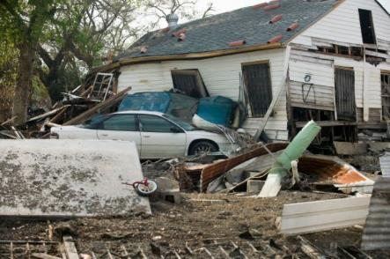
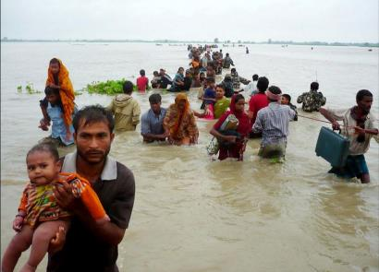
What problems does this cause?
Notes:
It causes the land and sea to become hotter, the ice to melt and increases the frequency and intensity of extreme weather events.
Drought photo is by Ken Kistler, PublicDomainPictures (link: https://tinyurl.com/y5hw3pcm)
Glacier melting photo, Glacier Bay, Alaska is by Jeff Walshe
Extreme weather picture is by Comfreak Pixabay (link: https://tinyurl.com/2h737eyr)
Hurricane Katrina photo by Andrea Booher (link: https://tinyurl.com/45cvkawa)
Coastal flooding photo is by Indi Samarajiva, Flickr (link: https://www.flickr.com/photos/indi/5348817584/)

Slide 7
Warming sea
Describe what happened in Experiment 1 (thermal expansion).
What happens to a liquid’s volume when it is heated?
How does this affect the sea level?
What issue is shown in this photo?
Notes:
Ask pupils to explain what happened in Experiment 1 (thermal expansion).
When a liquid gets warmer it expands.
As the sea gets warmer it expands so the sea level rises.
This leads to coastal flooding.
The sea level has risen about a quarter of a metre since 1850 (the industrial revolution). About a third of this is due to thermal expansion.
The photo of coastal flooding is by Indi Samarajiva, Flickr (link: https://www.flickr.com/photos/indi/5348817584/)

Slide 8
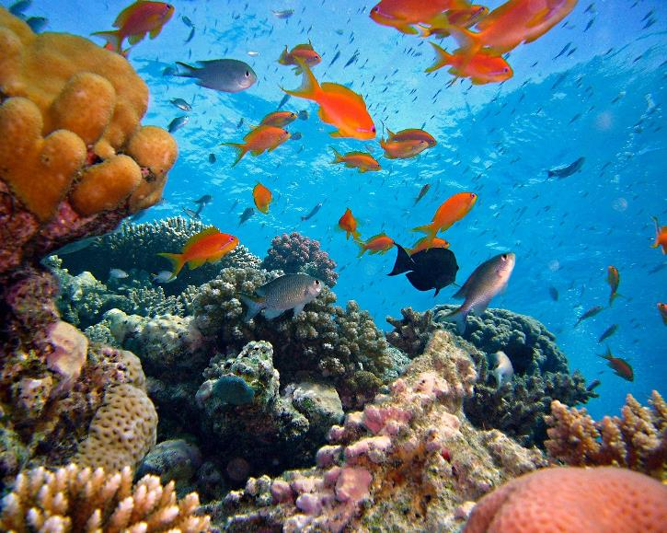
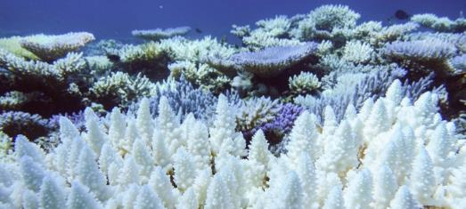
Coral bleaching
Coral reefs are homes to millions of fish.
Rising water temperatures can cause coral to bleach and eventually die.
Notes:
The first photo shows a live coral reef.
The second photo shows a coral reef which has suffered bleaching.
This reef can no longer support the fish and other life.
Coral reefs provide shelter to about a quarter of all ocean species.
The photo of the coral reef is by Joakant, Pixabay
The photo of coral bleaching is by the Australian Institute of Marine Science (link: https://www.aims.gov.au/coral-bleaching)

Slide 9
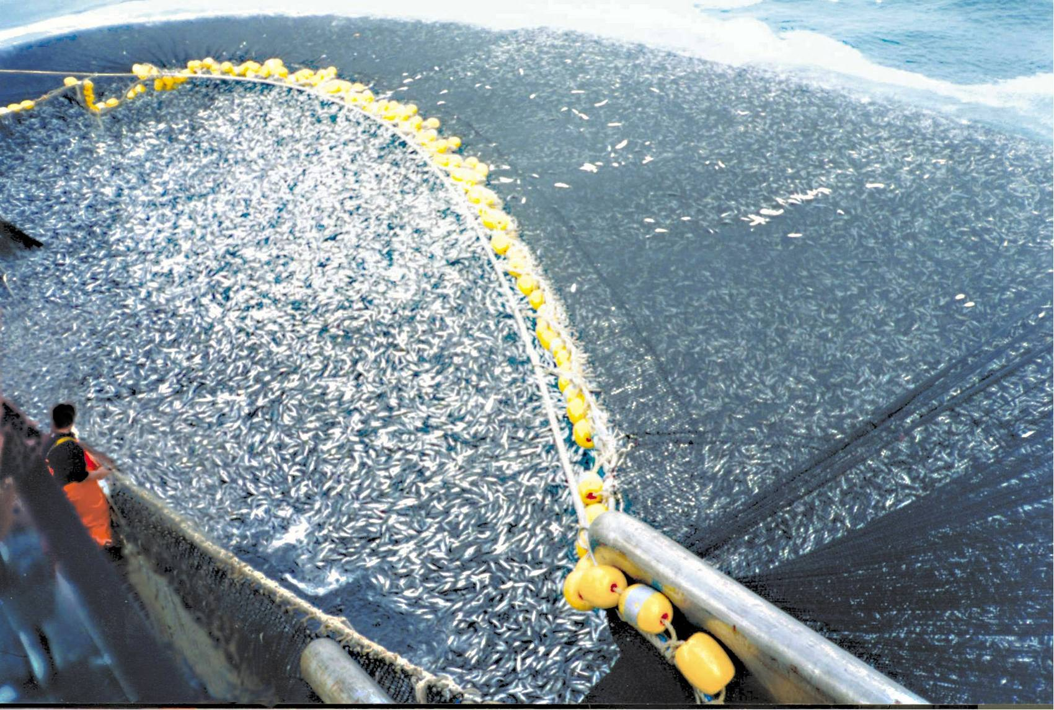
Over-fishing
As well as climate change, over-fishing is causing a decline in fish populations.
During commercial fishing, a lot of other creatures, such as dolphins and turtles, are also caught and killed accidentally.
Notes:
Overfishing is catching fish faster than stocks can replenish.
As well as catching the target species, fishing trawlers catch anything else in their path. Loads of additional marine life is hauled up with the catch and then discarded overboard, dead or dying.
Fishing gear can be modified to catch fewer of the non-target species.
In the Great Pacific Garbage Patch, of the 79,000 tons of plastic waste approximately 46% is fishing nets.
‘Bottom trawling’ also damages the sea bed.
This photo of overfishing cod is from Wikimedia (link: https://commons.wikimedia.org/wiki/File:Trawlers_overfishing_cod.jpg)

Slide 10
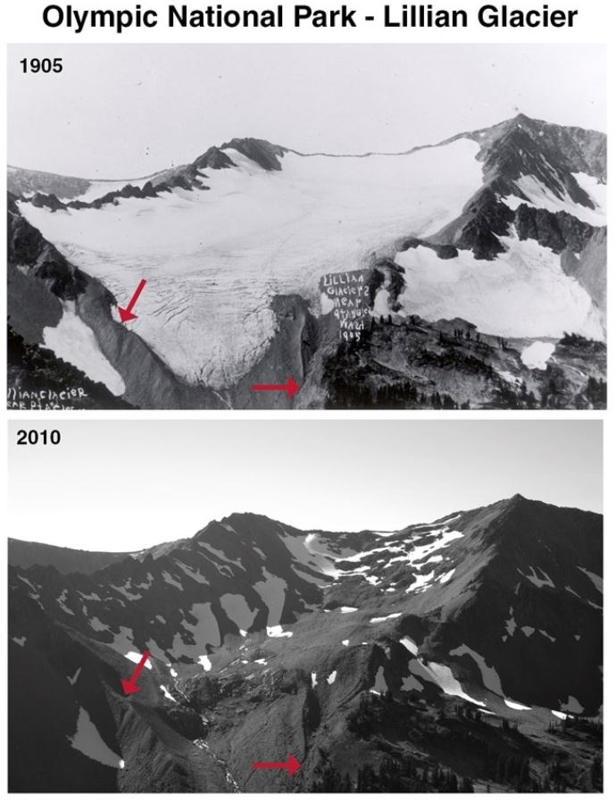
Melting ice
Describe what happened in Experiment 2 (ice melt rate – effect of temperature).
How did the rate at which ice melted vary with temperature?
What steps were taken to ensure a fair test?
These are photos of a glacier in the U.S. taken in 1905 and again in 2010. What has happened?
Notes:
Ask pupils to explain what happened in Experiment 2 (ice melt rate – effect of temperature).
They should have obtained the result that the higher the temperature, the more quickly the ice melts.
The same size ice cubes and the same amount of water were used for each.
The photos show that the Lillian Glacier in the Olympic National Park has completely melted between 1905 and 2010.
The glacier photo is shown with permission of the United States’ National Park Service. The 2010 photo was taken by Josh McClean.

Slide 11
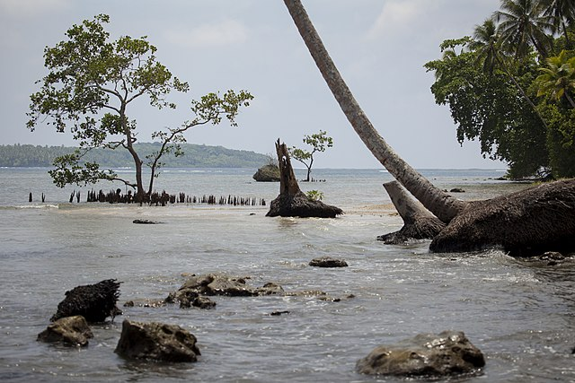
Rising sea level
Describe what happened in Experiment 3 (ice melting ‘on land’ and in water).
When the ice in the water melted, what happened to the water level?
When the ice ‘on land’ melted what happened to the water level?
What issue is shown in this photo?
Notes:
Ask pupils to explain what happened in Experiment 3 (ice melting - change in water level).
When the ice that was already in the water melted, this should not have changed the water level.
When the ice ‘on land’ melted, the water level should have risen.
The glaciers and ice sheets (e.g. Greenland and Antarctica) are land ice, so when they melt the sea level rises. About 2/3 of sea level rise is due to land ice melting.
Melting of the Arctic sea ice does not make the sea level rise. However the rapid loss of sea ice is threatening the survival of polar bears as they live and hunt on it.
This photo of Solomon island coast being swallowed by the sea is by Alex DeCiccio, Wikimedia (link: https://tinyurl.com/h3dezjrs)

Slide 12
Air pollution
Describe what happened in Experiment 4 (air pollution). What did you see on the spoon?
Why is burning described as an irreversible change?
Burning fossil fuels causes air pollution.
This increases the risk of asthma, heart attacks and other heath issues.
Notes:
Ask pupils to explain what happened in Experiment 4 (burning fossil fuels).
After holding the spoon in the flame, you should see soot on it – a black powdery substance made of carbon.
The candle is made of paraffin wax, derived from petroleum which is a fossil fuel.
Burning fossil fuels releases other pollutants as well as carbon dioxide into the atmosphere.
Diesel engines are particularly known for emitting a lot of soot particles in their exhaust.
Burning is irreversible because it cannot be undone – you can’t turn the products of burning a fossil fuel back into a fossil fuel.
Air pollution is a problem in many cities. The photos show Beijing in China.
Beijing used to have a major problem with air pollution, mainly due to coal burning and traffic emissions.
After 20 years spent working on the problem (e.g. by closing down factories and power plants that burned coal and switching buses and some cars to electric) it has greatly improved.
These photos of Beijing are by Bobak, Wikimedia (link: https://tinyurl.com/2dk63awf)

Slide 13
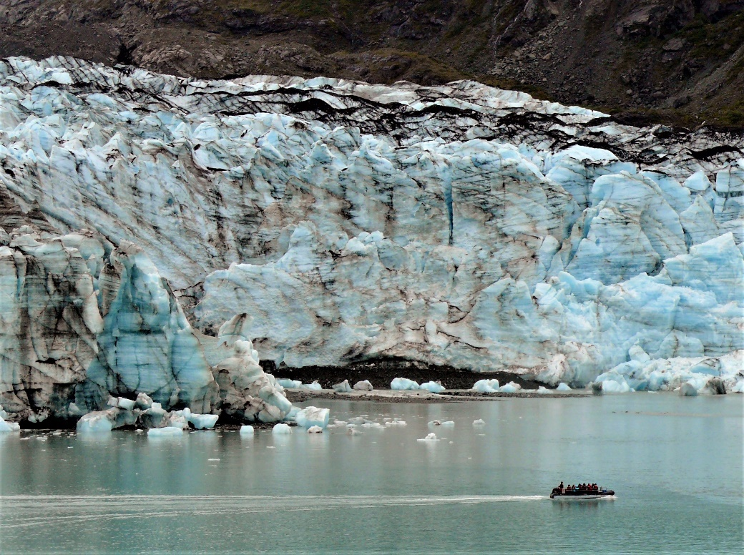
Ice melting more quickly
Describe what happened in Experiment 5 (ice melt rate – effect of colour).
What ice melts, which states does it change from/to?
Which ice cube melted more quickly? Why?
What will happen if glaciers are darkened by soot or dirt?
This is a glacier in Alaska, USA.
Notes:
Ask pupils to explain what happened in Experiment 5 (ice melting – effect of colour).
When ice melts it changes from a solid to a liquid.
The ice covered with black paper should have melted more quickly than the one covered with white paper.
Black paper absorbs more heat from the sun than white paper so it gets hotter.
When ice is darkened by dirt or soot (as in this photo) it absorbs more heat from the sun and melts more quickly.
This glacier photo is by Jeff Walshe.

Slide 14
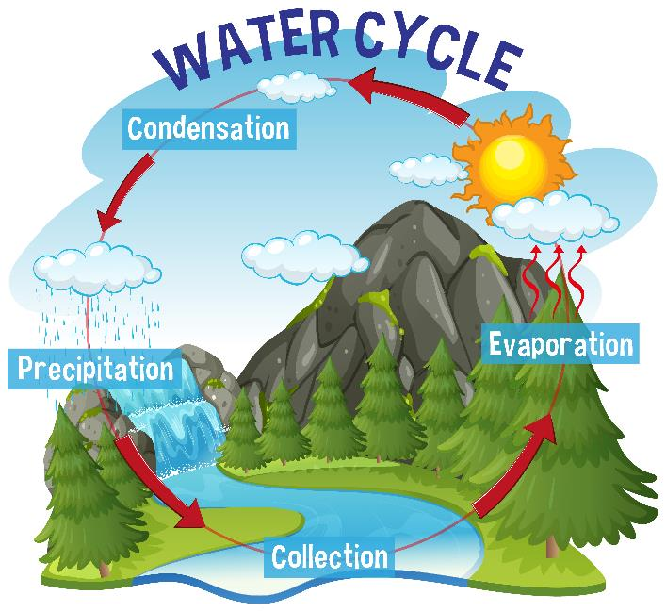
The water cycle
Describe what happened in Experiment 6 (evaporation).
Which evaporated more quickly, the cooler or the warmer water?
Describe what happened in Experiment 7 (condensation).
In which part of the water cycle does water change from liquid to gas? From gas to liquid?
Notes:
Ask pupils to explain what happened in Experiment 6 (evaporation).
The water in the warmer bottle lid should have evaporated more quickly than that in the cooler bottle lid.
Ask pupils to explain what happened in Experiment 7 (condensation).
Hot water in the mug should have evaporated and then condensed on the cooler funnel.
As more condensation formed the droplets should have joined together and then run down the inside of the funnel.
During the water cycle, the sun heats up the water (liquid) in the sea or in rivers and lakes and turns it into water vapour (gas), which rises into the air.
This cools and condenses in tiny droplets (liquid) to form clouds. The water builds up in the clouds and falls down as precipitation, which then collects again.
The picture of the water cycle is by brgfx (link: https://tinyurl.com/2k9twuuf)

Slide 15
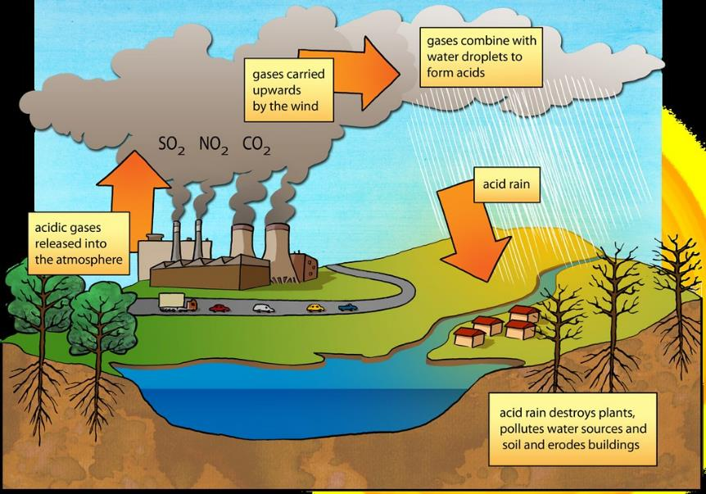
Acid rain
Describe Experiment 8 (acid rain).
What happened to the plants when they were sprinkled with vinegar?
What causes acid rain?
What effect does this have?
Notes:
Ask pupils to explain what happened in Experiment 8 (acid rain).
When fossil fuels are burned, particularly coal, acidic gases are released into the atmosphere.
These gases can combine with water droplets to cause acid rain.
Acid rain can damage plants, both by removing vital chemicals from the soil and by directly by damaging the leaves themselves.
Acid rain also pollutes water sources and kills fish.
The diagram of acid rain is by Siyavula Education, Flickr.

Slide 16
Extreme weather
Why does climate change cause more extreme weather?
Notes:
As global temperatures rise, more energy is available from thermal air currents to power storms, hurricanes, cyclones and tornadoes which are becoming more frequent and intense.
Warmer air increases evaporation and the air can hold more water vapour which affects the rain patterns so that severe droughts occur.
The higher temperatures and lack of rain results in more extreme heatwaves and wild fires.
As the air holds more water vapour this can then turn into more major downpours when it does eventually rain.
The picture is by Comfreak Pixabay (link: https://tinyurl.com/2h737eyr)

Slide 17
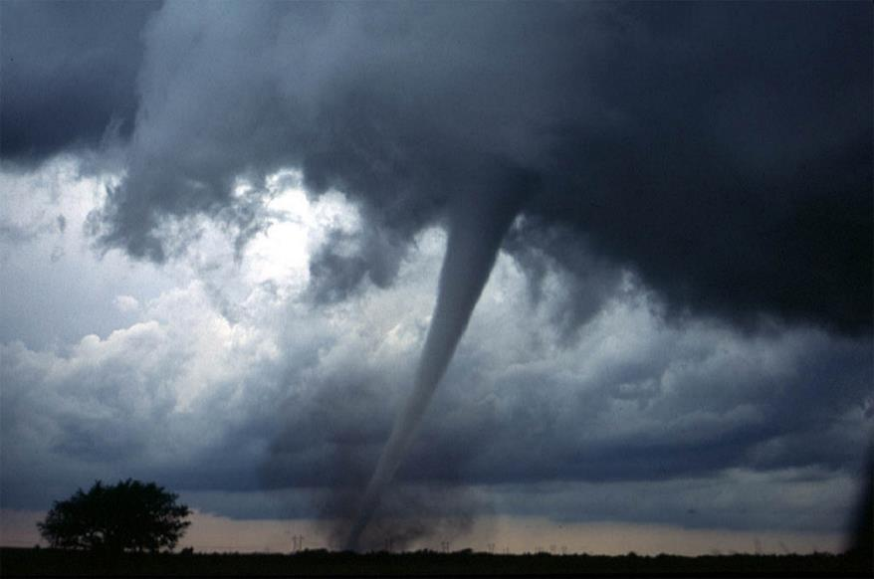
Tornadoes
Describe what happened in Experiment 9 (tornado).
What powered the ‘tornado’?
What is a real tornado?
Notes:
Ask pupils to explain what happened in Experiment 9 (tornado).
They should have been able to feel a stream of hot air rising from the tea light.
This should have powered the foil ‘tornado’. (N.B. The spin of a real tornado is not caused by the same mechanism as the spin of the foil spiral.)
A tornado is a violently rotating column of air which can reach windspeeds of up to 300 mph and do huge amounts of damage.
These often result from thunderstorms which contain rotating air and are powered by warm moist air rising up the middle.
The tornado photo is by Jean Beaufort, PublicDomainPictures (link: https://tinyurl.com/3jwd6crh)

Slide 18
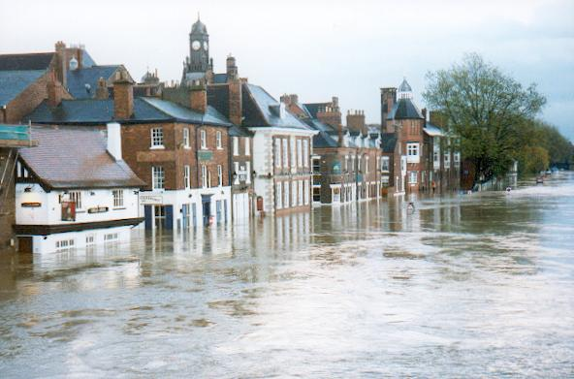
Floods
A warmer atmosphere holds and releases more water
This can lead to more major downpours and increased flooding
Notes:
This photo shows the river Ouse flooding in York, UK in 2012.
A flood is an accumulation of water on normally dry land.
As well as climate change and sea level rise, human changes to the environment such as deforestation and removal of wetlands can cause increased flooding.
As sea level rise and extreme weather events increase with climate change, floods are becoming more common.
The photo is by Benjamin Shaw, Wikimedia (link: https://tinyurl.com/4276jpbu)

Slide 19
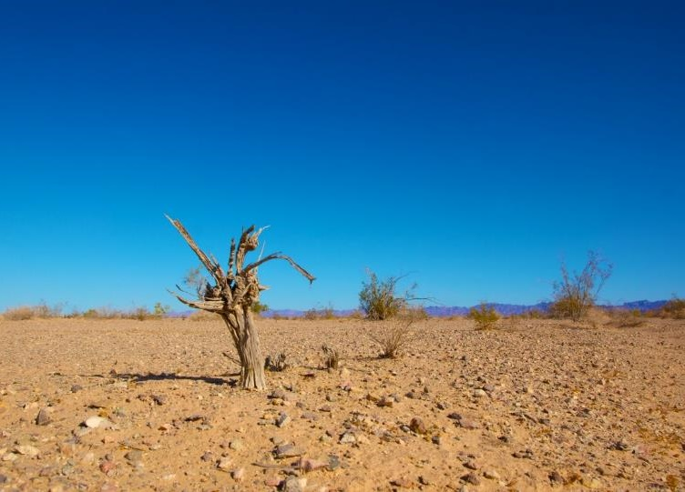
Drought
Describe Experiment 10 (drought).
What happened to the plants when they ran out of water?
Was this as you predicted?
What is a drought?
Notes:
Ask pupils to explain what happened in Experiment 10 (drought).
A drought is an event of prolonged water shortage.
This can damage the ecosystem or agriculture of the region.
Droughts have become worse due to climate change.
This drought photo is by Ken Kistler, PublicDomainPictures (link: https://tinyurl.com/y5hw3pcm)

Slide 20
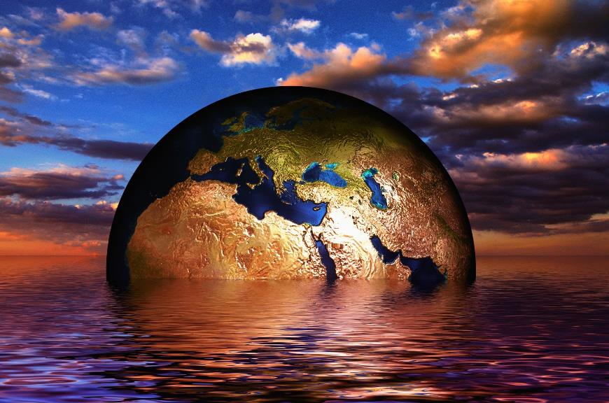
What have you learnt?
What do we mean by ‘climate change’?
What human activities cause climate change?
What effect does this have?
Suggest some issues resulting from climate change.
Notes:
Climate change is the change in average conditions (such as temperature and rainfall) in a region.
Burning fossil fuels and increasingly intensive agriculture produce greenhouse gases which warm up the planet.
Deforestation reduces the planet’s ability to absorb greenhouse gases.
Warming of the planet leads to issues such as rising sea levels, increasing storms, droughts and flooding and loss of habitat causing species extinction.
The picture is by Gerd Altmann, Pixabay.

Slide 21
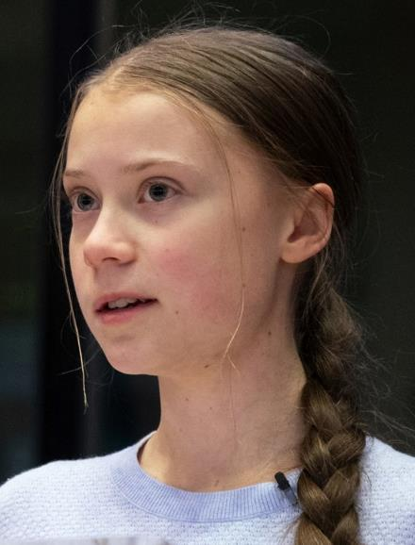
What can we do?
Pressurise governments to limit climate change. Everyone’s voice is important.
How can individuals help reduce their impact on the environment?
As climate activist Greta Thunberg says, ‘No-one is too small to make a difference’.
Copyright © Caroline Alliston 2021
Notes:
You could write persuasive letters to your local MP to encourage them to support government legislation about more climate action.
Re-iterate the message ‘reduce, re-use and recycle’ and discuss how more could be done.
Discuss how you could reduce impact on the environment by buying less things or buying second-hand.
Reduce food wastage and reduce consumption of red meat and highly processed foods.
Discuss travel options, both local (alternatives to car use) and holiday travel (alternatives to flying).
Discuss how home heating and electricity consumption could be reduced.
For further ideas on how individuals can reduce their impact on the environment see TTS’s Carbon Footprint Calculations and Design an Eco-home card sets.
The photo is from Wikipedia (link: https://en.wikipedia.org/wiki/Greta_Thunberg)

