Slide 1
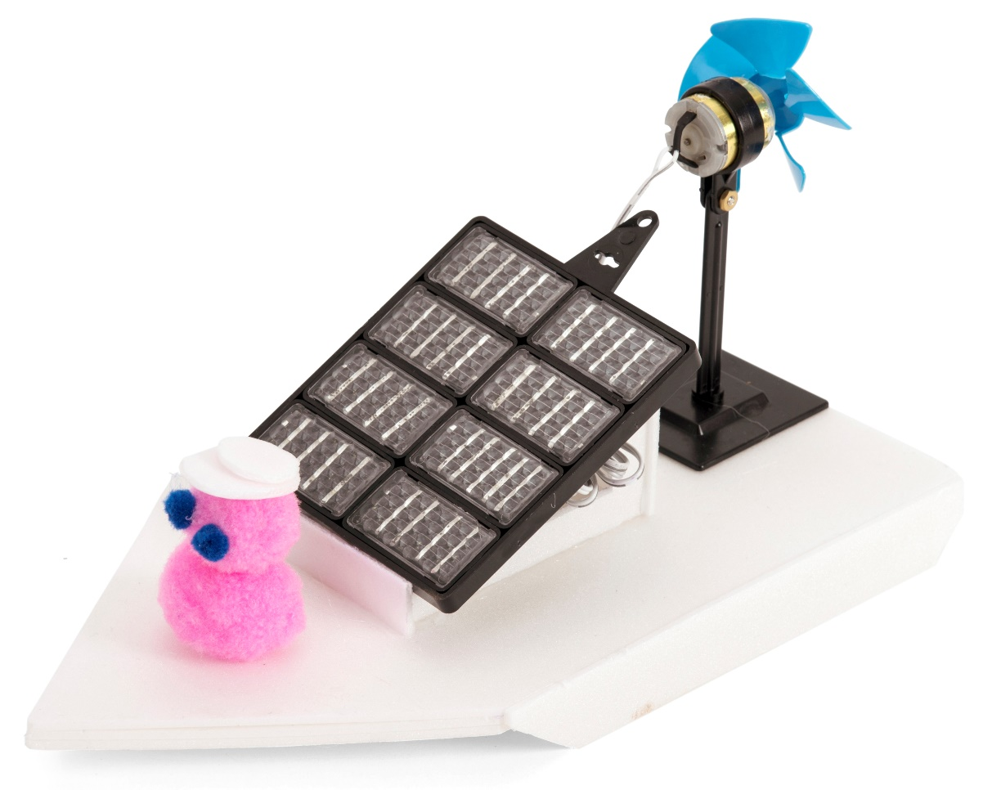
Renewable energy – Module 3
What energy do we use for transport?
Could more of this be renewable energy?
Make a solar powered electric boat

Slide 2
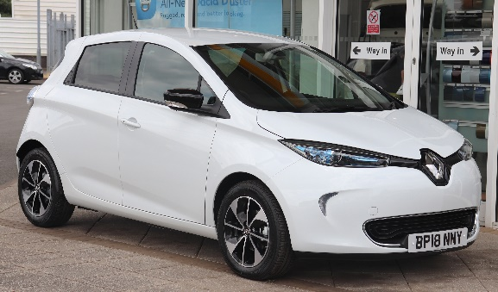
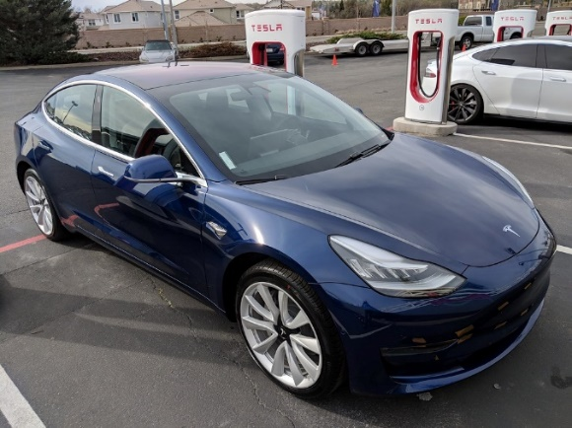
Energy used in transport
About a quarter of our total energy is used in transport
About 90% of this comes from burning fossil fuels, causing climate change
Increasingly, people are using electric vehicles which include a large battery to store electricity
The electricity could be produced from renewable sources

Slide 3
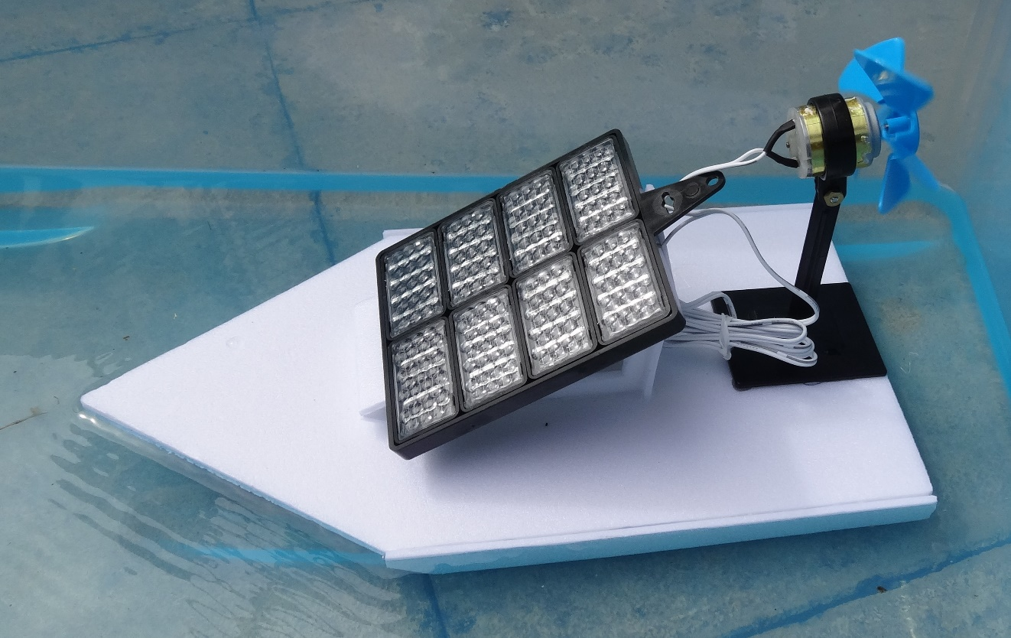
Make a solar powered electric boat

Slide 4
STEM learning objectives
Science: Materials – give reasons for the particular uses of everyday materials Forces – explore resistance in water by making and testing boats
Technology – design, make and evaluate a product
Engineering – understand propulsion, drag and streamlining
Maths – measure distance and time, calculate average speed

Slide 5
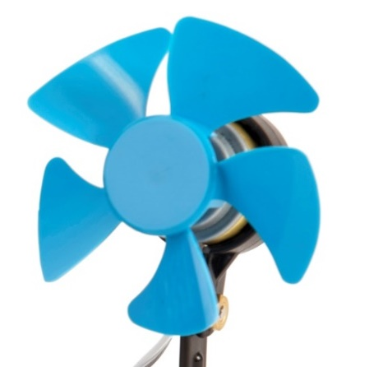
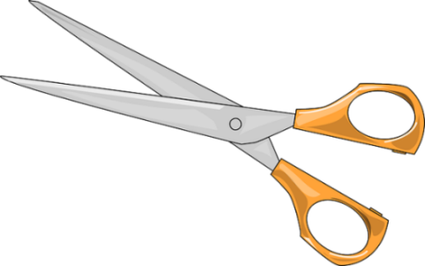
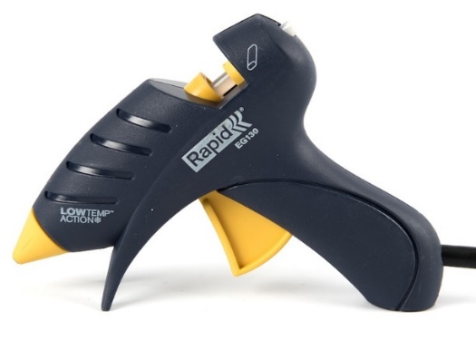
1. Work safely
Look at the tools and equipment. Can you spot any potential hazards?
Can you think of ways to reduce the risks?
Notes:
Don’t cut yourself or burn your fingers.
Use cool melt glue guns to avoid serious burns.
Don’t put the fan near your eye.
Don’t look directly at the sun as you could damage your eyes.

Slide 6
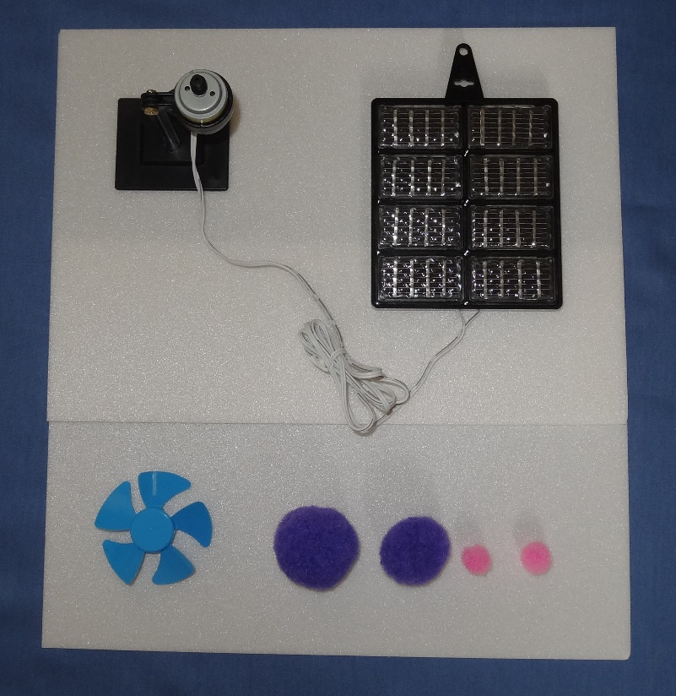
2. Collect your materials
You will need:
A solar energy kit (fairground ride completed in module 2)
2 sheets of polystyrene foam
A propeller
Pompoms to make passengers and/or decorations

Slide 7
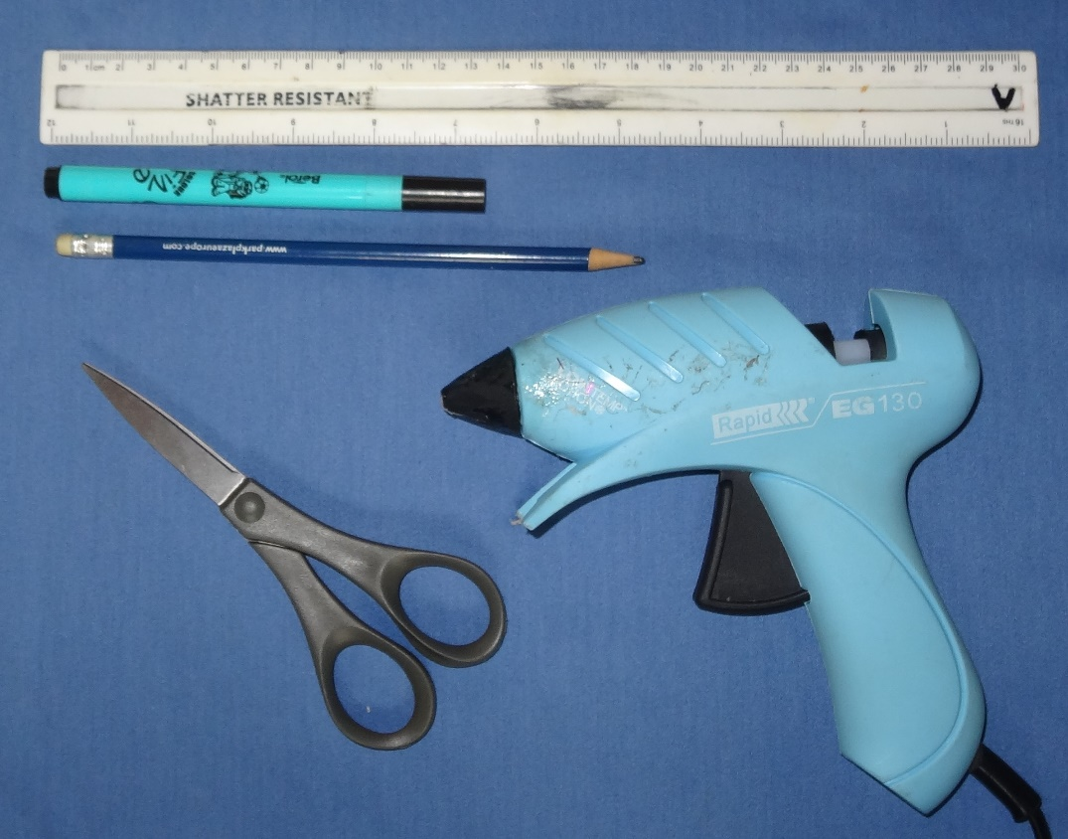
3. Assemble your tools
You will need:
A ruler
A felt tip pen
A cylindrical pencil
A pair of scissors
A cool melt glue gun

Slide 8
4. Set design criteria
Discuss what your boat should do
It ought to float!
Should it go in a straight line?
Carry passengers?
Any more ideas?
Write a list of design criteria in your workbook

Slide 9
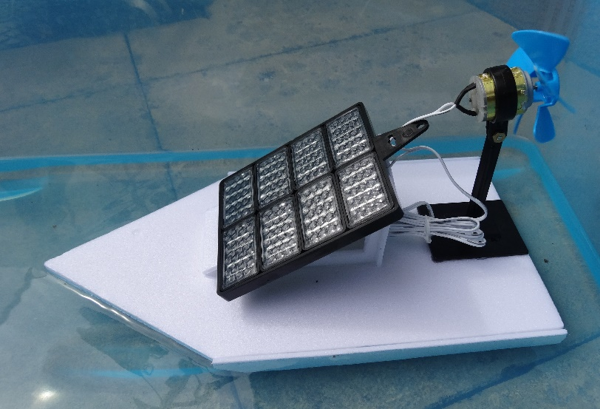
5. How will the boat work?
What properties of the polystyrene foam sheet make it suitable for making a model boat?
What force pulls the boat down onto the water?
What force pushes the boat up?
What happens if the force pulling it down is bigger than the force pushing it up?
What will make the boat go along?
What force slows the boat down?
Notes:
The polystyrene foam sheet is very buoyant (i.e. it floats well) and does not absorb water.
It is also easy to cut with scissors and join the parts together with the glue gun.
Gravity pulls the boat down.
Upthrust (provided by the water) pushes the boat up.
If the force pulling it down is bigger than the force pushing it up it will sink.
The friction acting between the boat and the water slows it down. This is water resistance or ‘drag’.
The fan pushes the air backwards; the opposing force of the air on the fan pushes the boat forwards.

Slide 10
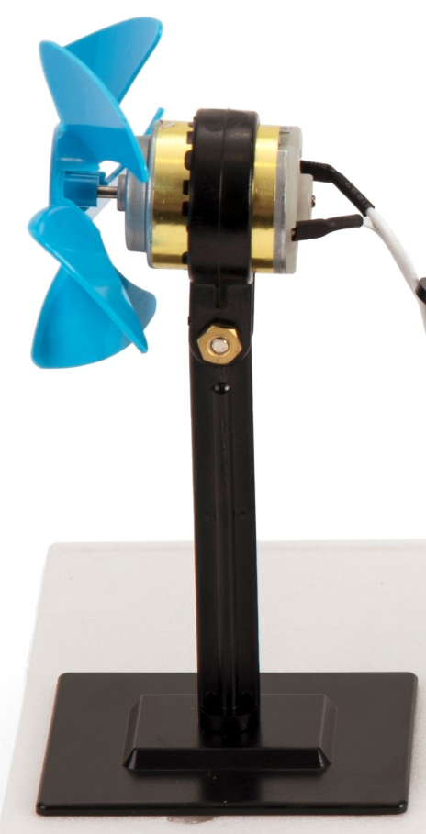
6. Prepare the fan
Carefully peel the motor stand off the base.
Keep the base for use in module 4.
Pull the motor pulley off the motor shaft and store it safely.
Replace it with the propeller.
Use the plastic spanner from the solar energy kit to loosen the nut slightly on the motor stand
Turn the motor so the shaft is horizontal and re-tighten the nut

Slide 11
7. Design your boat
Think about where the parts will go
How will you make sure the boat is balanced?
The solar panel is very heavy – how will you stop the boat sinking?
What is streamlining?
How could you get the boat to go in a straight line?
Where will your passengers go?
Sketch a design for your boat
Notes:
You can balance the boat on the cylindrical pencil and adjust the position of the parts to get it roughly balanced.
You need to use a lot of polystyrene foam to support the heavy parts. Be careful not to make the base too small. It is advisable to use a triple layer of foam.
A streamlined boat has a hull shape designed to feel less resistance from the water as it travels. When you streamline your model you adjust the shape to help it pass through the water more easily, for example by making the front pointed.
You can add fins or similar to your boat to help it go straight. Don’t make them too deep so they get stuck on the bottom of the paddling pool.

Slide 12
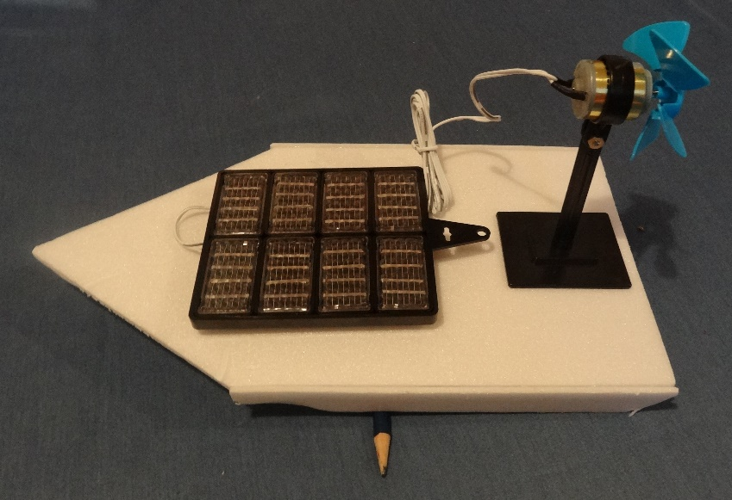
8. Construct your boat
Use the ruler and felt tip pen to mark out the parts for your boat base.
Check with an adult that your design looks feasible before you cut out the parts.
Glue the parts together.
Place the boat base on the cylindrical pencil. Adjust the position of the solar panel and fan to get the boat roughly balanced

Slide 13
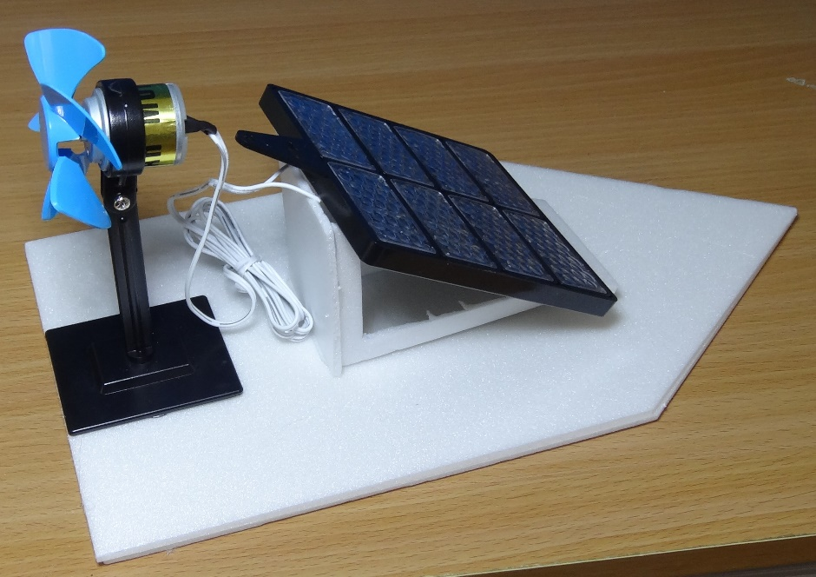
9. Mount the solar panel and fan
Work out how to mount your solar panel
It will work best if it is at right angles to the sun
You can use the angle you measured in module 1 or you can assume a default angle of 30°
Glue the fan stand and solar panel on so they don’t fall in the water
Don’t put too much glue on the solar panel as you can damage it, and you will need to peel it off the boat to use in module 4

Slide 14
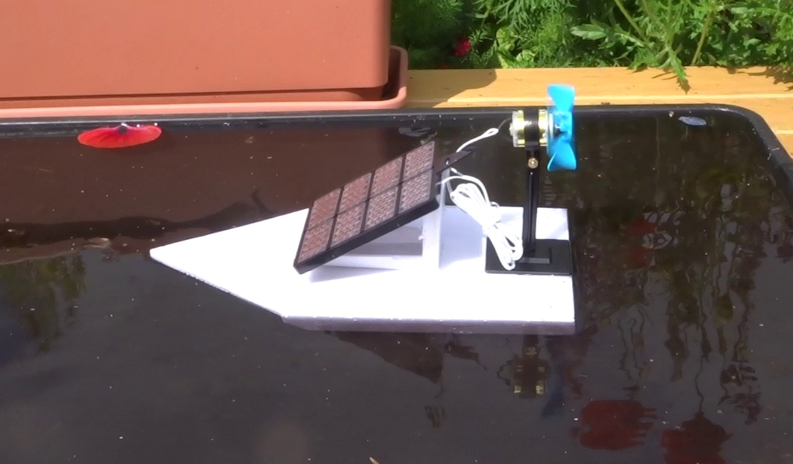
10. Try out the boat
Place the boat in the water tray or paddling pool
Hold on to it until you are sure it floats!
Try out the boat with the solar panel facing the sun
Does it meet your design criteria?
Do you need to make any improvements?

Slide 15
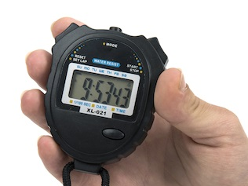
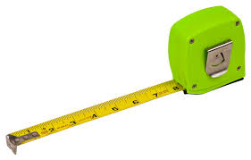
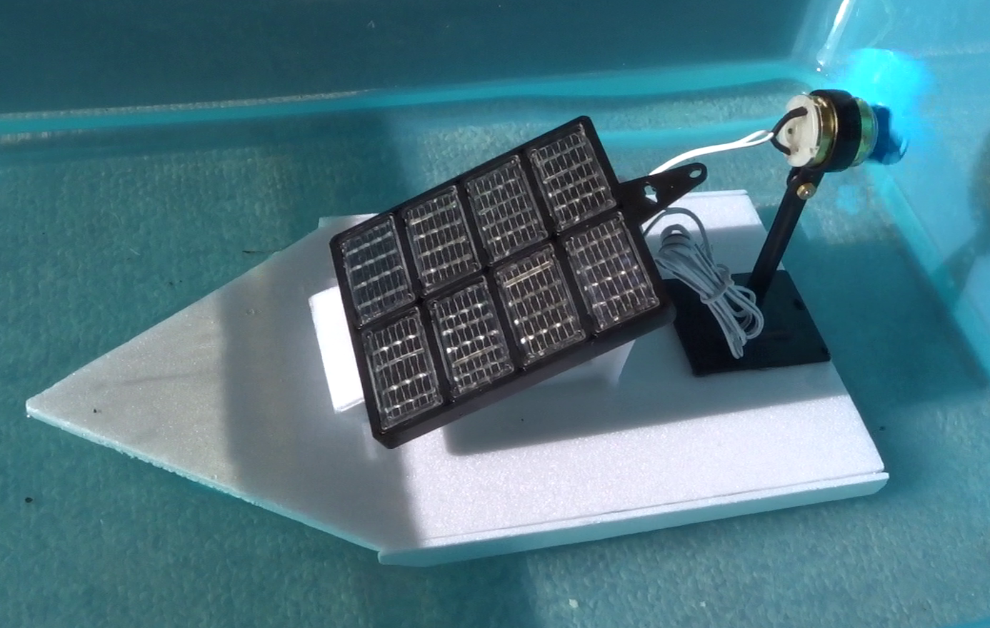
11. Compare the boats’ performance
Time how long it takes for each boat to travel the length of the paddling pool
Compare the times
Measure the distance travelled
Divide the distance travelled by the time taken to work out the average speed
Which boat goes fastest?

Slide 16
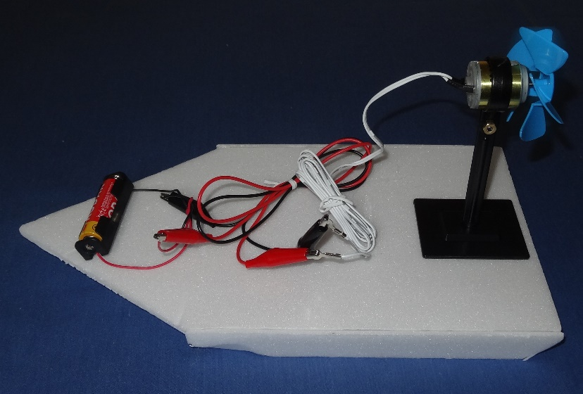
12. Extension activity (optional)
Remove the solar panel from the boat and disconnected the two motor contacts (put the nuts and washers back on so you don’t lose them)
Use two crocodile leads to connect the battery to the motor contacts
Check the fan is blowing air away from the motor – otherwise swap over the crocodile leads
Try out the boat – compare the performance with that obtained using the solar panel
Notes:
The batteries and crocodile leads are those used in module 2.
When comparing performance, remember that the boat will be significantly lighter without the solar panel, so the drag should be reduced because less of the boat hull is in the water.

Slide 17
13. What did you learn?
How much of our energy is used in transport?
How is most of this energy produced?
What is the problem with this?
What forces act on a fan boat, and in which direction?
Why is polystyrene foam sheet useful for making a model boat?
Did you make any improvements to your boats?
Which features of the fastest boats do you think helped them go faster?
Which part of the activity did you enjoy the most?
Notes:
Roughly a quarter of our energy is used in transport.
About 90% of this comes from burning fossil fuels which causes climate change.
Gravity acts downwards.
Upthrust from the water opposes this.
The fan pushes the air backwards, and the opposing force from the air acting on the fan pushes the boat forwards (propulsion).
The friction between the boat and the water acts to slow the boat down – this is called water resistance or drag. (This is far more than air resistance because water is much denser than air.)
Polystyrene foam sheet is very buoyant (floats well), doesn’t absorb water and is also easy to cut and join.

