Slide 1
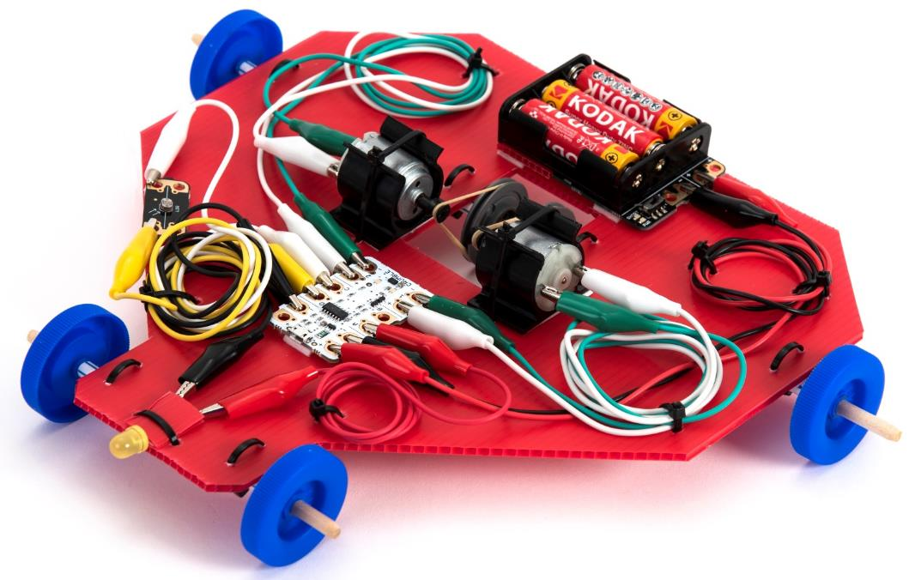
Crumble Vehicle Extension Activities

Slide 2
Learning objectives
Electricity – compare and give reasons for variations in how components function.
Forces - Identify the effects of friction that act between moving surfaces.
Design and Technology – design, make, evaluate and improve products.
Computing – use sequence, selection, repetition, variables, inputs and outputs.

Slide 3
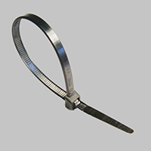
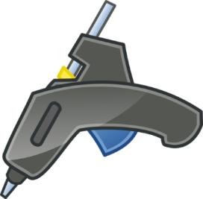
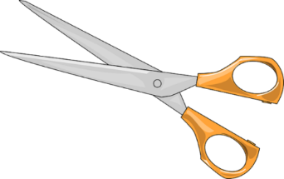
1. Work safely
Look at the tools and equipment. Can you spot any potential hazards?
Can you think of ways to reduce the risks?
Notes:
Pupils sometimes cable tie their fingers which could cut off the blood supply. You need to cut off the cable tie.
Use low melt glue guns to avoid nasty burns. Hold any burns under running water for ten minutes.

Slide 4
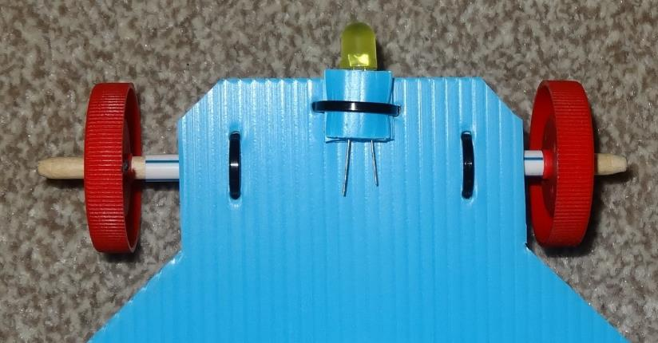
2. Fit an LED headlight
LED stands for ‘Light emitting diode’.
Carefully separate the LED legs a little.
Cut two 1.5 cm squares of corrugated plastic.
Use foam tape to sandwich them either side of the LED legs.
Foam tape and cable-tie the LED sandwich to the front of the vehicle.
The long leg should be on the left.
Notes:
Unlike a traditional lamp, which glows white hot to produce light, an LED transforms electrical energy directly into light energy. This is much more efficient because you don’t waste so much energy in heat.

Slide 5
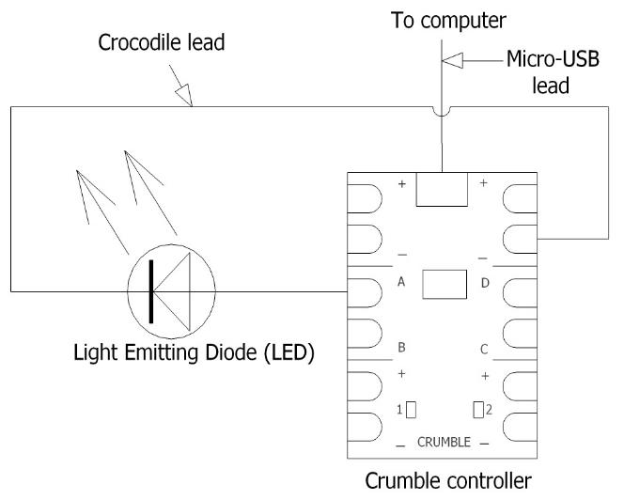
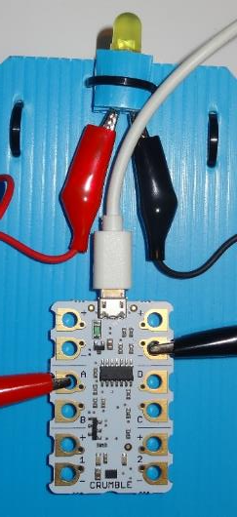
3. Connect up the headlight
Connect a crocodile lead from the long leg of the LED to terminal A on the Crumble.
Connect a crocodile lead from the short leg to the negative (-) ‘Power out’ terminal.
Plug in the micro-USB lead.
Notes:
You may need to move the Crumble back a little to enable you to plug in the USB lead.

Slide 6
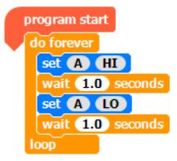
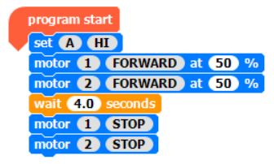
4. Switch the headlight on
Run this program and check the headlight comes on.
Try flashing the headlight on and off continuously.
Run the vehicle with the headlight on – an example is shown here.
Remember to run the motors at 50% power or less so the Crumble can boot up.
Notes:
Remember to switch off the battery box when not in use to avoid draining the battery.

Slide 7
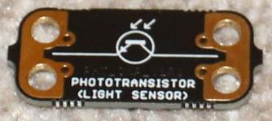
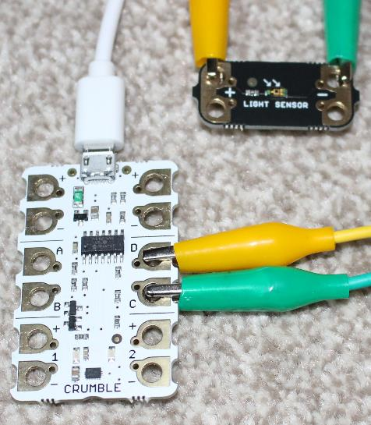
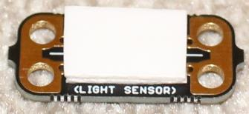
5. Fit a light sensor
Stick a double layer of foam tape on the bottom of your light sensor.
Attach the light sensor somewhere accessible on your vehicle.
Use a crocodile lead to connect the positive (+) terminal to terminal C on the Crumble.
Use a crocodile lead to connect negative (-) terminal to terminal D on the Crumble.
Notes:
The light sensor is a phototransistor, which is a semi-conductor device whose characteristics change with the light level.
When light falls on the semi-conductor it frees up electrons and holes to allow current to flow.
The double layer of foam tape is to allow space (height) to attach the crocodile clips.

Slide 8
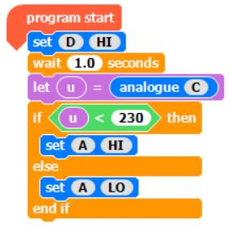
6. Make the headlight come on in the dark
Here is an example of how to make the headlight come on in the dark.
It sets output D (to the light sensor) high.
It then reads the value at C (coming back from the light sensor).
If it is light then the light sensor conducts easily, so the value at C is high, similar to D.
If it is dark then the light sensor will not conduct easily, so the value at C will be low.
Construct and run this program – cover and uncover the light sensor with your hand to switch the headlight on and off.
Notes:
The program contains a conditional statement. There is a flowchart on the worksheet which shows its logic. If the value at C is low it switches the headlight on. If the value at C is high it switches it off. You can adjust the light level at which it switches by changing the value of 230 to other values; you could try a range of around 150 to 300, for example.

Slide 9
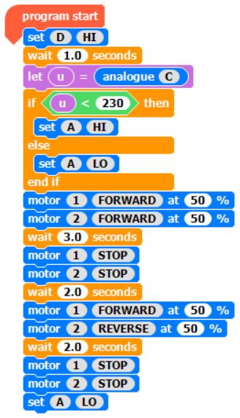
7. Run the vehicle with automatic headlight
Here is an example of a program to run a vehicle with an automatic headlight.
The check for light/darkness is at the beginning.
Design your own program by constructing a flowchart.
Construct the program and test it out: check the headlight comes on if you cover the light sensor with your hand when starting the vehicle.
Notes:
Pupils should construct a flowchart in the space provided on their worksheet.

Slide 10
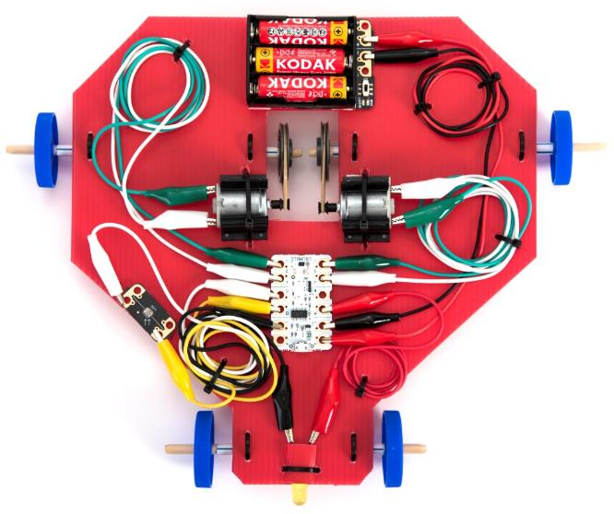
8. How the vehicle steers
The vehicle is steered by driving the two rear axles independently.
In order to turn, you can drive one faster than other, leave one stationary and drive the other, or drive one forwards and one backwards.
The front wheels are not steerable.
In order to turn, the front wheels need to skid across the floor.
How does this differ from a normal car?
Notes:
In a normal car you turn the front wheels in order to steer, so you need good traction on the front wheels.

Slide 11
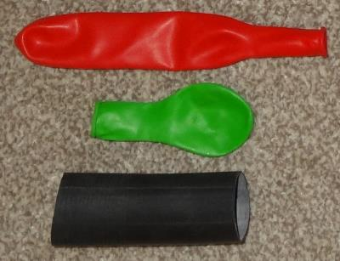
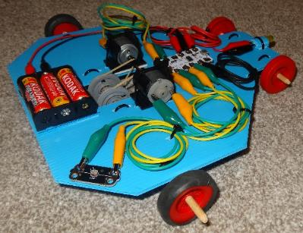
9. Improve traction on the driving wheels
Cut 1.5 cm slices of inner tube or balloon to make tyres for your rear wheels and help them grip the floor better.
Should the front wheels grip the floor?
Try the vehicle on different surfaces, e.g. the school hall, carpet or the playground.
Can the vehicle turn easily on these?
Is there a way to reduce the friction on the front wheels to help the vehicle turn?
Notes:
The front wheels need low traction so they can skid as the vehicle turns. The vehicles may not turn easily on carpet or in the playground. Explain about centre of gravity, and how you can find roughly where it is by balancing the vehicle on the side of your finger to make a pivot. If you adjust the centre of gravity backwards to just in front of the rear axles this will reduce the weight on the front wheels, and hence the friction. Then you may be able to get the vehicle to turn even on carpet.

Slide 12
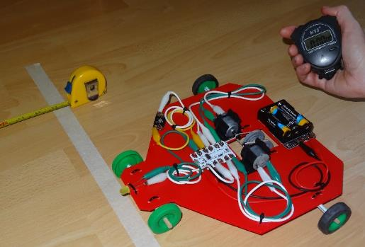
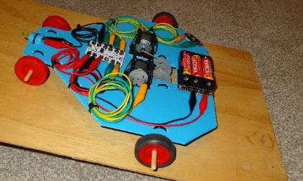
10. Measure your vehicle’s performance
Set out a start and finish line.
Run both motors forwards at 50%
Time the vehicle.
Calculate and record the average speed.
Which vehicle is the fastest?
Try out the vehicle up a ramp and record the steepest angle the vehicle can travel up.
Program your vehicle to follow the course laid out – who can complete it in the shortest time?
Notes:
Explain that average (mean) speed is the total distance divided by the total time.
A likely average speed is around 0.6 m/s and a likely maximum angle up the ramp is around 10°.
Set up a simple course (e.g. large square) and challenge your pupils to program their vehicles to get round the course in the least time.
Can the pupils suggest any reasons why some of their vehicles perform differently from others?
You can set up a more complicated course to challenge the more advanced pupils.

Slide 13
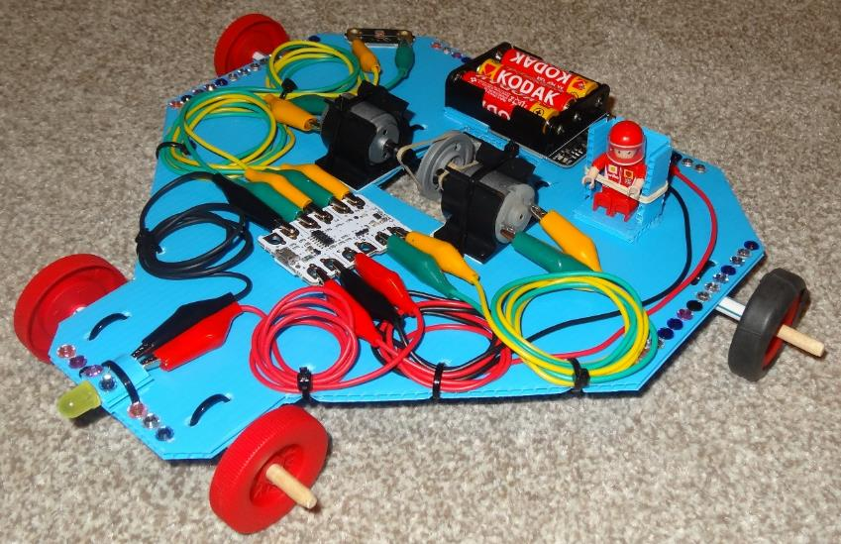
11. Carry a passenger
Design and make a seat for your passenger.
Where will it fit on your vehicle?
How will you stop the passenger falling out?
Decorate your vehicle.

Slide 14
12. Plenary
Discuss what you learnt and complete your worksheet.
What does LED stand for? What does it do?
What does the light sensor do?
Do they need to be connected a particular way round?
Which of the programs you wrote demonstrates repetition?
Which uses selection?
What did you use as a variable in your program?
Where did you want high or low friction on your vehicle?
What was used to increase friction or to decrease friction?
What did you enjoy the most?
Notes:
LED stands for light emitting diode.
The light sensor changes its characteristics depending on the light level. When light falls on it, it allows electricity to flow.
The LED needs to be connected with the long leg to positive or it won’t light up (it doesn’t damage it connecting it back to front).
The light sensor only works in one direction. If you connect it the other way round then you will have to also program it the other way round.
Flashing the headlight on and off demonstrates repetition.
Making the headlight come on in the dark demonstrates selection.
The variable ‘u’ was used to determine the level of light/darkness to switch the headlight on and off.
Rubber bicycle inner tube (or balloons) were used to increase traction on the driving wheels.
The front wheels were left as plastic without tyres to keep the friction down.
Rubber bands were used to provide traction on the pulleys.
Straws were used to keep the friction down between the axles and bearings.

Slide 15
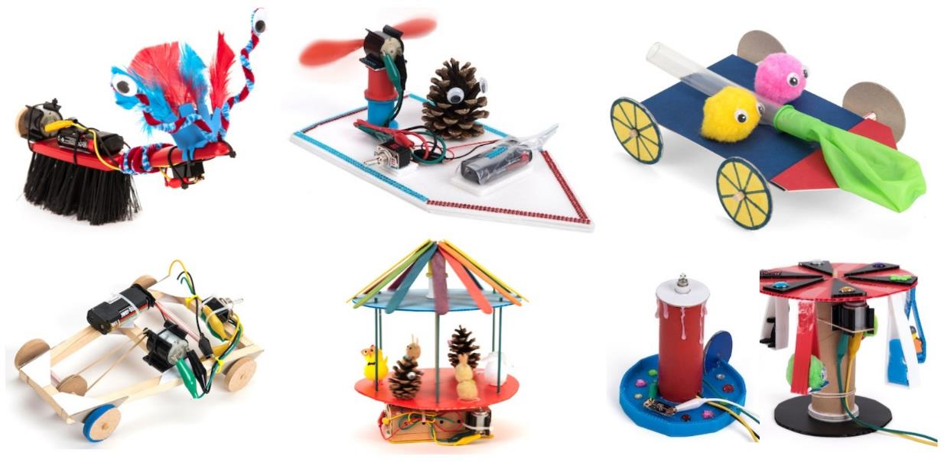
More fun design and make STEM activities
Copyright © Caroline Alliston 2022

