Slide 1
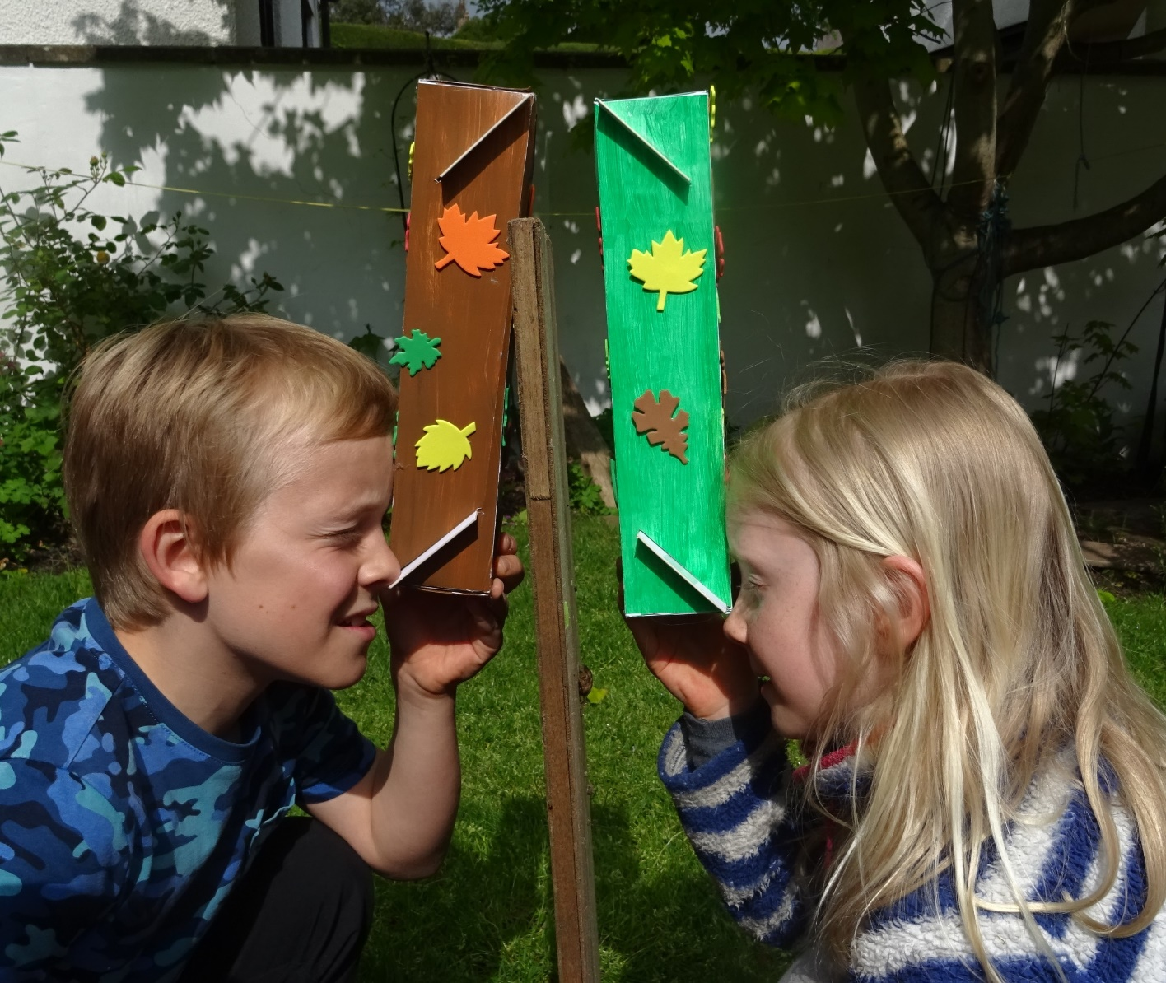
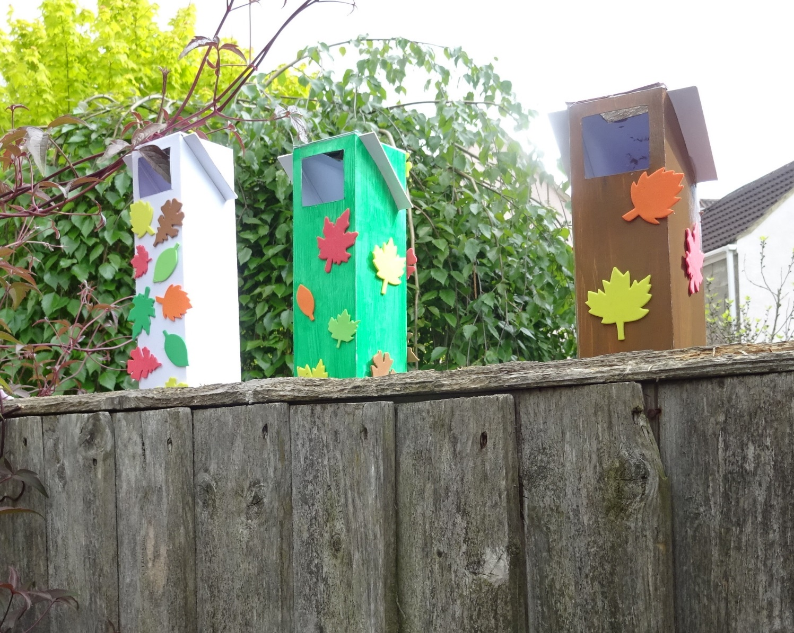
Periscopes PowerPoint

Slide 2
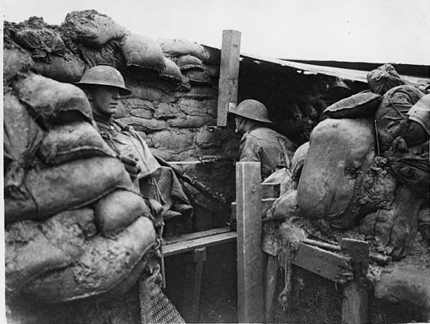
Where periscopes are used
What are periscopes used for?

Slide 3
STEM Learning objectives
Science – explore the way that light behaves
Technology – give reasons for the particular uses of everyday materials
Engineering – construct a periscope and understand how it works
Maths – draw and measure angles in degrees using a protractor

Slide 4
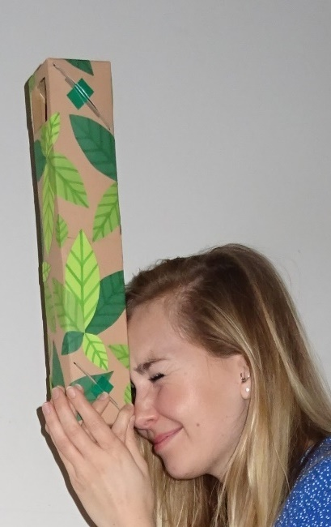
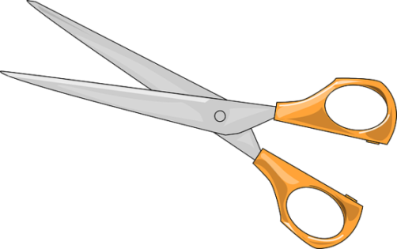
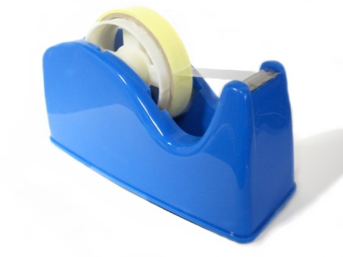
1. Work safely
Look at the tools and equipment. Can you spot any potential hazards?
Can you think of ways to reduce the risks?

Slide 5
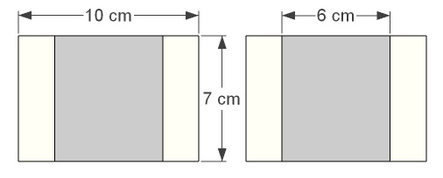
2. Cut and mount your mirrors
Mark and cut two rectangles of mountboard 7 cm x 10 cm.
Mark and cut two rectangles of mirror 6 cm x 7 cm.
Peel the plastic covers off the back of the mirrors and stick them to the mountboard as shown.
Peel the plastic covers off the front of the mirrors.

Slide 6
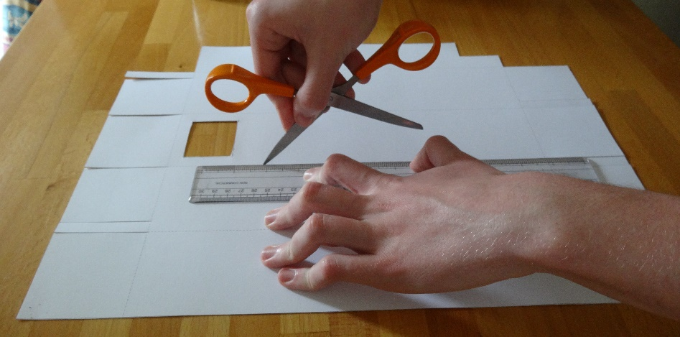
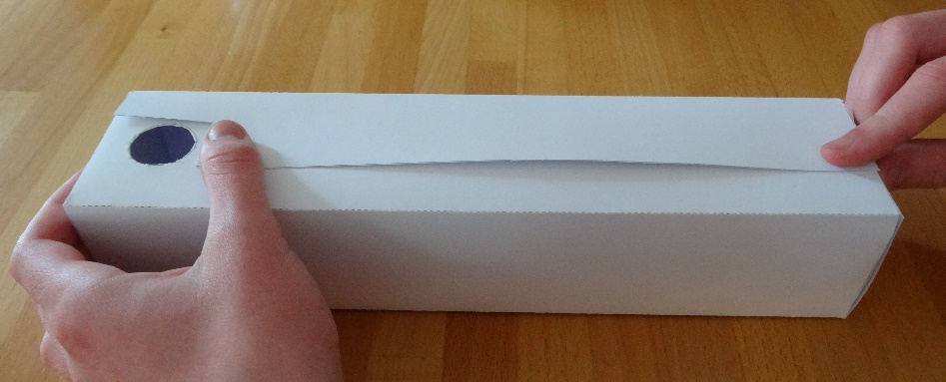
3. Cut and fold your box
Carefully cut the box template along each of the solid lines.
Use a ruler and one blade of the scissors to score along the dashed lines.
Fold the card along the dashed lines to make a box.
The score lines should be on the outside.

Slide 7
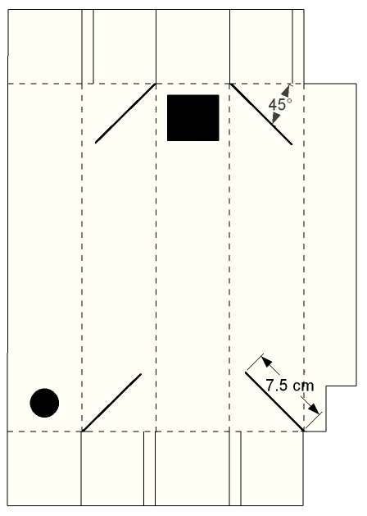
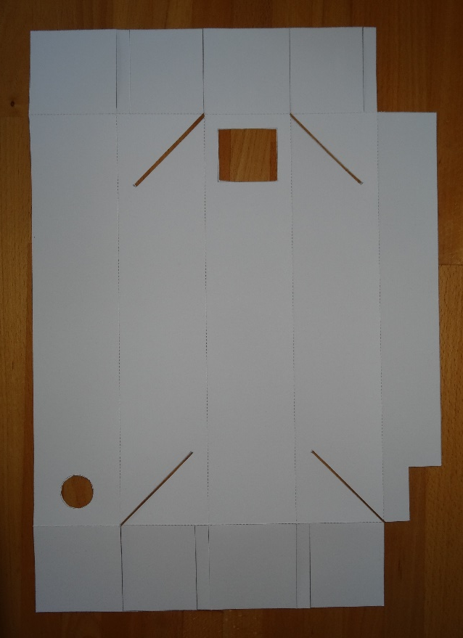
4. Cut slots to mount the mirrors
Open the box out flat again.
Measure and draw four 7.5 cm long lines at 45° as shown.
Cut 2 mm wide slots along the four lines.

Slide 8
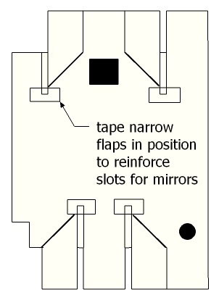
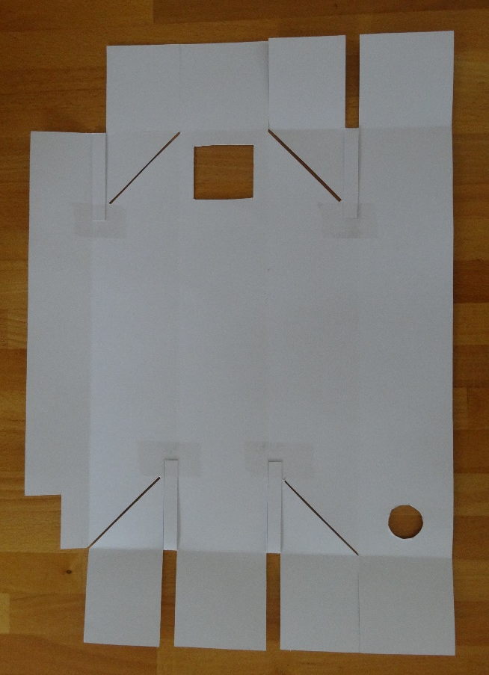
5. Reinforce the slots for the mirrors
Turn the box over.
Fold the four narrow flaps down flat.
Tape them in position.
Don’t block the slots with tape.

Slide 9
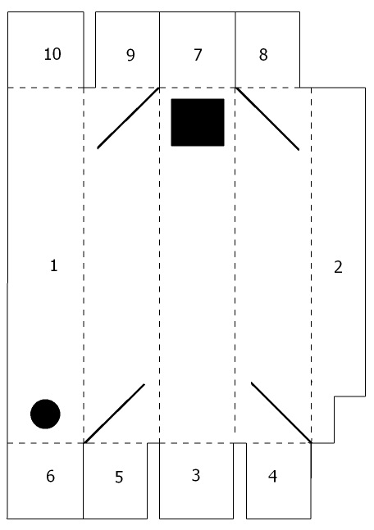
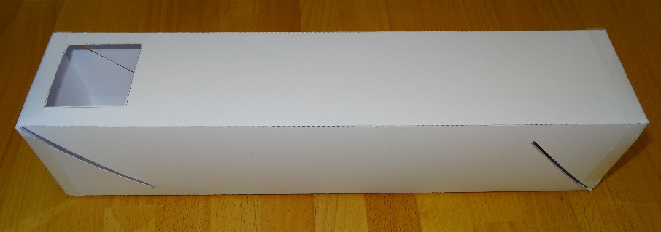
6. Fold into a box shape
Fold the box along the fold lines in the order shown.
The dashed lines should be on the outside.
Tape up all the seams.
Don’t block the slots with tape.

Slide 10
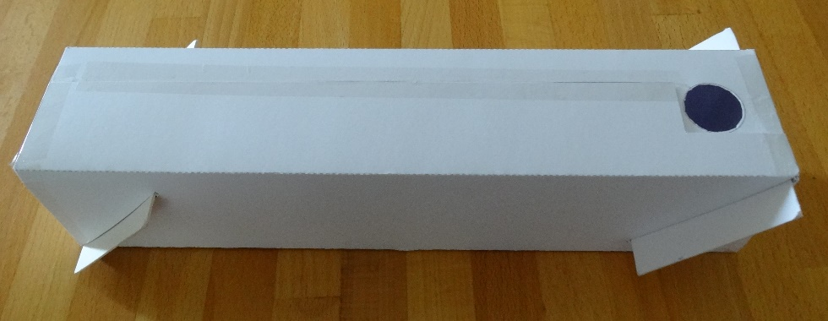
7. Fit the mirrors
Slide the two mirrors into the slots.
If the slots are too narrow cut them slightly wider.
One mirror should be facing the round hole.
The other mirror should be facing the rectangular hole.
Tape the ends of the mountboard in place.

Slide 11
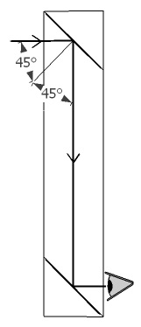
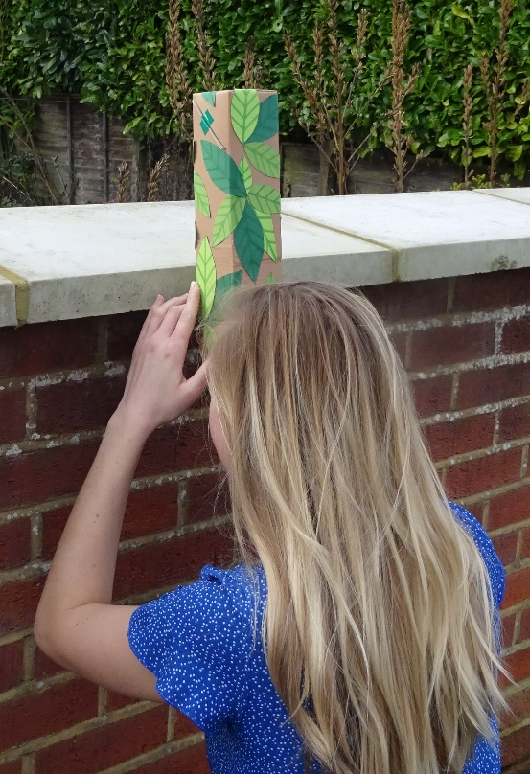
8. How the periscope works
Look into the round hole to try out your periscope.
Discuss how the periscope works.
What does reflection mean?
Why is it important for the mirrors to be at 45° to the incoming light?

Slide 12
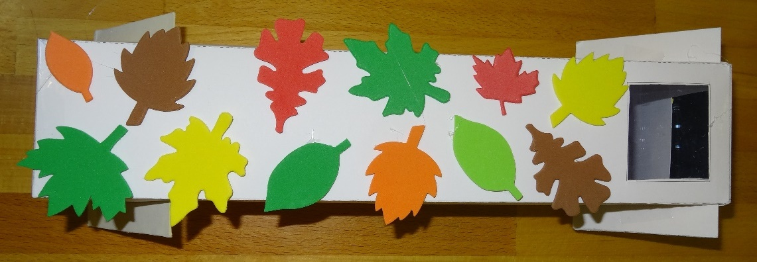
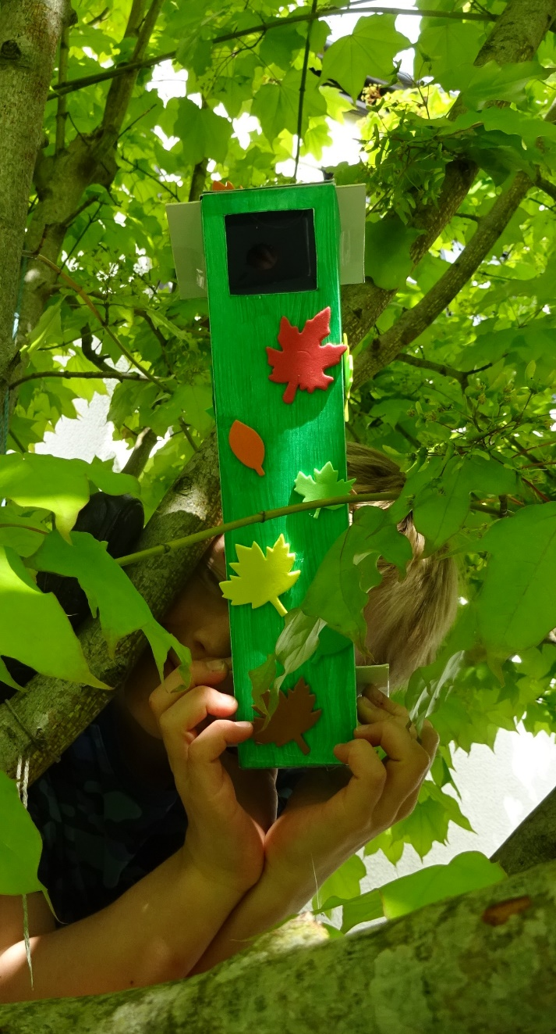
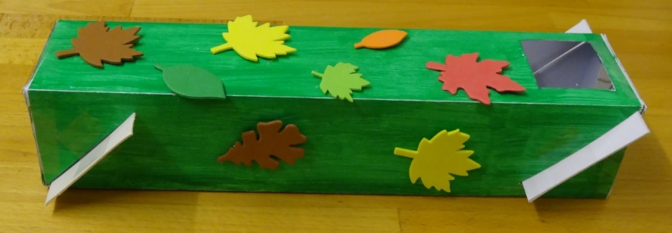
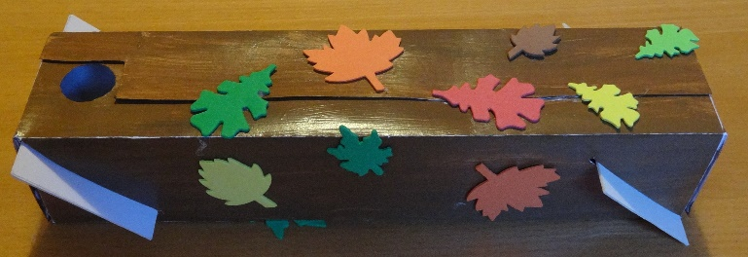
9. Decorate your periscope
Decorate your periscope.
You could use foam leaves to camouflage it.
Suggest situations where you might want a periscope not to be noticed.

Slide 13
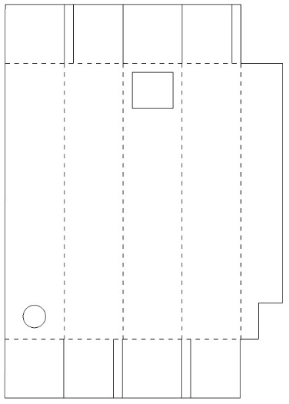
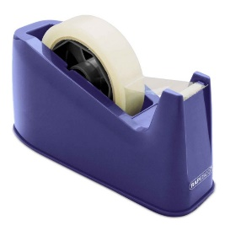
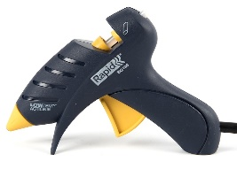
6. Properties of materials
Does a smooth shiny surface or a dull surface reflect light better?
Which of the materials you used reflects light?
Which needs to be stiff? Why?
Which ones are sticky?
Which do you need to be able to cut?
Which do you need to be able to bend?
Mountboard Mirror
Sticky tape
Box template Glue

Slide 14
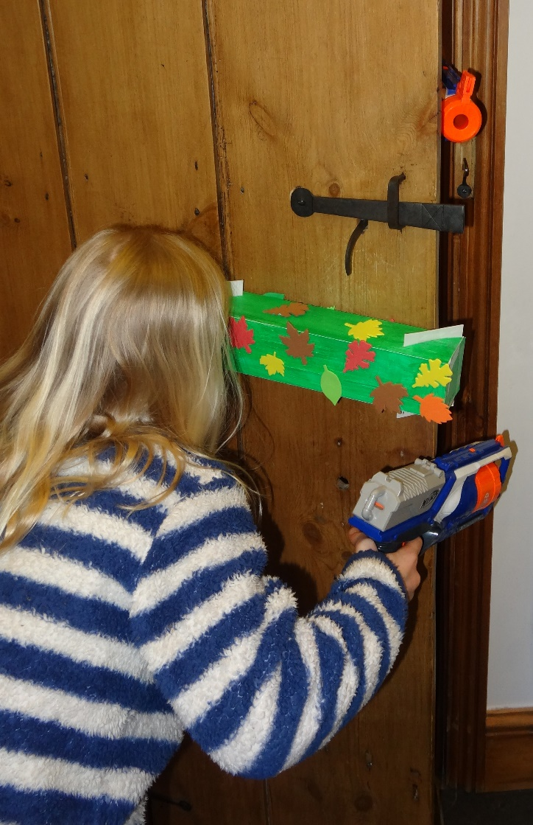
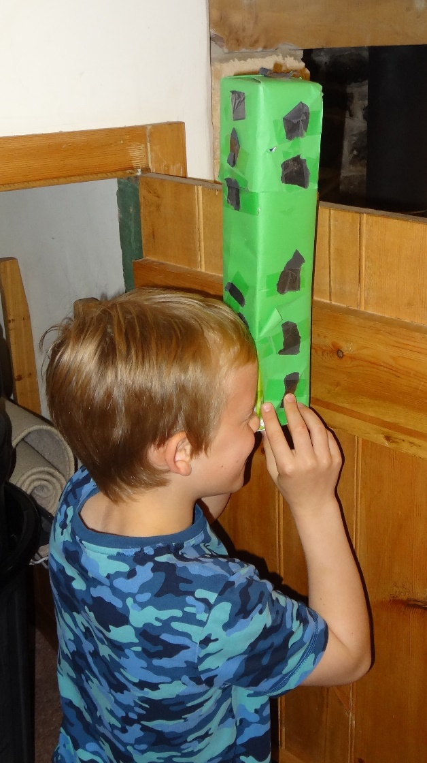
7. Plenary
Discuss how the activity went and what you have learnt.
What difficulties did you encounter and how did you overcome them?
What have you learnt about:
How light behaves?
How you see things?
How a periscope works?
Using materials for particular purposes?
What did you enjoy most about the activity?

Slide 15
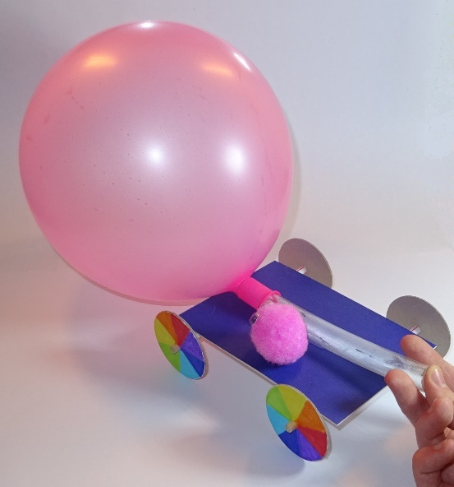
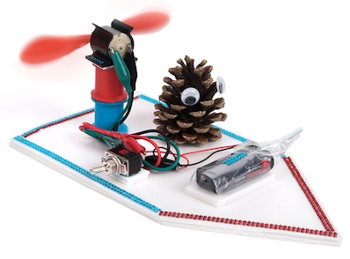
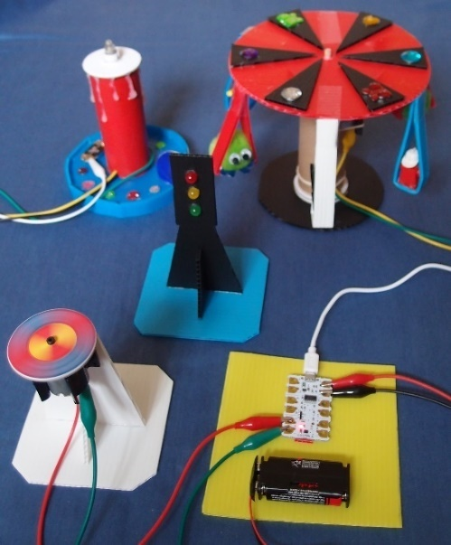
More fun TTS class kits
Balloon buggies Fan boats Crumble kit
Copyright © Caroline Alliston 2018

