Slide 1
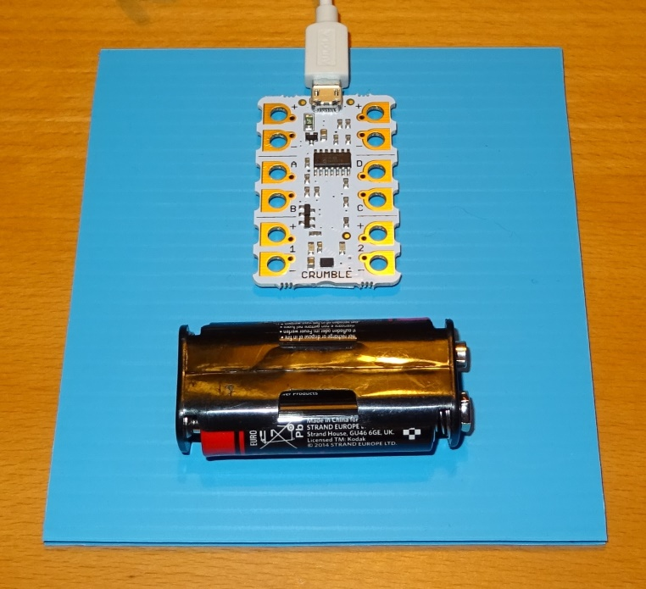
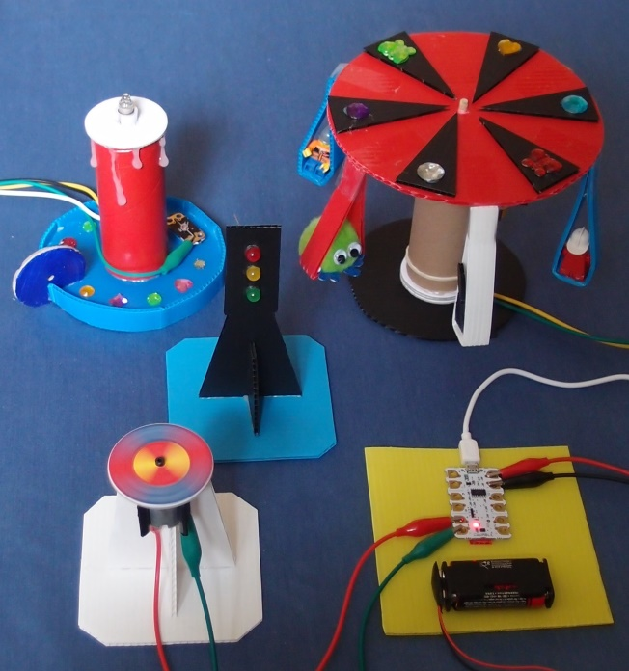
Crumble PowerPoint 1

Slide 2
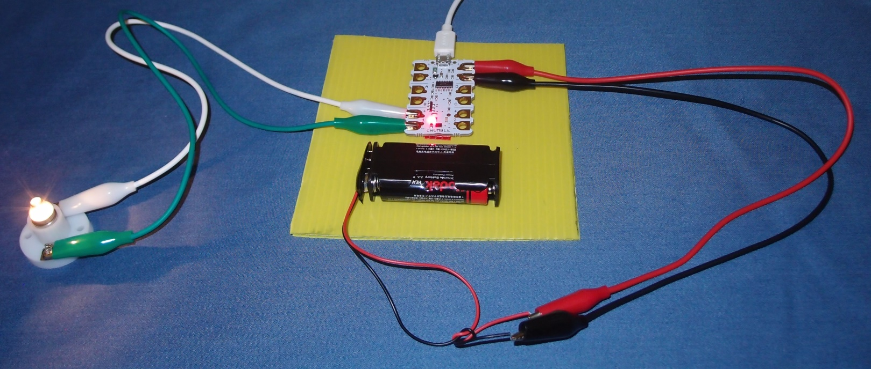
Set up the controller

Slide 3
Learning objectives
Recognise electrical components and their symbols
Identify conductors and insulators
Learn to follow a circuit diagram
Investigate motors, bulbs and LEDs
Create computer programs that control physical systems

Slide 4
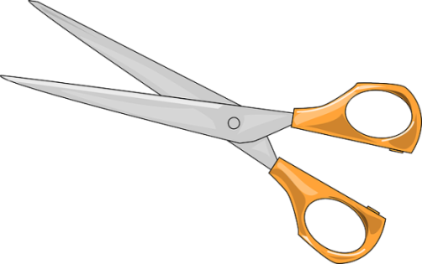
1. Work safely
Look at the tools and equipment. Can you spot any potential hazards?
Can you think of ways to reduce the risks?

Slide 5
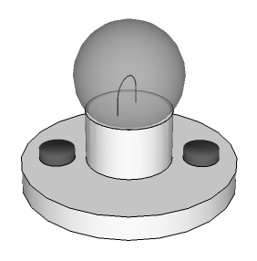
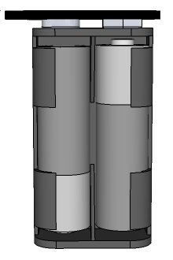
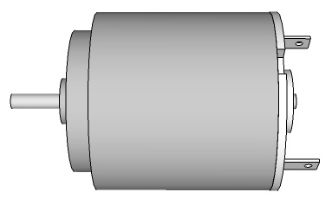
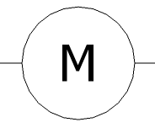
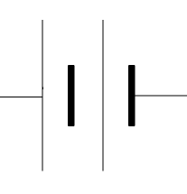
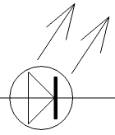
2. Identify the electrical parts
Name these electrical components and their symbols:

Slide 6
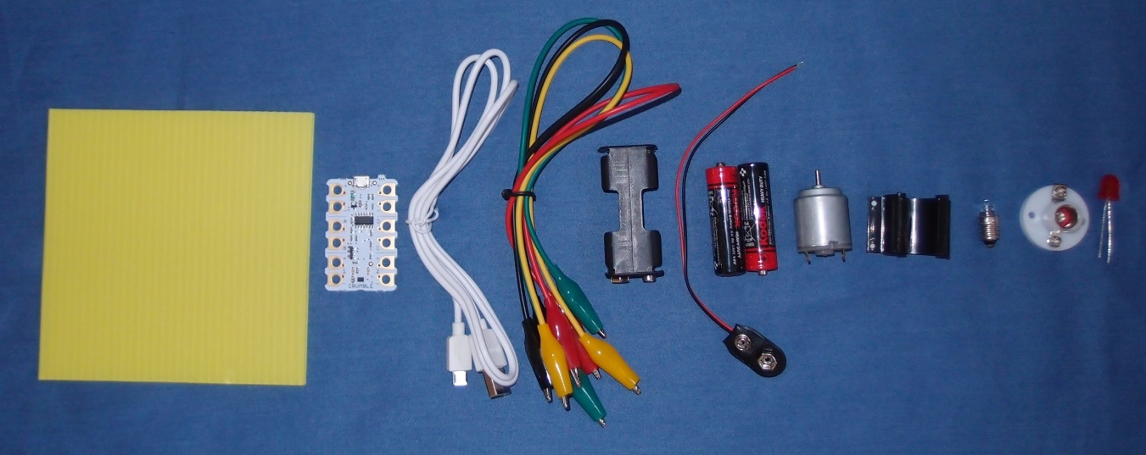
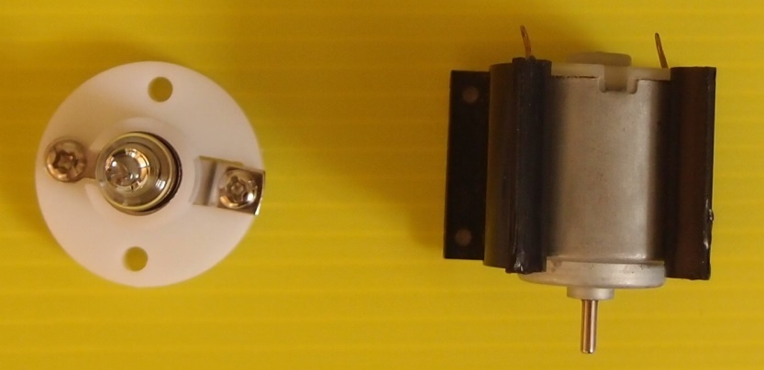
3. Collect your parts
Make sure you have all the parts listed in your workbook.
Screw the bulb into the bulb holder and clip the motor into the motor mount.

Slide 7
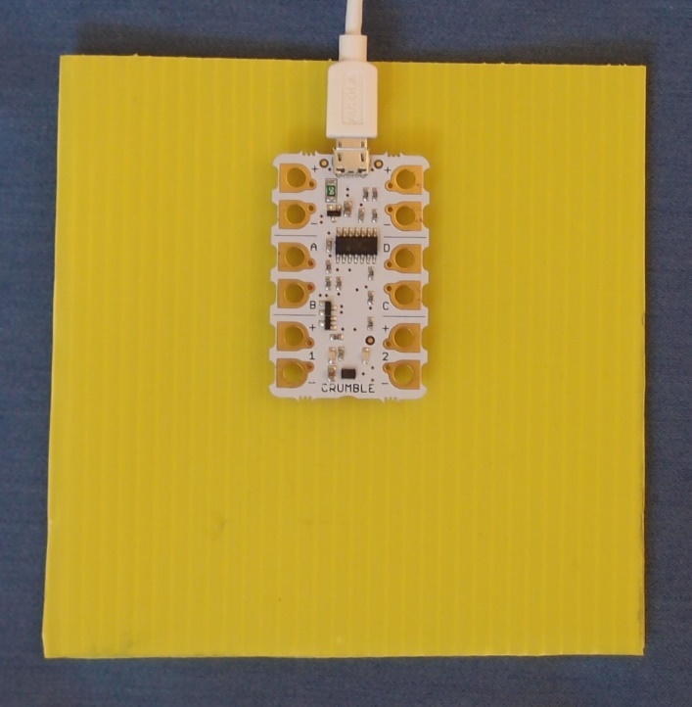
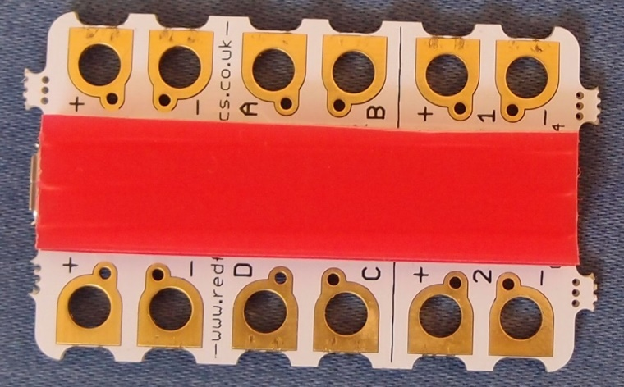
4. Mount your Crumble
Cut a strip of corrugated plastic and use it to attach the Crumble controller to the base.
Connect the controller to the computer with the micro-USB cable.

Slide 8
5. Avoid short circuits
If batteries are ‘short-circuited’ they can get very hot. Do not connect the bare metal ends of the wires from the battery directly together.
Tie the black wire and the red wire from the battery clip in a reef knot. This makes the metal ends point in opposite directions to prevent them touching.

Slide 9
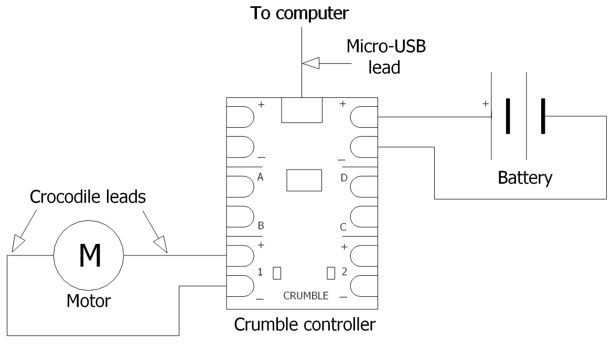
6. Make this circuit
Why do you need to attach your crocodile clips to metal parts, not plastic?

Slide 10
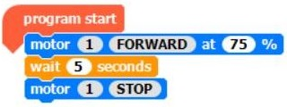
7. Create this program
Drag and drop commands to create this program. Attach each command to the one above. Click on the values show in white to alter them.
Run the program and check the motor shaft rotates. Save it in the Crumble folder. Call it ‘Run motor’.
Unclip the crocodiles from the motor contacts and clip them to the lamp terminals.
Run the program and check the lamp comes on.
Does it matter which way round you connect the lamp?

Slide 11
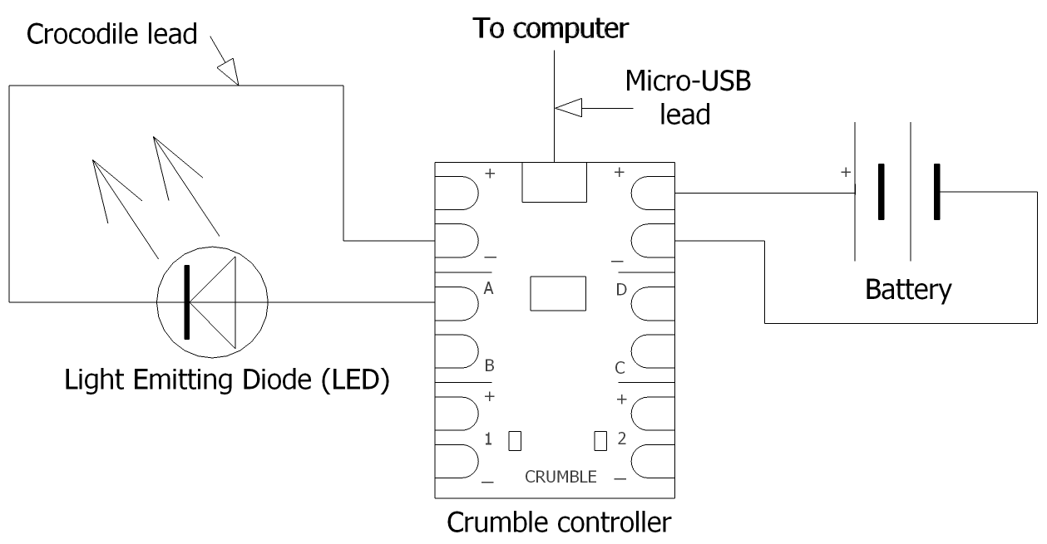
8. Make this LED circuit

Slide 12
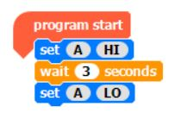
9. Create a new program
Run the new program and check the LED comes on.
Does it matter which way round you connect your LED?
Save your new program in the Crumble folder. Call it ‘Light LED’.

Slide 13
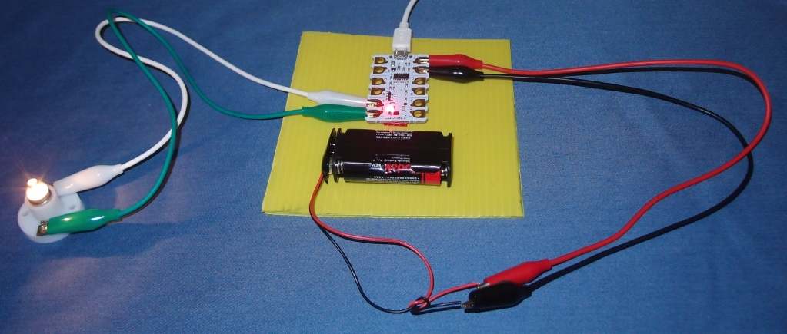
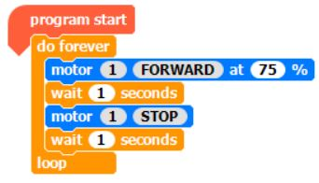
10. Extension activities
Re-connect the lamp circuit.
Alter the ‘Run motor’ program to make the lamp glow more or less brightly.
Try writing a program to make the lamp flash on and off.

Slide 14
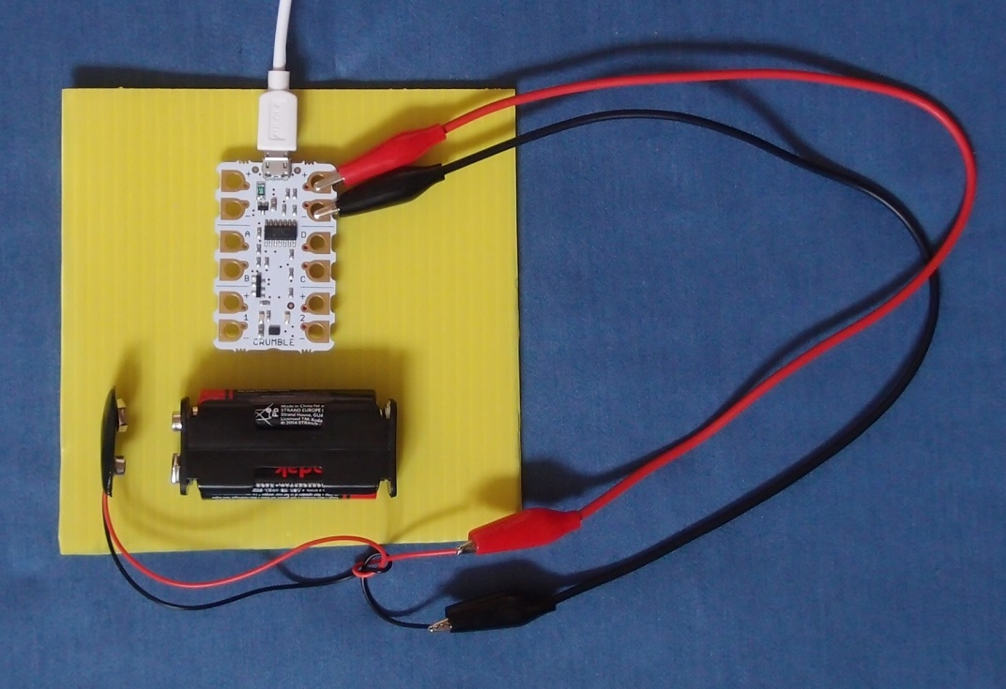
11. Disconnect the battery
Unclip the snap battery connector to avoid draining the battery when not in use.

Slide 15
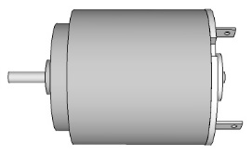
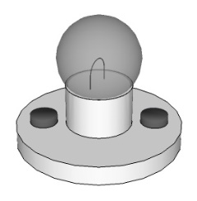
What did you learn?
Why use a symbols in a circuit diagram, instead of drawing the actual components?

Slide 16
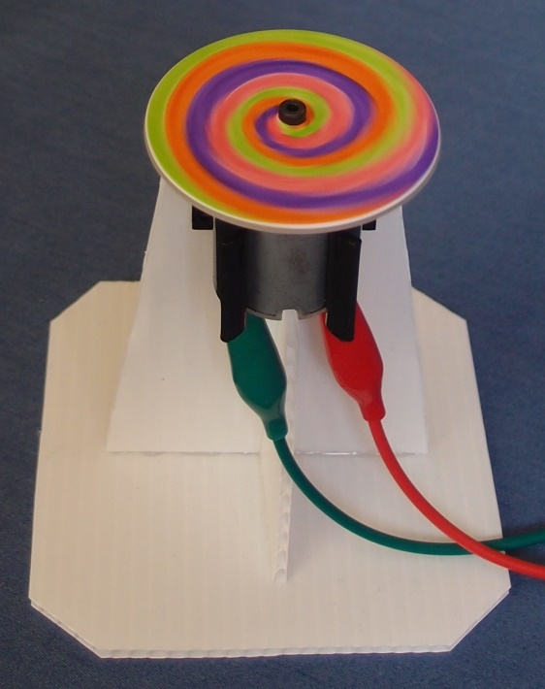
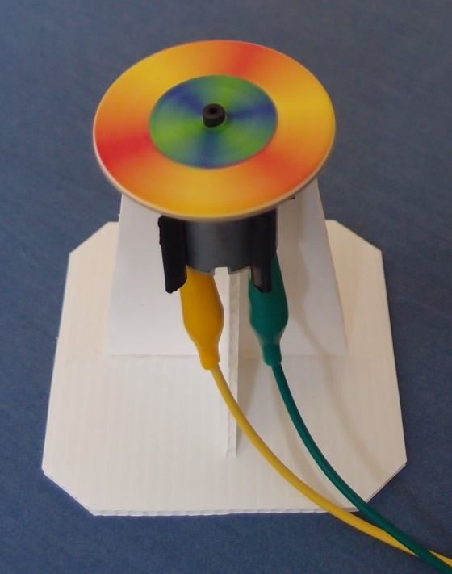
Move on to the next module
Copyright © Caroline Alliston 2017

