Slide 1

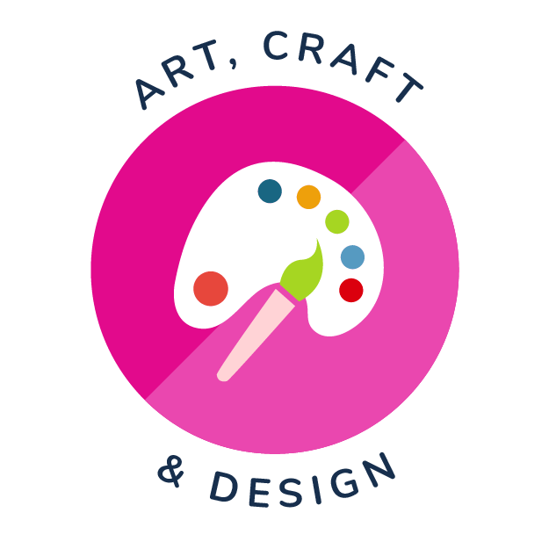
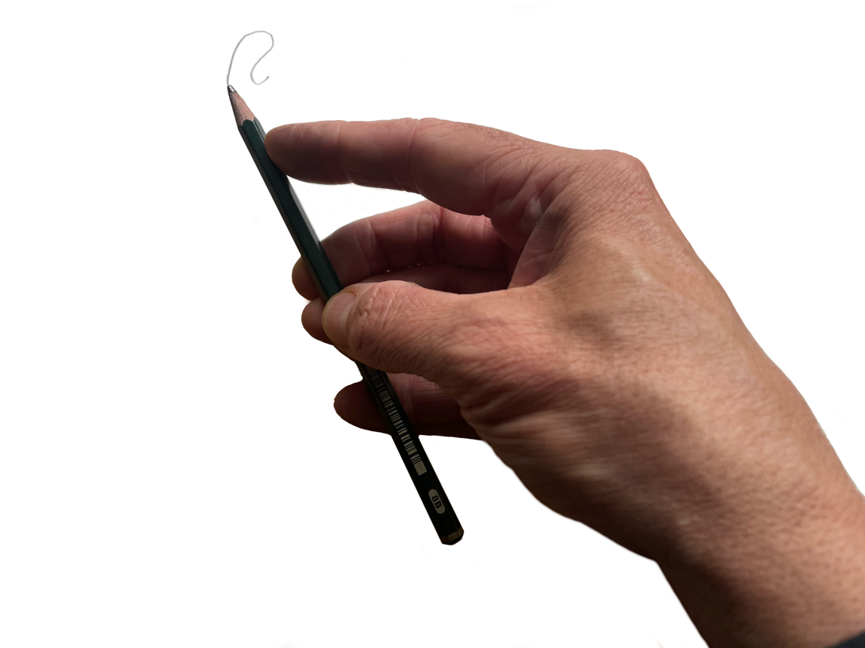
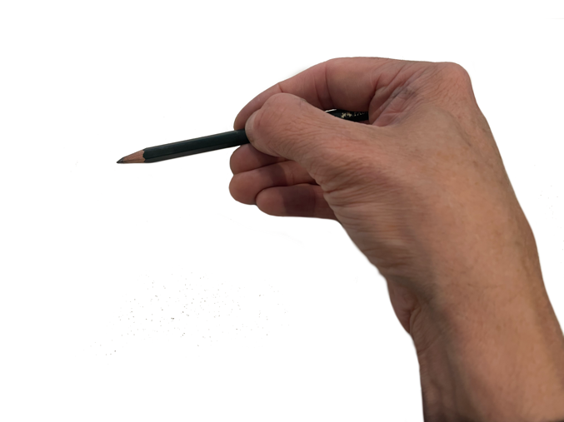
Drawing Skills, Paul Carney
Enjoy reading Paul’s blog on Drawing first and then try these activities with your students.
Overhand Gesture grip used for expressive drawing
Modified side grip, used for shading. See how the fingers are pulled back, out of the way of the pencil, and the wrist is tilted forward so that the pencil is as horizontal to the surface as possible.
Pupils should find whichever way suits them.

Slide 2
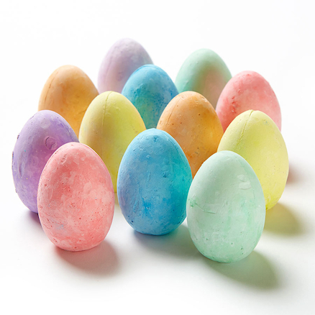
Develop fine motor skills through shading. Start by using charcoal, chalk, pastels and even paint first. Then progress on to using a pencil.
Drawing Skills Shading
Egg-shaped chalks on black sugar paper would be a great way to begin learning uniform shading. I’d even blunt the egg-shaped chalks by sanding them on a pavement, so that the surface they were shading with was larger and made more contact with the paper.
Alternatively, you might use jumbo playground chalk.
Charcoal is also a familiar medium for this kind of work, but make sure you work on sugar paper and use a range of colours for different effects. I preferred buff coloured sugar paper for charcoal, and I would use white chalk to create and blend highlights. A good tip here is to show the children how to grip the chalk or charcoal using the overhand gesture grip. This is where you snap a small piece off the chalk or charcoal and lay it flat on the paper, then grip it a bit like a mechanical crane would grip a log. This grip is very useful for covering large areas and for drawing free-flowing, gestural lines.

Slide 3
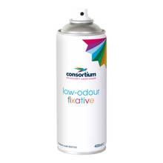
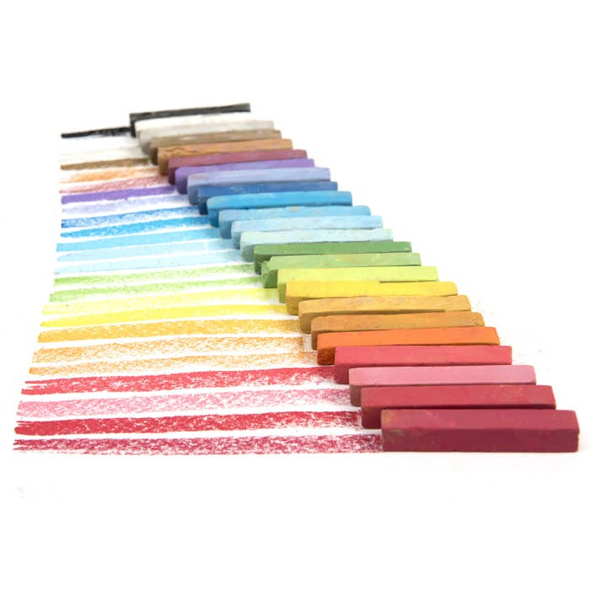
Shading R/Y1
As children move into reception and year 1, use Inscribe soft pastels for the same effect. You can of course use oil pastels in the same way. The main difference is that chalk pastels need to be used on textured sugar paper so that the chalk has something to bind with. They also need to be fixed with fixative as does charcoal.
Oil pastels don’t need fixing and can be used on a wider range of surfaces, which makes them very versatile. However, they are harder to blend than chalk pastels.
All pastels are hard to store though. Once opened or snapped they usually end up in a large box of assorted coloured pieces and often get wasted. Try storing them in small containers separated by colour and you’ll get more use out of them.

Slide 4

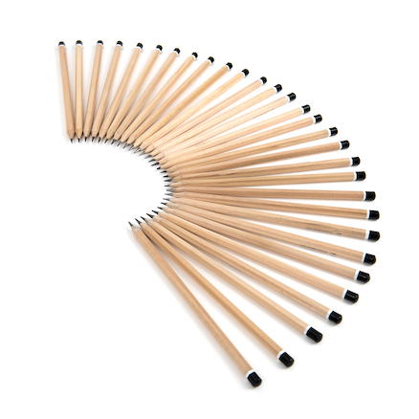
Shading
Progression
As pupils progress, they should learn how to blend mediums to create gradations of tone, and to make hard edges and straight lines. They also should learn when they’ll need both skills. Hard edges are usually created by using the tip of the medium and holding it using the same dynamic tripod grip they use when writing. To get sharp edges, try using a small piece of sandpaper and sand the tip to a point.
Creating gradations of tone usually involves controlling the pressure of the material, especially when using pencil so use soft pencils such as 2B-4B.
You could also try using charcoal pencils or graphite sticks combined with chalk.
You want to demonstrate how to shade using the side of the pencil point or drawing tool, which involves using a modified side grip so the pencil is horizontal to the paper. It’s quite a hard skill to learn this and yet it’s fundamental to being able to draw well. Those that do it easily in key stage one, do so because they’ve almost certainly done lots of colouring books or drawing when they were younger. Essentially, it’s all down to practice and iteration which in turn requires lots of motivation. If pupils enjoy it, they’ll do it again and again. These key aspects of drawing are often thought to be down to some innate talent, when in fact they are usually due to constant practice.

Slide 5
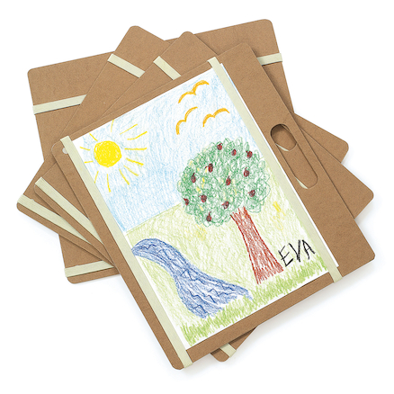
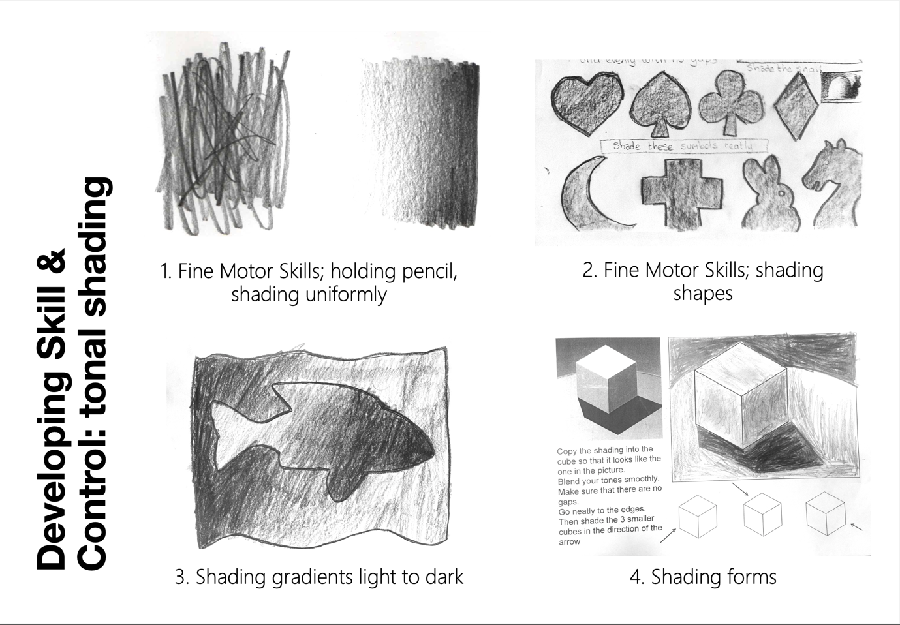
Drawing Skills Shading

Slide 6
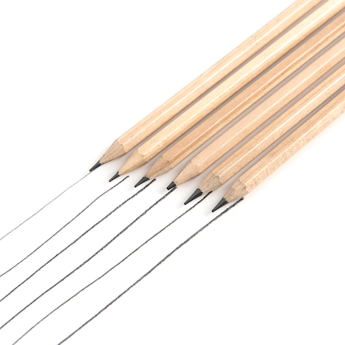
Drawing Skills Lines
Rendering line when drawing is also important. Again, it’s down to fine motor skills, but line work is also strongly linked to the same graphomotor skills we use when writing. Graphomotor skills include not only the mechanical and visual perceptual processes of graphics and handwriting, but also the acquisition of language, spelling and phonetics/phonology.
They require small muscle development in the hands, hand-eye coordination, utensil/drawing tool grip, the ability to make basic marks, lines and shapes, orientation and the ability to cognitively perceive, recognise and plan the production of forms. It sounds so complicated I’m surprised small children learn how to do it, yet they do it all the time, only to differing levels.
Drawing requires the development of our sensorimotor system and motor control to match with our visual input. This visual-motor coordination is what describes our ability to carry out drawings to our intentions. It is what is later described as skill, but it begins with developing those fine motor skills in the Early Years.

Slide 7
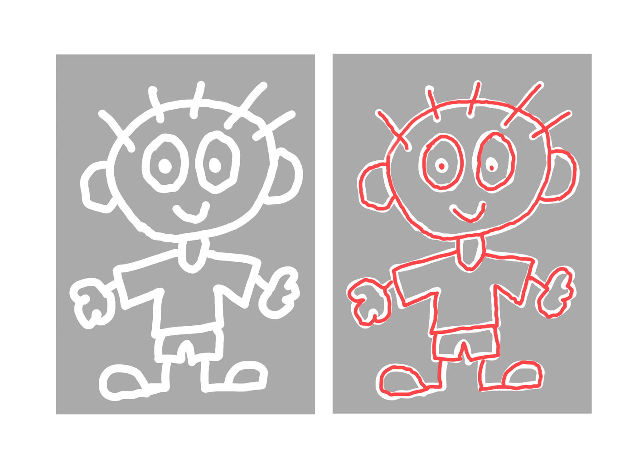
Lines Progression
With this in mind, tracing or copying forms is great practice. Simple shapes are best and getting children to copy their favourite cartoons is recommended because children love doing it so much.
A good technique here is to find some cartoon clip art line drawings then import them into a computer image programme such as Pixlr or Photopea, which are free online. Invert the image then reduce the contrast to a light grey, (it saves on printing!). Print them out and get the children to trace the image by keeping inside the white line. It’s quite difficult to do, but it’s a super way of developing Fine Motor Skills and drawing skills.
You might laminate the images and get the children to draw over the laminate using fibre tip or washable pens. There’s no age limit on using this technique because you can simply make the images more complex or simpler, depending on your pupil’s ability.

Slide 8
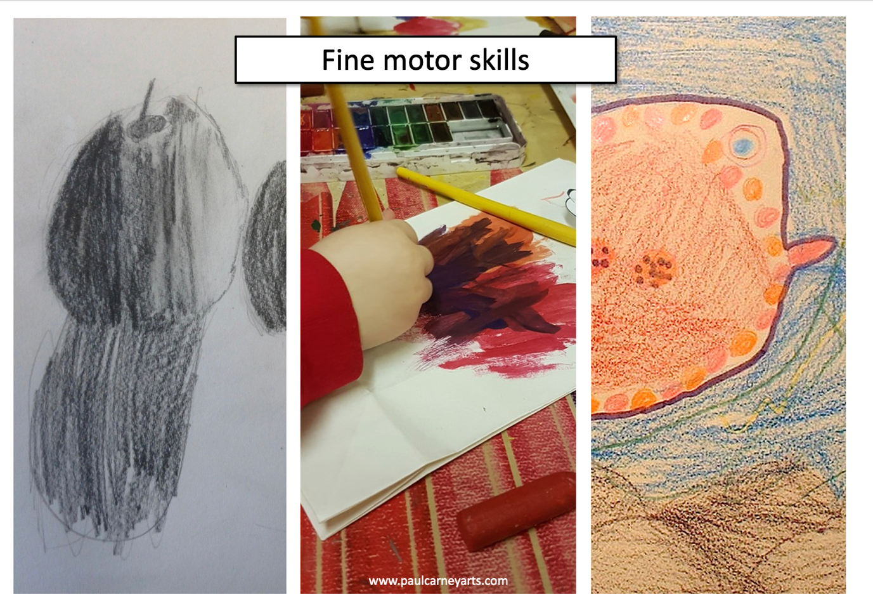
Fine motor skills overlap between skills areas. You aren’t teaching different skills, but rather the same skill in different guises. Also, FMS development continues into adulthood. It isn’t only an EYFS skill.
Drawing Skills
Fine motor skills exercise

Slide 9
Many thanks to Paul Carney
www.paulcarneyarts.com
Drawing Skills
I hope these techniques help you understand that the development of drawing isn’t a series of distinct, separate skills, but rather it relies on the development of a small set of key practical techniques. These techniques are largely dependent on the fine motor skills we use across the curriculum and the same graphomotor skills we need for handwriting. In this way, learning is more connected than it appears. Everything is part of a much bigger whole. When you understand that, it hopefully becomes much easier to master.
Be sure to read Paul’s second blog about Painting.

