Slide 1


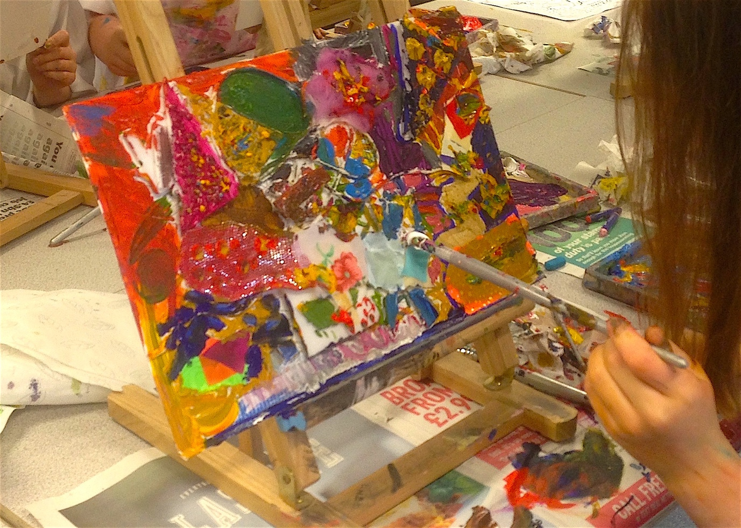
Ideally you want to be doing painting exercises that develop both fine and gross motor skills.
Painting Skills, Paul Carney
Enjoy reading Paul’s blog on Painting first and then try these activities with your students.
To utilise gross motor skills more easily remove chairs and make the children stand up when painting. This will get them using their whole arm and even bodies when painting. If pupils are sat at desks, they are viewing their painting surface at a 45-degree, head-height angle, and only working from their wrist, or at best, elbow. This restricts the kinds of brush strokes they can make.
You want them to paint from their shoulder, to use their whole arm, and taking the chairs away does just that.
If you have some additional budget, or sources of revenue, you can buy desktop easels that solve the motor skills problem nicely, because they enable pupils to paint vertically, and so use their whole arm. If you can’t afford easels, then prop a drawing board up against something such as a wall.

Slide 2
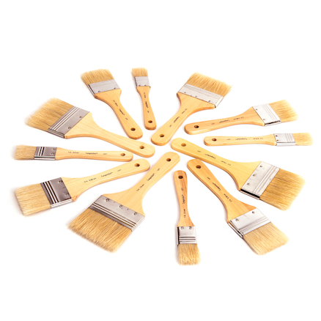
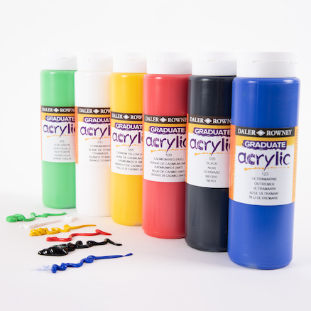
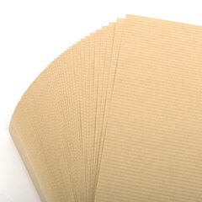
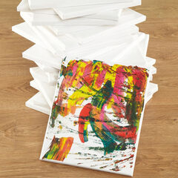
Painting Resources
When painting at easels or standing up, I would use:
      Daler Rowney Systems Acrylic paints
Hog hair or bristle brushes
Heavy paper 130/140gsm
Canvas
Brown paper
Oh, and don’t forget to use those all-important aprons to protect uniforms.

Slide 3
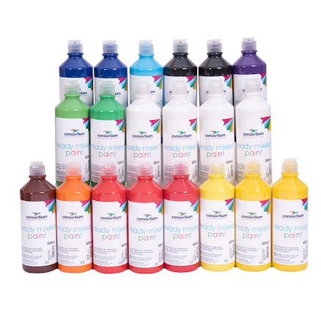
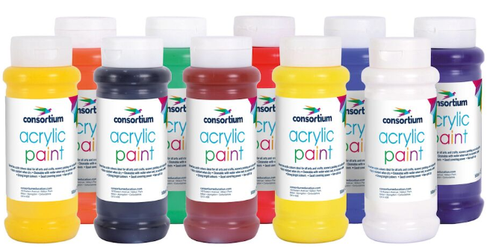
Ready Mixed
Choosing the paint
Acrylic Paint
You can use ready mixed or powder paint. I found it difficult to get good results from these, but other teachers love them. A difficulty I have with them is that, in the case of powder paint, the range of colours is limited. Also, it’s harder to get good results using ready mixed paint because it is too translucent - it doesn’t quite cover surfaces as smoothly as acrylic paint does. This makes it difficult to build layers of colour.
When painting you’re very often trying to capture the solidity of form, as in still life or landscape painting, or you want to show illumination or light. Decent acrylic paints are opaque, so you can add light colours over dark ones and build form that way.
Watercolour paints depend on their translucency, and it’s this property that makes them my favourite paint to use on a day-to-day, classroom basis. Their translucent nature allows the under drawing to show through (so long as you don’t mix it too thickly), so even if the pupil makes mistakes, they don’t spoil their work. This is a significant issue with primary school painting and leads to a lot of frustration on behalf of the pupil. They develop the (mistaken) belief that painting spoils their drawing, when really, it’s because of using the wrong type of paint and brushes.

Slide 4

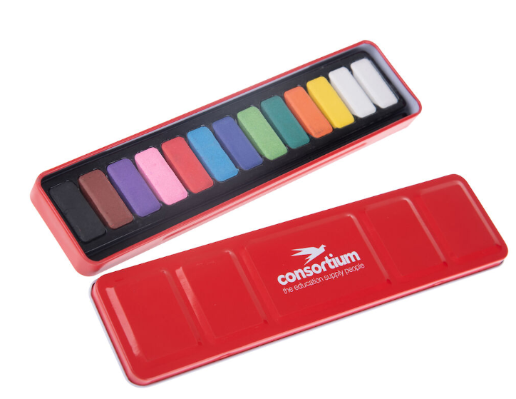
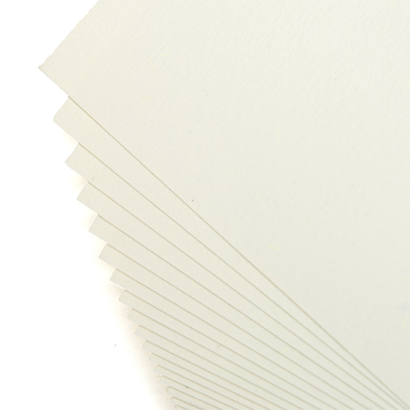
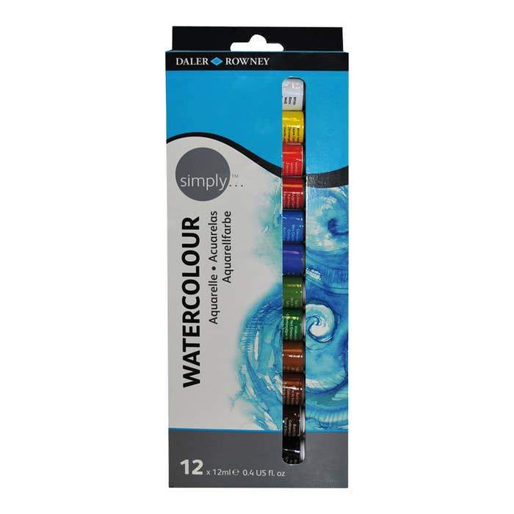
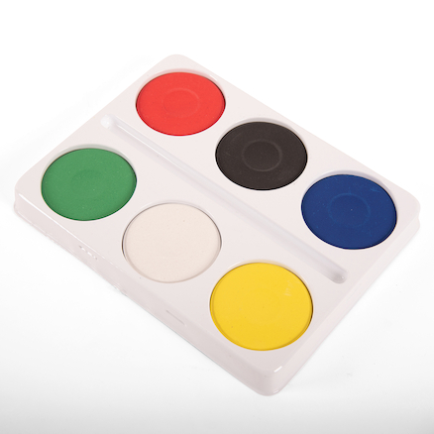
Watercolours
When you are using watercolour, you must leave the white paper blank to create highlights. You must paint from light to dark for this reason - to plan out the lightest areas before you begin painting. The reason watercolour paint is preferable over ready mixed paint is that it lays on the surface of the paper better. Ready mixed leaves streaks or blotches and so is harder to apply. You should try out different paint types, paint with them, see what they can do, record what their properties are and so be able to work out which paint type works best for the subject you’re painting.
The red tins of watercolours have become ubiquitous in primary classrooms, but to be honest I mostly used block paints in as a teacher in block palettes. They go further and so are more cost effective, but like powder paints, it’s difficult to get the full range of colours you need for painting. To this end, it really is worth investing in some tube watercolour paints. They will really improve the quality of your pupils’ painting, especially when using watercolour cartridge paper.

Slide 5
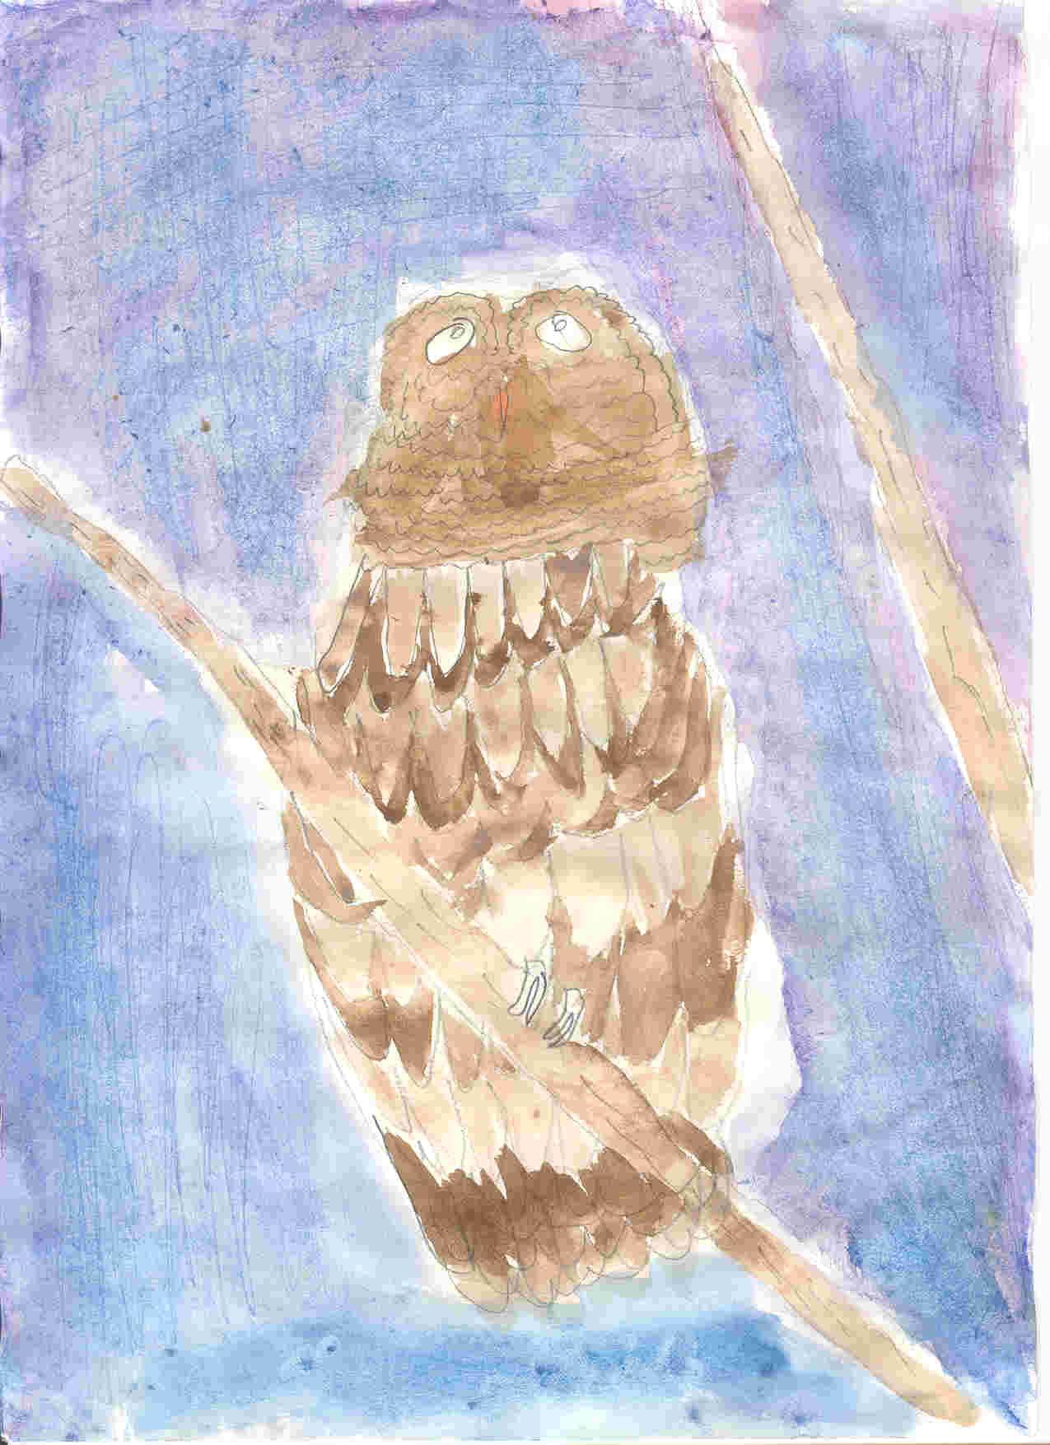
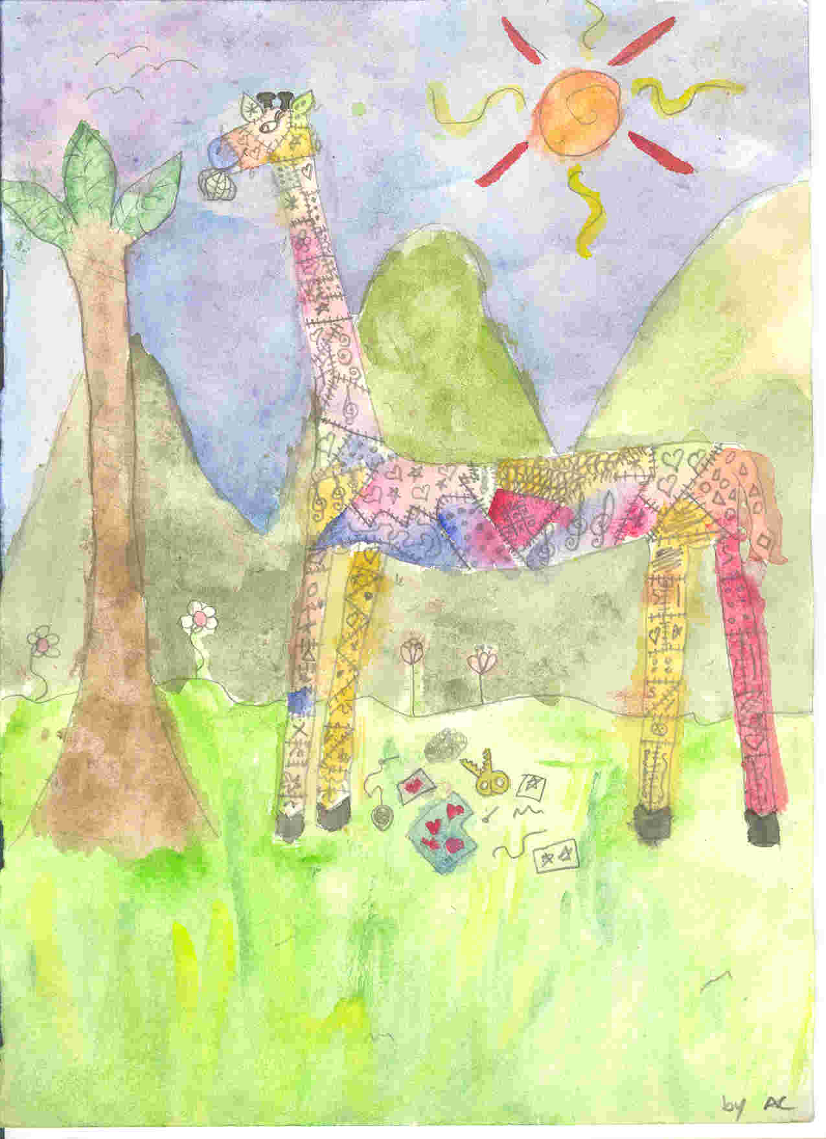
Watercolour painting Year 5. Inspired by Spike Milligan poetry
Watercolour Painting

Slide 6
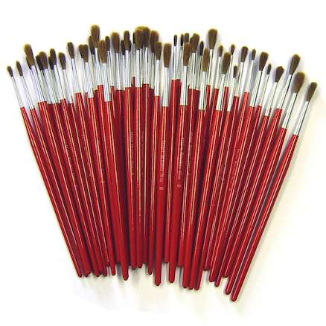
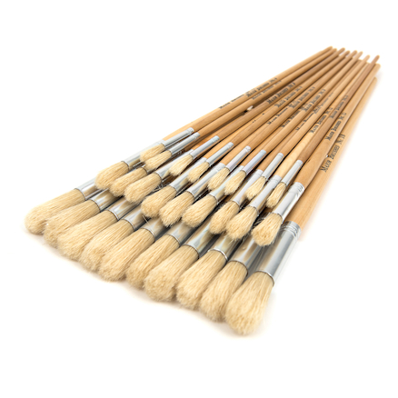
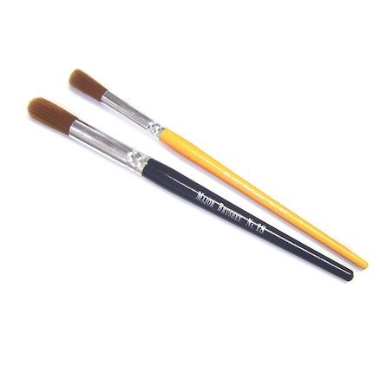
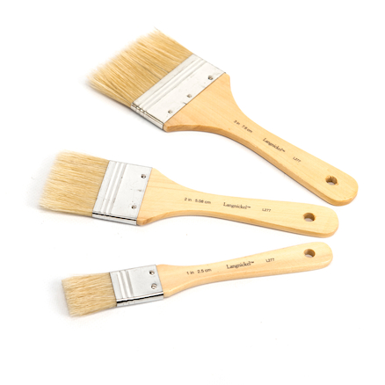
Choosing the brushes
Painting high-quality lines and shapes is very dependent on the brush you use. It may sound obvious, but to paint a thin line you’ll need a thin brush and to paint a large shape or area you’ll need a large brush, yet I regularly see children using the wrong size brush for the job. I like to buy sable substitute brushes for watercolour and general-purpose work. They hold their shape well and come in a range of sizes. I use size 0 for fine line work, size 4’s and size 10’s. For large areas you need larger brushes, and you could use your hog hair brushes, golden nylon junior brushes, or use a large area brush.

Slide 7
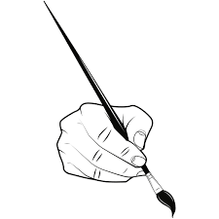
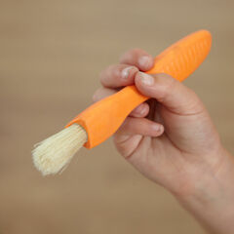
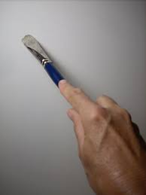
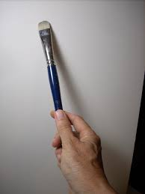
Paint brush hold
Most often, pupils will hold the brush using the same tripod grip they use for writing, but you can vary the way pupils grip the brush easily which can lead to a wide range of expressive mark making. Holding the brush further away from the metal ferrule usually leads to greater expressive brush work, because the artist has less control over the brush. Conversely, holding it closer to the bristles increases control. Good brush control helps us paint straight lines (using the side of the brush), and accurate details (using the tip). Brush control enables us to paint smooth, flat areas of colour or graduated tonal teas from light to dark. This is always learned through repeated practice, but I find that painting colouring pages is an effective, highly-motivational way to learn brush control. There are so many brilliant colouring pages these days, and essentially, they are a scaffolding mechanism to develop fine motor skills.

Slide 8
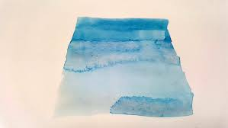
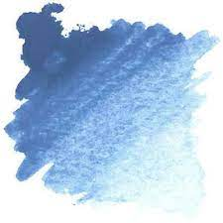
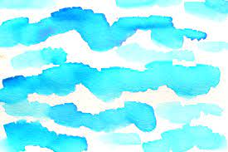
Painting Techniques
There are also many different painting techniques you can use, depending on the type of paint you’re using and the surface you’re working on. If you’re using watercolour paint, then you should teach pupils how to apply a watercolour wash. This isn’t something we master on our first attempt. It takes a lot of practice. To do it, you need to mix a small amount of paint with around three times the quantity of water in a palette. Then, using a wide brush, begin applying the paint in smooth, horizontal strokes across the page, blending the brush strokes as you go, so there are no brush marks showing. It’s the default technique for painting skies of course and you’d use a graduated wash where the tone gets lighter the closer it gets to the horizon. As I say, it’s not easy to do. I’ve seen year 4 and 5 pupils do it quite well, but year 11 students still struggle, so it isn’t easy. This same principle is used a lot when watercolour painting to blend tones and create lighter and darker areas

Slide 9
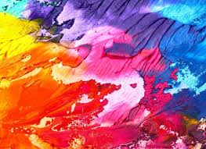
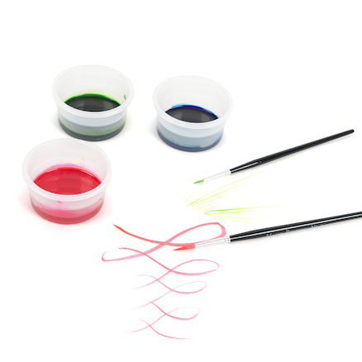
Creating Texture
Often, you want to create textures when painting. Depending on the texture you’re creating, you’ll use a combination of brush technique and paint type to create it.
The dry brush technique is where you use a small amount of paint on a coarse, textured brush and dab it over a base colour. You can use the dry brush technique using any type of paint, but it’s most often used with acrylics.
Pupils should learn how to create a variety of textures and I always link these to an artist’s technique.
Contemporary artists such as Anselm Kiefer and Frank Auerbach, used impasto techniques of painting with thick acrylic paint. Impasto uses a lot of paint and so is expensive, but you can thicken your paint with cornflour to save money.
Rembrandt, Corot and Lucien Freud used expressive, gestural brush strokes.
Van Gogh and the Post-Impressionists used directional brush strokes.
Signac, Seurat, and Pissarro used dabbing, Pointillist techniques.
Chinese and Japanese artists painted beautiful, gestural lines and textures using inks.
There is a lot to learn from how artists painted, how they used they brush and how they mixed colours.

Slide 10
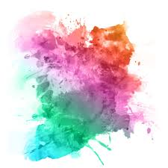
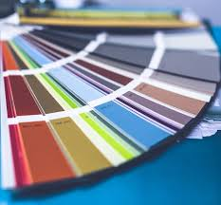
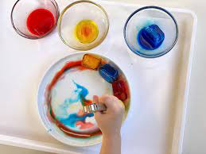
Colour Mixing
Colour mixing lessons, including learning colour wheels are common in both primary and secondary schools. I used them myself, but over time I used them less frequently because, if you provide the right colours then colour mixing is obvious and inevitable.
Through colour wheels and via paint manufacturers and suppliers, children come to believe that ‘brilliant’ colours are the ‘proper’ versions of the primary colours. However, that’s not true. Hues of colours lie within a wide spectrum and brilliant colours are just one variation of many.

Slide 11
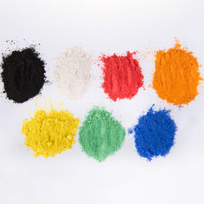
Colour Mixing continued
To teach colour mixing, I would only usually buy primary-coloured paints. That way, pupils have no choice but to learn how to mix them to create secondary colours. I would buy brilliant primary colours, along with sky blue, cobalt blue, crimson, lemon yellow and yellow ochre. Along with black and white, this would give pupils a full range of primary colours from which they could create unlimited secondary hues. You can then provide creative, open-ended colour mixing tasks that stimulate learning, such as painting the huge variety of greens in plants or jungle scene, or the vivid range of reds, yellows and oranges in flames, or the beautiful violet and purples a bouquet of lavender. You learn colour mixing by observing nature and learning from artists.

Slide 12
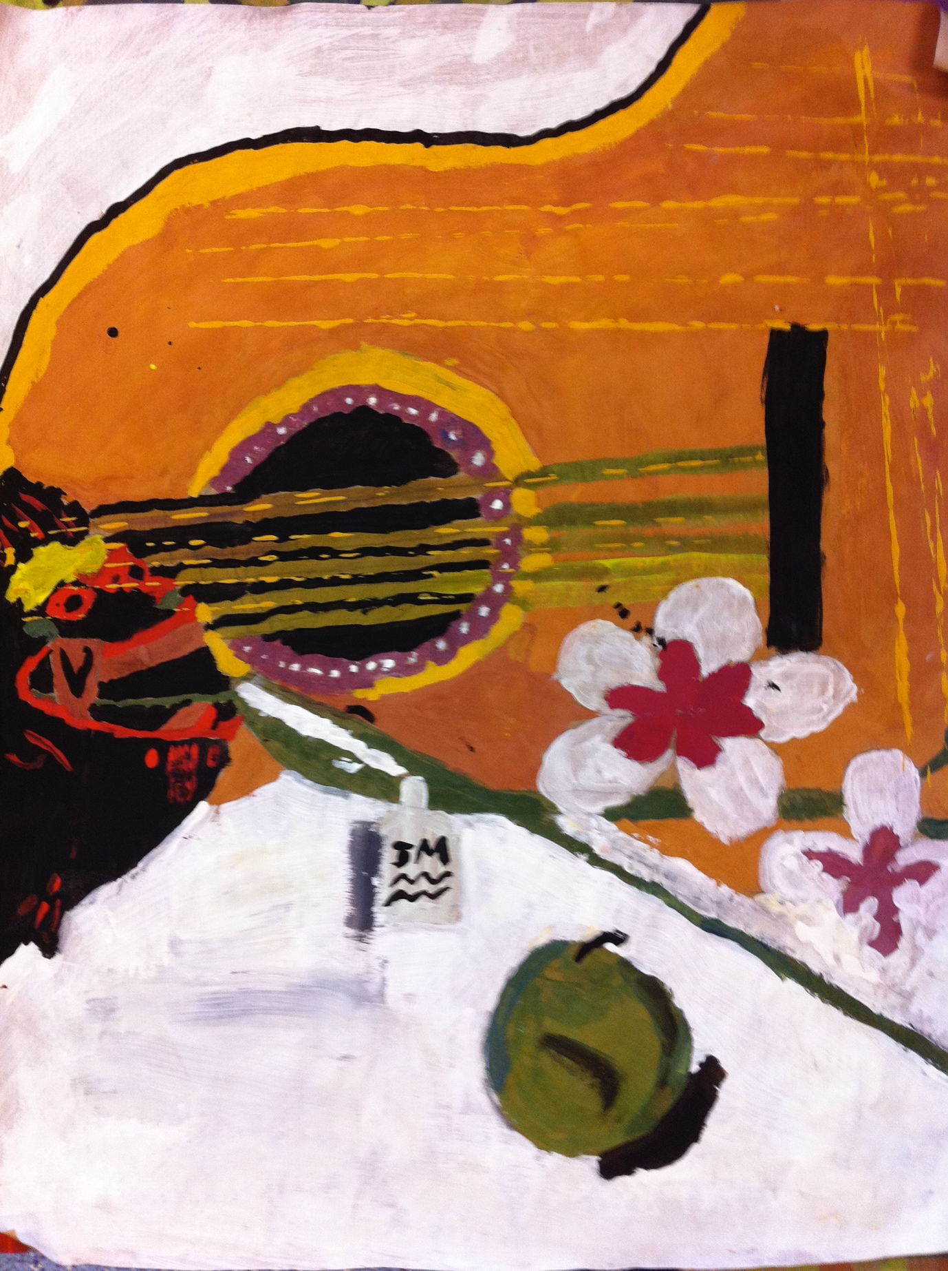
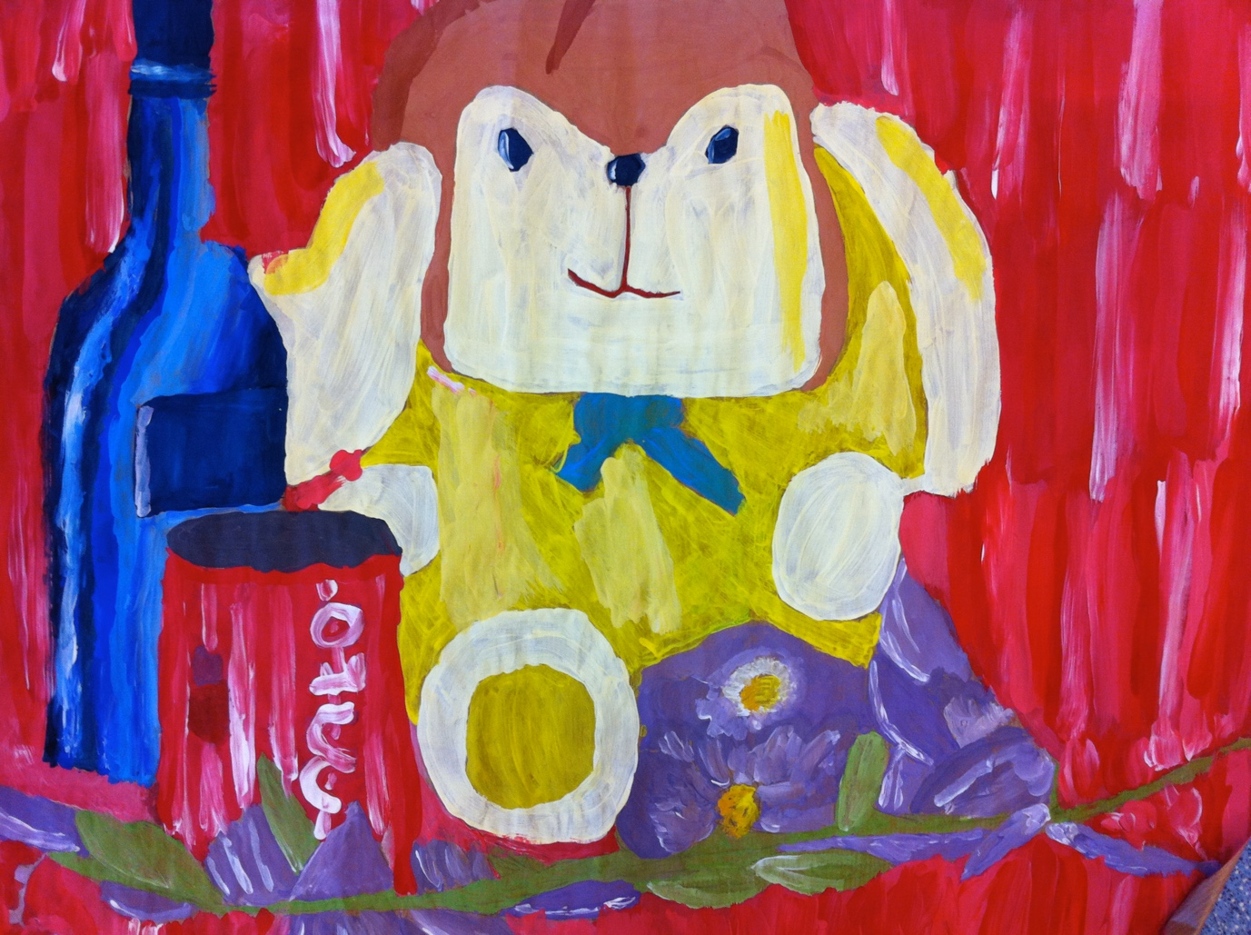
Still life painting from observation.
Acrylics on brown paper, year 8
Still Life
Many thanks to Paul Carney www.paulcarneyarts.com
Be sure to read Paul’s third blog about Sculpture.

