Slide 1
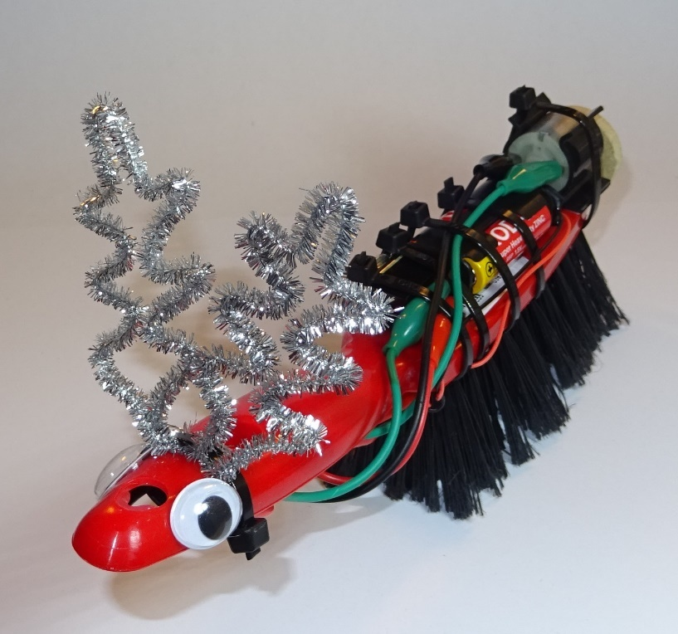
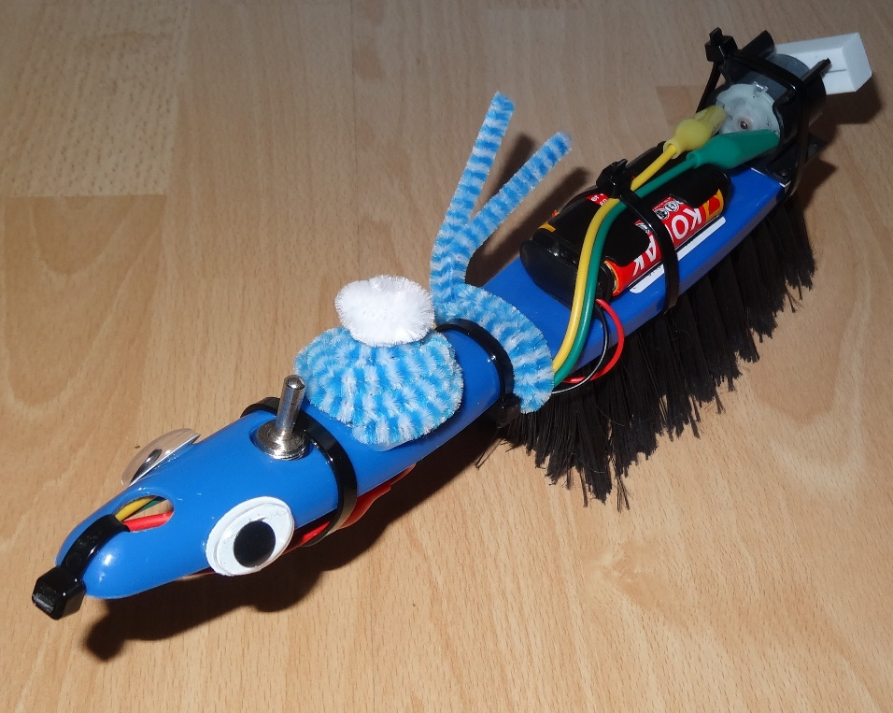
Brush Monsters PowerPoint

Slide 2
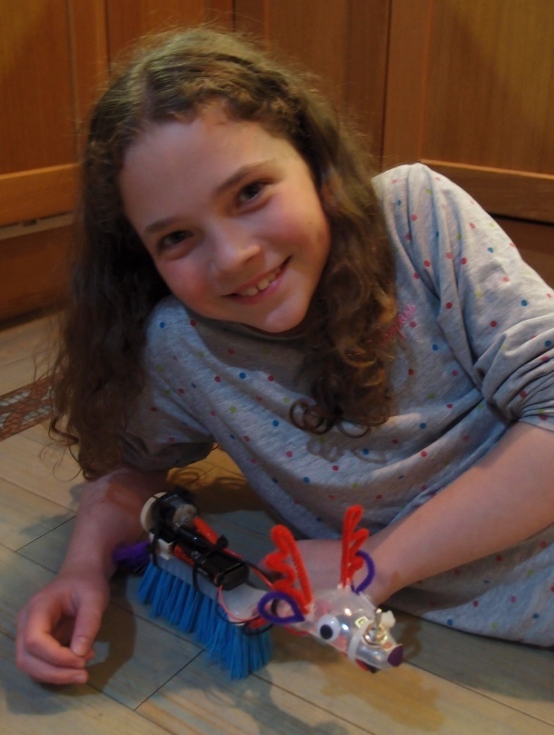
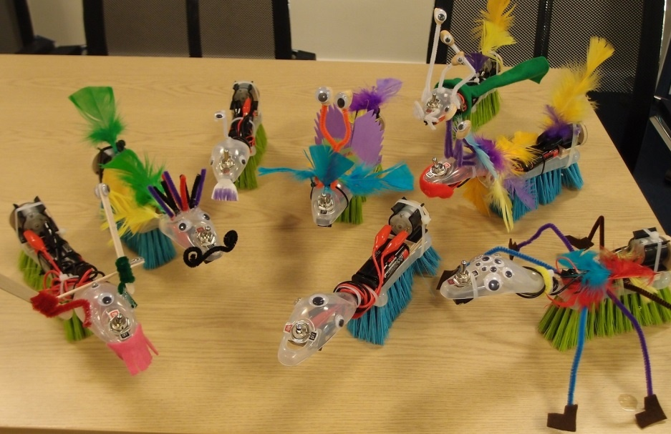
Make and test a brush monster

Slide 3
Learning objectives
Science – construct a simple series electrical circuit
Technology – understand and use electrical systems in products
Engineering – build, test and troubleshoot products
Maths – measure distance and time, calculate average speed
Discover how much fun STEM can be!

Slide 4
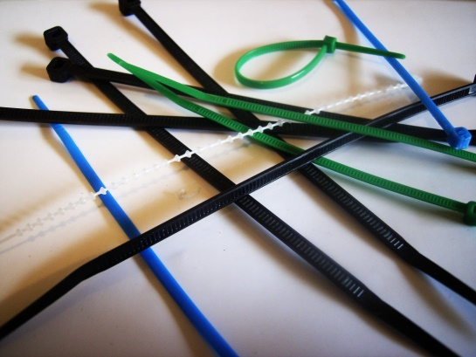
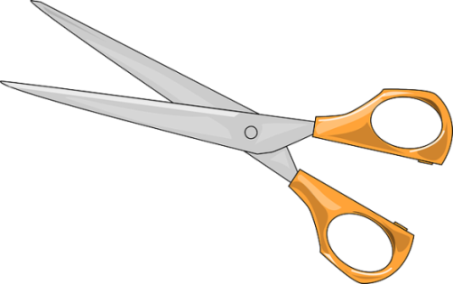
1. Work safely
Look at the tools and equipment provided. Can you spot any potential hazards?
Can you think of ways to reduce the risks?

Slide 5
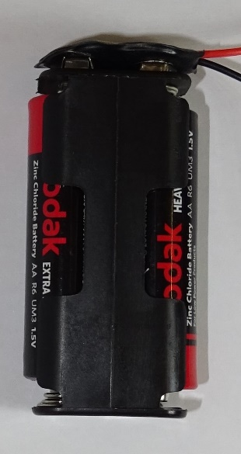
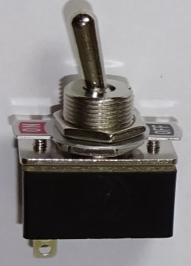
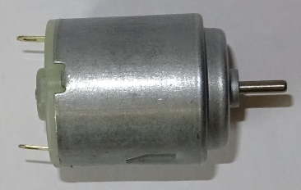
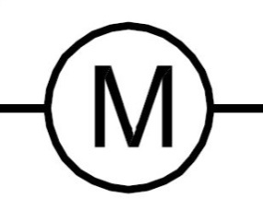
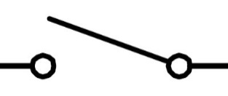
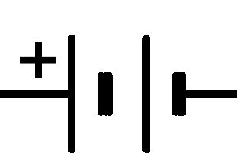
2. Electrical parts
Name these electrical components:

Slide 6
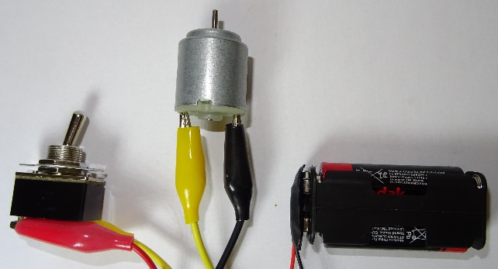
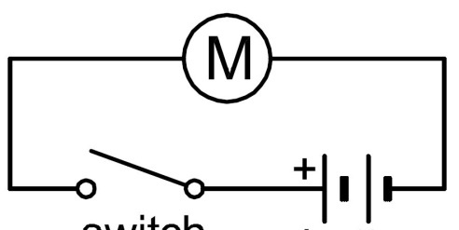
3. Electrical circuit
You will make this electrical circuit:
Using circuit symbols makes it easier to draw:

Slide 7
4. Avoid short circuits
If batteries are ‘short-circuited’ they can get very hot. Do not connect the bare metal ends of the wires from the battery directly together; they must be connected across the motor. Also:
Tie the black wire and the red wire from the battery clip in a reef knot to stop the bare ends touching.
Make sure the plastic sleeves cover the crocodile clips as shown here, to help prevent short-circuits if the clips touch.

Slide 8
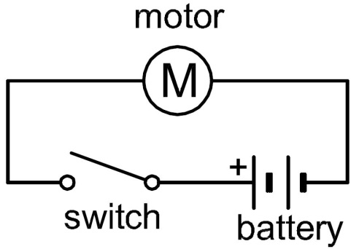
5. Make your circuit
Collect your electrical components
Tie the black and red wires from the snap battery connector in a reef knot then push the connector firmly onto the battery holder.
Lay out your components in a triangle and connect up the circuit.
Clip crocodile leads onto bare metal, not onto plastic insulation!
Fit the cells into the battery holder (the right way round). Switch on and check the motor shaft rotates, then switch off.

Slide 9
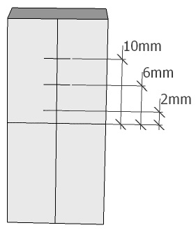
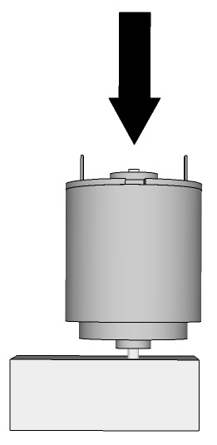
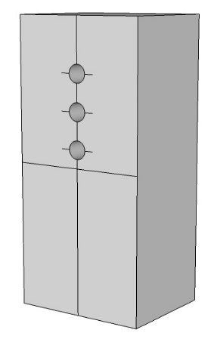
6. Prepare your eraser
Draw centre lines across the eraser as shown (the opposite side from the TTS symbol)
Mark lines 2mm, 6mm and 10mm from the short centre line.
Unclip the crocodile clips from your motor.
Lie the eraser flat and use the motor shaft to make holes at the 3 positions you marked. (Push down hard on the back of the motor, avoiding the terminals)
push down

Slide 10
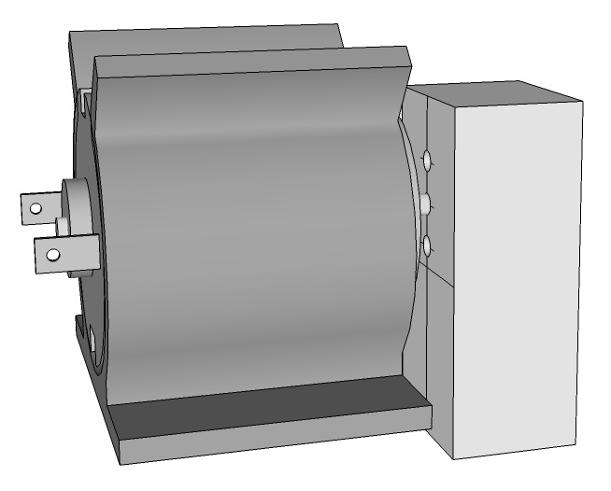
7. Prepare your motor
Remove the eraser and push the motor forwards into the motor mount (not from above as it can break the motor mount).
Make sure the back of the motor lines up and the front sticks out a little.
Rotate your motor in its mount until the two terminals are at roughly the same height.
Push the motor shaft into one of the holes in the eraser.
push this
way

Slide 11
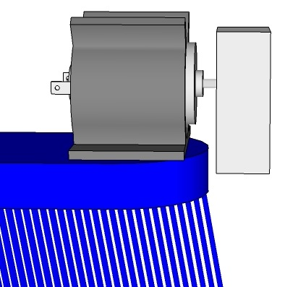
8. Fit your motor
Remove the plastic film from the bottom of the motor mount and stick the mount onto the brush, leaving about a 6mm gap to the end of the brush.
Make sure there is a gap between the eraser and the brush as shown.
Turn the eraser all the way round with your finger.
What would happen if the eraser hits the brush?
gap

Slide 12
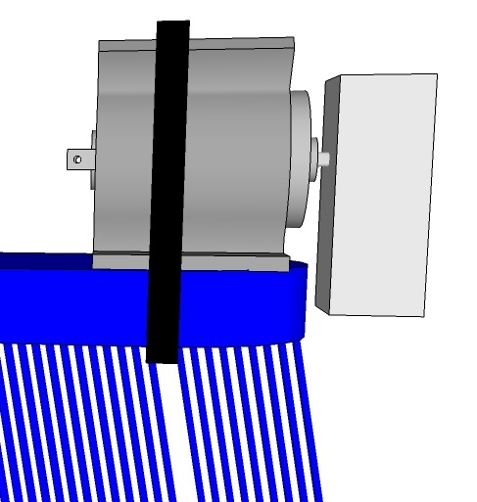
9. Attach your motor firmly
Your components will be subject to a lot of vibration, so if they aren’t firmly attached they will work loose.
Carefully feed a cable tie through the brush between the bristles as shown. Try to find a gap to avoid distorting the bristles too much.
(N.B. If the cable tie is placed too near the end of the brush it will slide off.)
Use the cable tie to attach the motor assembly firmly to the brush, pull it very tight then cut off the loose end with scissors.

Slide 13
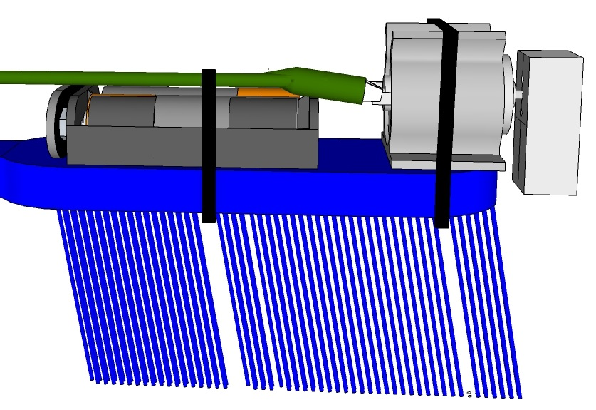
10. Attach your battery
Place your battery holder on your brush, with a gap between this and the motor.
Re-attach the crocodile clips to the motor terminals.
Ask someone to hold the battery holder and crocodile leads on while you cable tie them both firmly to the brush.
Try not to distort the bristles.
leave gap

Slide 14
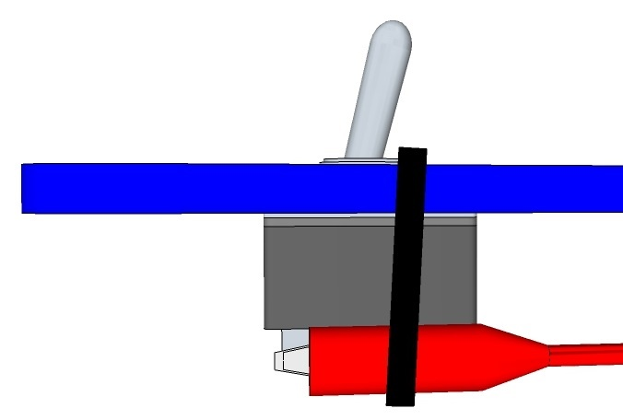
11. Attach your switch
Unscrew the first nut from your switch and remove the label. Your teacher will tell you where to put the nut and label.
Push the switch body up through the larger hole in the brush handle with the terminals facing the end of the handle.
Adjust the crocodile clips so they lie flat along the switch.
Ask someone to hold the switch while you cable tie both the switch and crocodile clips very firmly to the brush handle.
end of handle

Slide 15
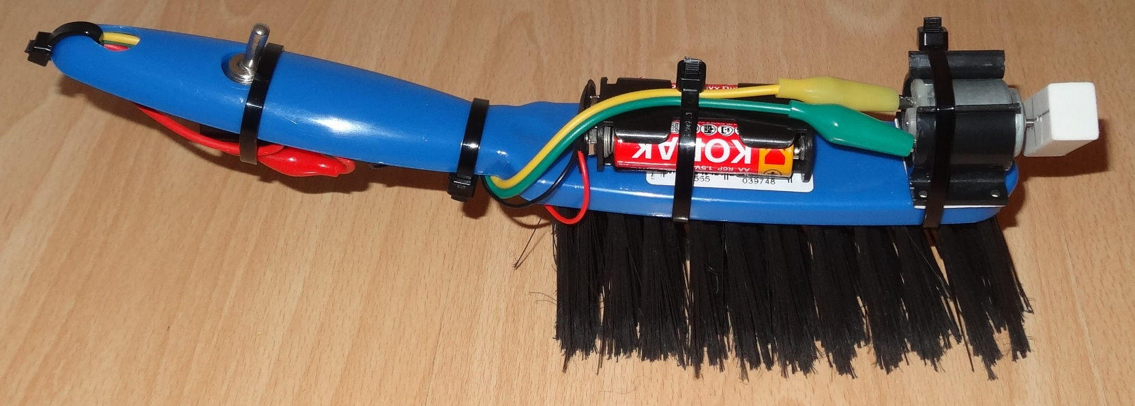
12. Tidy up the crocodile leads
Check there is still a gap between the eraser and brush end.
Switch on and check the eraser rotates, then switch off.
Tidy up the crocodile leads and cable tie them to the brush.

Slide 16
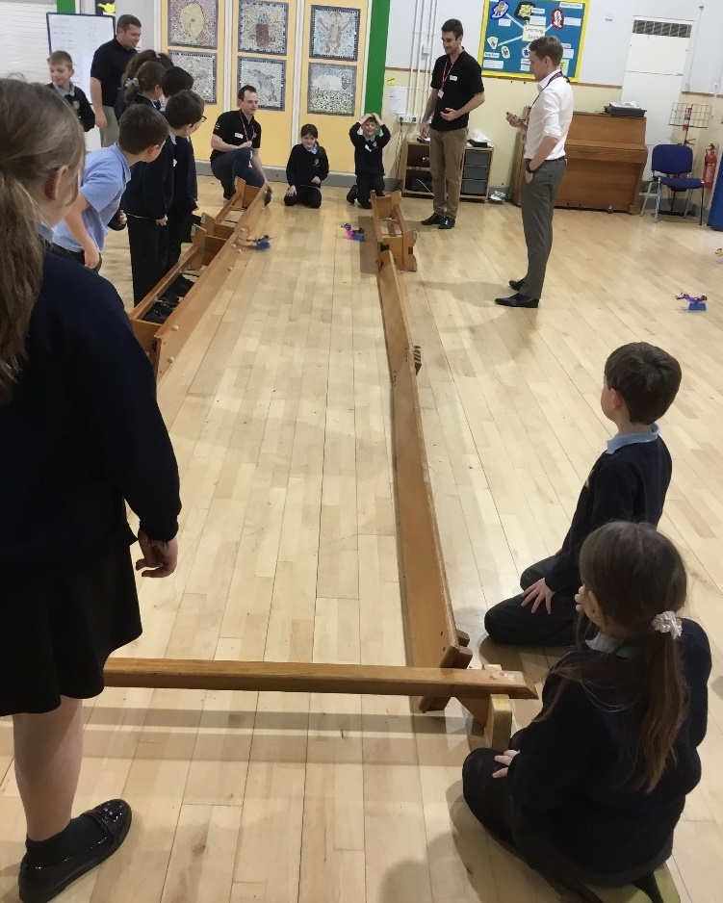
13. Try out your brush monster
Try out your brush monster on different surfaces.
Does it work better on a flat smooth floor or on carpet?
Can you get it to go in a straight line?
Try racing the brush monsters.
Time your brush monster over a known distance, e.g. 1 m. Divide the distance by the time to calculate the average speed.

Slide 17
14. Fix and improve your brush monster
If your brush monster stops working can you work out why?
Could any crocodile clips have come off their contacts?
Could your motor have moved back in its mount so that the eraser is jammed against the brush?
Can you get your brush monster to go in a straight line? What if you mount your eraser using a different offset hole?
What happens if you swap over the crocodile clips attached to the motor terminals? Does it affect the direction of movement?
Can you get your brush monster to go faster?
Could you use a spare motor to make more holes at different offset distances to try out?

Slide 18
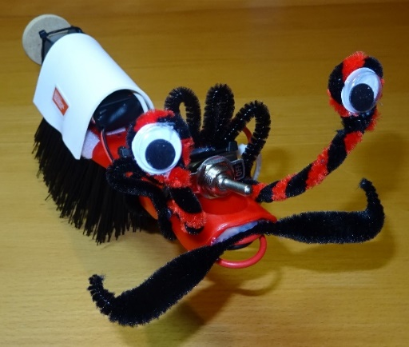
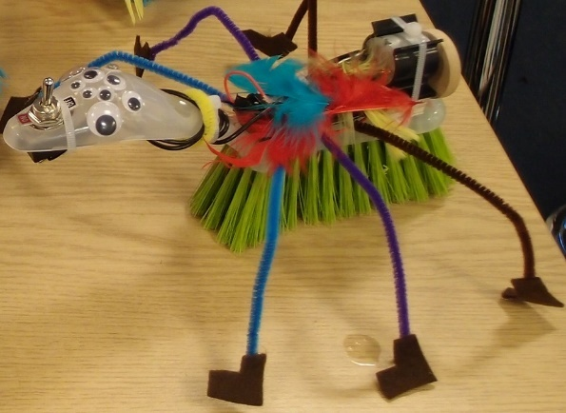
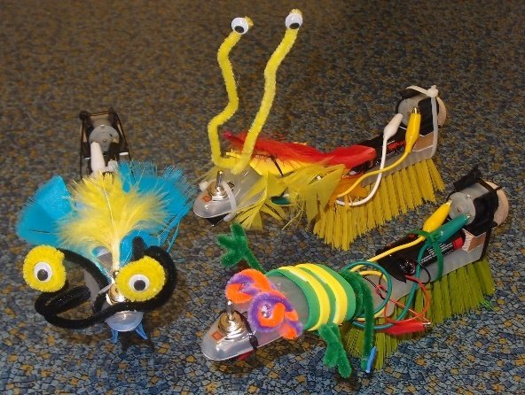
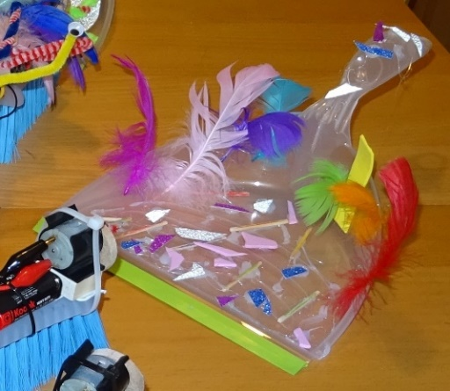
15. Decorate your brush monster
Decorate your brush monster and give it a name.
You can glue on eyes, pipe cleaners and feathers and make shapes using the self-adhesive foam.
You could turn your dustpan into a bed for your brush monster when it gets tired!

Slide 19
16. Plenary
Discuss how the brush monster works:
Slide the bristles of your brush over your hand forwards and then backwards. Do they slide more easily one way than the other?
Why is the eraser mounted on an offset hole? As the eraser turns what happens to its centre of gravity?
What did you learn about electric circuits?
Which different joining methods did you use to create your brush monster?
What problems did you encounter and how did you overcome them?
What did you enjoy the most?

Slide 20
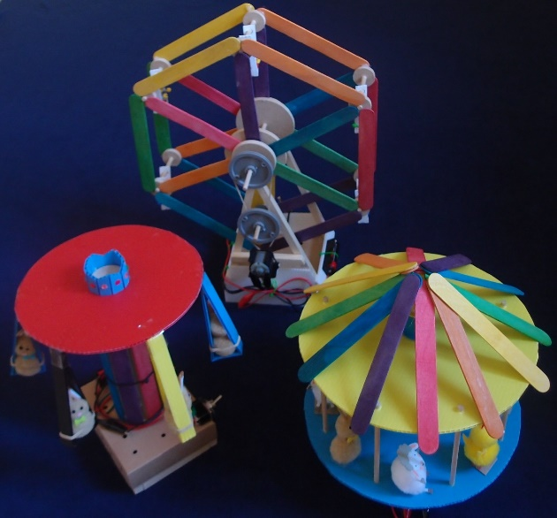
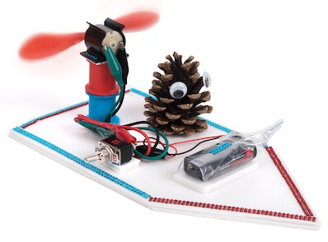
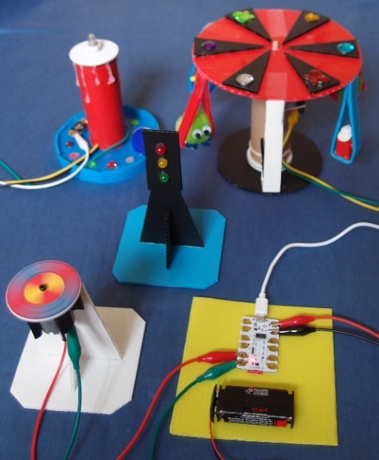
More fun TTS class kits
Fairground rides Fan boats Crumble kit
Copyright © Caroline Alliston 2020

