Slide 1
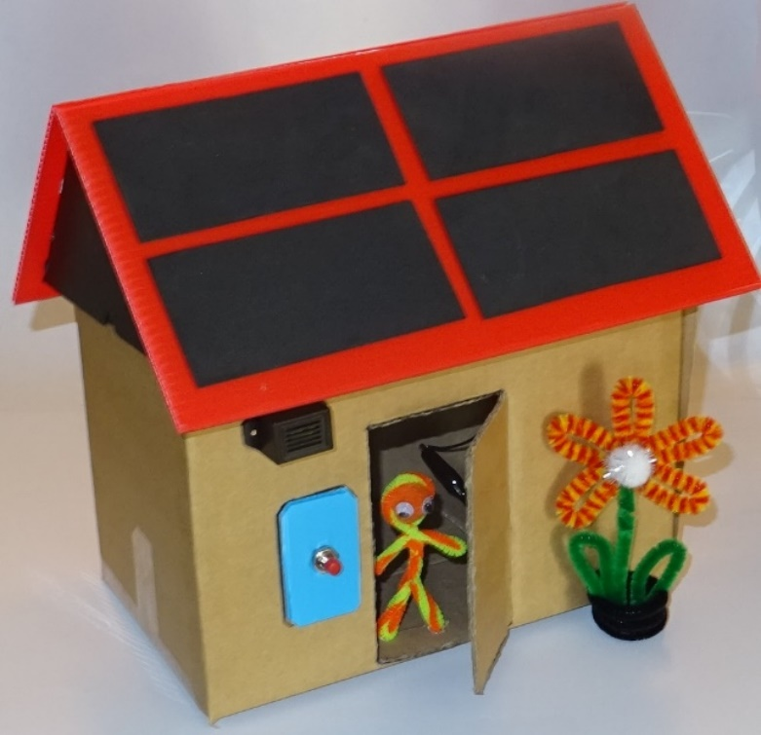
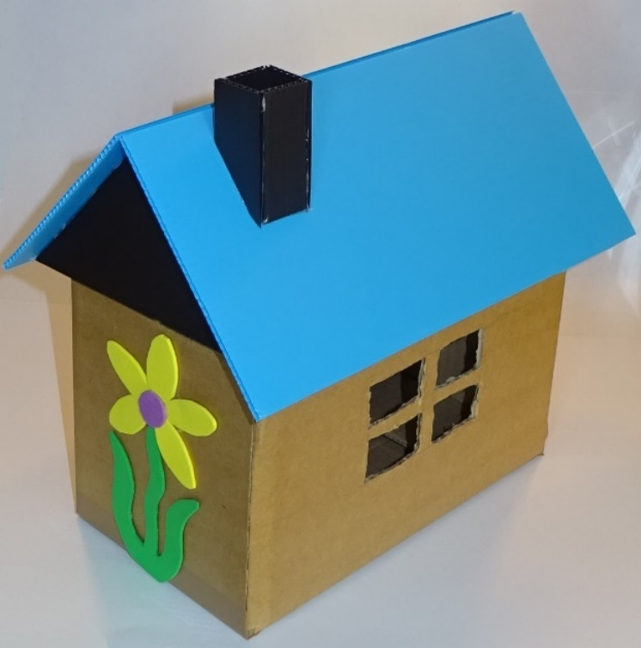
Build-a-House PowerPoint

Slide 2
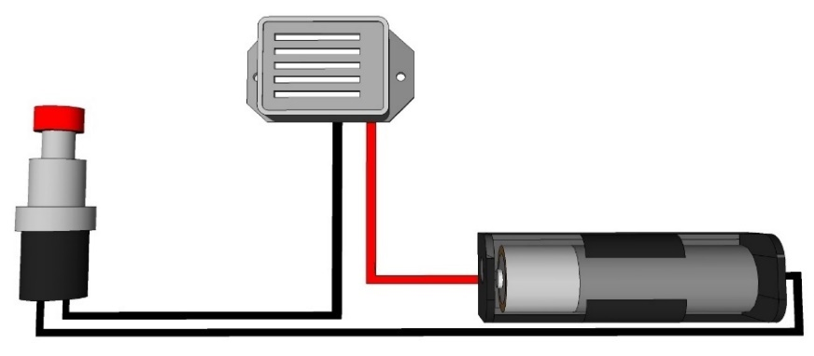
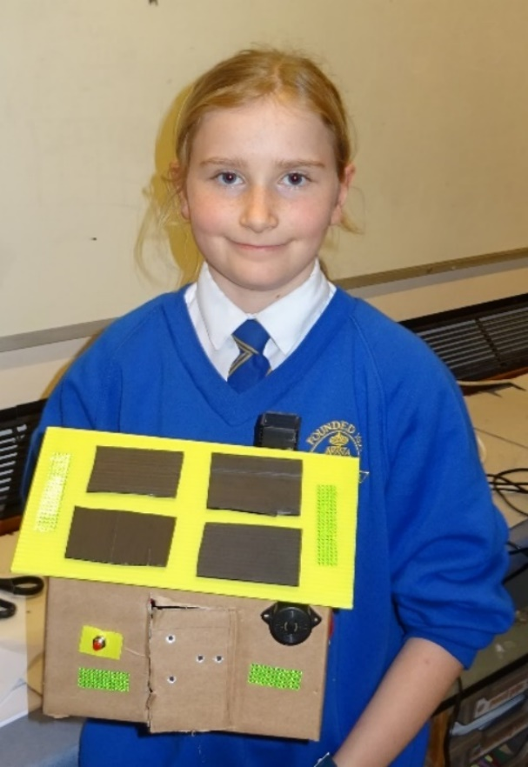
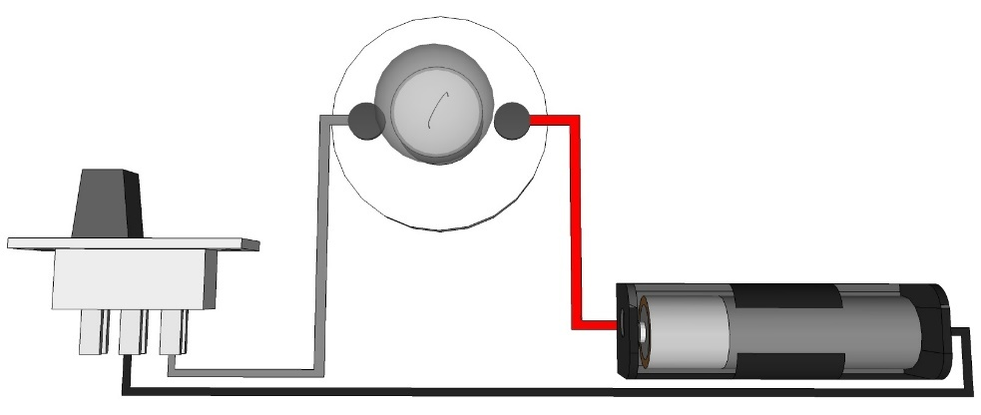
Make and wire up a model house
Doorbell
Light

Slide 3
Learning objectives
Science – construct simple series electrical circuits
Technology – understand and use electrical systems in products
Engineering – understand what different switches are used for
Maths – measure distances and angles
Discover how much fun STEM can be!

Slide 4
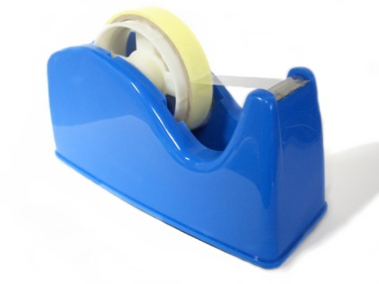
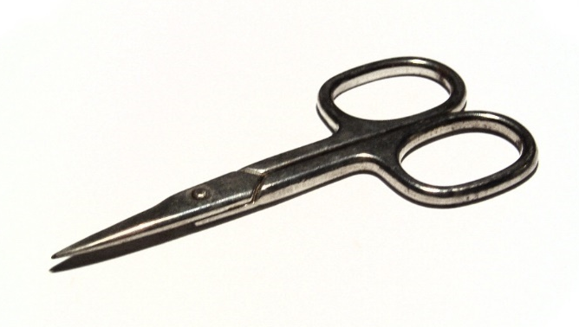
1. Work safely
Look at the tools and equipment provided. Can you spot any potential hazards?
Can you think of ways to reduce the risks?

Slide 5
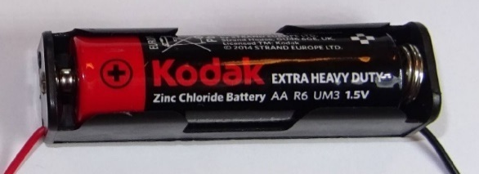
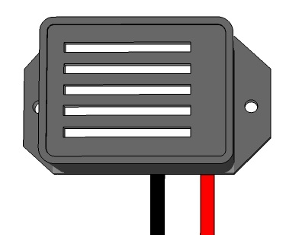
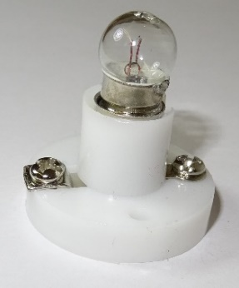
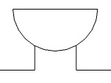
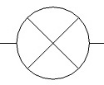
2. Electrical parts
Name these electrical components:

Slide 6
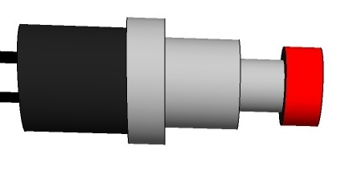
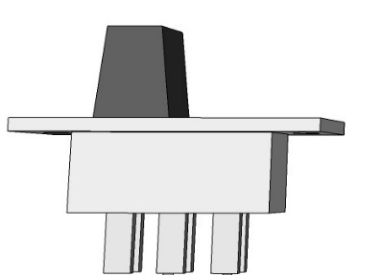
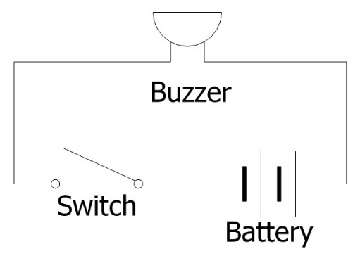
3. Electrical circuit
How do you operate a push-to-make switch?
How do you operate a slide switch?
Why would you use a circuit diagram to represent your circuit?

Slide 7
4. Avoid short circuits
If batteries are ‘short-circuited’ they can get hot.
Do not connect the bare metal ends of the wires from the battery directly together; the battery must be connected across the buzzer or the bulb.
Make sure the plastic sleeves cover the crocodile clips as shown here, to help prevent short-circuits if the clips touch.

Slide 8
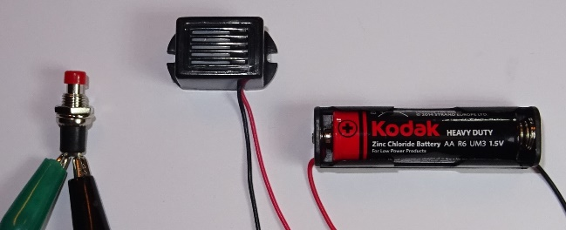
5. Make your doorbell circuit
Collect these components: 1 buzzer, 1 push-to-make switch, 1 cell, 1 battery holder, 3 crocodile leads
Lay out your components in a triangle and connect up this circuit. The red wire from the battery must be connected to the red wire to the buzzer.
Clip crocodile clips onto bare metal, not onto plastic insulation!
Fit the cell into the battery holder (the right way round). Press the red button and check the buzzer sounds.

Slide 9
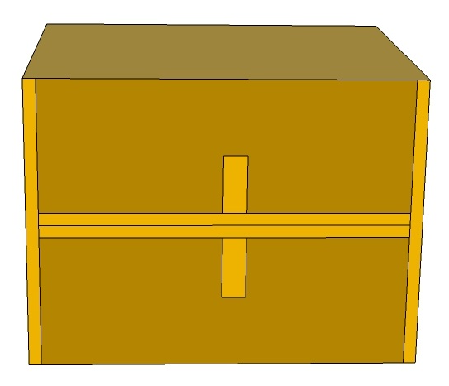
6. Start making your house
Collect a cardboard box.
Open it up and fold in two end flaps.
Fold in the two side flaps.
Tape the flaps in position as shown.
This will be the bottom of your house.

Slide 10
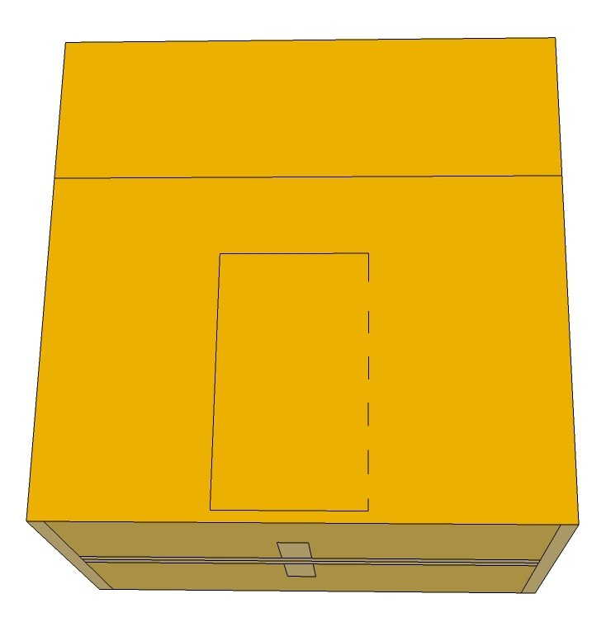
7. Make your door and windows
Use the ruler and felt tip pen to draw a front door on the box. Make sure it is big enough to get your hand through.
Cut out three sides with the pointed scissors, leaving the fourth side as a hinge (shown here as a dashed line) so you can open and shut the door.
Mark and cut out one or more windows at the back of the house.

Slide 11
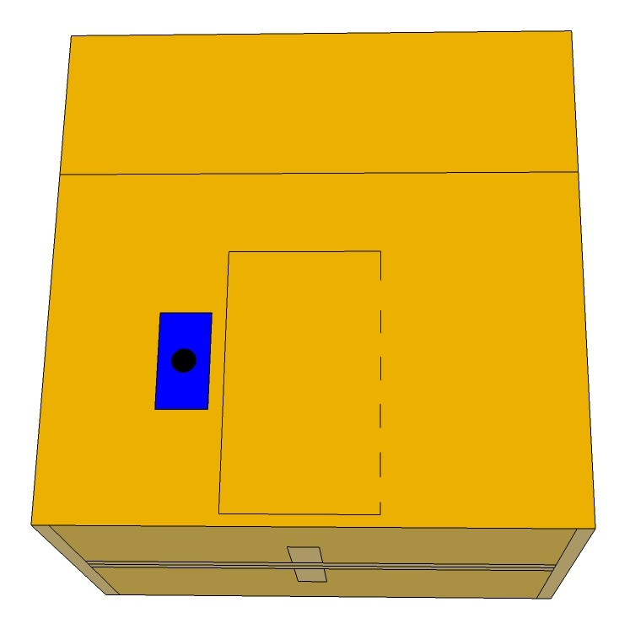
8. Prepare your doorbell attachment
Cut out a 3 cm x 5 cm rectangle of corrugated plastic.
Use the sharp pencil to make a hole in the middle.
Place the rectangle near the door, draw round it with the felt tip pen and mark the hole.
Cut a hole in the cardboard where you marked it – this hole must be big enough for the switch to fit through.

Slide 12
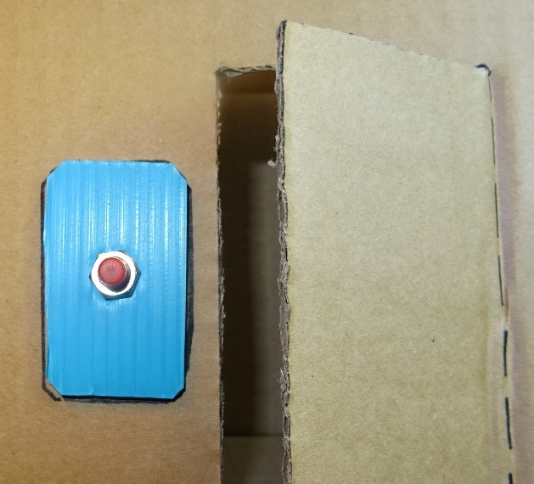
9. Fit your push-to-make switch
Unclip the crocodile leads.
Unscrew the nut and remove the spring washer from the switch. Don’t lose them!
Enlarge the hole in the plastic rectangle and push the threaded part of the switch through – it should fit tightly.
Refit the washer and nut – tighten with the pliers or spanner.
Glue the plastic in the position you marked on the house, with the red button on the outside.

Slide 13
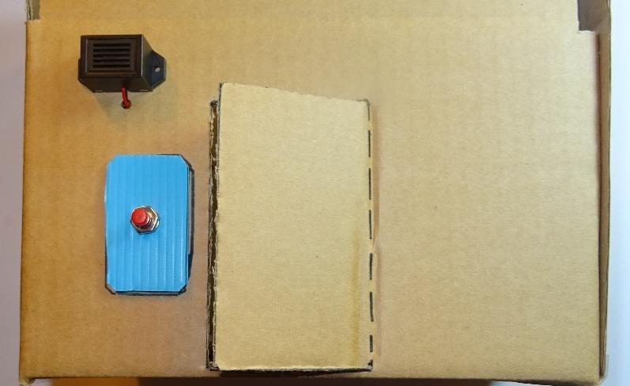
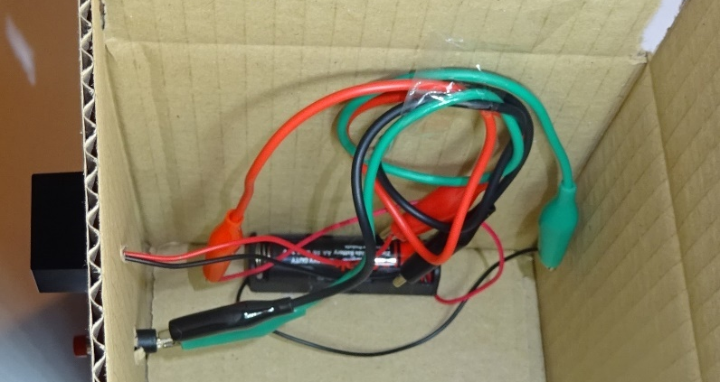
10. Fit your buzzer and re-make the circuit
Glue the buzzer to the outside of the house.
Pierce a hole with the sharp pencil and push the wires though.
Glue the battery box inside the house.
Re-connect the wires.
Try out the doorbell and make sure it works.
Tidy up the wires and tape them to the inside of the house.

Slide 14
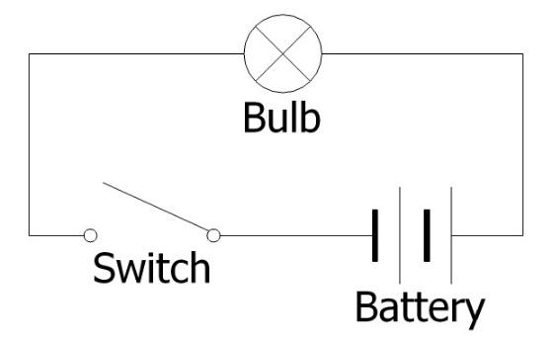
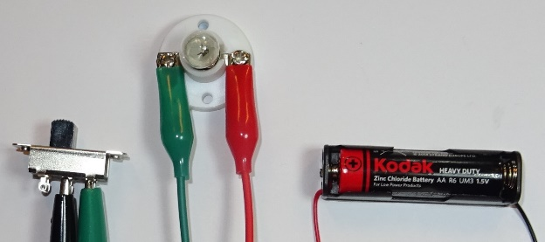
11. Make your lighting circuit
Collect these components: 1 bulb holder with bulb fitted, 1 slide switch, 1 cell, 1 battery holder, 3 crocodile leads
Lay out your components in a triangle and connect up this circuit.
Clip crocodile clips onto bare metal, not onto plastic insulation!
Fit the cell into the battery holder (the right way round). Check the bulb lights up when you slide the switch one way, and goes off when you slide it the other way. Switch off when not in use.

Slide 15
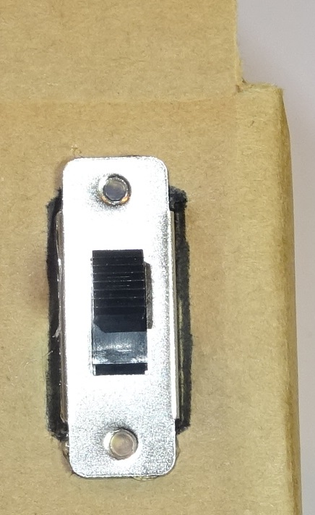
12. Fit your light switch
Unclip the crocodile leads.
Work out a position on the outside of the house to fit your light switch. (If you put it on the outside you can reach it easily.)
Cut a rectangle 13 mm wide by 25 mm high.
Check the switch body slides into this hole.
Glue on the switch.

Slide 16
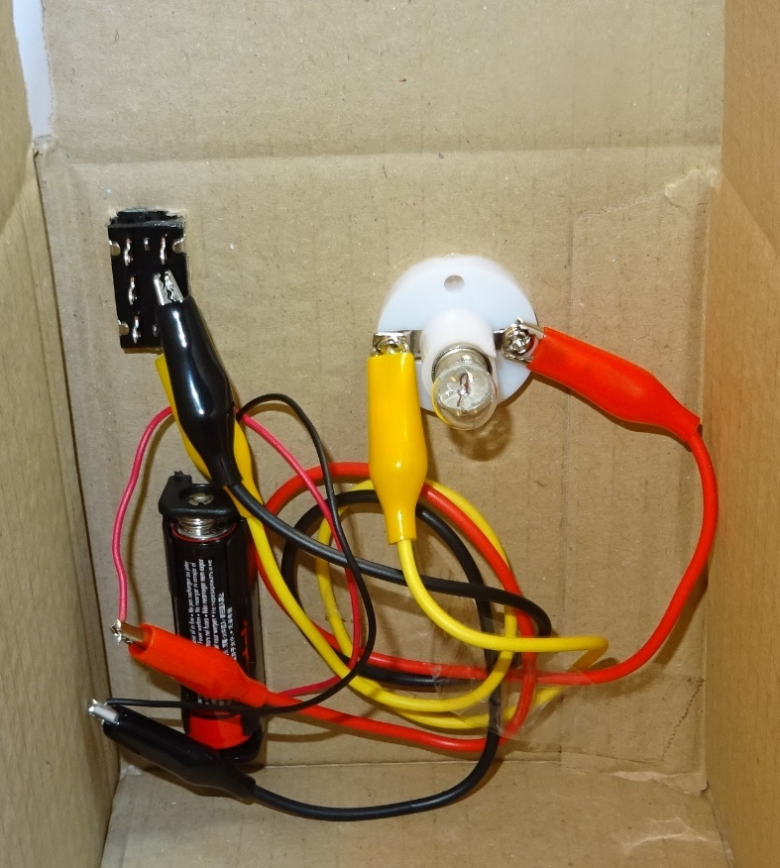
13. Fit your lamp and re-make the circuit
Work out a position inside your house to fit your bulb holder.
Glue it in position.
Work out where to attach your battery and glue it on.
Re-connect the wires.
Try out the light, then switch off.
Tidy the wires and tape them to the inside of the house.

Slide 17
14. Electrical safety
Your circuit uses 1.5 Volts of electricity.
Mains voltage used in a real house (in the UK) is 240 Volts.
Can you think of any hazards of mains electricity?
Can you think of ways to avoid these hazards?

Slide 18
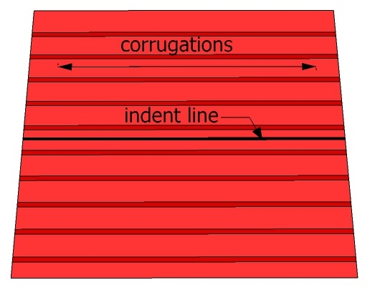
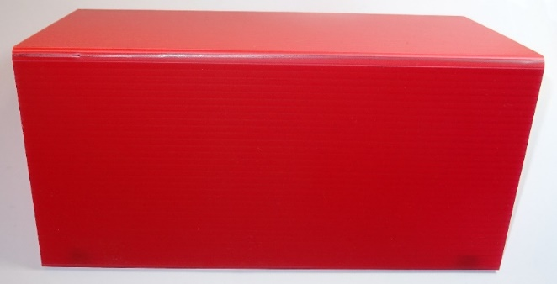
15. Start making the roof
Take your large square of corrugated plastic.
Use the ruler and blunt pencil to indent a line down the middle. Make sure it is in line with the corrugations as shown.
Bend the roof in half with the line your have scored along the ridge-line. It should bend neatly where you have indented it.

Slide 19
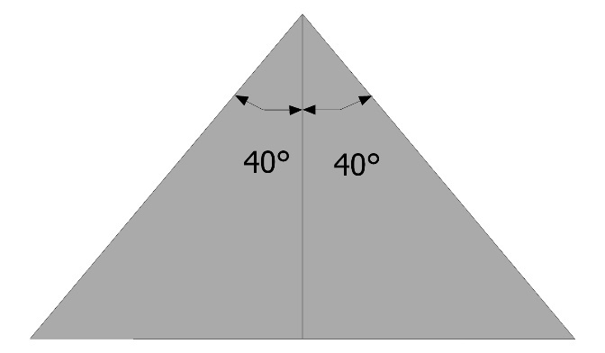
16. Make the ends of the roof
Take your small square of corrugated plastic.
Cut it in half diagonally with the large scissors.
Mark the centre line of each triangle with the felt tip pen.
Use the protractor to measure and mark 40° from the centre line in either direction.
Trim both the triangles to the shape shown.

Slide 20
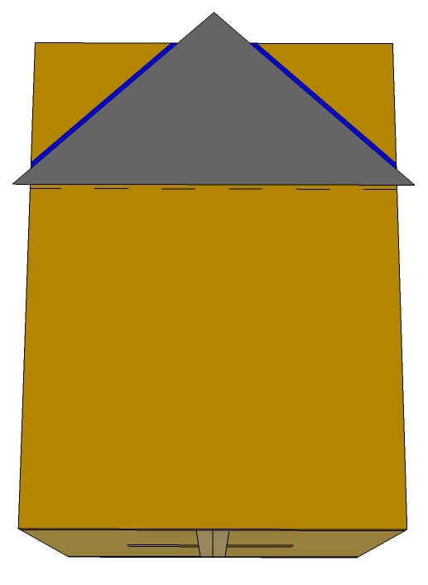
17. Trim the box ends to fit the roof
Fold the side flaps on top of your box inwards and tape in place.
Leave the end flaps sticking up.
Place one of your triangles against one of the sticking-up end flaps, with the bottom on the fold line.
Mark and then cut off the corners of the end flaps (indicated by the blue lines on the picture)
Repeat for the other end of the box.

Slide 21
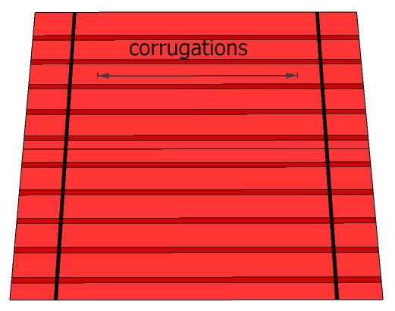
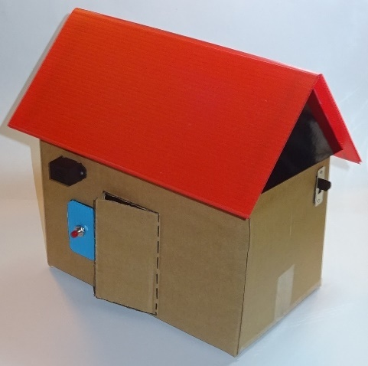
18. Finish the roof
Turn the roof over and mark two lines on the underside with the felt tip pen 15 mm from either end. These must be across the corrugations.
Run a line of glue along both short sides of a triangle, and stick it to the roof along the line you marked.
Repeat for the second triangle.
Place the roof on the house.

Slide 22
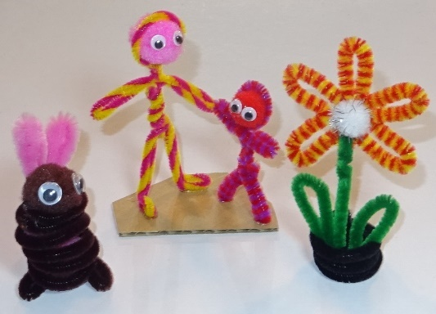
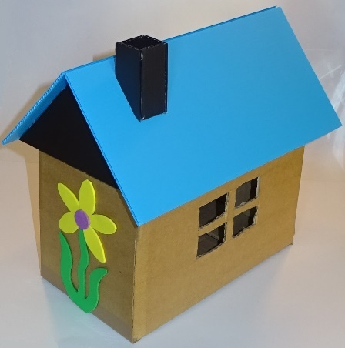
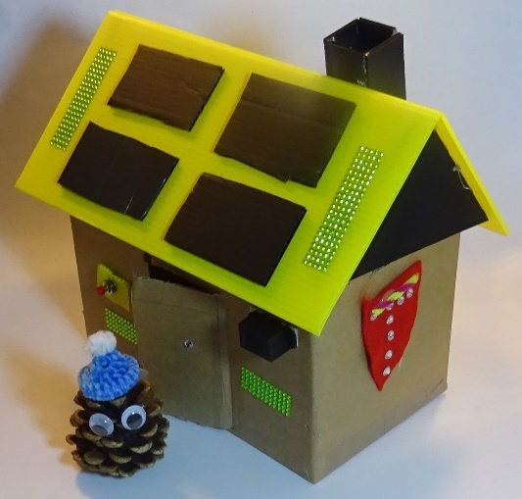
19. Decorate and populate your house
Use pipe cleaners, pompoms and wiggly eyes to make people and pets to go in your house.
Add decorations to the walls or roof made from self-adhesive foam sheet, for example climbing plants and solar panels.
Use offcuts of corrugated plastic to construct a chimney or furniture.

Slide 23
20. Plenary
Discuss what you have learnt.
What type of switch did you use for the doorbell circuit?
Would this switch be suitable for a lighting circuit?
What type of switch did you use for the lighting circuit?
Would this switch be suitable for a doorbell circuit?
Did it matter which way round you connected your buzzer?
How about your light?
What will happen if you leave your light switched on?
What did you enjoy most about this activity?

Slide 24
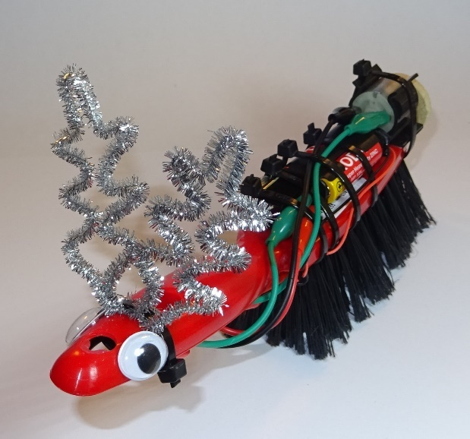
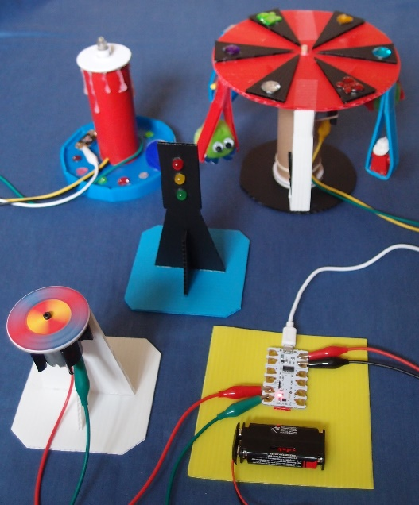
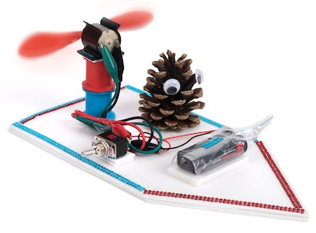
More fun TTS class kits
Vibrating brush monsters Fan boats Crumble kit
Copyright © Caroline Alliston 2018

