Slide 1
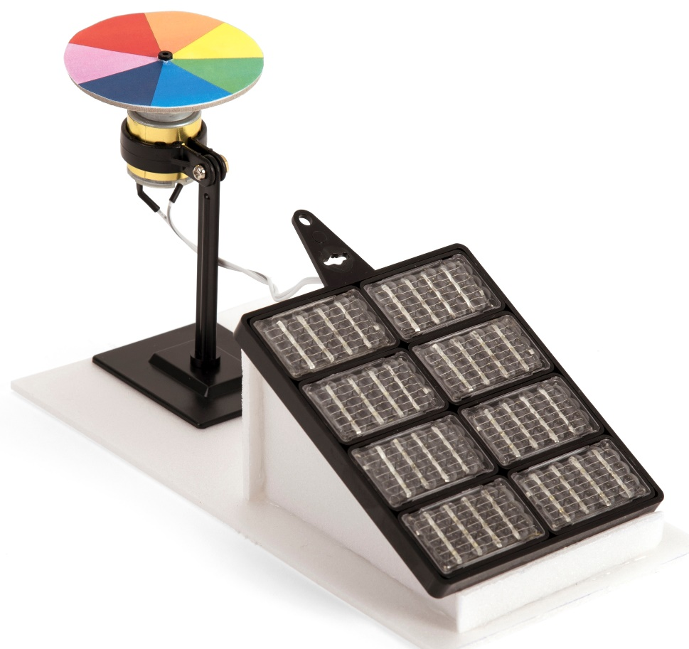
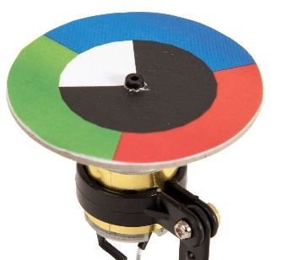
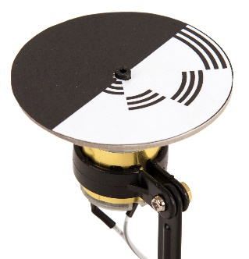
Renewable energy – Module 4
How can solar energy be used?
How does solar PV work?
Make a selection of solar powered rotating models

Slide 2
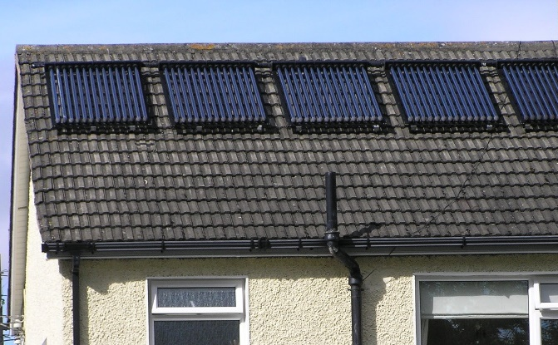
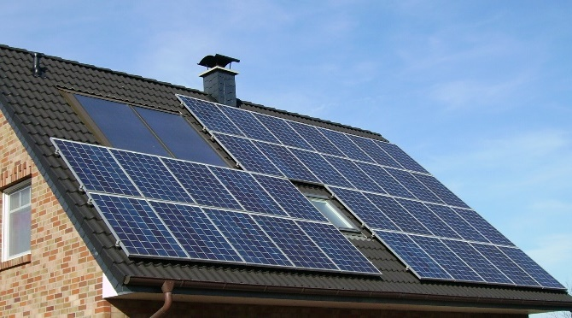
How can solar energy be used?
Solar energy can be used to heat water or to make electricity
Water is pumped through solar heating panels where it receives energy from the sun
Solar photovoltaic (PV) panels convert light into electrical energy
Solar panels only work during the day

Slide 3
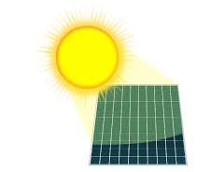
How does solar PV work?
A solar photovoltaic (PV) panel absorbs light energy from the sun.
It converts this into electrical energy.

Slide 4
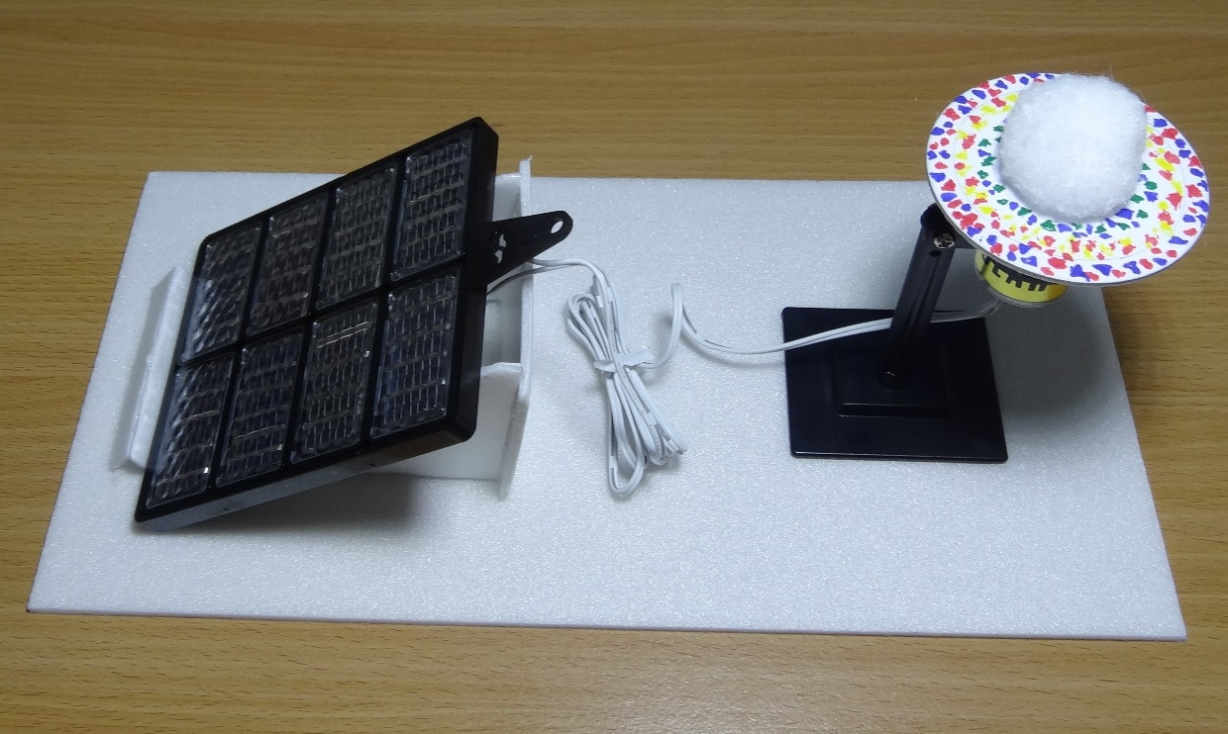
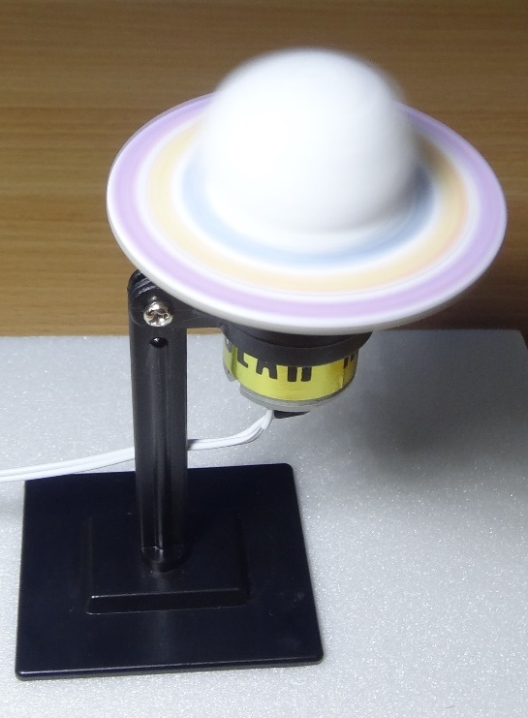
Make a solar powered spinner

Slide 5
STEM learning objectives
Science: Light – extend your experience of light by looking at a range of phenomena Earth and space – find out the way that ideas about the solar system have developed
Technology – design purposeful, functional, appealing products
Engineering – design, make, test and improve a product
Maths – draw 2-D shapes; know that diameter is twice the radius

Slide 6
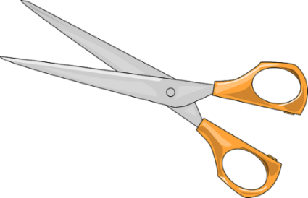
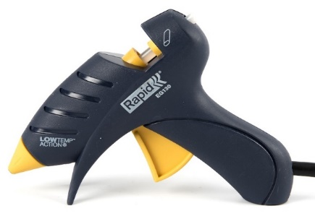
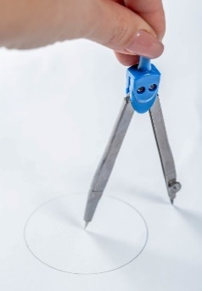
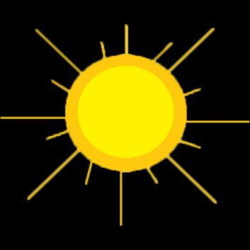
1. Work safely
Look at the tools and equipment. Can you spot any potential hazards?
Can you think of ways to reduce the risks?
Notes:
Don’t cut yourself or burn your fingers.
Use cool melt glue guns to avoid serious burns.
Don’t spike yourself with the compasses.
Don’t look directly at the sun as you could damage your eyes.

Slide 7
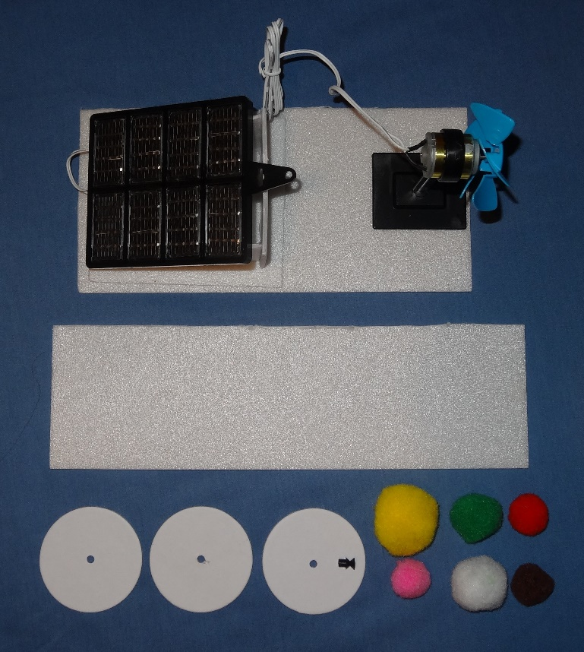
2. Collect your materials
You will need:
A solar energy kit (from the electric boat completed in module 3)
A polystyrene foam base (completed in module 2)
Offcuts of polystyrene foam
Several card discs
A motor pulley
Pompoms

Slide 8
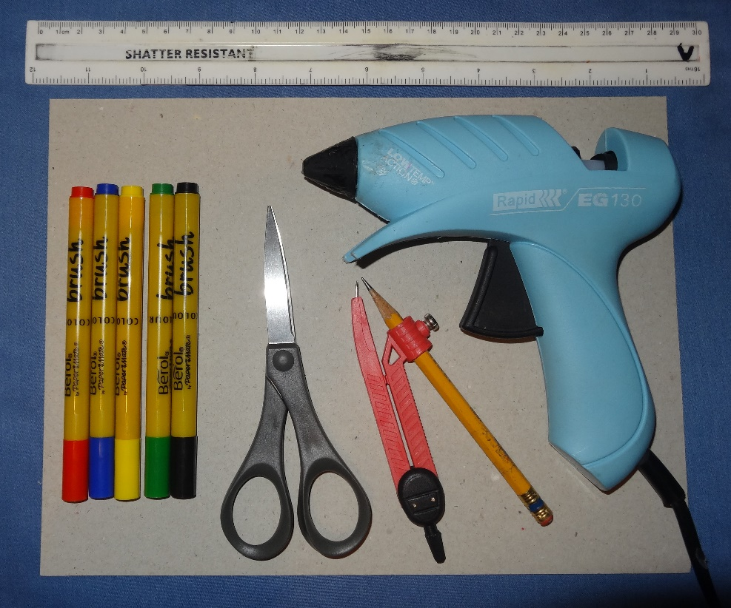
3. Assemble your tools
You will need:
A ruler
A sheet of card
Coloured felt tip pens
A pair of scissors
A pair of compasses
A cool melt glue gun

Slide 9
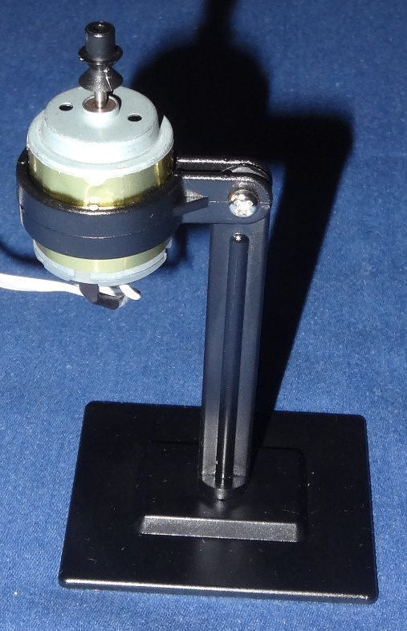
4. Prepare the motor
Pull the propeller off the motor shaft
Replace it with the motor pulley - the nose of the pulley must face away from the motor as shown
Use the plastic spanner from the solar energy kit to loosen the nut slightly on the motor stand
Turn the motor so the shaft faces vertically upwards
Re-tighten the nut

Slide 10
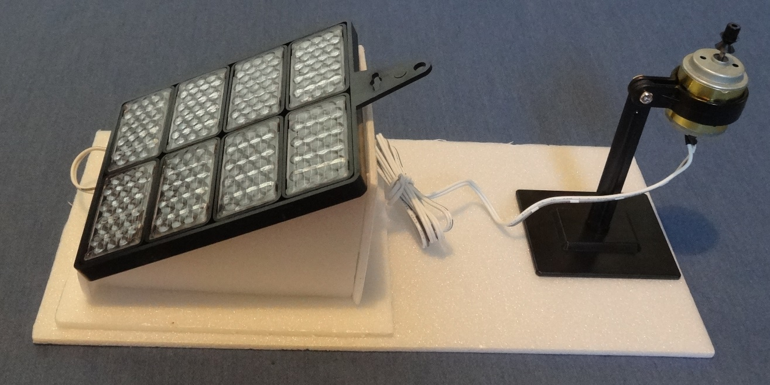
5. Mount the solar panel and motor
Carefully peel the solar panel and the motor stand off the boat
Place the solar panel on its stand
Glue the motor stand back to the other end with the motor on the side furthest away from the solar panel

Slide 11
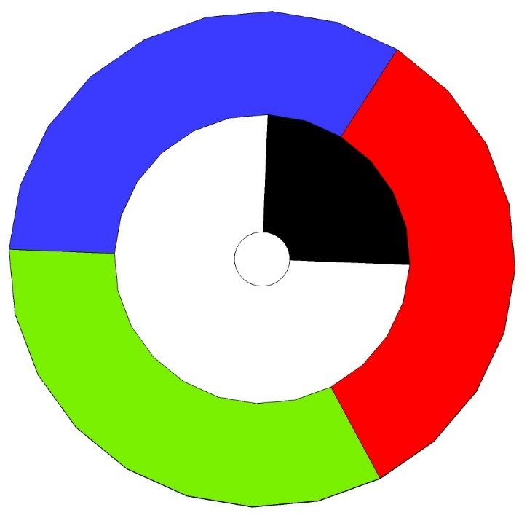
6. Make Maxwell’s disc
Hold the card disc firmly on the sheet of card and draw a circle of 4 cm diameter on it
Colour the outer ring in red, green and blue
Colour a segment of the inner ring in black
Place the disc on the nose of the motor pulley and get the motor to spin
Watch the colours that appear
Increase the size of the black segment until the colours match
Notes:
The radius is half the diameter.
This experiment was invented by James Clerk Maxwell in the 1850s as part of his research into colour vision and how different people see mixtures of colours.

Slide 12
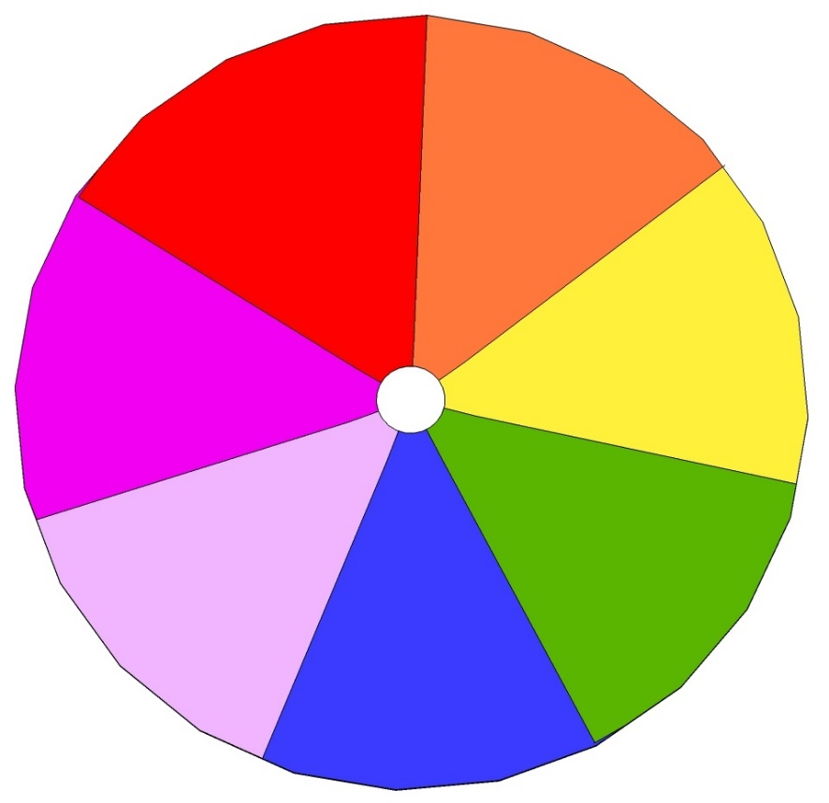
7. Make a Newton disc
A rainbow is an example of sunlight being split into its component colours by raindrops
What colour would you expect to see if you were to combine the colours of the rainbow?
Try colouring in a disc with all the colours of the rainbow
Place it on the motor pulley, spin it up to speed and see what colour you get

Slide 13
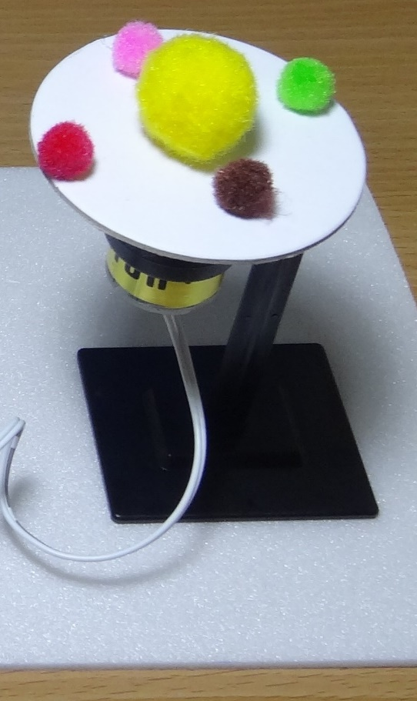
8. Make a model of the solar system
Use pompoms to represent the sun and the planets (or some of the planets!)
Originally the Earth was thought to be at the centre with the sun and planets moving around it (the geocentric model)
In the 16th century Nicolaus Copernicus presented the model with the sun at the centre (heliocentric model)
Decide which model you will make
Suggest some limitations in how this represents the movement of the solar system
Notes:
There are lots of limitations of this model! For example:
The relative sizes of planets are not representative
The relative spacing is not representative
The planets should travel on different orbits
The Earth should rotate about its own axis to create day and night

Slide 14
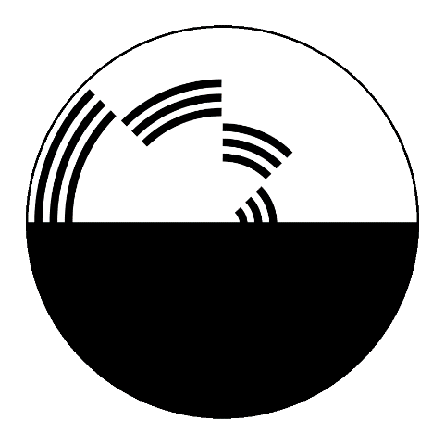
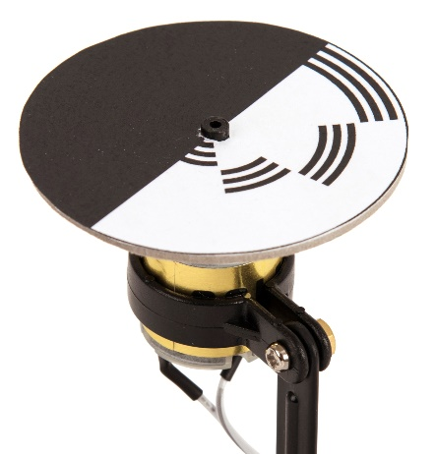
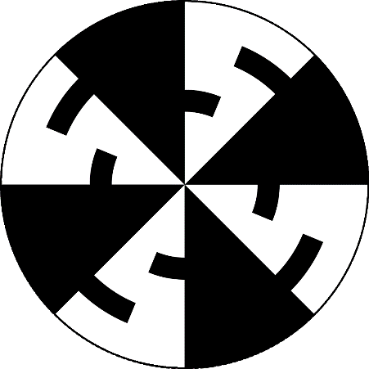
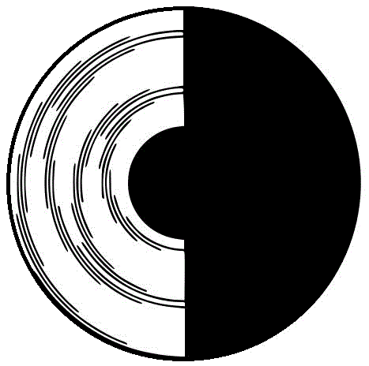
9. Make a Benham disc
Try making a Benham disc – here are some examples
Charles Benham developed them in 1895 to create optical illusions
Try partially covering the solar panel with your hand to slow the disc down and see what effects you get
Notes:
You should see different colours, particularly when the disc is rotating slowly.
The reasons for the optical illusion are not understood but may relate to the behavior of colour receptors in the eye.
This could prove useful for diagnosing eye diseases.

Slide 15
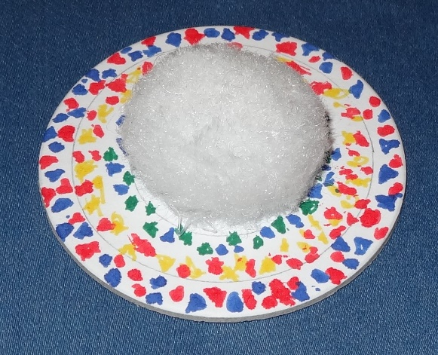
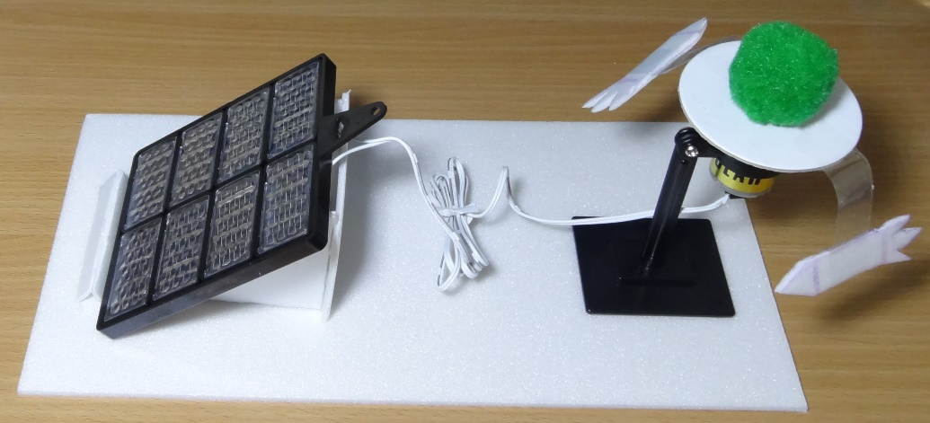
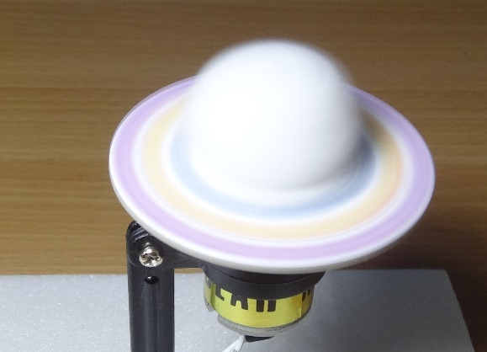
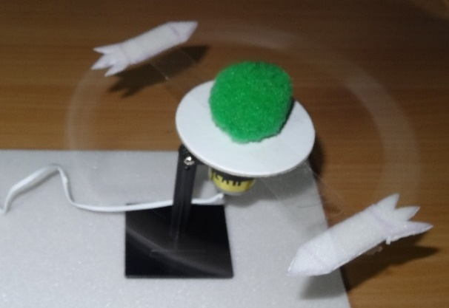
10. Design your own models
Notes:
The first model represents Saturn’s and its rings.
The rings appear solid but are thought to consist of lots of separate particles of dusty ice.
The particles appear to form solid rings because there are so many of them and the sun reflecting off the ice makes them look bright.
The second model represents rockets orbiting the Earth.

Slide 16
11. What did you learn?
How can solar energy be used?
What does a solar PV panel do when light falls on it?
Explain the geocentric model of the solar system
Explain the heliocentric model of the solar system
Which one is thought to be correct nowadays?
How is a rainbow formed?
Describe some of the optical effects you have seen.
Which energy conversions take place in the solar powered spinner?
Notes:
Solar energy can be used to heat up water or produce electricity.
When light falls on a solar PV panel it produces electricity.
In the geocentric model of the solar system the Earth is at the centre.
In the heliocentric model of the solar system the sun is at the centre.
The sun is thought to be at the centre nowadays.
A rainbow is formed when sunlight is split into its component colours by raindrops.
Light energy from the sun is converted by the solar panel to electricity; this is then converted to kinetic (movement) energy as the motor rotates.

