Slide 1
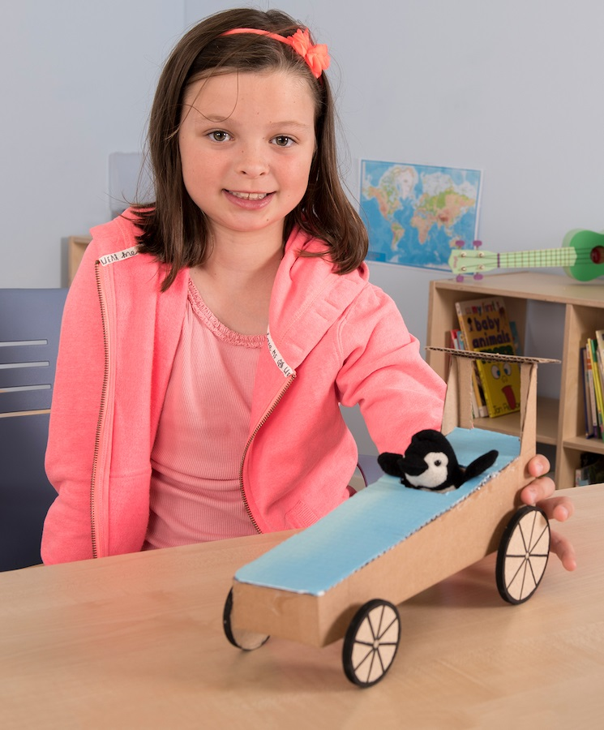
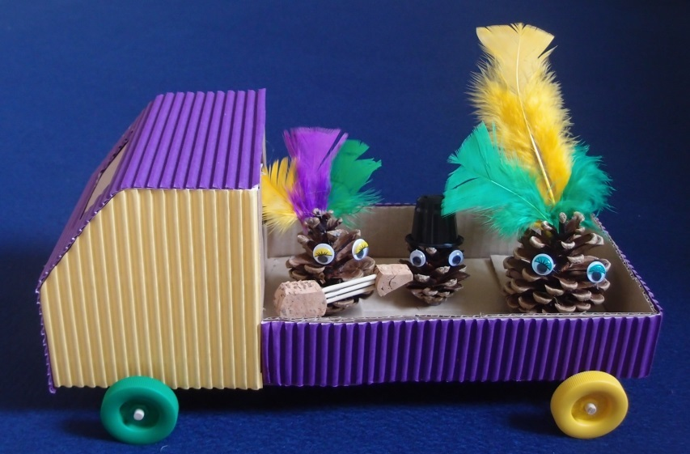
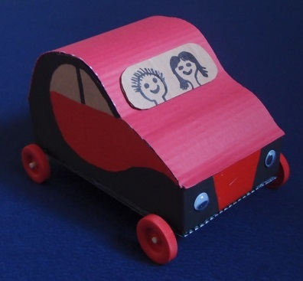
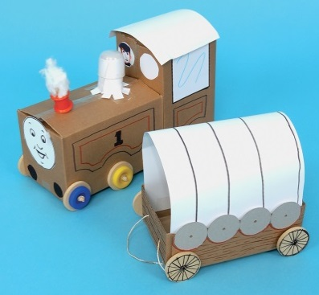
Design, build & test your own vehicle

Slide 2
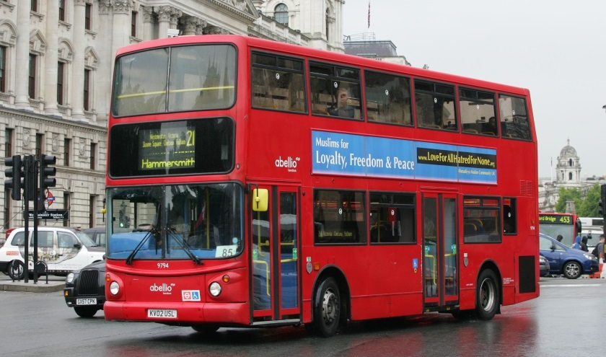
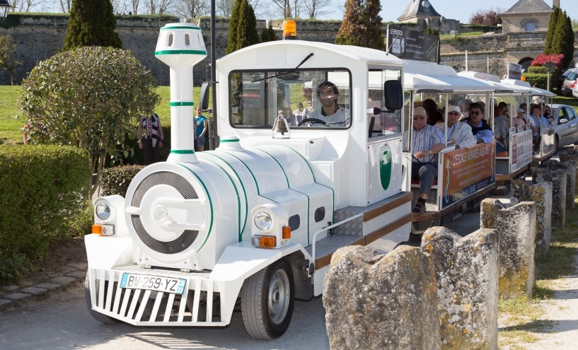
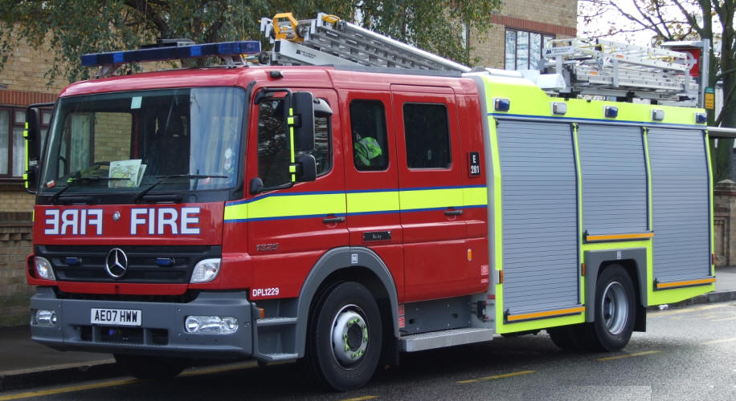
Vehicles
What are these vehicles used for?

Slide 3
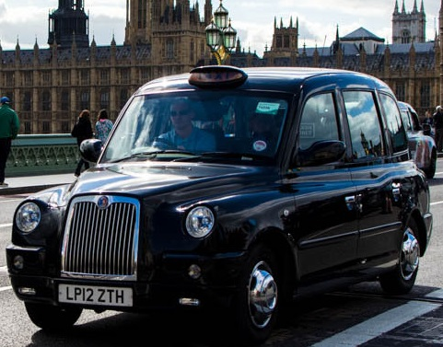
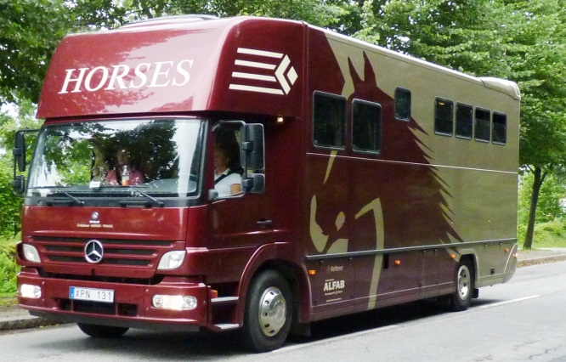
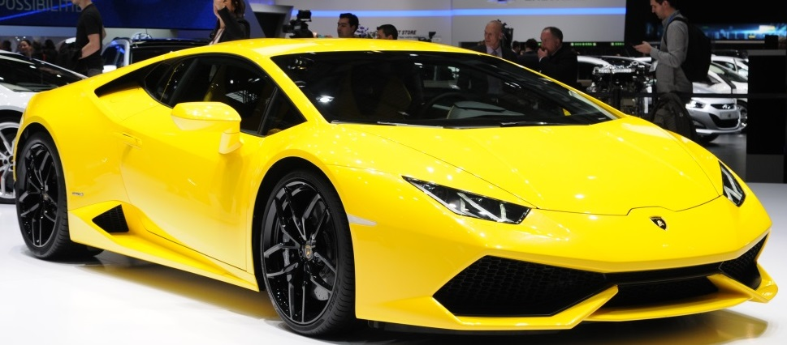
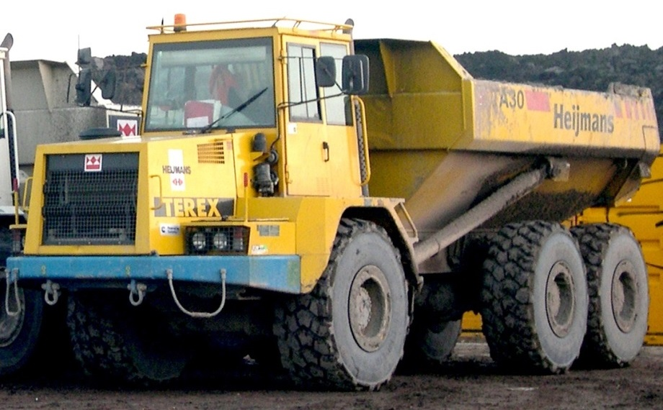
More vehicles
What about these vehicles?

Slide 4
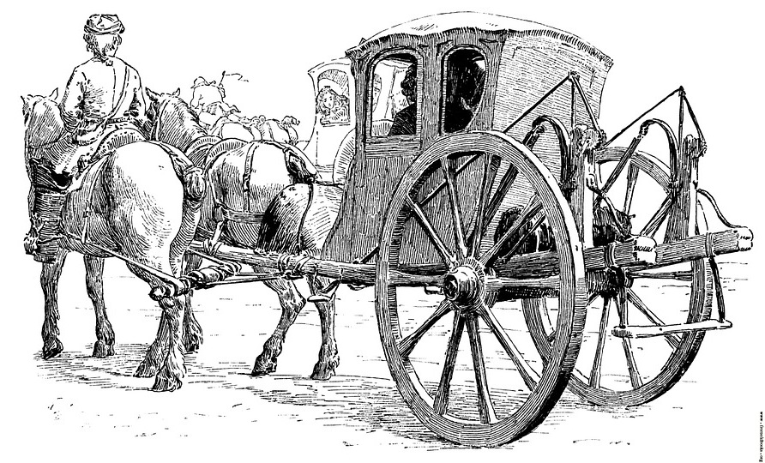
Wheels, axles and bearings
What do the wheels do?
What does the axle do?
What do the bearings do?

Slide 5
Learning Objectives
Engage in the design and make process
Understand and use mechanical systems, e.g. wheels, axles and bearings
Identify the effects of gravity and friction
Set up practical enquiries and take measurements

Slide 6
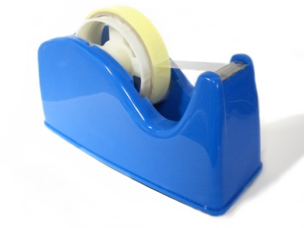
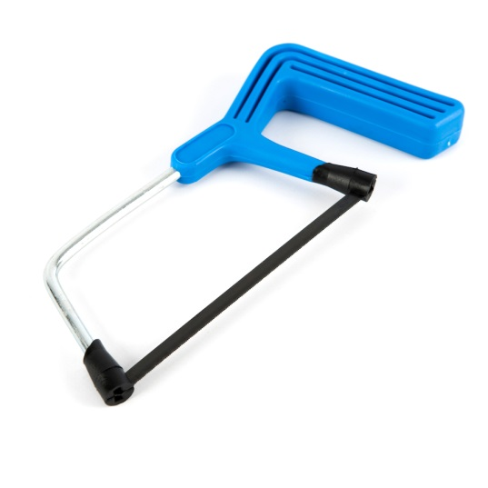
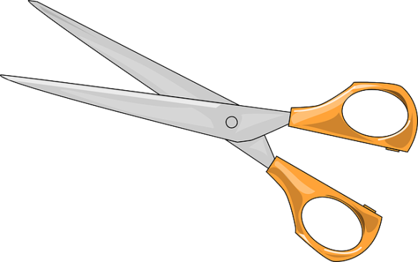
1. Safety
Look at the tools and equipment.
Can you spot any potential hazards?
Can you think of ways to reduce the risks?

Slide 7
2. How the vehicle works
Try running the sample vehicle down a gentle slope.
What force is pulling the vehicle down the slope?
What force is resisting its movement?
Identify the wheels, axles and bearings (straws).
Run through the pitfalls highlighted in the lesson plan.
Can you think of ways to reduce the risks?

Slide 8
3. Design criteria
If your vehicles are being designed to a particular theme then discuss this.
On your worksheet write down some design criteria for your vehicle. For example would you like your vehicle to:
Carry a passenger, several passengers or a load?
Go as far or as fast as possible?
Be bright and colourful?
Keep the passengers safe?
Look nice?
Anything else?

Slide 9
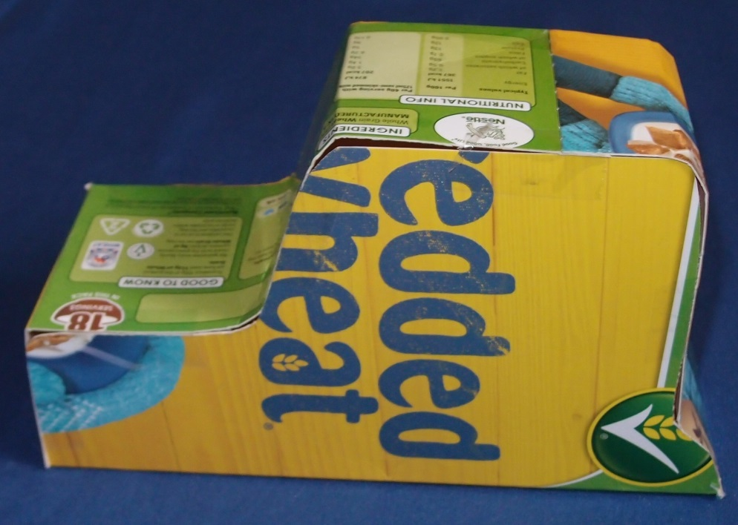
4. Sketch your vehicle
Sketch your vehicle on your worksheet.
Fill in the table listing which parts you will need.
If you are making a prototype for your bodywork then draw it out on your A4 card or cereal box, cut it out and stick it together with transparent sticky tape.

Slide 10
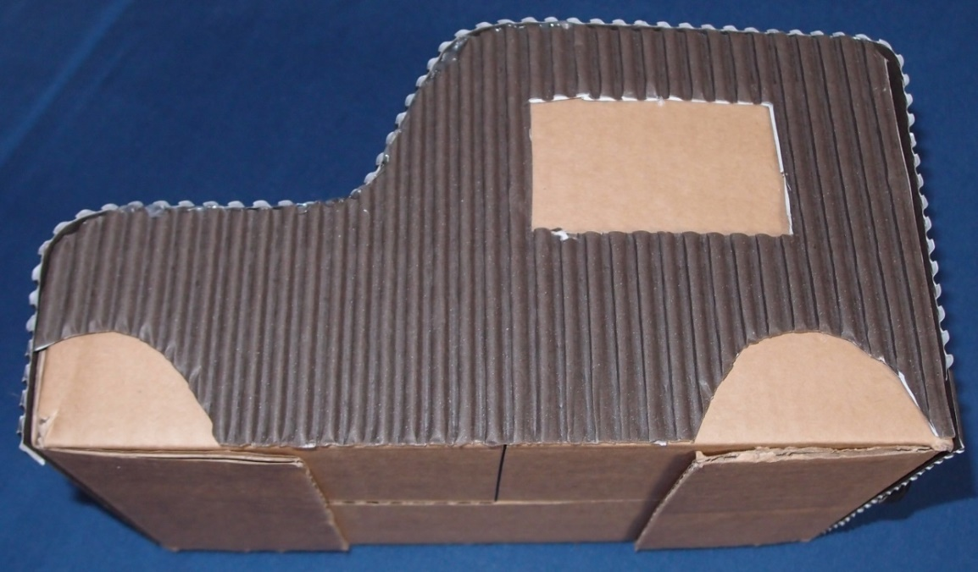
5. Construct your bodywork
Use the pencil and ruler to draw your design on your cardboard box and then cut it out with scissors.
Fold in the side flaps and then stick down the end flaps firmly.
You can cut pieces of corrugated card and stick them onto your bodywork as required.

Slide 11
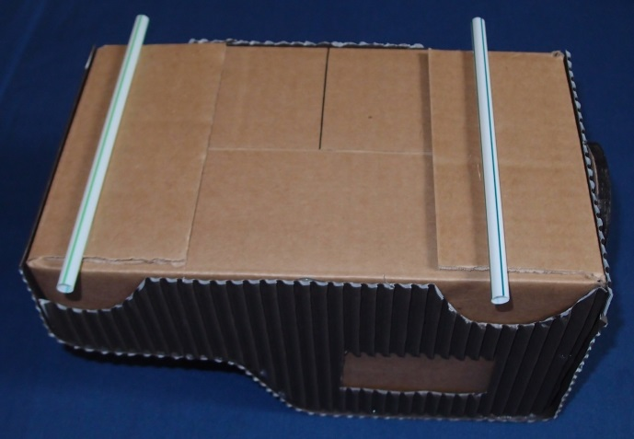
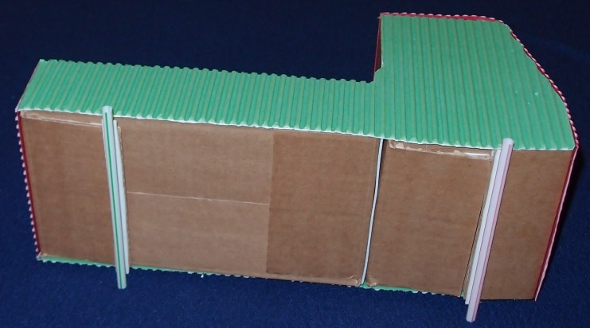
6. Fit your bearings & prepare your axles
Cut straw lengths 2 cm longer than the width of your bodywork. Round out the flattened cut ends with a pencil.
Stick the straws onto the end flaps of your vehicle, with the ends protruding either side.
Cut axles 2 cm longer than your straws. Smooth the ends with sandpaper so that the wheels go on more easily.

Slide 12
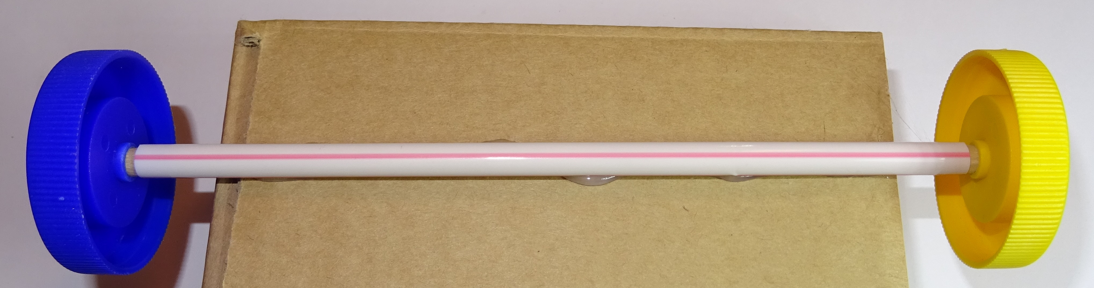
7. Fit your wheels
Push a wheel onto the end of each axle.
Slide the axles through the straws and push a second wheel onto the other end.
Push the wheel along the axle until there is a small gap of about 1 mm between the wheel and the end of the straw.
Hold the vehicle and spin the wheels to check they rotate easily.
Leave a small gap between the wheel and straw

Slide 13
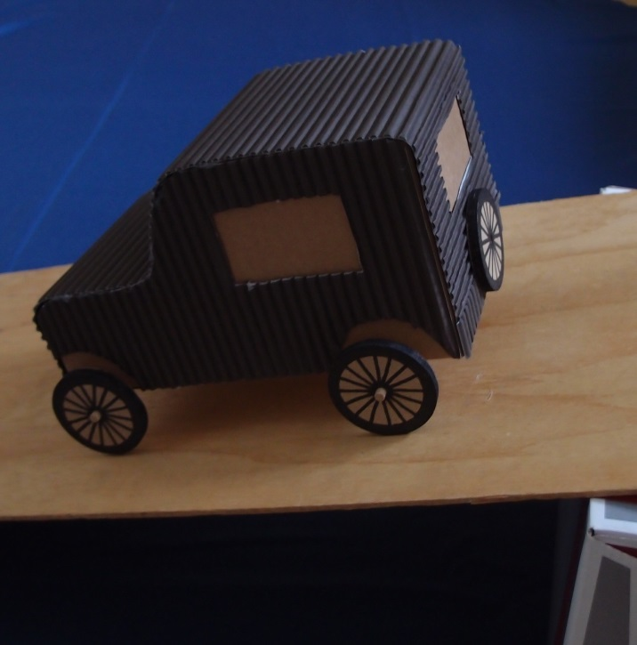
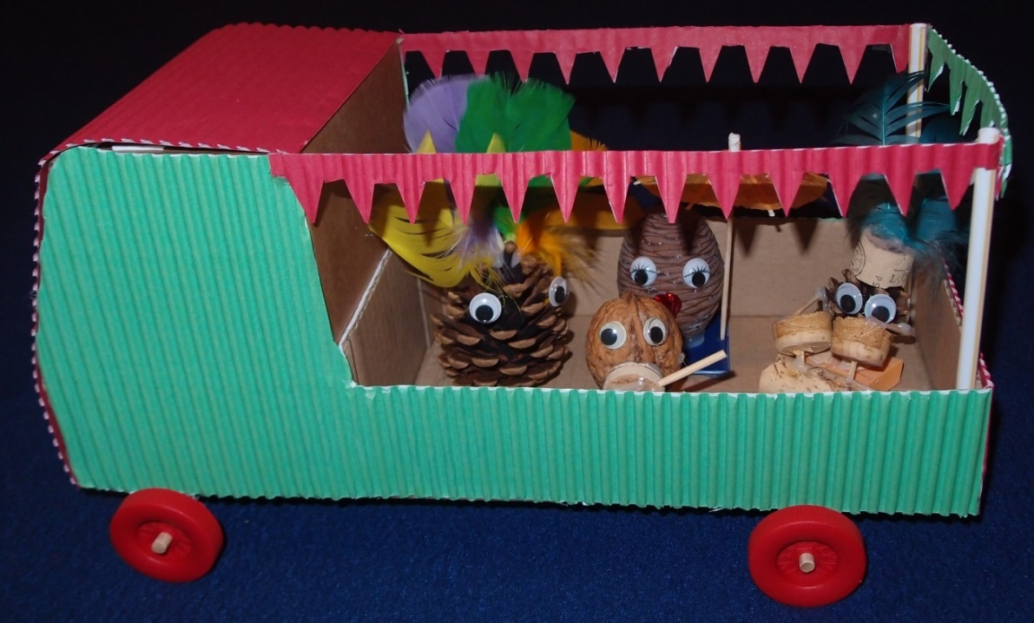
8. Complete your vehicle
You can decorate your vehicle, e.g. by drawing on it with felt tip pens, painting it or sticking on decorations or corrugated card.
You could make some passengers, e.g. from modelling clay, pine cones with googly eyes etc.

Slide 14
9. Try out your vehicle
Try running your vehicle down the ramp and see how far it travels before it comes to a halt (the ‘range’).
You can try out different material surfaces on the ramp or on the floor and see how they affect the range of the vehicle.
You can find out how changing the slope of the ramp affects the range.
You can change the weight of your vehicle and check how this affects the range.
You can time how long the vehicle travels for and divide the distance by the time to calculate the average speed.

Slide 15
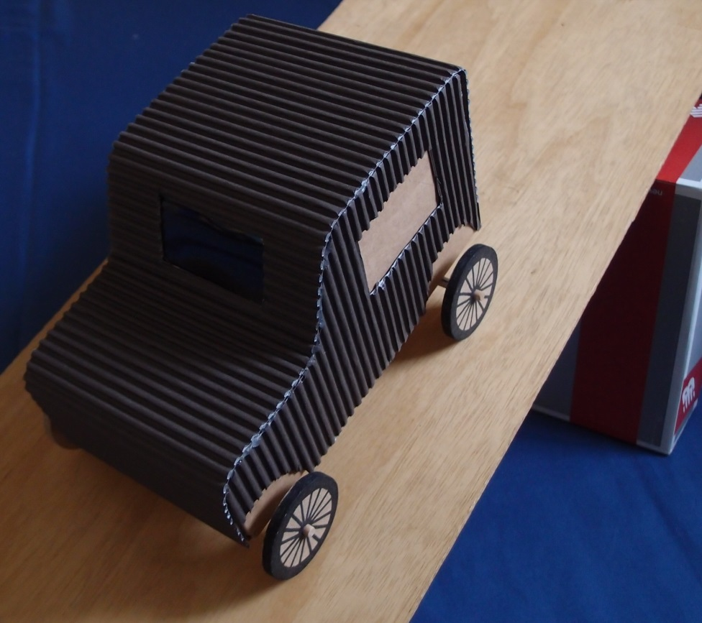
10. Set up an investigation
What would you like to investigate? Write this down on your worksheet.
Make a list of the equipment you will need.
Which variable do you need to change, and which variables do you need to keep the same for a fair test?
Conduct your investigation.
What did you discover?

Slide 16
11. Evaluate your design
Look back at your design criteria.
Does your design do what you wanted it to do?
Is there anything you would like to change or improve?
Ask other people what they think of your vehicle.
Complete your worksheet.
Write your name on your vehicle.
Tidy up thoroughly.

Slide 17
12. Plenary
Discuss how the activity went and what you have learnt.
What did you investigate?
What were your conclusions?
What have you learnt about:
Setting up an enquiry?
Taking measurements?
The design and make process?
Friction?
Wheels, axles and bearings?
What did you enjoy most about the activity?

Slide 18
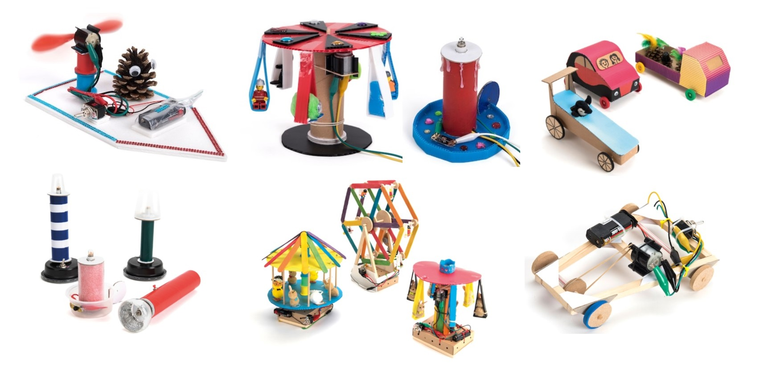
Fun TTS STEM design & make class kits
Fan boats Crumble controlled models D&T vehicles
Make your own light Fairground rides Motorised vehicles

